Slide 1
Functional Programming in Python

Slide 2
Functional Programming Concepts
What is Functional Programming?
Pure Functions and Referential Transparency
Data Immutability IN, Side-Effects OUT
What is a Variable?
Functions as First Class Objects
Lambda Expressions / Anonymous Functions
The Concept of Closure
High-Order Functions
Expressing Iteration as Recursion
Programming Design Patterns and High-Order Functions
Using List Comprehensions and Recursion
Lazy Evaluation and Python Generators
Currying
Pipelines

Slide 3
Stateless Functional Programming Tools
A loop has state which changes in every iteration, and this is expressed by the values of the local variables of the loop body.
Because of that, a loop is not a Functional Programming concept: if we want to write programs according to the functional approach, we must prevent the use of loops.
Instead of using loops, we have to use stateless functional programming tools:
In chapter 3 of this course we studied recursion as an equivalent stateless alternative to iteration.
In this chapter we will study how to implement three fundamental Programming Patterns: map, filter, and reduce.
Those programming patterns may be implemented using imperative programming tools, but we will study here three functional ways of implementing them: using Recursion, using List Comprehensions, and using the reduce high order function as one of the most basic functional programming tool.
In chapter 2 we studied three High-Order functions which implement those three programming patterns, and are called exactly the same: two (map and filter) are built-in functions, and the other one (reduce) needs to be imported from the functools module.

Slide 4
Fundamental Programming Patterns in Programming in general and in Functional Programming in particular

Slide 5
List Comprehension
L = [output-expr for item in input-iterable if boolean-expr]
For each item in the input iterable, this expression produces an element of the output list
input
For each item in the input iterable, this boolean expression is used to decide if the item will be passed to the output expression.
A List Comprehension produces a list composed by values produced by the output-expr, based on the items of the input-iterable.
If the boolean-expr is included, it is used as a selection condition.

Slide 6
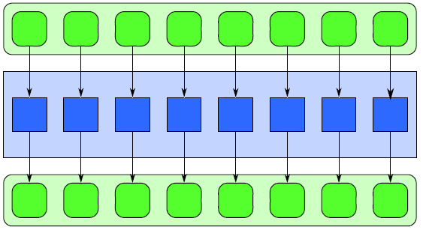
MAP (“for all”) pattern
In
A₁
A₂
A₃
A₄
A₅
A₆
A₇
A₈
Fnc
Fnc
Fnc
Fnc
Fnc
Fnc
Fnc
Fnc
Out
6
N independent instances of the same Fnc functional object are applied on N non necessarily distinct input values A_{i}, i=1,…,N, in any sequential order, or in parallel, producing the output values Fnc(A_{i}), i=1,…,N.

Slide 7

MAP (“for all”) pattern
Mathematical Definition
$$Out=\{x | ∀A(A∈In  x= F(A))\}$$
Functional/List Comprehension implementation
Out = [F(A) for A in In]
$$∀A(A∈In)$$
A declarative/stateless implementation of the MAP pattern.
7

Slide 8
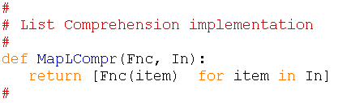
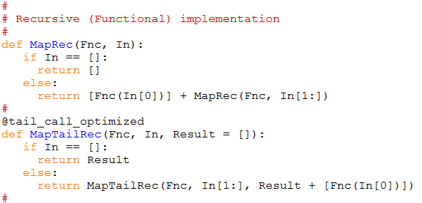
MAP (“for all”) pattern
Implemented by
List Comprehension
Recursion
8

Slide 9
MAP (“for all”) pattern
The built-in map high-order function
Functional Input sequences
object that having the same
expects N length M
parameters
Out = map (func, In₁, In₂, …., In_{N})
[func(In₁[0], … In_{N}[0]), …, func(In₁[M], … In_{N}[M])]
9

Slide 10
FILTER pattern
A₁
A₂
A₃
A₄
A₅
A₆
A₇
A₈
bF
bF
bF
bF
bF
bF
bF
bF
M<=N values are chosen from the N non necessarily distinct input values A_{i} i=1,…,N, by applying N independent instances of the same Boolean functional object bF, in any sequential order, or in parallel.

Slide 11

FILTER pattern
Mathematical Definition
$$Out=\{x | ∀A(A∈In  bF(A)  x=A)\}$$
Functional/List Comprehension implementation
Out = [A for A in In if bF(A)]
$$∀A(A∈In)$$
A declarative/stateless implementation of the FILTER pattern.
11
11

Slide 12
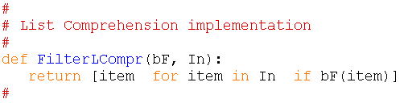
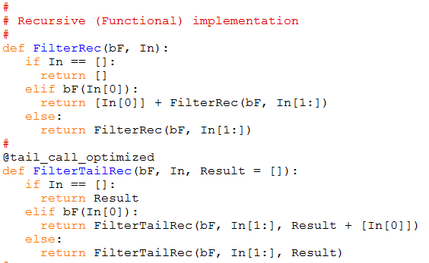
FILTER pattern
Implemented by
List Comprehension
Recursion
12

Slide 13
FILTER pattern
The built-in filter high-order function
Boolean
functional
object Input sequence
Out = filter (bF, In)
[bF(In[0]) In[0], …, bF(In [k]) In[k], …,bF(In[M]) In [M]]
13

Slide 14
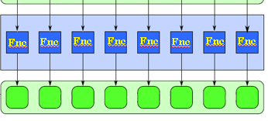
MAP-FILTER pattern
M <= N of non necessarily distinct input values are chosen by applying the same Boolean functional object bF, and the same functional object Fnc is applied on all those M values.
In both function application levels, the functional object instances are independent of each other. Because of that, they may be applied in any sequential order , or in parallel.
bF
bF
bF
bF
bF
bF
bF
bF

Slide 15

MAP-FILTER pattern
Mathematical Definition
$$Out=[x | ∀A(A∈In  bF(A)  x=F(A))]$$
Functional/List Comprehension implementation
Out = [F(A) for A in In if bF(A)]
$$∀A(A∈In)$$
A declarative/stateless implementation of the MAP-FILTER pattern.
15
15

Slide 16
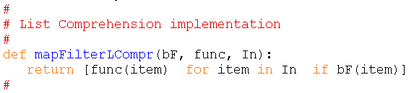
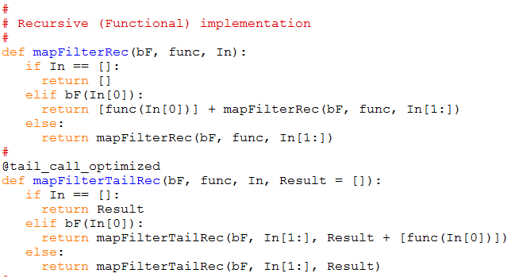
MAP-FILTER pattern
Implemented by
List Comprehension
Recursion
16

Slide 17
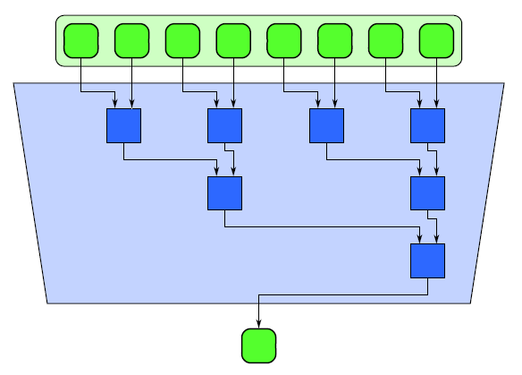









REDUCE (“Accumulate”) pattern
In
A₁
A₂
A₃
A₄
A₅
A₆
A₇
A₈
At each step i, an instance of the same functional object Fnc, is applied on the pair of the two first elements of In, and its result substitute that pair. This iterates until a unique result value is calculated, which is the Fnc-reduction of the N input values.
i = 1
Fnc
Fnc
Fnc
Fnc
i = 2
Fnc
Fnc
i = 3
i = 4
Fnc
i = 5
result
i = 6
i = 7
17

Slide 18
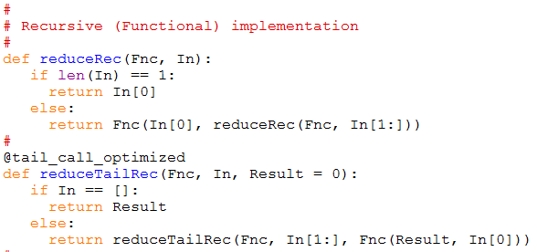
REDUCE (“Accumulate”) pattern
Implemented by Recursion

Slide 19
REDUCE (“Accumulate”) pattern
In
A₁
A₂
A₃
A₄
A₅
A₆
A₇
A₈
i = 1
Fnc
Fnc
Fnc
Fnc
Fnc
Fnc
i = 2
i = 3
Fnc
result
result
At each step i, N/2^{i} independent instances of the same functional object Fnc, are applied in any sequential order, or in parallel, on N/2^{i} pairs of values. The end result is a unique value, which is the Fnc-reduction of the N input values.
19

Slide 20
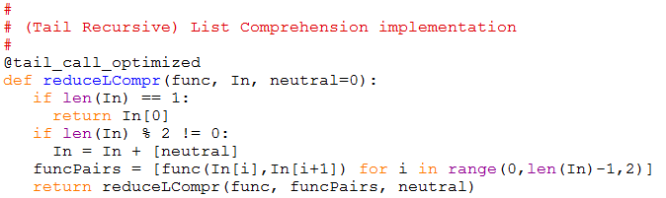
REDUCE (“Accumulate”) pattern
Implemented by (recursive) List Comprehension

Slide 21
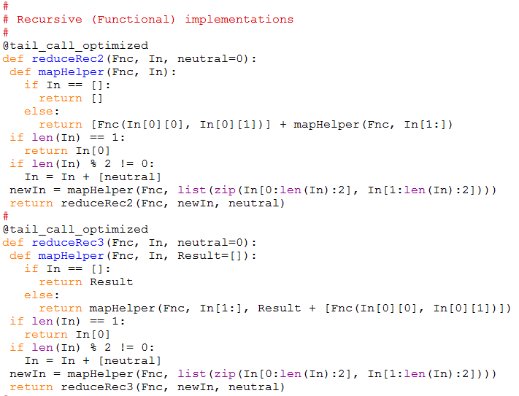
REDUCE (“Accumulate”) pattern
Implemented by Recursion

Slide 22
REDUCE (“Accumulate”) pattern
The reduce high-order function must be imported from the functools module
Functional
object Input sequence
result = reduce (Func, In,[initValue])
22

Slide 23
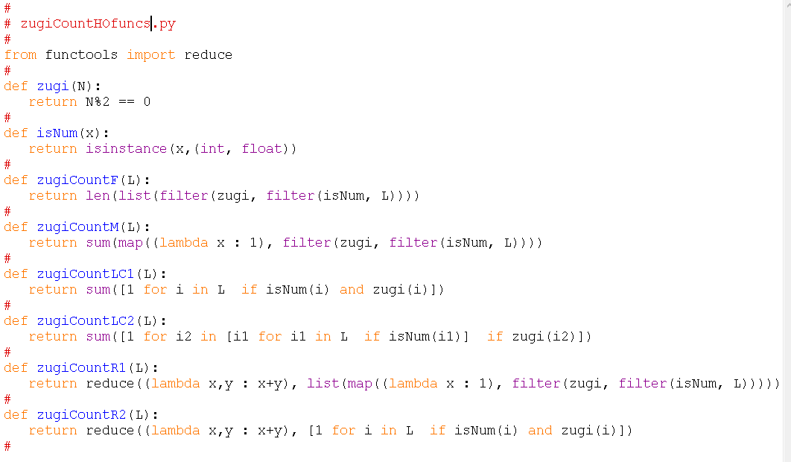
Using the map, filter, and reduce
23

Slide 24
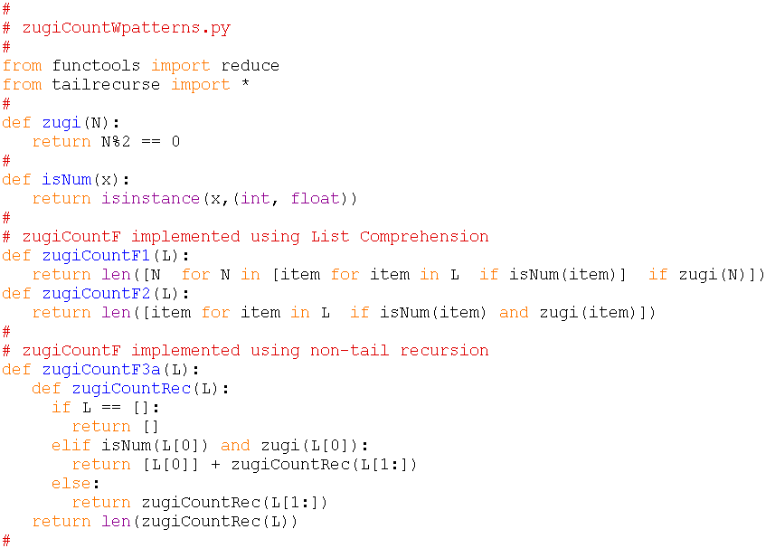
Using the map, filter, and reduce patterns
24

Slide 25
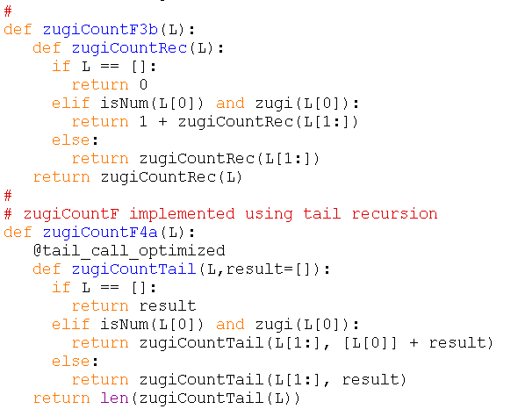
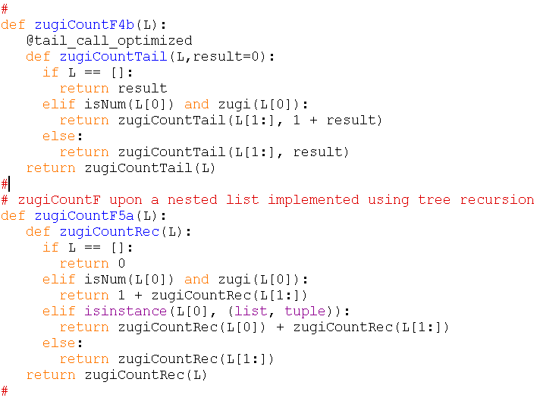
Using the map, filter, and reduce patterns
25

Slide 26


reduce is one of the most basic functional operators
(based on http://blog.lerner.co.il/summary-reduce-series/)
The classic use of reduce, as we already learned, is to sum numbers, or any other type of data upon which an appropriate two-operand operator/function is defined.
We also may initialize the total (or result) value by using the (optional) third parameter of reduce:
26

Slide 27

reduce is one of the most basic functional operators
(based on http://blog.lerner.co.il/summary-reduce-series/)
Assume that we are playing a “Scrabble” game, and we want to have a computational mechanism to calculate the score of any word we build during the game. Let’s do it by using the function reduce:
We built the word “encyclopedia”, and we want to calculate its score. Let’s do it with reduce:
27

Slide 28
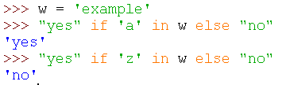
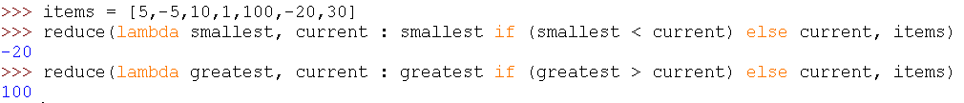
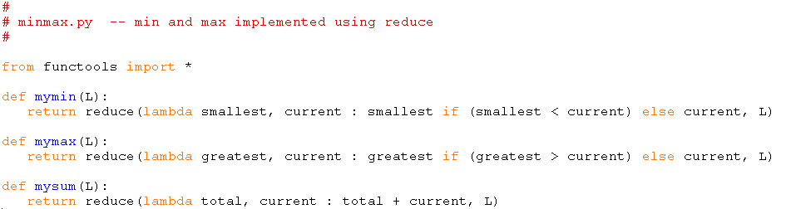
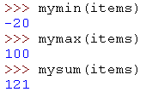
reduce is one of the most basic functional operators
(based on http://blog.lerner.co.il/summary-reduce-series/)
Let’s implement the functions min, max, and sum using reduce:
To do it we will use a special kind of if expression:
28

Slide 29
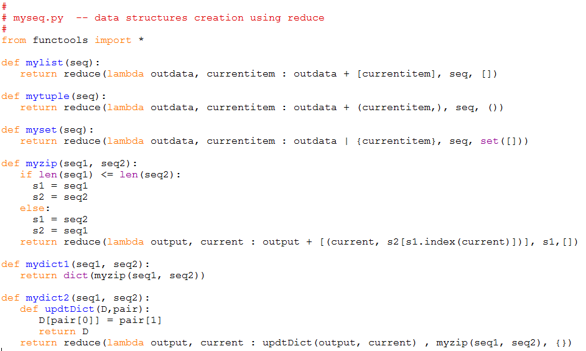
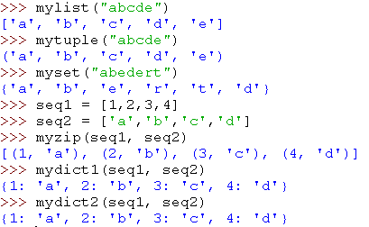
reduce is one of the most basic functional operators
(based on http://blog.lerner.co.il/summary-reduce-series/)
Let’s create compound data structures using reduce:
29

Slide 30
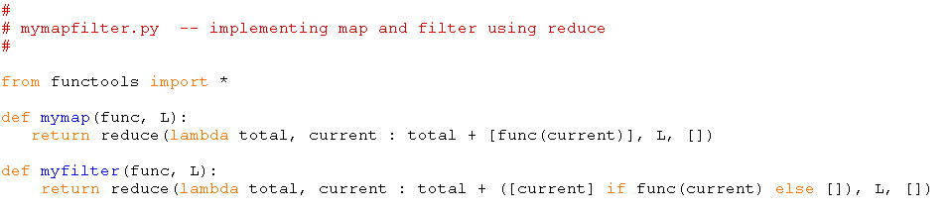
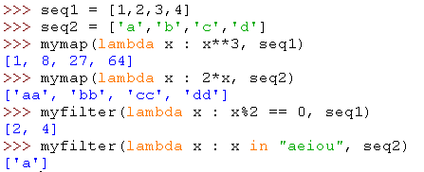
reduce is one of the most basic functional operators
(based on http://blog.lerner.co.il/summary-reduce-series/)
Let’s implement map and filter using reduce:
30

Slide 31
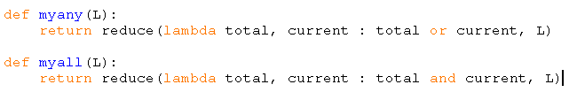

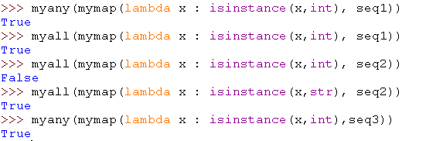
reduce is one of the most basic functional operators
(based on http://blog.lerner.co.il/summary-reduce-series/)
Let’s implement and and any using reduce:
31

Slide 32
reduce is one of the most basic functional operators
(based on http://blog.lerner.co.il/summary-reduce-series/)
Conclusions about reduce as a basic, fundamental, functional operator
We showed that using the reduce high-order function we can create instances of any of the built-in Python collection data types: list, tuple, set, dict (may be others too …).
We showed that using the reduce high-order function we can implement the built-in min, max, and sum functions.
We showed that using the reduce high-order function we can implement the built-in any and all functions.
We showed that using the reduce high-order function we can implement the zip function.
We showed that using the reduce high-order function we can implement the other two built-in high-order functions, map and filter.
All the above shows that the reduce high-order function is one of the most basic operators in Functional Programming.
32

Slide 33
Lazy Evaluation and Python Generators
Lazy evaluation is an evaluation strategy which holds the evaluation of an expression until its value is needed. It avoids repeated evaluation.
Haskell is a good example of such a functional programming language whose fundamentals are based on Lazy Evaluation.
Lazy evaluation is used in Unix map functions to improve their performance by loading only required pages from the disk. No memory will be allocated for the remaining pages.

Slide 34
Lazy Evaluation and Python Generators
Lazy Evaluation − Advantages
It allows the language runtime to discard sub-expressions that are not directly linked to the final result of the expression.
It reduces the time complexity of an algorithm by discarding the temporary computations and conditionals.
It allows the programmer to access components of data structures out-of-order after initializing them, as long as they are free from any circular dependencies.
It is best suited for loading data which will be infrequently accessed.

Slide 35
Lazy Evaluation and Python Generators
Lazy Evaluation − Drawbacks
It forces the language runtime to hold the evaluation of sub-expressions until it is required in the final result by creating thunks(delayed objects).
Sometimes it increases space complexity of an algorithm.
It is very difficult to find its performance because it contains thunks of expressions before their execution.

Slide 36
Lazy Evaluation and Python Generators
Lazy Evaluation using Python:
The range method in Python follows the concept of Lazy Evaluation.
It saves the execution time for larger ranges and we never require all the values at a time, so it saves memory consumption as well.
Take a look at the following example.
r = range(10)
print(r[3])
It will produce the following output −
3

Slide 37
What are generators in Python?
There is a lot of overhead in building an iterator in Python; we have to implement a class with __iter__() and __next__() method, keep track of internal states, raise StopIteration when there are no values to be returned etc.
This is both lengthy and counter intuitive. Generator comes into rescue in such situations.
Python generators are a simple way of creating iterators. All the overhead we mentioned above are automatically handled by generators in Python.
Simply speaking, a generator is a function that returns an object (iterator) which we can iterate over (one value at a time).

Slide 38
How to create a generator in Python?
It is fairly simple to create a generator in Python. It is as easy as defining a normal function with yield statement instead of a return statement.
If a function contains at least one yield statement (it may contain other yield or return statements), it becomes a generator function. Both yield and return will return some value from a function.
The difference is that, while a return statement terminates a function entirely, an yield statement pauses the function saving all its states and later continues from there on successive calls.

Slide 39
Differences between a Generator function and a Normal function
A Generator function contains one or more yield statements.
When called, it returns an object (iterator) but does not start execution immediately.
Methods like __iter__() and __next__() are implemented automatically. So we can iterate through the items using next().
Once the function yields, the function is paused and the control is transferred to the caller.
Local variables and their states are remembered between successive calls.
Finally, when the function terminates, StopIteration is raised automatically on further calls.

Slide 40
Example: a generator function
# A simple generator function
def my_gen():
n = 1
print('This is printed first')
# A Generator function contains yield statements
yield n
n += 1
print('This is printed second')
yield n
n += 1
print('This is printed at last')
yield n

Slide 41
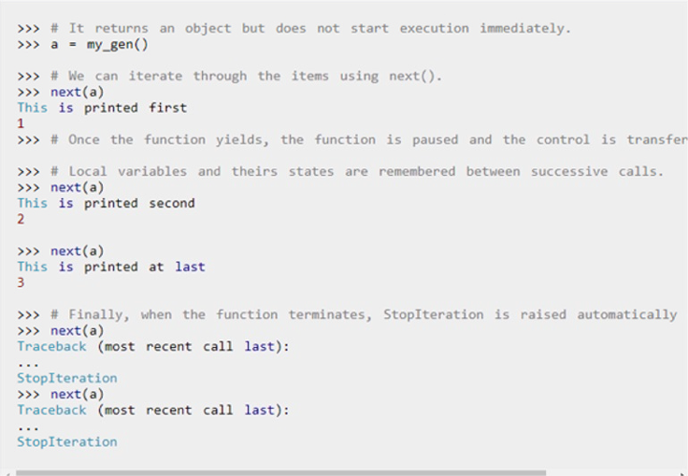
Output:

Slide 42
One interesting thing to note in the above example is that, the value of variable n is remembered between each call.
Unlike normal functions, the local variables are not destroyed when the function yields. Furthermore, the generator object can be iterated only once.
To restart the process we need to create another generator object using something like a = my_gen().
we can use generators with for loops directly.
This is because, a for loop takes an iterator and iterates over it using the next() function. It automatically ends when StopIteration is raised. Check here to know how a for loop is actually implemented in Python.

Slide 43
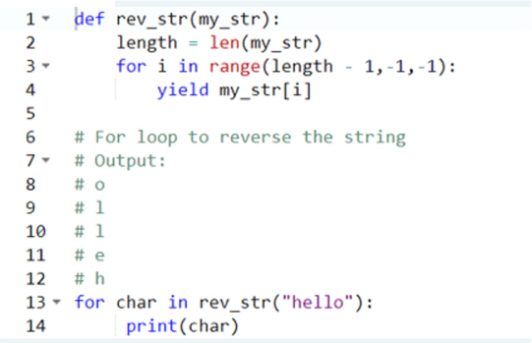
An example to a reverse generator

Slide 44
Python Generator Expression
Simple generators can be easily created on the fly using generator expressions. It makes building generators easy.
Same as a lambda expression creates an anonymous function, a generator expression creates an anonymous generator.
The syntax for generator expressions is similar to that of a list comprehension in Python. But the square brackets are replaced with round parentheses.
The major difference between a list comprehension and a generator expression is that while a list comprehension produces the entire list, a generator expression produces one item at a time.
They are a kind of lazy evaluators, producing items only when asked for. For this reason, a generator expression is much more memory efficient than an equivalent list comprehension.

Slide 45
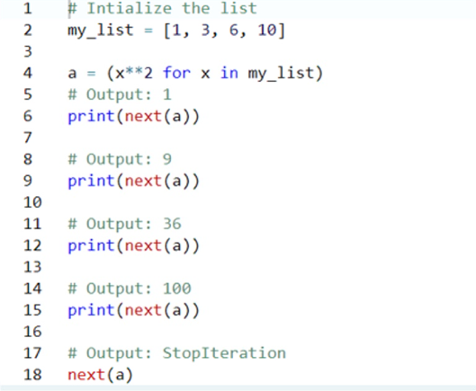
Example of a generator expression

Slide 46
Or:
Generator expression can be used inside functions. When used in such a way, the round parentheses can be dropped.
>>> sum(x**2 for x in my_list)
146
>>> max(x**2 for x in my_list)
100

Slide 47
Why generators are used in Python?
1. Easy to Implement
Generators can be implemented in a clear and concise way as compared to their iterator class counterpart.
Following is an example to implement a sequence of power of 2's using iterator class.
class PowTwo:
def __init__(self, max = 0):
self.max = max
def __iter__(self):
self.n = 0
return self
def __next__(self):
if self.n > self.max:
raise StopIteration
result = 2 ** self.n
self.n += 1
return result
This was lengthy. Now lets do the same using a generator function.
def PowTwoGen(max = 0):
n = 0
while n < max:
yield 2 ** n
n += 1

Slide 48
Why generators are used in Python?
2. Memory Efficient
A normal function to return a sequence will create the entire sequence in memory before returning the result. This is an overkill if the number of items in the sequence is very large.
Generator implementation of such sequence is memory friendly and is preferred since it only produces one item at a time.

Slide 49
Why generators are used in Python?
3. Represent Infinite Stream
Generators are excellent medium to represent an infinite stream of data. Infinite streams cannot be stored in memory and since generators produce only one item at a time, it can represent infinite stream of data.
The following example can generate all the even numbers (at least in theory).
def all_even():
n = 0
while True:
yield n
n += 2

Slide 50
Why generators are used in Python?
4. Pipelining Generators
Generators can be used to pipeline a series of operations.
This is best illustrated using an example.
Suppose we have a log file from a famous fast food chain. The log file has a column (4th column) that keeps track of the number of pizza sold every hour and we want to sum it to find the total pizzas sold in 5 years.
Assume everything is in string and numbers that are not available are marked as 'N/A'. A generator implementation of this could be as follows.
with open('sells.log') as file:
pizza_col = (line[3] for line in file)
per_hour = (int(x) for x in pizza_col if x != 'N/A')
print("Total pizzas sold = ",sum(per_hour))
This pipelining is efficient and easy to read (and yes, a lot cooler!).

Slide 51
Currying
The substitution model has two levels:
(1) at the functional expression:
all the sub-expressions are evaluated in parallel
and then substituted in the functional expression;
only after all the sub-expressions are substituted by their values, the function may be applied on them.
(2) at the actual execution of the functional body:
after binding all the formal parameters to the actual parameters received from the function application,
a textual transformation of the function body takes place;
the occurrences of each one of the formal parameters are substituted by the value of the corresponding actual parameter, one-at-a-time;
after all those substitutions took place, the body of the function may actually be evaluated and its value returned.
This one-at-a-time substitution process is called Currying.

Slide 52
example
Assuming that we define the following:
def f(a):
return a*a
the functional expression f (3 + 2) is evaluated as follows:
(1) at the first level of substitution:
f is substituted by the functional object that f refers to,
and 3+2 is substituted by its value 5,
transforming the functional expression in
<f functional object> (5)
then, the functional object is applied on the parameter value 5

Slide 53
example
(2) then:
the function application itself is evaluated, using the second level of substitution,
which transforms the function such that all the occurrences of the unbound formal parameter A in the body of the function is substituted by the value of the actual parameter 5.
Then, the function f is transformed in a 0-parameters function that may be evaluated as an expression like in the first level of substitution:
def f(a):
return a*a return 5*5
The process of transforming a function of N parameters in one of N-1, and then N-2, etc., until 0 parameters , substituting in each step the corresponding parameter in the body of the function, is called the Currying process.
The actual evaluation of the function body is executed only when all the substitutions have been made.

Slide 54
End Good luck!

