Slide 1
Demand Forecast for ABC Ltd.
Aviral Agarwal

Slide 2


Forecasting demand has been one of the most classic challenge for any business. Accurate estimation of future demand has proven to have direct positive impact on a businesses efficiency and in turn, its revenues.
Demand Forecast
Accurate Demand Forecast
Core Business Challenge
Business Efficiency
Increases Revenue
Data
Machine Learning

Slide 3

Descriptive Analysis

Slide 4
Trends
Highest Demand in Q4
Weakest Demand in Q2
Total Noodle Packs ordered in 2018: 5,68,455
Price of a noodle pack has continuous increasing trend.
Demand is mostly stable with a few peaks.
Two dates, where prices see sharper increase, April ‘18 and Dec ’18, have sharp rise in demand too. This may indicate towards marketing techniques like rebranding or a campaign.
Highest peak in demand at 30th Jan ’18 seems to be an outlier.
Quarter | No. of Orders | %age of Total Orders
Qtr1 | 1,23,603 | 22%
Qtr2 | 90,170 | 16%
Qtr3 | 1,53,083 | 27%
Qtr4 | 2,01,600 | 35%

Slide 5
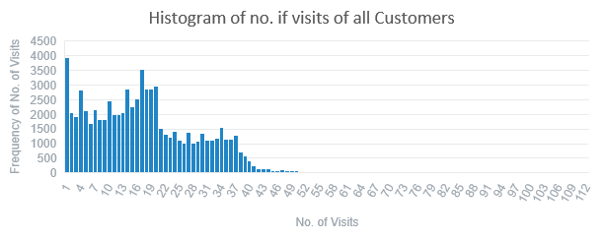
Visits and Customers
Customer Cluster 3
Customer Cluster 2
Customer Cluster 1
Based on frequency of visit of sales representatives, customer can be divided into 3 clusters.
Cluster 3 for customers who are visited the most.
Cluster 1 for least visited customers.
Customers do not order in 94% of the visits.
This makes direct regression difficult as the most of the data points have less than one quantity.
Hence we will have to implement two step approach to predict quantity that a customer will order in future. First we need to classify whether a customer will order in a visit. If yes, then we need to estimate the order quantity.
Customer Cluster | Average quantity ordered per customer per visit
1 | 0.162384
2 | 0.182801
3 | 0.261444

Slide 6

Feature Engineering

Slide 7
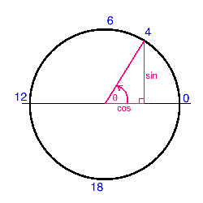

Date Features
Encoding
Date
Day of Month
Day of week
Quarter of Year
Week of Year
Month Start/Mid/End
These are cyclic in nature such that each cyclic element are equal yet they follow cyclic sequence.
But they cannot be encoded as 1,2,3 etc. as that would mean, in case of months,
Feb (2) > Jan (1)
Hence each element is considered like a point on a circle like hours on a clock and represented as sin and cos components.
This makes them numeric and retains their cyclic property without assigning greater value to anyone.
Breaking down of date of visit in these components enables us to capture seasonality effects.
Seasonality can be within an year or a month or any given period.

Slide 8
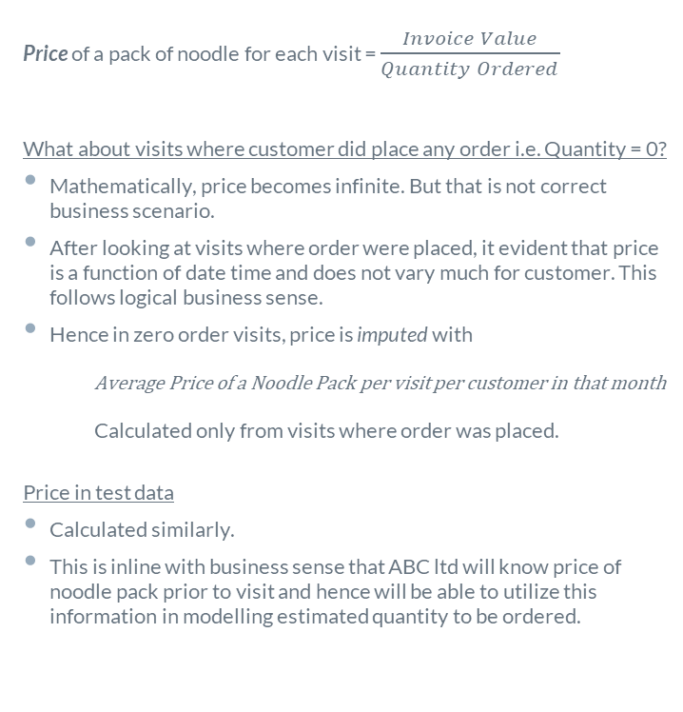
Price
Customer Cluster
Price of a pack of noodle for each visit = $\frac{Invoice Value}{Quantity Ordered}$
What about visits where customer did place any order i.e. Quantity = 0?
Mathematically, price becomes infinite. But that is not correct business scenario.
After looking at visits where order were placed, it evident that price is a function of date time and does not vary much for customer. This follows logical business sense.
Hence in zero order visits, price is imputed with
Average Price of a Noodle Pack per visit per customer in that month
Calculated only from visits where order was placed.
Price in test data
Calculated similarly.
This is inline with business sense that ABC ltd will know price of noodle pack prior to visit and hence will be able to utilize this information in modelling estimated quantity to be ordered.
Based on frequency of visit to customers (slide Visits and Customers), customers can be classified in to 3 major categories
Highly visited customers, encoded as 3
Medium visited customers, encoded as 2
Least visited customers, encoded as 1
Ordinal Encoding logic comes out of fact that average quantity ordered per customer per visit also follows same order.
3 > 2 > 1
How were clusters created?
K-Means algorithm was used with number of visits as numerical variable.
The number of optimum clusters was also verified using elbow method.
Customer Cluster in test Data
Customers in each cluster were identified from train data.
Any new customer is assigned to cluster with minimum average quantity i.e. 1.

Slide 9
Lag and Moving Average Features
Lag and Moving Average terms are also created to consider recent buying behaviour of a customer.
This is similar to Auto Correlation AR and Moving Average MA terms in ARIMA models.
We can use ACF and PACF to determine when lag and MA terms stop being corelated to each other and only use those terms.
Lag and MA features in test data
Earliest entry of a customer is picked up from test data.
Calculate Lag and MA terms using order history of the same customer from training data
Estimate order quantity for the earliest entry from test data using ML model.
Use the estimated order quantity for the earliest entry and use it to create lag and MA features for the next earliest entry in test data.
Continue this for all entries for all customers in Test data.
Series | lag 1 | lag 2 | lag 3 | Moving Average 2 | Moving Average 3
t | 0 | 0 | 0 | AVERAGE( 0 , 0 ) | AVERAGE( 0 , 0 , 0 )
t+1 | t | 0 | 0 | AVERAGE( 0 , 0 ) | AVERAGE( 0 , 0 , 0 )
t+2 | t+1 | t | 0 | AVERAGE( t+1 , t ) | AVERAGE( t+1 , t , 0 )
t+3 | t+2 | t+1 | t | AVERAGE( t+2 , t+1 ) | AVERAGE( t+2 , t+1 , t )
t+4 | t+3 | t+2 | t+1 | AVERAGE( t+3 , t+2 ) | AVERAGE( t+3 , t+2 , t+1 )
t+5 | t+4 | t+3 | t+2 | AVERAGE( t+4 , t+3 ) | AVERAGE( t+4 , t+3 , t+2 )
t+6 | t+5 | t+4 | t+3 | AVERAGE( t+5 , t+4 ) | AVERAGE( t+5 , t+4 , t+3 )
t+7 | t+6 | t+5 | t+4 | AVERAGE( t+6 , t+5 ) | AVERAGE( t+6 , t+5 , t+4 )

Slide 10

Modelling

Slide 11

Model Architecture
New Visit
Create Features
Date Features, Price, Customer Cluster
No
Will customer order?
CLASSIFICATION MODEL
Yes
REGRESSION MODEL to estimate Quantity
Estimated Quantity
0 if no order
Create Lag and MA terms using historical data
Historical Data

Slide 12
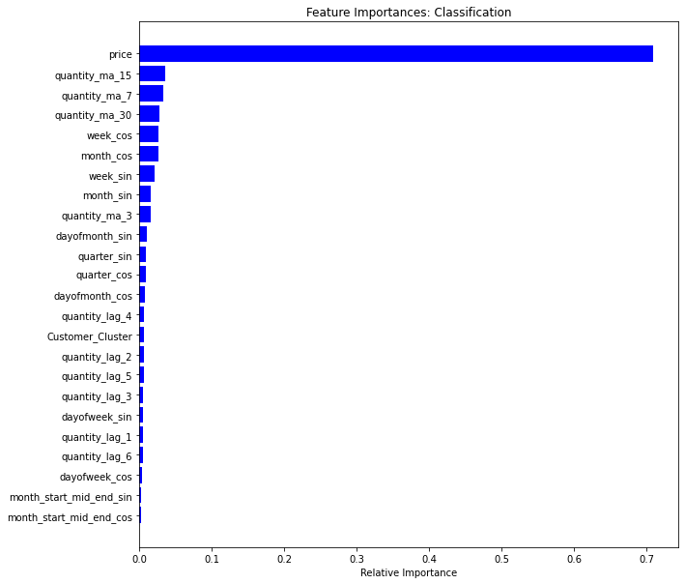
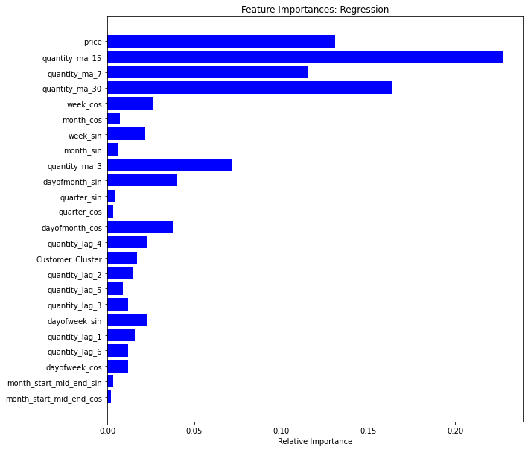
Feature Selection
To classify whether a customer is going to order is very much effected by the price of a noodle pack.
Quantity in a given order is very much influenced by recent purchase history quantified by moving average terms.
Week of year and day of a month also add value to estimation process.

Slide 13
Classification Model
ML model being used
Random Forest using sklearn library
Parameters: to be tuned using GridSearchCV (coded but time did not permit)
n_jobs=-1 + default
Preparing Train Data
For customers who have been visited even once but did not order, the best logical estimate is that they will not order on their next visit.
These customers are also not considered for training the classification model.
Note: No visits were made to such customers in Test Data i.e. visits in 2019. This validates this assumption, but has not been coded in interest of time.
Confusion Matrix |  | Predicted
 |  | 0 No Order | 1 atleast 1 qty
Actual | 0 No Order | 87924 | 152 | Recall or Sensitivity | 0.9983
 | 1 atleast 1 qty | 159 | 58558 | Specificity | 0.9973
 |  | Precision | Negative Predictive Value | Accuracy | 0.9979
 |  | 0.9982 | 0.9974 | F1 Score | 0.99823455
Sampling to handle Imbalanced Data
We need to create train data by oversampling the class where customers ordered as we have imbalanced class problem where customer does not order in 94% of the visits.
Used all visits data where customer ordered as train data. This would constitute 40% of total train data.
60% of all train data has visits where no order was made.
Stratified sampling is used to maintain proportion of visits from each month and customer cluster within the sampled training visits where no order was made.

Slide 14
Regression Model
ML model being used
Random Forest using sklearn library
Parameters: to be tuned using GridSearchCV (coded but time did not permit)
n_jobs=-1,n_estimators=10
Train Data
We are only considering visits where customers placed an order for training the regression model.
This fits in our model architecture as we are only going to use this regression model to estimate order quantity for those visits where our classification model predicts an order will be made.
Non Zero Accuracy | 72%
R-squared | 100%
Mean Absolute percentage Error | 125%
Mean Squared Error | 47%
Root Mean Squared Error | 7%

Slide 15
Assumptions and Suggestions
Reduce granularity and estimate monthly quantity for each customer for more accurate regression and spread it over weeks using an index to distribute monthly quantity within a month.
Since we are using ensemble architecture for estimating order quantities, we can leverage the classifier to create a feature which can be utilized for regression greatly improving regression performance.
Since we have no geographical details for a customer, it is assumed that they are all located in same geographical area and cater to same market.
If we can have information about marketing activities of ABC ltd, we can better estimate order quantity.

Slide 16


Thanks!
Any questions?
You can find me at:
+91 9004201116
aviral.agarwal93@gmail.com
LinkedIn
Medium

