Slide 1
Financial Health Review
A simple breakdown of our numbers (Apr - Aug 2024)
Labhyansh Solution
Prepared by: Aviral Dubey

Slide 2
What Are We Looking At?
We took raw accounting data and made it easy to understand.
We are looking at 5 months of activity: April to August 2024.
The goal is to see if we are making money, where it's coming from, and where it's going.
No complex accounting terms—just straightforward business insights!

Slide 3
The Big Picture: Are We Making Money?
1. Total Money In (Revenue): Rs. 6.78 Cr
2. Total Money Out (Expenses): Rs. 6.11 Cr
3. What We Kept (Net Profit): Rs. 67.77 L
We are profitable! For every Rs. 100 we make, we keep about Rs. 10 as profit.
Our sales grew by an impressive 40% over these 5 months.

Slide 4
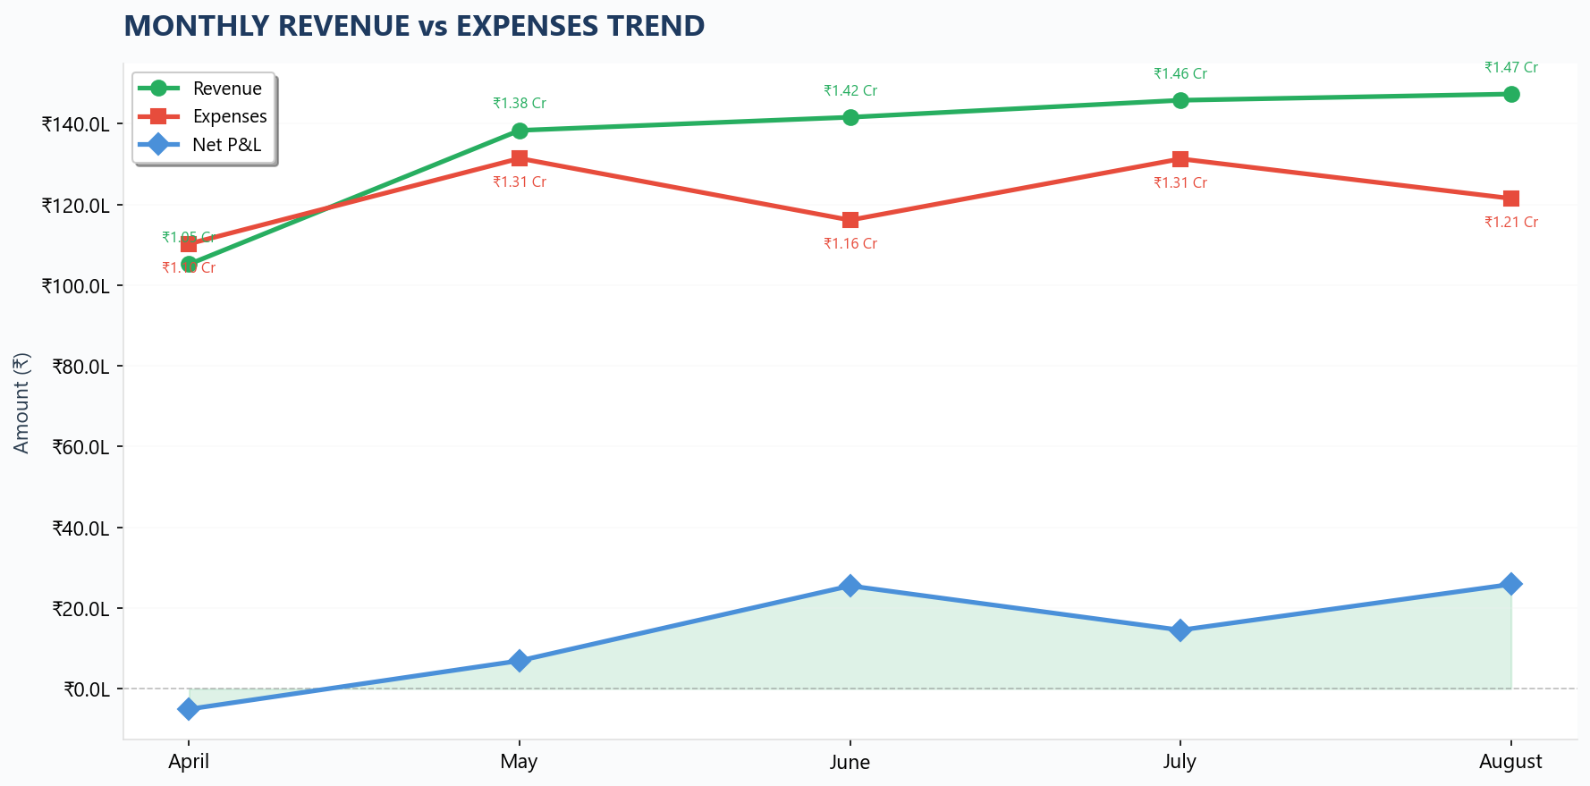
How Did We Do Month by Month?

Slide 5
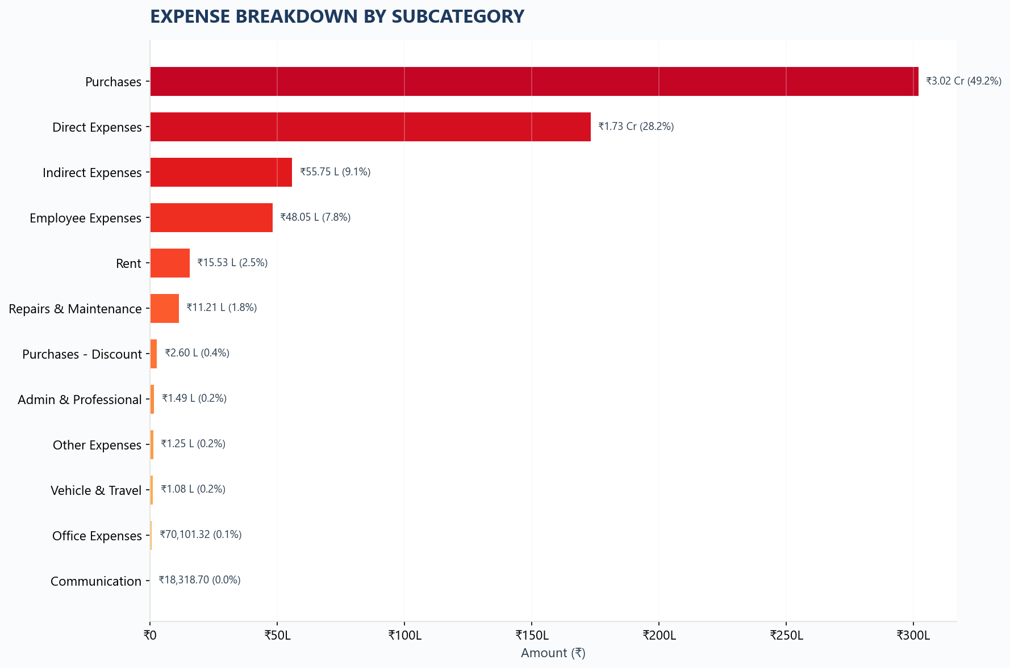
Where is the Money Going?

Slide 6
What We Own & Our Cash Position
Total Value of Things We Own (Assets): Rs. 24.81 Cr
This includes our machinery, vehicles, and customer dues.
Cash on Hand & in Bank: Rs. 4.51 Cr
Having this much cash is great. It means we can comfortably pay bills and handle small emergencies.

Slide 7
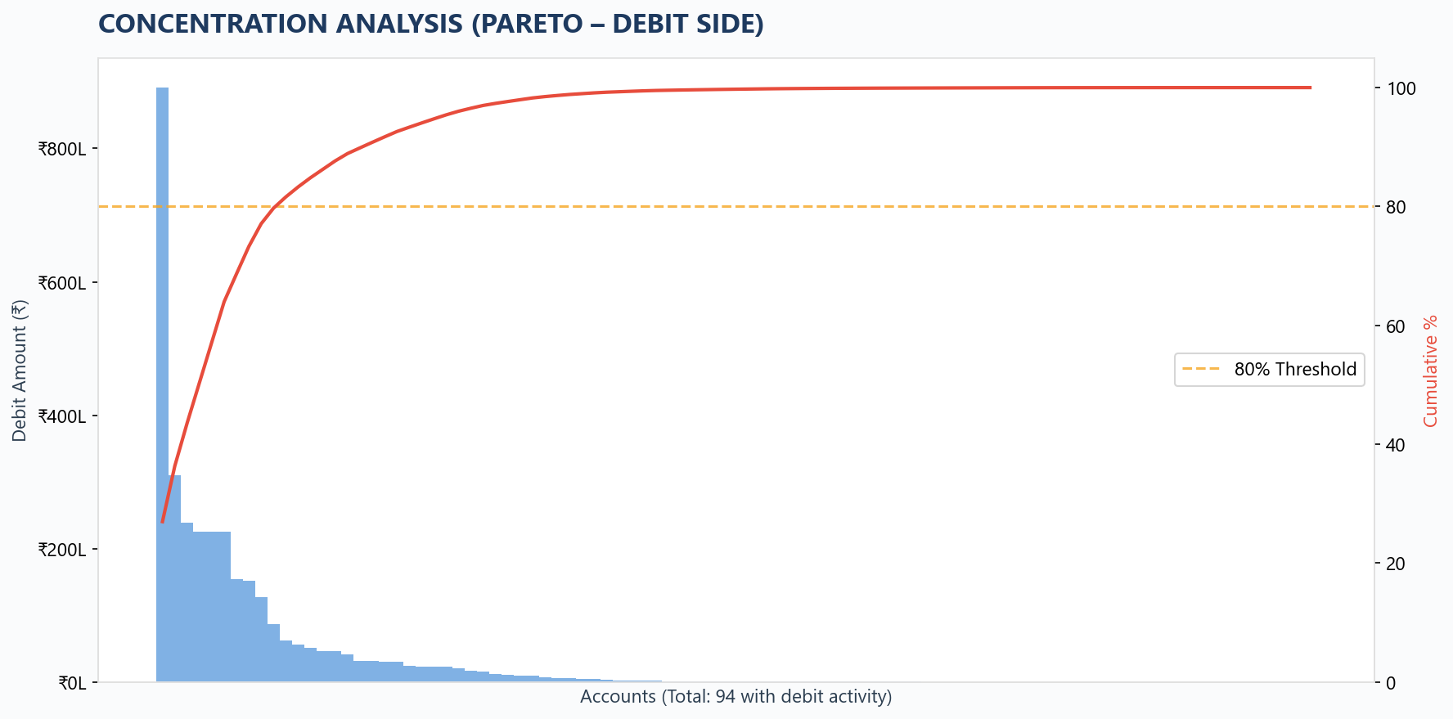
A Hidden Risk: Who Pays Us?

Slide 8
What Should We Do Next?
1. Negotiate Better Deals: Purchases are our biggest cost. Even a 2% discount will save us lakhs.
2. Find New Customers: Right now, 5 customers bring in 80% of our money. If one leaves, it hurts. We need to diversify.
3. Review Team Setup: Our team costs are reasonable, but we should make sure everyone has exactly what they need to be productive.
4. Keep Cash Safe: Let's keep 2-3 months of expenses in the bank, untouched, just in case.
5. Keep Watching: Let's do this review every month so we aren't surprised by anything.

Slide 9
Thank You!
Questions & Open Discussion

