Slide 1
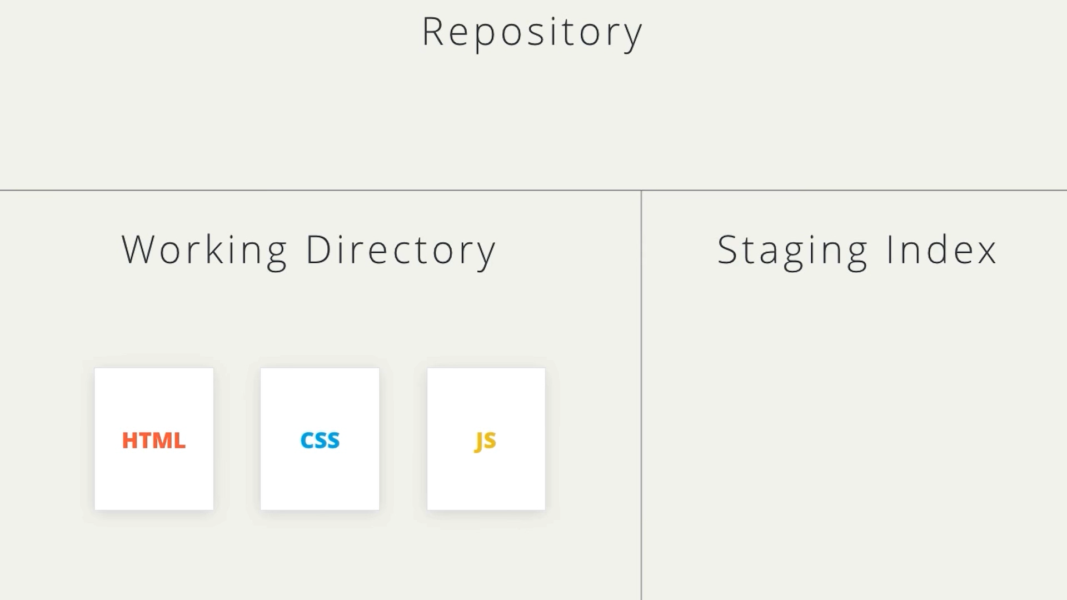
Initially we are in the working directory

Slide 2
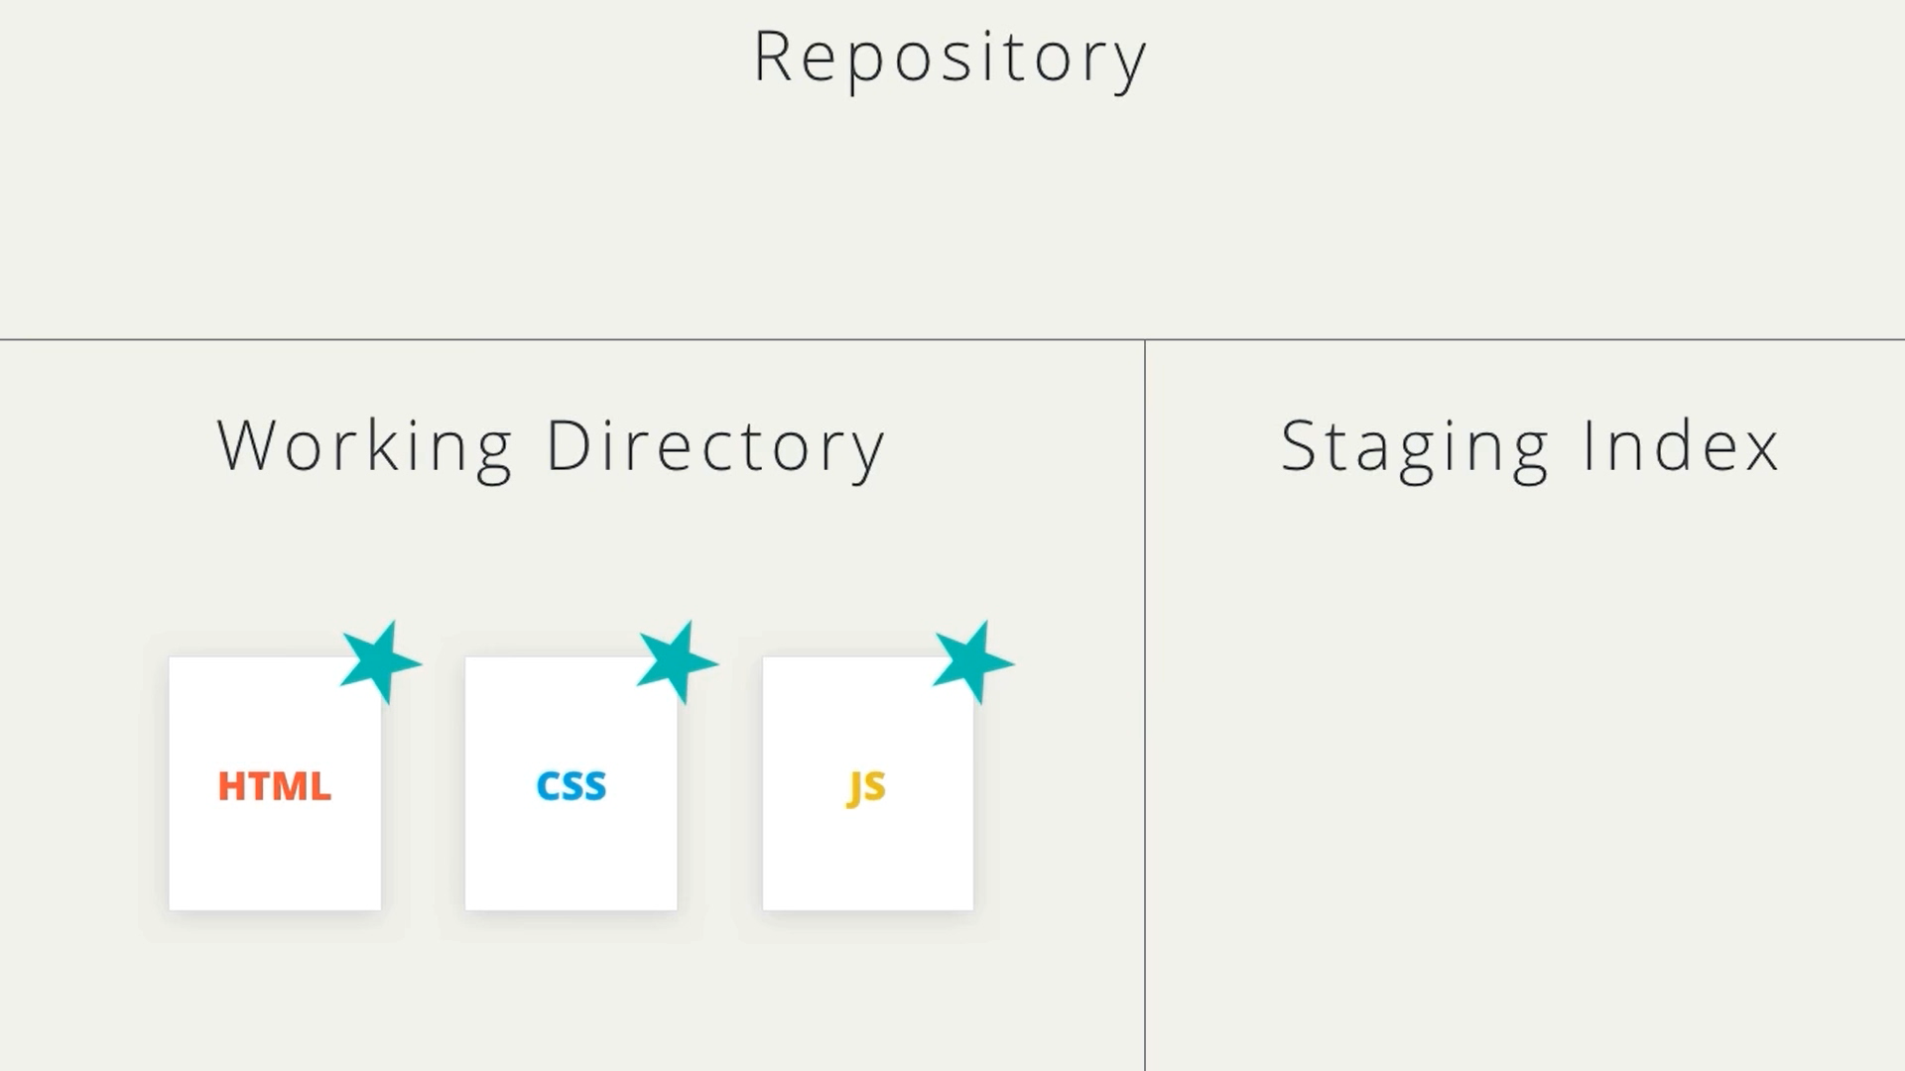
New Files added. Ready to move to staging index

Slide 3
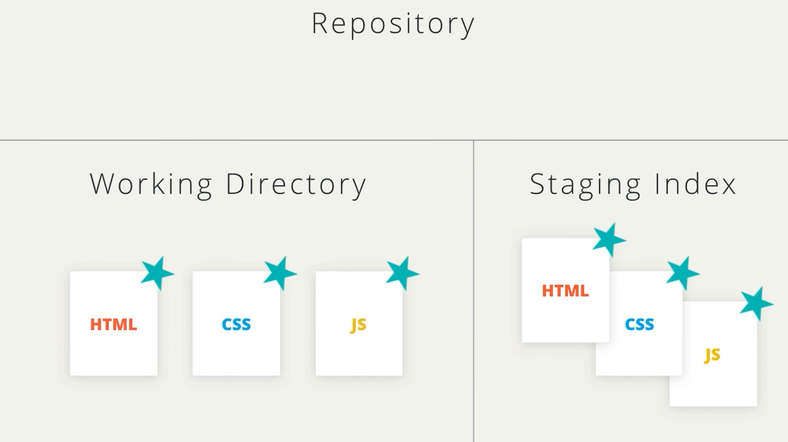
From staging index files are moved to the Repository

Slide 4
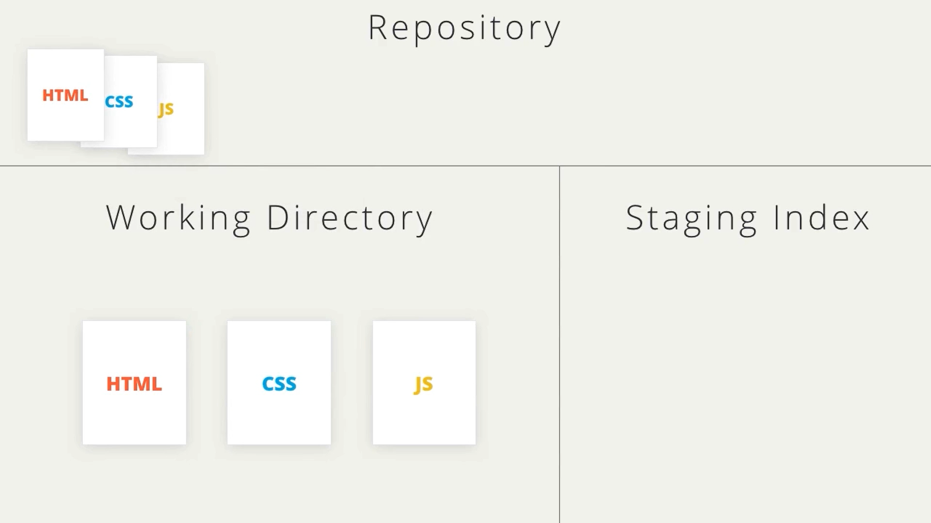
Files are now in the repository

