Slide 1
✦
THRIVE
WELLBEING
BEGINS WITH
A CHECK-IN
Mental Wellness and Support Platform
A student-focused space to check in, understand wellbeing needs,
and discover practical support.
PROJECT GUIDE
Dr. Vijendra Singh Bramhe
VIT Bhopal University • Project Exhibition I • 2026
THRIVE • Mental Wellness & Support Platform
01

Slide 2
Project team & guidance
OVERVIEW
Five-member team • roles reflect project work
Aviraj Singh Thakur
Avika Panday
Manish Kumar
25BCE10894
Team lead • frontend • integration • coordination & report
25BCE10928
UI/UX • frontend interface • content support
25BCE10933
Backend • database • testing
Udit Ravikant Chaubey
Aviral Verma
Project Guide
25BCE11330
Feature implementation • check-in scoring logic
25BCE10954
Testing • interface review • documentation
Dr. Vijendra Singh Bramhe
Assistant Professor • SCOPE
THRIVE • Mental Wellness & Support Platform
02

Slide 3
Introduction: why THRIVE?
CONTEXT
A simple digital entry point for everyday student wellbeing
Student life can bring overlapping pressures.
The THRIVE idea
Academic workload, deadlines and performance pressure
A welcoming platform to check in, see the highest-scoring areas and explore supportive guides.
Stress, sleep disruption and hard-to-maintain habits
Relationships, confidence and changing life circumstances
Design principle
Supportive and educational—not a diagnosis, crisis service or replacement for professional care.
Uncertainty about which practical resource to start with
Awareness • practical self-help • resource discovery • progress reflection
THRIVE • Mental Wellness & Support Platform
03

Slide 4
Problem & existing approaches
CONTEXT
THRIVE aims to make the first step toward support easier
Problem
Existing approaches & limits
Students may know they need support but not know whether to begin with stress, sleep, study pressure, confidence or relationships.
Static articles can be hard to navigate; broad apps may feel generic; formal care remains essential but is not the only entry point.
THRIVE’s role
Connect a short self-reflection to curated resources
Use transparent category scores instead of opaque AI predictions
Bring check-in, resource guides and progress into one experience
Digital guidance complements professional support; it does not replace it.
THRIVE • Mental Wellness & Support Platform
04

Slide 5
Project objectives
SOLUTION
A focused, usable student wellbeing platform
01
Accessible resource library
02
Structured 10-item check-in
03
Transparent category scoring
04
Personalised practical suggestions
05
Previous check-in comparison
06
Account access and support form
Scope
Full-stack web application tested locally; not yet deployed as a public production service.
THRIVE • Mental Wellness & Support Platform
05

Slide 6
Proposed solution & methodology
SOLUTION
A clear journey from reflection to relevant resources
1
2
3
4
5
6
Sign in / sign up
Answer 10 items
Calculate scores
Rank categories
Show guidance
Review progress
Account access
Five areas
0–4 per answer
Highest first
Tips + guide
Compare sessions
Questionnaire scoring + deterministic rules + curated resources (not AI/ML)
THRIVE • Mental Wellness & Support Platform
06

Slide 7
Novelty & real-world usage
SOLUTION
Connected experience with explainable recommendations
Personalised starting point
Explainable rules
Connected journey
Primary and secondary areas are ranked from the user’s answers.
Category scores and mappings are deterministic and easy to describe.
Check-in, guides, profile history and support in one platform.
Before a busy week
During a difficult period
Over time
A student checks in and sees study pressure as a useful area to explore.
The student opens practical tips for stress, sleep or relationships.
Profile view helps reflect on changes between check-ins.
Scores are self-reflection signals, not clinical assessments. Urgent needs require appropriate emergency/professional support.
THRIVE • Mental Wellness & Support Platform
07

Slide 8
Hardware & software requirements
TECHNICAL
Designed to run locally during development
Software stack
Environment
Frontend
• React 19 + TypeScript
• Vite, React Router, Tailwind CSS
• Fetch API
Backend
• Node.js + Express
• PostgreSQL via pg
• bcrypt, JWT, dotenv, CORS
• Laptop or desktop computer
• Modern web browser
• Node.js/npm runtime
• PostgreSQL database service
• Frontend: localhost:5173
• Backend: localhost:5000
• Database: localhost:5432
No specialised hardware required.
Deployment status: local development setup; public production deployment is not claimed.
THRIVE • Mental Wellness & Support Platform
08

Slide 9
Overall system architecture
ARCHITECTURE
Frontend → API routes → PostgreSQL
CLIENT LAYER
APPLICATION LAYER
DATA LAYER
React + TypeScript
Node.js + Express
PostgreSQL
HTTP / JSON
SQL
Home • Resources • Support
Login/Signup • Check-in • Profile
REST routes
/auth • /users • /resources
/support • /checkins
Users • Resources
Support requests
Check-in sessions
Authentication uses bcrypt and JWT; current endpoint protection is not uniform.
THRIVE • Mental Wellness & Support Platform
09

Slide 10
Core modules
ARCHITECTURE
Clear responsibilities across the application
Authentication
Resource library
Wellbeing check-in
Signup, login, password hashing and JWT
Browse, search, category filtering and guides
10 questions across five categories
Rule-based recommendation
Profile & progress
Support requests
Rank scores and map to guidance
Latest/previous sessions and score comparison
Contact form saved to PostgreSQL
API groups: /api/auth • /api/users • /api/resources • /api/support • /api/checkins
THRIVE • Mental Wellness & Support Platform
10

Slide 11
Check-in workflow
WORKFLOW
From answers to primary and secondary areas
10 answers
Group answers
Sum scores
Sort scores
Map guidance
Each response: 0–4
2 per category
Each area: 0–8
Highest to lowest
Tips + guide link
Not at all = 0 • A little = 1 • Sometimes = 2 • Often = 3 • Very often = 4
Areas: Academic Pressure • Relationships & Friendship • Stress & Overwhelm • Sleep & Rest • Confidence & Self-Esteem
THRIVE • Mental Wellness & Support Platform
11

Slide 12
Scoring & recommendation logic
WORKFLOW
Transparent rules—not machine learning
Illustrative saved check-in
Academic Pressure
7/8
Primary area
Relationships & Friendship
7/8
Academic Pressure / Relationships & Friendship (tied highest)
Stress & Overwhelm
3/8
Sleep & Rest
5/8
Recommendation
Top-ranked areas map to practical tips and relevant guide links.
Confidence & Self-Esteem
3/8
Rule sequence: sum by category → sort descending → select top two → display guidance.
THRIVE • Mental Wellness & Support Platform
12

Slide 13
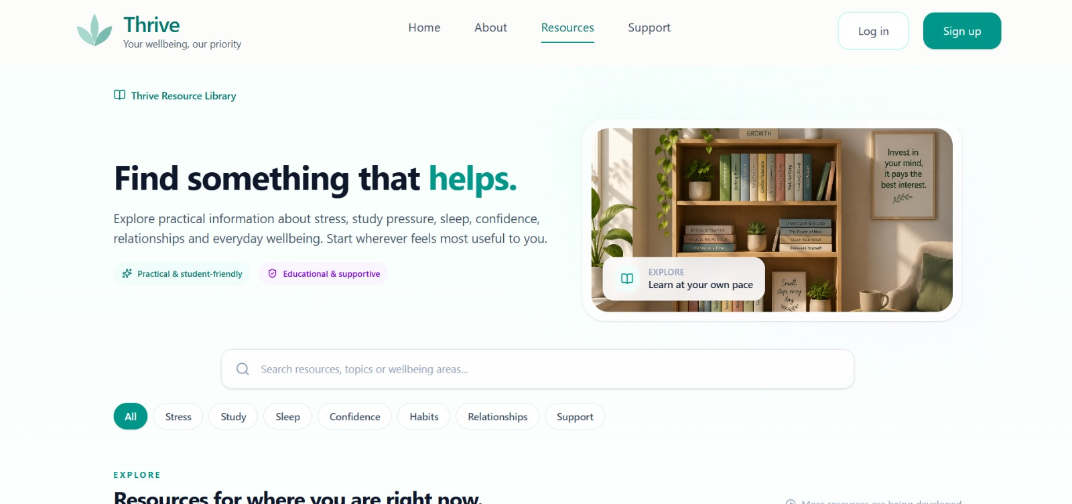
Project snapshot: resource library
SCREENSHOTS
Search and topic filters make resources easier to discover
Search
Matches resource titles, descriptions, categories and tags.
Filter topics
Stress, study, sleep, confidence, habits and relationships.
Availability
Some guides are available; others are marked in development.
THRIVE • Mental Wellness & Support Platform
13

Slide 14
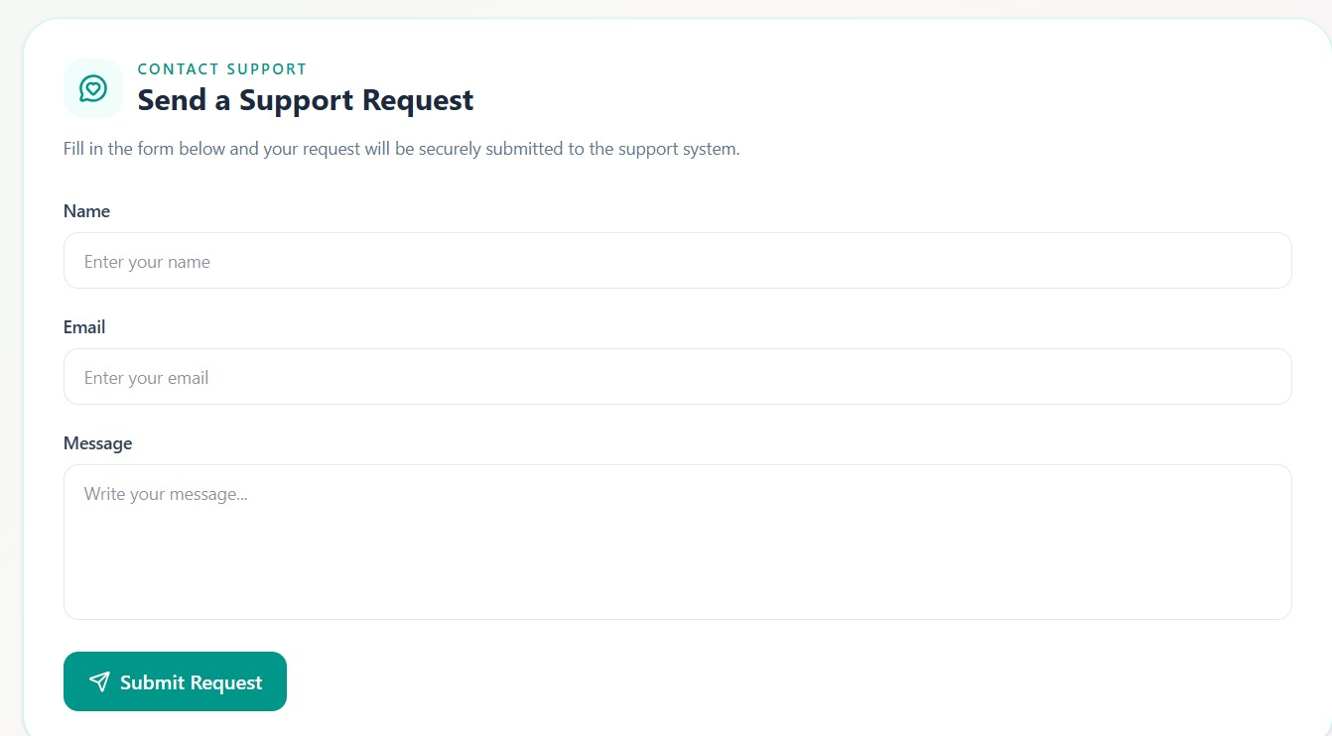
Project snapshot: support request
SCREENSHOTS
A simple contact form connected to the backend
Inputs
Name • email • message
Backend action
Validates required content and stores the request.
Boundary
Submission does not guarantee response time or clinical care.
THRIVE • Mental Wellness & Support Platform
14

Slide 15
Implementation & data model
TECHNICAL
Full-stack web app with a relational database
Frontend / backend
Database entities
React + TypeScript
Vite • React Router • Tailwind CSS
Fetch API service
Node.js + Express REST API
JWT auth • bcrypt password hashing
Routes for auth, users, resources, support and check-ins
users — account identity
resources — title, slug, description, category, tags, availability
support_requests — name, email, message, timestamp
checkin_sessions — five scores, primary/secondary areas, timestamp
Setup note: the app expects a users table; ensure it exists during database initialization.
Search is debounced and uses request cancellation; API base URL uses VITE_API_URL (fallback localhost:5000).
THRIVE • Mental Wellness & Support Platform
15

Slide 16
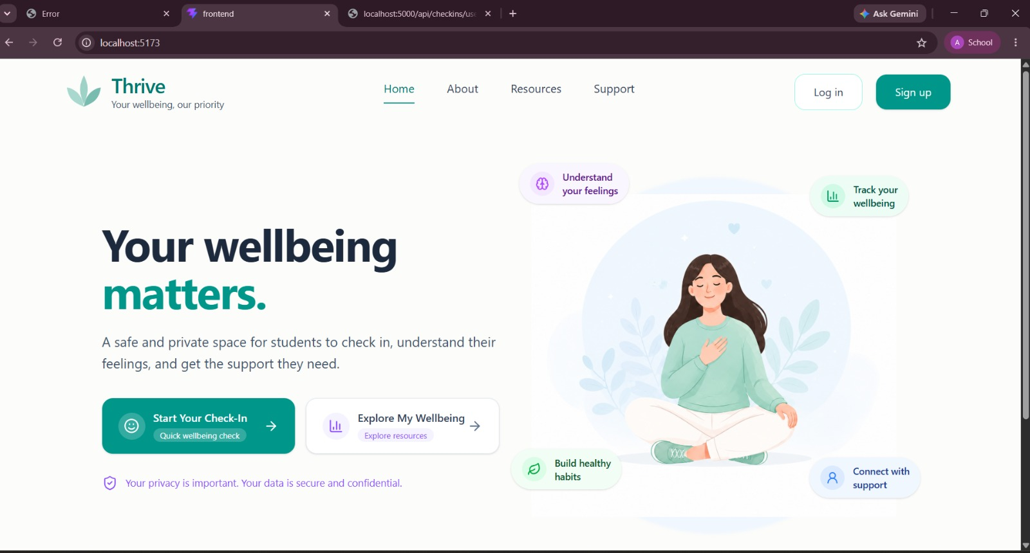
Project snapshot: home page
SCREENSHOTS
The landing page introduces the check-in and resource journey
Clear entry points
Start a check-in or explore resources.
Calm visual style
Light backgrounds, teal accents and reassuring copy.
Actual project screenshot
THRIVE • Mental Wellness & Support Platform
16

Slide 17
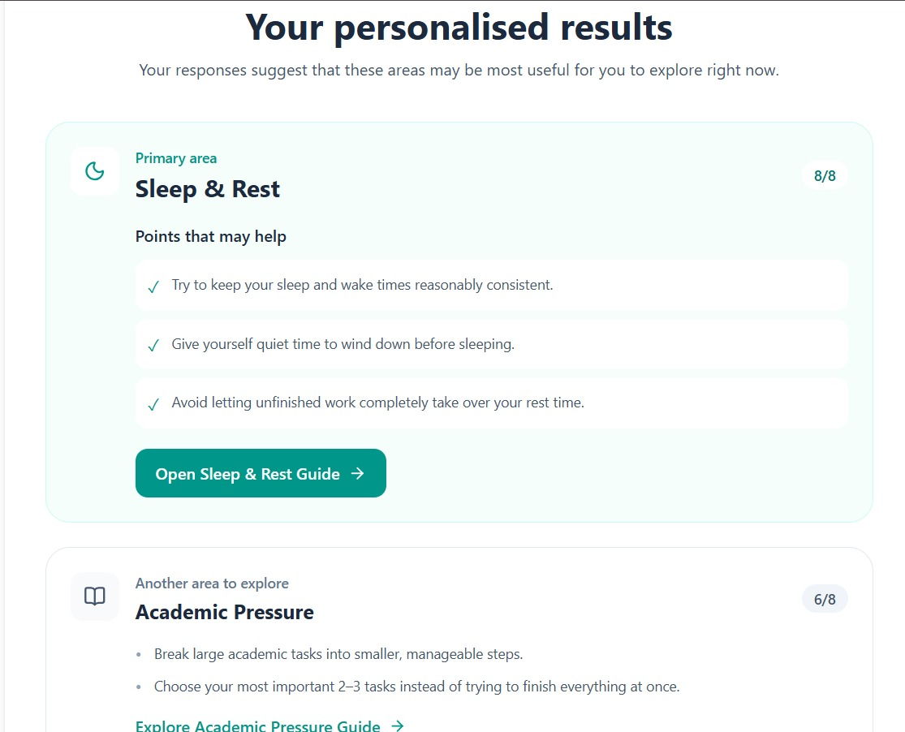
Project snapshot: personalised results
SCREENSHOTS
Primary and secondary areas with actionable suggestions
Primary area
Sleep & Rest — 8/8 in the attached example.
Secondary area
Academic Pressure — 6/8 in the attached example.
Scores are not a clinical diagnosis.
THRIVE • Mental Wellness & Support Platform
17

Slide 18
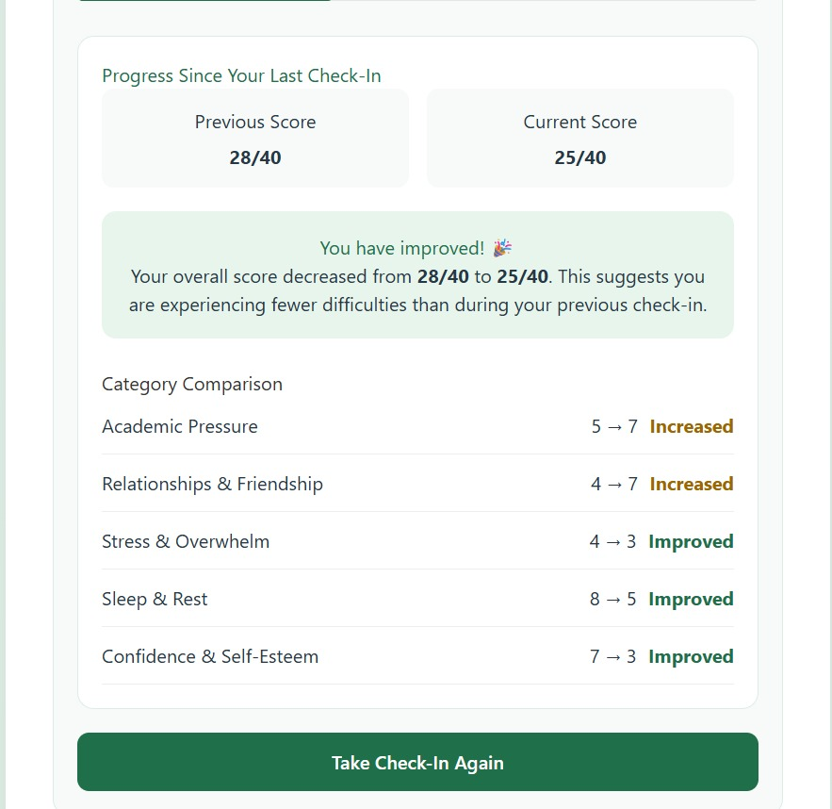
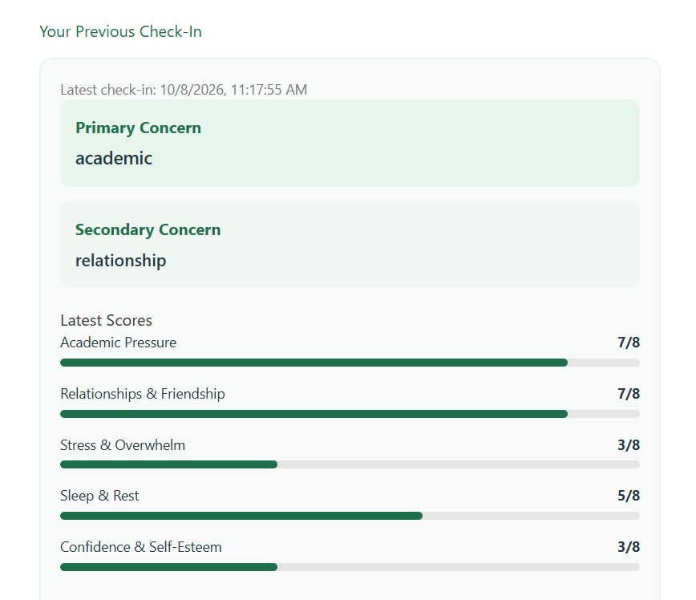
Project snapshot: profile & progress
SCREENSHOTS
Recent sessions and category changes support reflection
Example: overall score moves from 28/40 to 25/40; category-level changes are displayed.
THRIVE • Mental Wellness & Support Platform
18

Slide 19
Testing & observed results
TESTING
Functional checks performed during local project testing
Signup / login
Account creation, credential check and token flow
Local functional test
Resource browsing
Listing, search and category filtering
Local functional test
Check-in scoring
Category totals and top areas displayed
Local functional test
Profile progress
Latest and previous sessions compared
Local functional test
Support request
Form validation and request storage
Local functional test
Production validation
Deployment, penetration and formal usability studies
Not claimed
Implementation-level outcomes are not evidence of clinical effectiveness.
THRIVE • Mental Wellness & Support Platform
19

Slide 20
Limitations, security & future scope
LIMITATIONS
Honest scope is essential for a wellbeing-related application
Secrets
Endpoint protection
Current source includes a fallback JWT secret and local DB credentials; move secrets to environment variables.
Some check-in and support-list endpoints are not protected by authentication.
Access control
Next steps
Resource write endpoints require login but do not have a separate admin role.
Automated tests, case-sensitive build checks, deployment review, accessibility and consent-based usability evaluation.
THRIVE is an educational self-reflection tool—not diagnosis, emergency care or a substitute for a qualified professional.
THRIVE • Mental Wellness & Support Platform
20

Slide 21
Demo video: end-to-end walkthrough
DEMO
Show the provided demo during the presentation
▶
Video embedded and playable
Video file
Demo sequence: Home → login/signup → check-in → results → profile → resources/support
Provided demo video included with project materials.
THRIVE • Mental Wellness & Support Platform
21

Slide 22
Demo video: end-to-end walkthrough
Click the video during Slide Show mode. Some preview apps do not play embedded media.
If it doesn't play
1. Download/open the separate MP4.
2. Open this deck in desktop PowerPoint.
3. Start Slide Show and click the video.
Demo sequence
Home → login/signup → check-in → results → profile → resources/support
THRIVE • Mental Wellness & Support Platform
22

