Slide 1
FINAL PROJECT REVIEW
THRIVE
A Wellbeing Support & Resource Platform
Project presentation
Guide: Dr. Vijendra Singh Bramhe
Assistant Professor
School of Computing Science and Engineering
VIT Bhopal University
Team Members:
Aviraj Singh Thakur • 25BCE10894
Avika Panday • 25BCE10928
Manish Kumar • 25BCE10933
Udit Ravikant Chaubey • 25BCE11330
Aviral Verma • 25BCE10954
SUPPORT • REFLECT • GROW
FINAL REVIEW • 2026

Slide 2
01 / OVERVIEW
02
Presentation Roadmap
Introduction
Existing work & limitations
Proposed system
The problem and the purpose of THRIVE
What current approaches miss
Our approach and methodology
01
02
03
Architecture & modules
Implementation & demo
Testing & results
How the platform is organised
Frontend, backend, APIs and database
Input/output and observed behaviour
04
05
06

Slide 3
02 / PROBLEM & PURPOSE
03
Introduction
Wellbeing support should be easy to find, private to access, and practical to use.
The challenge
The idea
The goal
Students may experience academic pressure, stress, sleep difficulties and relationship concerns, but may not know where to start.
THRIVE brings wellbeing information, self-reflection check-ins and support pathways into one web platform.
Help users reflect on their current concerns and discover relevant educational resources and support options.
THRIVE is a wellbeing support tool — not a diagnostic or medical service.

Slide 4
03 / CONTEXT
04
Existing Work & Limitations
Common existing approaches
Limitations addressed by THRIVE
• Static articles scattered across websites
• Generic advice that may not match a user's concern
• Support information separated from self-reflection
• Limited continuity between visits
• A central place for wellbeing resources
• Category-based resource navigation
• Login and profile flow
• Check-in concept for identifying relevant topics
• Support and information pages
This slide describes general design limitations, not a claim that every existing platform has them.

Slide 5
04 / APPROACH
05
Proposed Work & Methodology
Discover
Organise
Authenticate
Identify common wellbeing topics and support needs
Group information into clear resource categories
Provide signup/login and user-specific access where protected
01
02
03
Reflect
Recommend
Evaluate
Use check-in answers to summarise concern areas
Guide users to relevant resource pages
Test forms, APIs, navigation and saved data
04
05
06

Slide 6
05 / WHAT THRIVE ADDS
06
Novelty of the Project
The contribution is in the integrated user journey—not a claim to invent wellbeing support itself.
Connected experience
Topic-aware navigation
Continuity
Signup/login, resource discovery, check-in and support pages in one platform.
A check-in can direct users toward the resource category that best matches their answers.
Authenticated, user-linked check-in history is a planned/implemented capability to demonstrate if verified.
Do not describe the tool as diagnosing mental-health conditions.

Slide 7
06 / USER JOURNEY
07
Real-Time Usage Scenario
1
2
3
4
5
6
→
→
→
→
→
Open THRIVE
Create account
Sign in
Explore
Check in
View guidance
Home page
Signup form
Login API returns token
Resource and support pages
Answer wellbeing questions
Relevant resource category
Illustrative user journey; demonstrate only the steps that work in the current build.

Slide 8
07 / SETUP
08
Hardware & Software Requirements
Hardware
Software / stack
• Laptop or desktop computer
• Recommended: 8 GB RAM or more
• Internet connection for development and testing
• Smartphone/browser for responsive checks
• Frontend: React, TypeScript, Vite
• Backend: Node.js and Express
• Database: PostgreSQL
• Libraries: bcrypt, jsonwebtoken, cors, dotenv
• Tools: VS Code, Git and browser DevTools
Requirements are practical recommendations; confirm package versions from package.json.

Slide 9
08 / ARCHITECTURE
09
Overall System Architecture
USER / BROWSER
Signup • Login • Home • Resources • Check-in • Profile
↓ HTTP / JSON
FRONTEND — React + TypeScript
Forms • Routing • Fetch requests • UI state
↓ HTTP / JSON
BACKEND — Node.js + Express
Auth routes/controllers • JWT middleware • Resource/support APIs
↓ HTTP / JSON
DATABASE — PostgreSQL
Users • Resource data • Support/check-in data (as implemented)

Slide 10
09 / BACKGROUND
10
Literature Review
Digital wellbeing resources
Self-reflection tools
Web authentication
Online information can make educational material available on demand, but content quality and discoverability matter.
Questionnaires can help people organise their own reflections, but scores are not diagnoses unless clinically validated.
Password hashing, server-side verification and secure session/token handling are important for protected user data.
Add 3–5 verified papers or official documentation references here before final submission.

Slide 11
10 / MAIN COMPONENTS
11
Module Description
Authentication
Profile
Signup, login, password verification and JWT-based identity
Displays user-related information after login
Resource Library
Check-in
Browse wellbeing guides by topic/category
Collects answers and summarises category scores
Support & Information
Database/API
Provides information and routes to support options
Persists records and serves frontend requests

Slide 12
11 / REQUEST LIFECYCLE
12
Module Workflow
UI
HTTP
ROUTE
LOGIC
DB
RESPONSE
User submits a form
→
Frontend sends JSON
→
Express matches method/path
→
Controller validates and processes
→
SQL query reads/writes data
→
JSON returned to UI
For protected routes, JWT middleware verifies the token before controller logic runs.

Slide 13
12 / TECHNOLOGY CHOICES
13
Implementation & Coding
Frontend
Backend & persistence
React + TypeScript build the interactive interface.
• Components organise pages and forms
• Routing connects pages
• Fetch/API calls communicate with Express
• localStorage currently holds login token/user data
Node.js + Express expose endpoints.
• Routes map HTTP paths to controllers
• bcrypt verifies password hashes
• JWT supports token-based authentication
• PostgreSQL stores persistent records
Use exact file names and screenshots from the current codebase in the final version.

Slide 14
13 / EVIDENCE
14
Demo Video & Project Screenshots
Screenshots to capture
Demo video sequence
1. Home page
2. Signup form and success state
3. Login success / Profile page
4. Resources listing and guide
5. Check-in questions and results
6. Support / Information page
• Open the running application
• Demonstrate signup and login
• Browse a resource category
• Complete the check-in if stable
• Show API/database result only if verified
• End with support and conclusion
Replace this guidance with real screenshots and a link to your recorded demo.

Slide 15
14 / TEST CASES
15
Testing
Test case
Input / action
Expected result
Signup
Valid new user details
User record created; success response
Duplicate signup
Already registered email
Clear error; no duplicate user
Login success
Correct email/password
Token and user details returned
Login failure
Incorrect password
Authentication rejected
Protected API
Missing/invalid token
401 response
Resource browsing
Open resource route
Relevant guide renders
Check-in save
Submit answers with valid token
Record saved to logged-in user
Mark each test Pass/Fail after running it; the expected results above are not claimed test outcomes.

Slide 16
15 / INPUT AND OUTPUT
16
Results & Discussion
Inputs
Outputs to demonstrate
• Name, email and password for signup
• Email and password for login
• Navigation choices and resource topics
• Check-in answers, where enabled
• Signup success/error message
• Login response and token handling
• Profile page after login
• Resource guide content
• Check-in category scores and suggested resource, if working
Capture actual output from the application; avoid invented performance or user-study claims.

Slide 17
16 / WRAP-UP
17
Conclusion & Future Scope
Conclusion
Future scope
THRIVE brings wellbeing information, user authentication and resource navigation together in a single web application. The check-in feature aims to help users reflect and find relevant educational guidance.
• Stronger protected-route and session handling
• Saved check-in history and trends
• Accessibility and responsive testing
• Reviewed, evidence-based resource content
• User feedback and usability evaluation
THRIVE — Support. Reflect. Grow.

Slide 18
THANK YOU
Questions & Discussion
THRIVE • FINAL PROJECT REVIEW

Slide 19
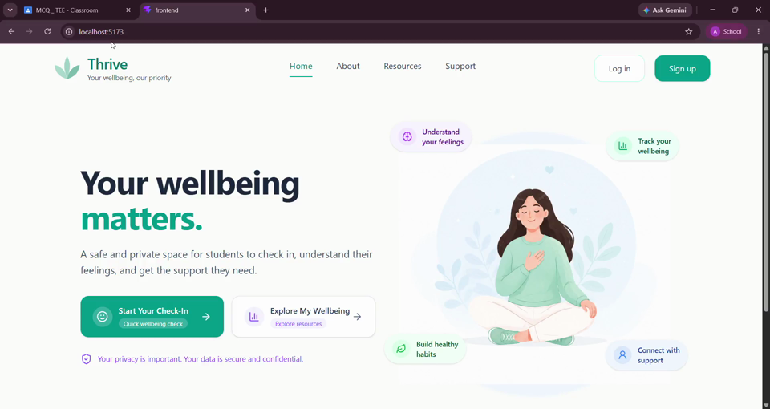
PROJECT DEMO
THRIVE — Demo Video
Embedded project walkthrough supplied by the team
If playback does not start automatically, click the video frame in slideshow mode.

