Slide 1
Deep Learning Neural Networks For Vision and Classification In Torch7
Major Project
Mentor: R.K. Yadav, Assistant Professor, COE
Aviral Takkar (2K11/CO/031), Aishwarya Deep (2K11/CO/010) and Amanjeet Singh Bhatia (2K11/CO/020)

Slide 2
Outline Of This Presentation
Aim of the Project
Overview
Motivation for doing ‘deep learning’
Torch7
Kaggle Classification Challenge – Forest Cover Type Prediction
Its Results and Conclusion
Moving beyond Multi Layer Perceptrons to Convolutional Neural Networks
SVHN Dataset
Using ConvNets for Vision
Results and Conclusion
Acknowledgements
References

Slide 3
Aim Of The Project
Continuing from last semester, we researched applications of ‘Deep Learning Neural Networks’.
We chose two applications
Classification – Kaggle Forest Cover Type Prediction Challenge
Vision – SVHN Dataset
Platform for implementation – Torch7
In this project, we implement Feed Forward neural networks for the Classification Problem and more recently developed ‘Convolutional Neural Networks’ for Vision, and compare their ‘learning capacities’.
We demonstrate the scalability and performance of the Convolutional Neural Networks as compared with fully connected feed forward neural networks.

Slide 4
Overview – Part I Forest Cover Type Prediction
Feature Scaled Cartographic Data Store
54 Input Units
Multi Layered Hidden Units. (108 → 10)
7 Output Units
Predicted results store
Feed Forward Neural Network Model
1. Total number of input parameters/training example = 54
2. Total number of parameters to learn = 54*108 + 108*10 + 10*7 = 6,982
3. Total number of training examples = 15,120
Total Training Time: Approximately 10 minutes for 14000 training examples, 5 epochs, with around 6900 parameter modifications at each step.
Training accuracy around 75%
Poor testing accuracy of around 35%
Conclusion → Poor learning capacity of model.

Slide 5
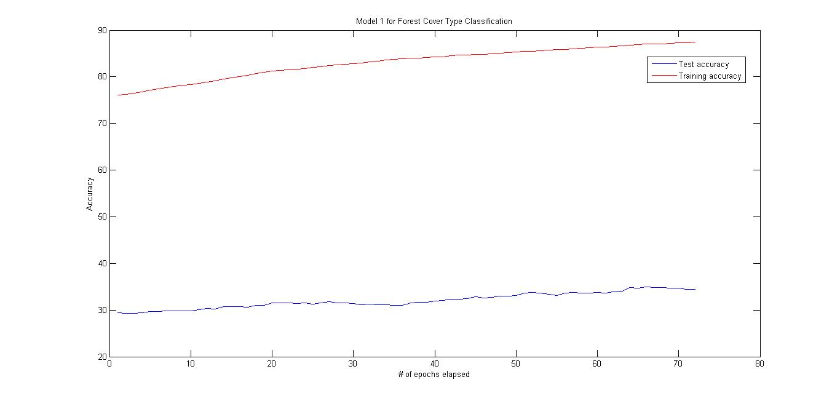
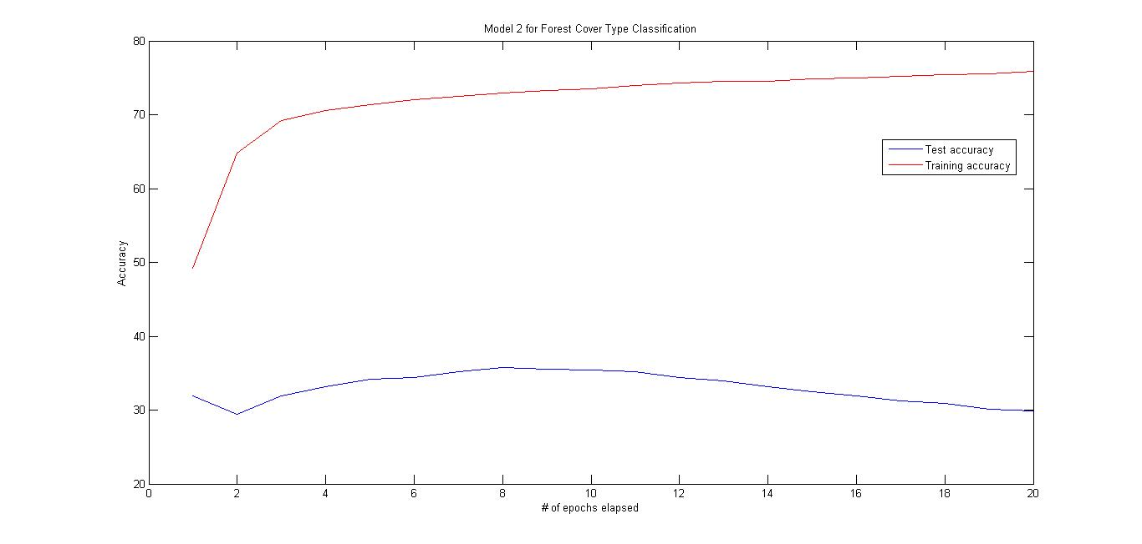
Accuracy plots of the two best forest cover type classification models

Slide 6
Overview – Part II The need for Convolutional Neural Nets
Problem with the FNN model → Fully connected model has too many parameters to fine tune with less amount of training. Overfitting evident despite regularization and feature scaling.
Possible solutions
Get more training data
change the model; use methods such as random forests, decision trees etc.
Reduce the number of parameters to learn, without losing information in the network.
We reduce the number of parameters, without losing significant amounts of information, to learn by using Convolutional Neural Networks.
Use nature of the input to reduce number of parameters and increase the learning capacity of the model.

Slide 7
Overview Part II Learning Capacity of Convolutional Neural Nets
SVHN Image Store
3*32*32 = 3072 input units
16 kernels (5*5 convolutions) → 28*28 dimension
Lp Pooling layer
256 kernels (5*5 convolutions)
Predicted results store
10 output units
Multi Layered Hidden Units. (128)
Lp Pooling layer
Total Training Time: Approximately 2 hours for around 79,000 training examples, 5 epochs, with around 35,728 parameter modifications at each step.
Training accuracy around 90%
Testing accuracy of around 89%
Conclusion → Information preserved despite parameter reduction; no overfitting observed.

Slide 8
Overview – Part III FNN vs CNN for Image Recognition
Feed Forward Neural Network Model
1. Total number of input parameters/training example = 32*32*3 = 3,072
2. Total number of parameters to learn assuming 2 hidden layers = 2 * (3,072 * 2 * 3072) + (3072*10) = 3,77,79,456 ~~ 37 million
3. Total number of training examples = 73,257
Convolutional Neural Network Model
1. Total number of input parameters/training example = 32*32*3 = 3,072
2. Total number of parameters to learn (16*5*5) + (16*256) + (265*5*5*128) = 8,52,496
3. Total number of training examples = 73,257
Total gain → #parameters/input sample in FNN by #parameters/input sample in CNN is ~ 44.
Thus, we have reduced the number of parameters to be learnt by 44 times, and lost none of the information in the input due to convolutions

Slide 9
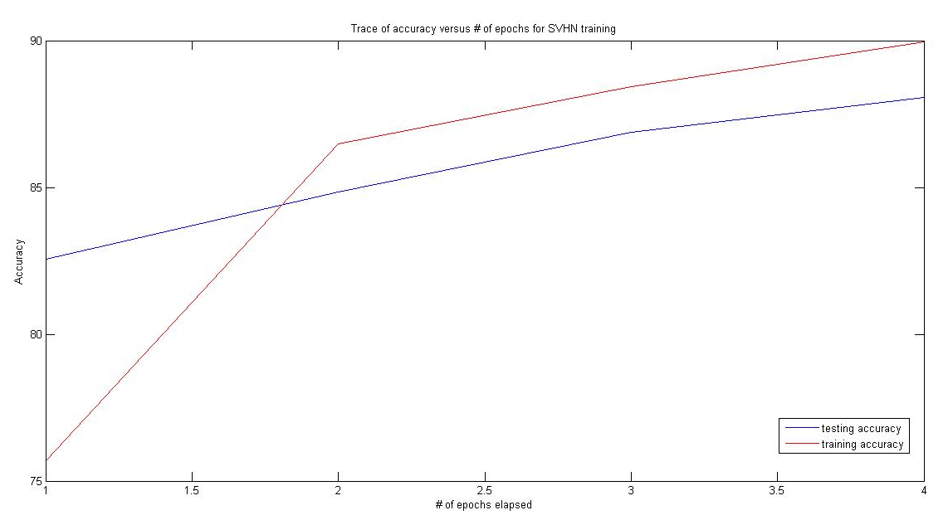
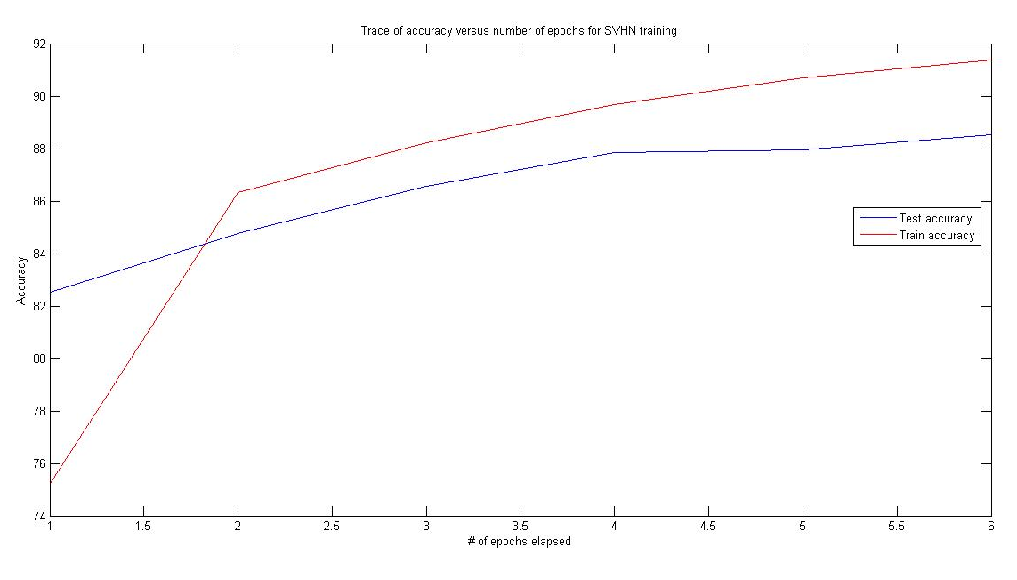
Lp-pooling ‘p’ value 12
Lp-pooling ‘p’ value 24
Accuracy plot showing highly improved results

Slide 10
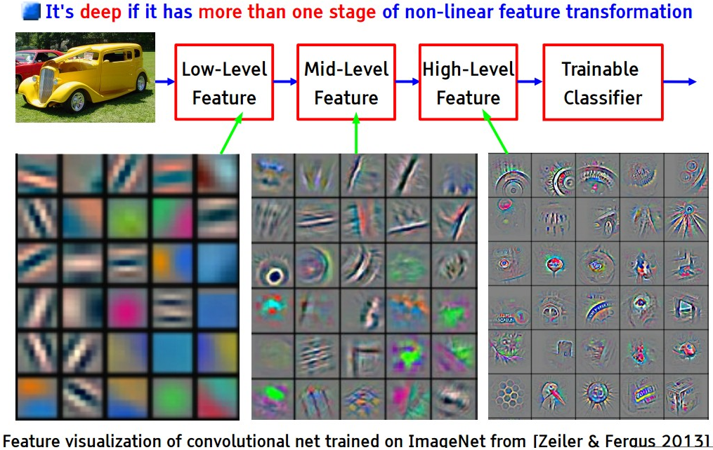
Motivation
Deep Learning is a very hot area of Machine Learning Research, with many remarkable recent successes, such as 97.5% accuracy on face recognition, nearly perfect German traffic sign recognition, or even Dogs vs Cats image recognition with 98.9% accuracy. Many winning entries in recent Kaggle Data Science competitions have used Deep Learning.
The term "deep learning" refers to the method of training multi-layered neural networks, and became popular after papers by Geoffrey Hinton and his co-workers which showed a fast way to train such networks.
In May 2014, Baidu, the Chinese search giant, has hired Andrew Ng, a leading Machine Learning and Deep Learning expert (and co-founder of Coursera) to head their new AI Lab in Silicon Valley, setting up an AI & Deep Learning race with Google (which hired Geoff Hinton) and Facebook (which hired Yann LeCun to head Facebook AI Lab).
We experimented with such deep learning networks.

Slide 11
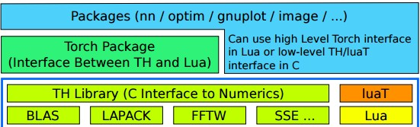
Torch7
A new framework, where new algorithm prototypes and experiments can be set up as quickly as possible with best possible computational performance.
Torch7 is a versatile numeric computing framework and machine learning library that extends a very lightweight and powerful programming language Lua.
Its goal is to provide a flexible environment to design, train and deploy learning machines.
Developed by - Ronan Collobert, Koray Kavukcuoglu, and Clement Farabet.
Modular Structure of Torch7. Low level numerical libraries are interfaced with TH to provide a unified tensor library. luaT provides essential data structures for object/class manipulation in Lua. The core Torch package uses TH and luaT to provide a numerical computing environment purely in Lua. All other packages can use either Torch interface from inside Lua scripting environment or can interface low-level C interfaces for increased performance optimizations.

Slide 12
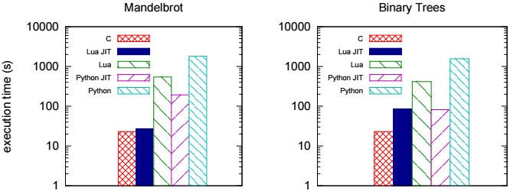
Torch7
This figure compares runtime efficiency of various available machine learning platforms. Clearly, Torch7 is a winner.
We made use of the following neural networks libraries available in Torch7 :-
Neural Network Package ‘nn’: This package provides an easy and modular way to build and train simple or complex neural networks using Torch.
Optimization Package ‘optim’: This package contains several optimization routines for Torch. Each optimization algorithm is based on the same interface → x*, {f}, ... = optim.method(func, x, state).
‘Image’ - An image library for Torch. This package provides routines to load/save and manipulate images using Torch's Tensor data structure, changing color spaces, rotate, translate, warp etc

Slide 13
Kaggle Challenge – Forest Cover Type Prediction
What is the challenge?
In this competition you are asked to predict the forest cover type (the predominant kind of tree cover) from strictly cartographic variables.
The data is in raw form (not scaled) and contains binary columns of data for qualitative independent variables such as wilderness areas and soil type.
What is the data?
The study area includes four wilderness areas located in the Roosevelt National Forest of northern Colorado. Each observation is a 30m x 30m patch. You are asked to predict an integer classification for the forest cover type. The seven types are:
1 - Spruce/Fir 2 - Lodgepole Pine 3 - Ponderosa Pine 4 - Cottonwood/Willow 5 - Aspen 6 - Douglas-fir 7 - Krummholz

Slide 14
The training set (15120 observations) contains both features and the Cover Type. The test set contains only the features. You must predict the Cover Type for every row in the test set (565892 observations).
Data Fields
Elevation - Elevation in meters
Aspect - Aspect in degrees azimuth
Slope - Slope in degrees
Horizontal_Distance_To_Hydrology - Horz Dist to nearest surface water features
Vertical_Distance_To_Hydrology - Vert Dist to nearest surface water features
Horizontal_Distance_To_Roadways - Horz Dist to nearest roadway
Hillshade_9am (0 to 255 index) - Hillshade index at 9am, summer solstice
Hillshade_Noon (0 to 255 index) - Hillshade index at noon, summer solstice
Hillshade_3pm (0 to 255 index) - Hillshade index at 3pm, summer solstice
Horizontal_Distance_To_Fire_Points - Horz Dist to nearest wildfire ignition points
Wilderness_Area (4 binary columns, 0 = absence or 1 = presence) - Wilderness area designation
Soil_Type (40 binary columns, 0 = absence or 1 = presence) - Soil Type designation for the 40 types of soil. (like Cathedral family, Ratake family etc.)
Cover_Type (7 types, integers 1 to 7) - Forest Cover Type designation
The wilderness areas are:
1 - Rawah Wilderness Area 2 - Neota Wilderness Area 3 - Comanche Peak Wilderness Area 4 - Cache la Poudre Wilderness Area

Slide 15
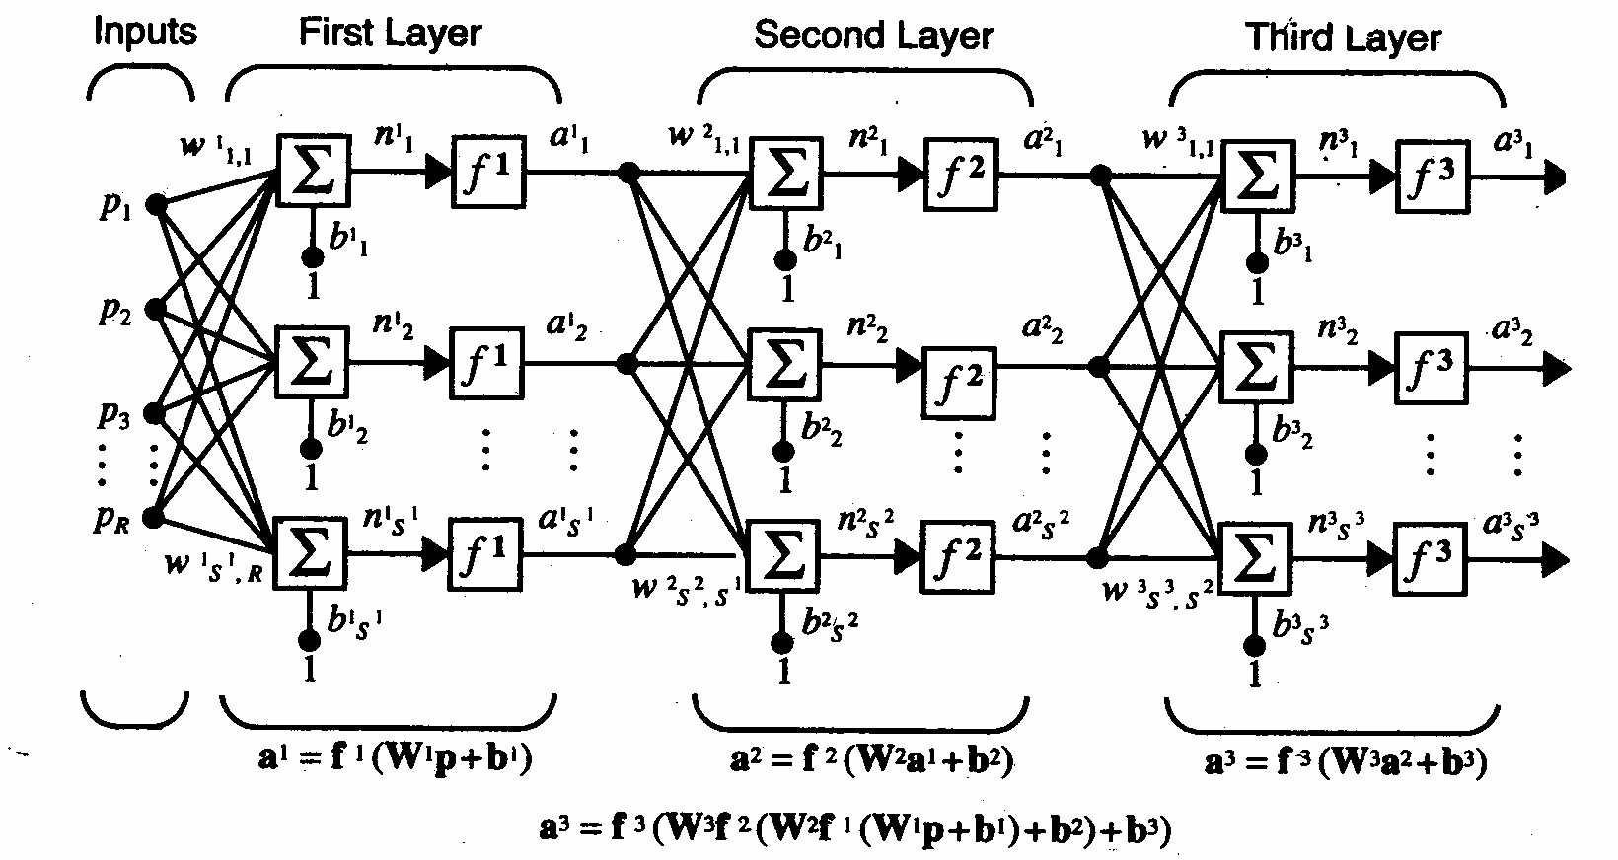
Kaggle Challenge – Forest Cover Type Prediction
The multi layer perceptron model we used.
The non-linearity function used in both layers was ‘Tanh()’ due to its conveniently calculable derivative.
We used a LogSoftMax regression model to select the final activation unit. This model generalizes logistic regression to classification problems where the class label y can take on more than two possible values (in this case, 7).
#inputs – 54 #outputs - 7
#hidden in layer 1 – 108
#hidden in layer 2 - 10

Slide 16
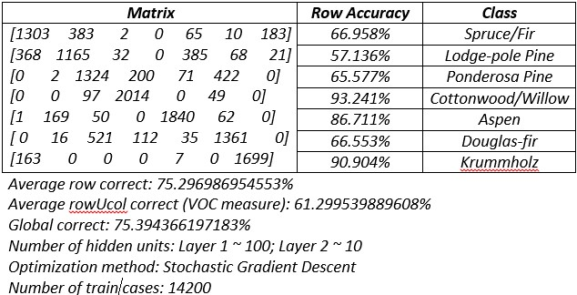
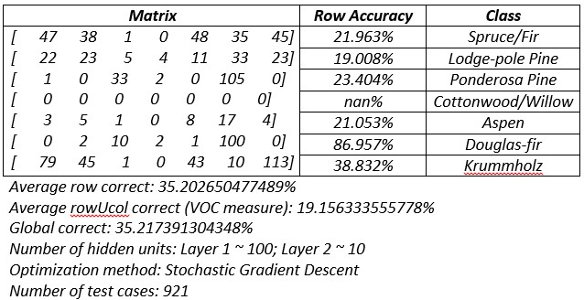
Kaggle Challenge – Forest Cover Type Prediction
We scaled the data before feeding it to the network, and performed regularization to penalize the network when it tries to overfit.
However, we still ended up with a high degree of overfitting and no useful results.
The Confusion Matrices for the training and test data reveal that the model overfitted.

Slide 17
Kaggle Challenge – Forest Cover Type Prediction
Our Conclusion → The model is incapable of capturing the relationship in the data.
Specifically, due to the large number of parameters to be learnt, the model tunes itself only to ‘rote’ the examples it sees and is therefore, unfit to make any kind of predictions on seeing new examples.
Despite employing feature scaling and regularization, overfitting poses a major challenge.
In our next application with many times more features, we use Convolutional Neural Networks to overcome this deficit.

Slide 18
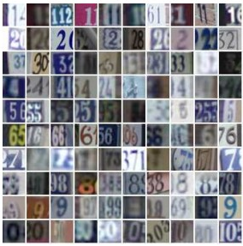
Second Application – Using SVHN Dataset To Train A Network For Vision
SVHN is a real-world image dataset for developing machine learning and object recognition algorithms with minimal requirement on data preprocessing and formatting.
SVHN is obtained from house numbers in Google Street View images.
The SVHN classification dataset contains 32x32 images with 3 color channels → 3*32*32 = 3,072 input units per image.
Total samples for training are 73,257 and 26,032 for testing.
This problem can clearly not be tackled by just a multi layer perceptron, as concluded from our previous work.
Therefore, we turn to Convolutional Neural Networks.
Cropped samples from the SVHN dataset.

Slide 19
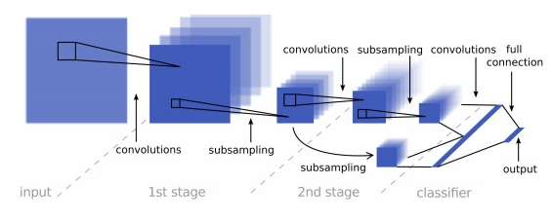
Convolution Neural Networks
Their capacity can be controlled by varying their depth and breadth.
They also make strong and mostly correct assumptions about the nature of images (namely, stationary nature of statistics and locality of pixel dependencies).
Thus, compared to standard feedforward neural networks with similarly-sized layers, CNNs have much fewer connections and parameters and so they are easier to train, while their theoretically-best performance is likely to be only slightly worse

Slide 20
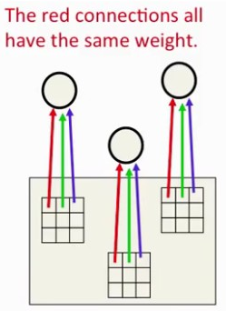
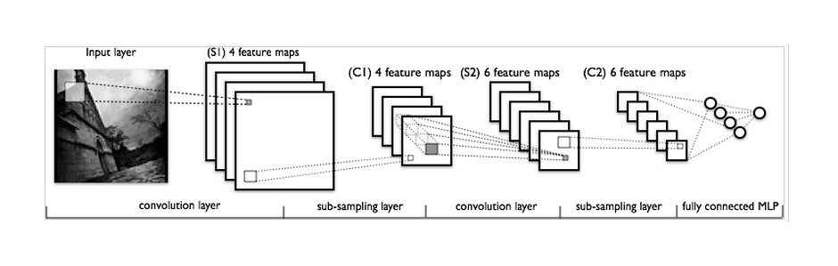
Convolutions
Convolution is a mathematical term, defined as applying a function repeatedly across the output of another function. In this context it means to apply a 'filter' over an image at all possible offsets. A filter consists of a layer of connection weights, with the input being the size of a small 2D image patch, and the output being a single unit.
A bank of different filters allows each patch of an image to be represented in several ways! Also, convolutions ensure detector of the same feature are available ‘everywhere’.
One Filter

Slide 21
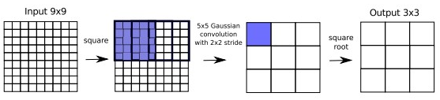
Pooling
Pooling of features is done after a bank of filters to gain a small amount of ‘translational invariance’, and to reduce the number of inputs to the next level.
So for example, we may take the mean of four replicated feature detectors before passing on its value (Mean Pooling).
We can have many more feature maps without drastically increasing the number of parameters to learn.
One problem → After many layers of pooling, we may lose precise spatial relationships for high level recognition. Thus, we stick to 2 pooling layers.
Many kinds of pooling (Max pooling, Mean Pooling). We use ‘Lp-pooling’.
A summary of L2-pooling.

Slide 22
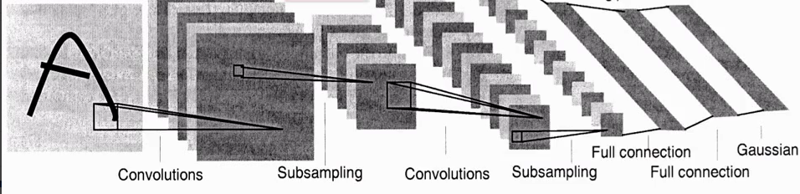
Putting them together → CNN
A Convolutional Neural Network (CNN or ConvNet) is comprised of one or more convolutional layers (with a pooling step) and then followed by one or more fully connected layers as in a standard multilayer neural network.
Easier to train than fully connected neural networks due to convolutions.
The ConvNet we used has 2 layers of feature extraction using Convolutions + Lp-pooling, followed by a fully connected two layer network.

Slide 23
SVHN Dataset
Character recognition in documents can be considered a solved task for computer vision, whether handwritten or typed.
It is however a harder problem in the context of complex natural scenes like photographs where the best current methods lag behind human performance, mainly due to non-contrasting backgrounds, low resolution, de-focused and motion-blurred images and large illumination differences.
Samples are pre-processed as follows
Conversion from RGB color space to YUV.
with a local contrast normalization (with a 7x7 kernel) on the Y channel of the YUV space followed by a global contrast normalization over each channel. YUV encodes a color image or video taking human perception into account, allowing reduced bandwidth for chrominance components, thereby typically enabling transmission errors or compression artifacts to be more efficiently masked by the human perception than using a "direct" RGB-representation.
All digits have been resized to a fixed resolution of 32-by-32 pixels.
The ‘stationary’ property of the images is exploited here, meaning that the statistics of one part of the image are the same as any other part. This suggests that the features that we learn at one part of the image can also be applied to other parts of the image, and we can use the same features at all locations i.e. ‘convolve’ them

Slide 24
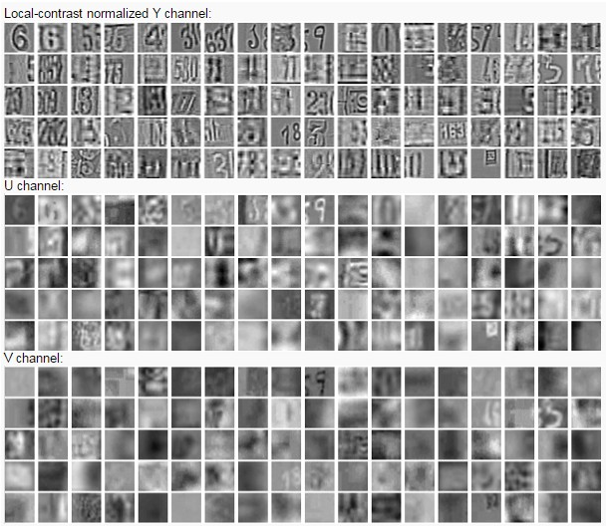
Preprocessed SVHN Samples
Original SVHN samples and preprocessed SVHN samples.

Slide 25
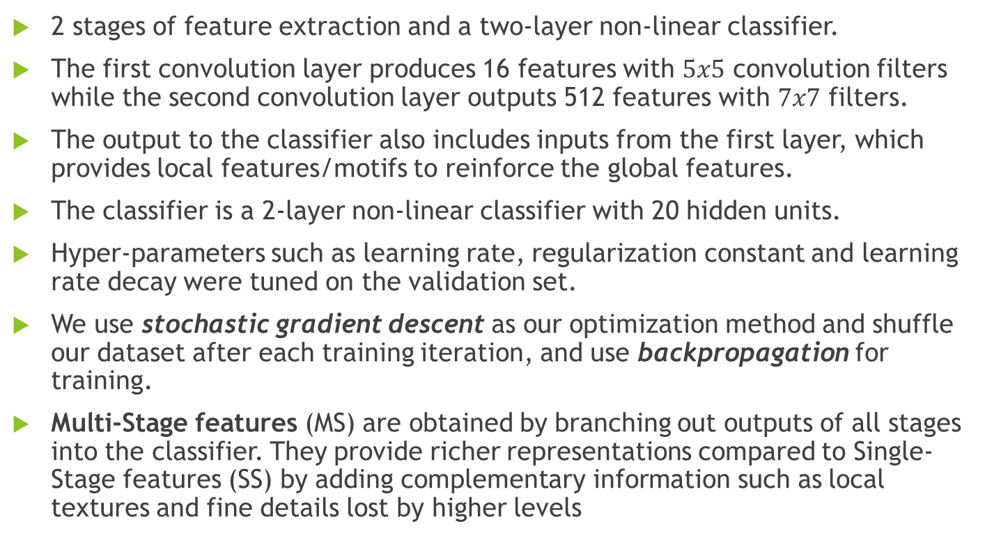
Architecture Of The CNN Used
2 stages of feature extraction and a two-layer non-linear classifier.
The first convolution layer produces 16 features with $5x5$ convolution filters while the second convolution layer outputs 512 features with $7x7$ filters.
The output to the classifier also includes inputs from the first layer, which provides local features/motifs to reinforce the global features.
The classifier is a 2-layer non-linear classifier with 20 hidden units.
Hyper-parameters such as learning rate, regularization constant and learning rate decay were tuned on the validation set.
We use stochastic gradient descent as our optimization method and shuffle our dataset after each training iteration, and use backpropagation for training.
Multi-Stage features (MS) are obtained by branching out outputs of all stages into the classifier. They provide richer representations compared to Single-Stage features (SS) by adding complementary information such as local textures and fine details lost by higher levels

Slide 26
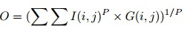
Architecture Of The CNN Used
For the pooling layers, we compare Lp-pooling for the value p = 1, 2, 4, 8, 12.
Lp-pooling is a biologically inspired pooling layer modelled on complex cells who’s operation can be summarized in the equation below.
It can be imagined as giving an increased weight to stronger features and suppressing weaker features.
Two special cases of Lp pooling are notable. P = 1 corresponds to a simple Gaussian averaging, whereas P = ∞ corresponds to max-pooling (i.e only the strongest signal is activated).
where G is a Gaussian kernel, I is the input feature map and O is the output feature map
A summary of L2-pooling.

Slide 27
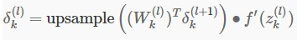
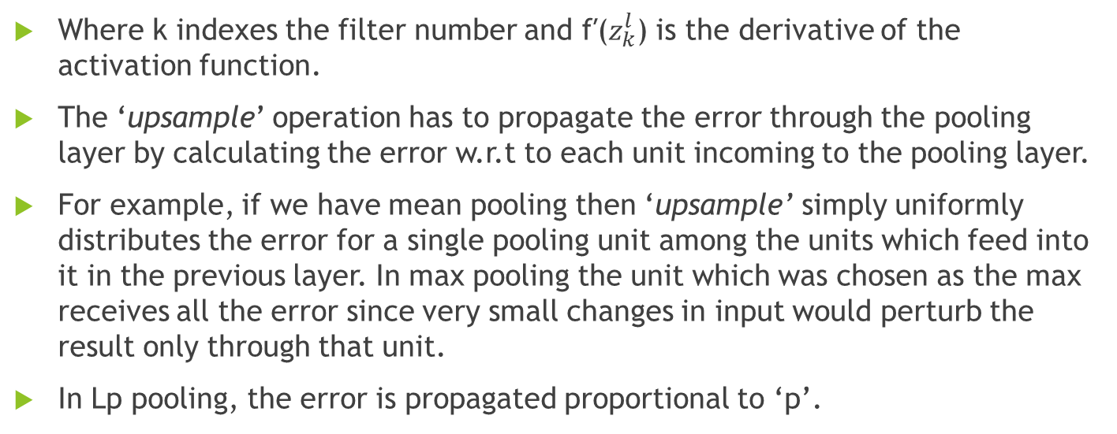
Backpropagation in the Convolution Layers
Where k indexes the filter number and f′($z_{k}^{l}$) is the derivative of the activation function.
The ‘upsample’ operation has to propagate the error through the pooling layer by calculating the error w.r.t to each unit incoming to the pooling layer.
For example, if we have mean pooling then ‘upsample’ simply uniformly distributes the error for a single pooling unit among the units which feed into it in the previous layer. In max pooling the unit which was chosen as the max receives all the error since very small changes in input would perturb the result only through that unit.
In Lp pooling, the error is propagated proportional to ‘p’.

Slide 28
Implementing in Torch7
Network parameter optimization method → Backpropagation to compute derivatives in each iteration, and stochastic gradient descent to update parameters.
The standard gradient descent algorithm updates the parameters θ of the objective J(θ) as, θ=θ−α∇θE[J(θ)]; where the expectation in the above equation is approximated by evaluating the cost and gradient over the full training set.
Stochastic Gradient Descent (SGD) simply does away with the expectation in the update and computes the gradient of the parameters using only a single or a few training examples. The new update is given by,
θ=θ−α∇θJ(θ;x(i),y(i))
with a pair (x(i),y(i)) from the training set.
‘optim’ - This package contains several optimization routines for Torch. Each optimization algorithm is based on the same interface:
x*, {f}, ... = optim.method(func, x, state)
Where fucn = user defined closure function; x = parameter vector; state = {learning rate, momentum, etc}; x* = updated parameter vector; f = table of all ‘f’ values.

Slide 29
Experiments
We implemented the CNN previously described → first made by Yann Le cunn in C++ platform, in Torch7.
Experimented with various values of ‘p’ in Lp-pooling → 2, 4, 6, 8, 10, 12.
To define hyper-parameters such as regularization constant and learning rate decay, we referred to the paper by Yann Lecunn on Convolutional Neural Networks, trained on this data. [http://arxiv.org/pdf/1204.3968v1.pdf]
All experiments were done on the Torch7 platform, on Ubuntu 14.04 operating system using a standard Dell (Intel Pentium i3 processor) laptop.
Using more powerful hardware would have enabled us to train more, hence we can expect even better results..

Slide 30
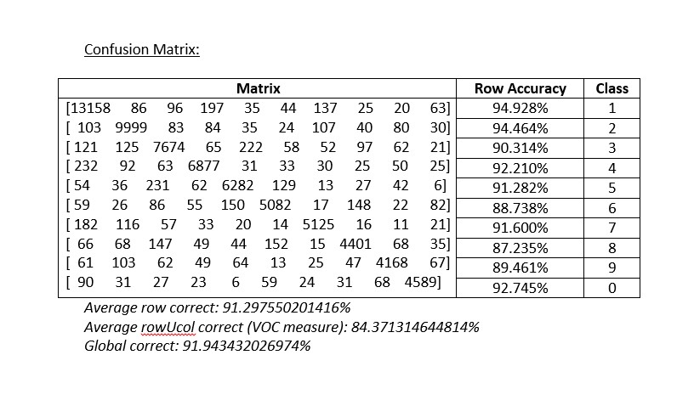
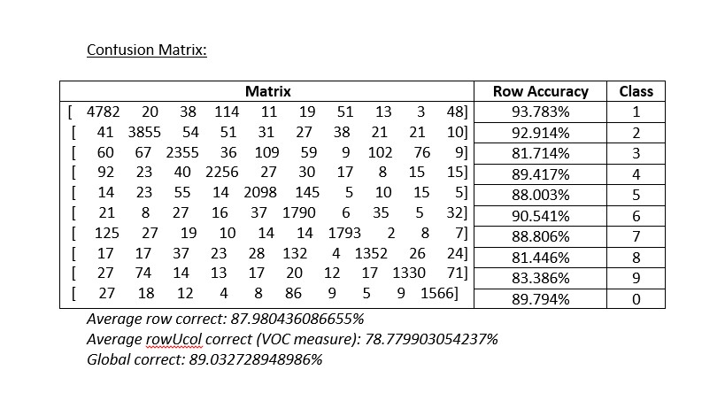
Results
We achieved the following results after 4 training epochs (L12-pooling used in this case).
Training accuracy
Testing accuracy

Slide 31
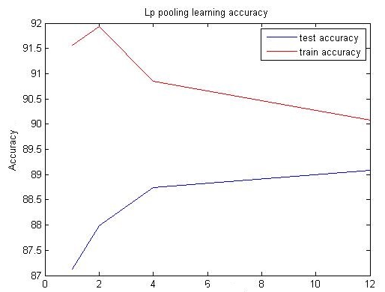
Results
There is no single optimum value for ‘p’ as we know from LeCun et al.
The value is dependent on the input space.
For the SVHN space, this value seems to converge towards 12.
A more accurate picture can come about by training for an even larger number of epochs.
In the research work we cite, the number of training epochs were around 1000, compared with our 5 to 6.
Training accuracy vs ‘p’ of Lp-pooling

Slide 32
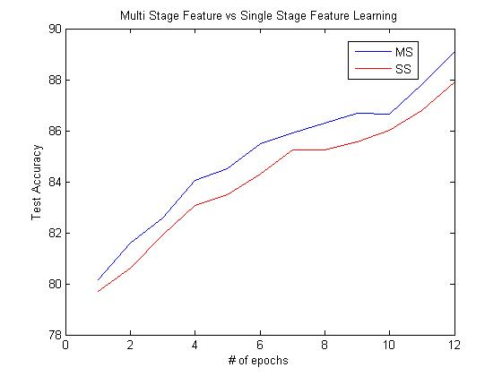
Results
→ Improvement of Multi-Stage features (MS) over Single-Stage features (SS) in accuracy on testing set.
→ Time taken to train over 12 epochs → 8 hours

Slide 33
Some Observations and Conclusion
Through this project and the results obtained, it is clear that CNNs have a vastly greater learning potential than multi layer perceptrons.
The learning capacity of the CNNs can be adjusted by controlling their height and width.
Lp-pooling is an effective way of pooling the features → it enhances stronger features in the image patch being learnt and diminishes the weaker features, thus enabling better learning.
Learning in CNNs is much faster than MLPs, since only its last two layers are fully connected.
This makes training faster and easier.
It reduces over-fitting.
Each layer of the CNN is learning a different feature → from simple abstract features to more complicated ones as we propagate through the network.
Using Multi-Stage features is an effective way to increase performance and also to capture geo-spatial information in an image, which may be lost due to pooling.

Slide 34
Research Work Publication
The research paper on this work has been accepted for publication in the following journals.
International Journal of Innovative Science, Engineering and Technology – ISSN 2348 – 7968
http://ijiset.com/articlesv2/articlesv2s4.html
Indexed in Institute for Science Information, ISSN, Google Scholar, Bing, International Scientific Indexing, NISCAIR, DRJI, Scientific Indexing Services
Journal of Control, Robotics and Mechatronics – United Scholars Publication, California, USA
http://www.unitedscholars.net/journal-of-control--robotics--and-mechatronic-systems.html
Indexed in Google Scholar, Bing

Slide 35
Acknowledgement
We would like to express our deep gratitude to Professor Rajesh K Yadav, Delhi Technological University, for his patient guidance, enthusiastic encouragement and useful critiques of this research work. His willingness to give his time so generously has been appreciated.
Thank you!

Slide 36
References And Bibliography
[1] Bache, K. & Lichman, M. (2013). UCI Machine Learning Repository. Irvine, CA: University of California, School of Information and Computer Science; http://www.kaggle.com/c/forest-cover-type-prediction
[2] Convolutional Neural Networks Applied to House Numbers Digit Classification. Pierre Sermanet, Soumith Chintala and Yann LeCun, The Courant Institute of Mathematical sciences.New York University. {sermanet,soumith,yann}@cs.nyu.edu http://arxiv.org/abs/1204.3968v1;
[3] Yuval Netzer, Tao Wang, Adam Coates, Alessandro Bissacco, Bo Wu, Andrew Y. Ng Reading Digits in Natural Images with Unsupervised Feature Learning NIPS Workshop on Deep Learning and Unsupervised Feature Learning 2011. (PDF); http://ufldl.stanford.edu/housenumbers/;
[4] http://torch.ch/
[5] http://ufldl.stanford.edu/wiki/index.php?title=SoftmaxRegression&oldid=2288
[6] http://ufldl.stanford.edu/tutorial/supervised/ConvolutionalNeuralNetwork/
[7] https://github.com/torch/nn
[8] https://github.com/torch/optim

Slide 37
All models are wrong, but some are useful.
George E. P. Box
Thank You!

