Slide 1

AI Detection in Content
Enterprises today face a growing and insidious threat: Shadow AI. Employees, often unknowingly, integrate AI tools like ChatGPT into their daily workflows, injecting AI-generated content into critical documents such as reports, contracts, policies, and emails.
This unregulated use poses significant risks, as manually identifying AI-created text is nearly impossible. Our solution leverages advanced technology to automatically detect and expose this hidden content.

Slide 2
The Problem: Unseen AI Risks
The unchecked proliferation of AI tool usage among employees introduces significant vulnerabilities. Without proper oversight, AI-generated content can seep into core business operations, creating a cascade of potential issues for enterprises.
Lack of Oversight
Compromised Data Integrity
Employees are increasingly utilizing external AI tools without official authorization or monitoring, leading to a loss of control over content generation.
Critical documents like contracts, reports, and communications may contain AI-generated text, lacking clear provenance and authenticity markers.
Compliance & Legal Risks
Data Leakage Potential
The inability to identify AI-generated content creates serious risks regarding regulatory compliance, intellectual property, and legal accountability.
Sending proprietary information to third-party AI services can inadvertently lead to sensitive data leakage and introduce new security vulnerabilities.

Slide 3
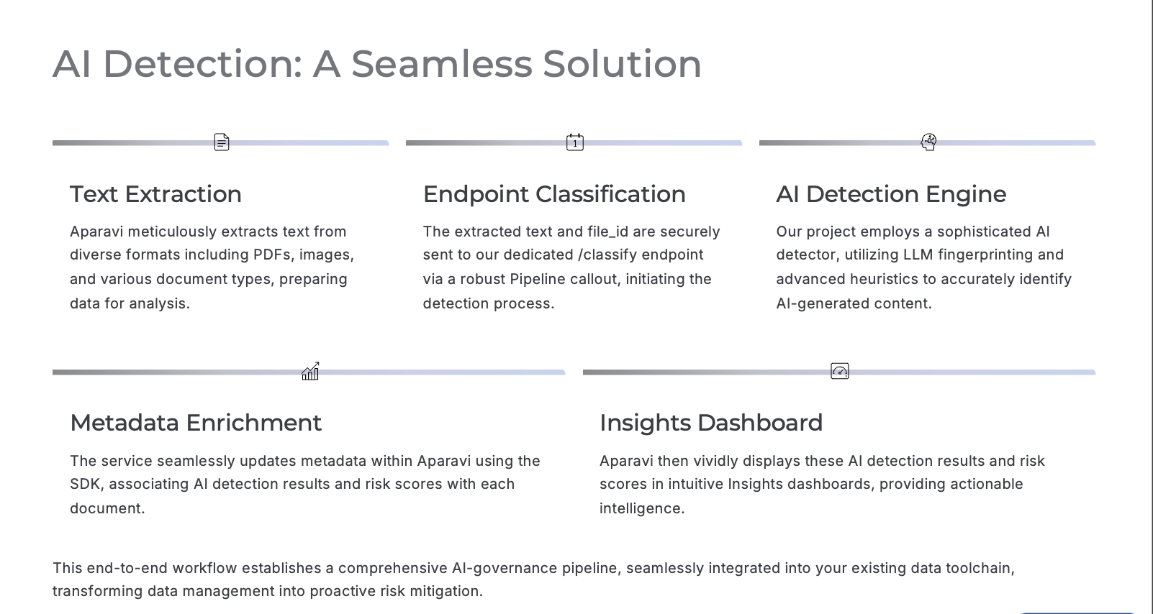


Slide 4
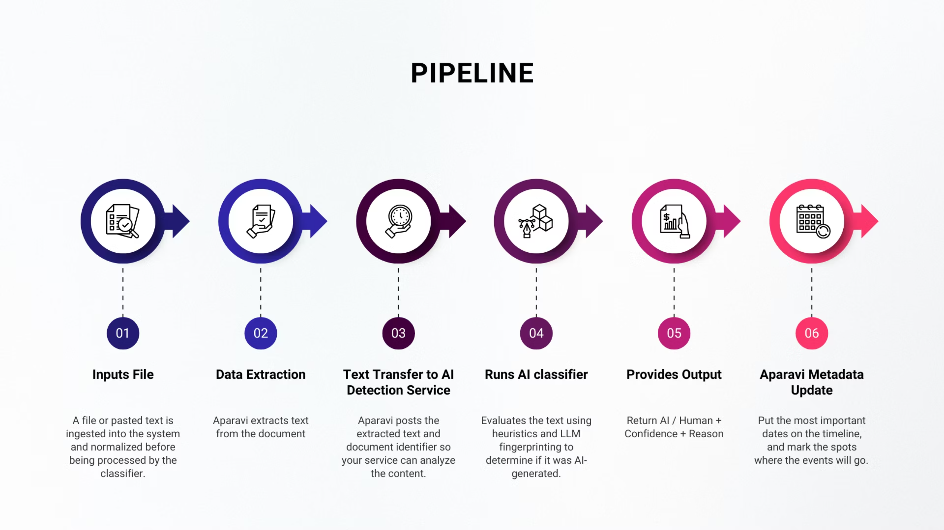
The Pipeline: A Visual Journey
This visual journey illustrates the fluid movement of data through each stage, from initial ingestion to final analysis, highlighting the efficiency and precision of Aparavi's approach.

Slide 5


What I Learned
What's Next
Ingestion & OCR layer eliminated heavy preprocessing
Native AI-provenance tracking
AI policy enforcement inside pipelines
Pipeline callouts made LLM integration smooth
Enterprise AI-risk scoring frameworks
Metadata features turned classifier output into real insights
Built-in AI detection models
Aparavi can become the foundation for AI governance across unstructured data.

