Slide 1

MANIPAL UNIVERSITY JAIPUR
Department of Computer and Communications Engineering
TEAM NAME
BYTE BINDERS
TEAM ID
UV19W 67A
PROBLEM STATEMENT ID
AI-02
PROBLEM STATEMENT TITLE
DATA-ANALYST AGENT ON MESSY DATABASES
THEME / DOMAIN
36-HOUR HACKATHON • 24–25 OCTOBER 2026
AI & MACHINE LEARNING
SYNORA - EVIDENCE-BACKED DATA ANALYSIS
CATEGORY
SOFTWARE
hypnexismuj.com | @hypnexis.muj | hypnexis2026@muj.manipal.edu

Slide 2
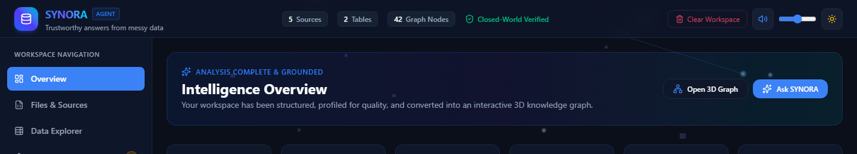
SYNORA / EVIDENCE-BACKED DATA ANALYST
BYTE BINDERS | UV19W 67A
PROBLEM STATEMENT
OUR SOLUTION
- Correct tables and columns are hard to discover
- Missing, duplicated, and inconsistent values distort analysis
- Natural-language questions still need safe SQL and verification
- A plausible wrong answer can be worse than no answer
- Schema-aware question answering
- Read-only, permission-aware query execution
- Result validation before explanation
- Evidence, provenance, and honest limitations
SYNORA workspace: analysis complete, grounded, and ready for inspection.

Slide 3
TECHNICAL APPROACH
BYTE BINDERS | UV19W 67A
SYSTEM ARCHITECTURE
CORE TECHNOLOGIES
Data source
- React 19 + TypeScript + Vite
- Express backend with server-side OAuth routes
- Three.js / OrbitControls knowledge graph
- AlaSQL in-browser read-only analysis
- XLSX, CSV, JSON, PDF, PPTX and DOCX ingestion
- Optional Gemini endpoints for OCR / model assistance
Schema + profile
Question to SQL
Policy gate
Read-only run
UNIQUE POINTS
- Closed-world answers grounded in uploaded data
- Query safety and role-aware access checks
- Validation records, SQL, result rows, and citations
- Explicit abstention when evidence is insufficient
Validate + evidence
Answer / limitation
Verified workspace state

Slide 4
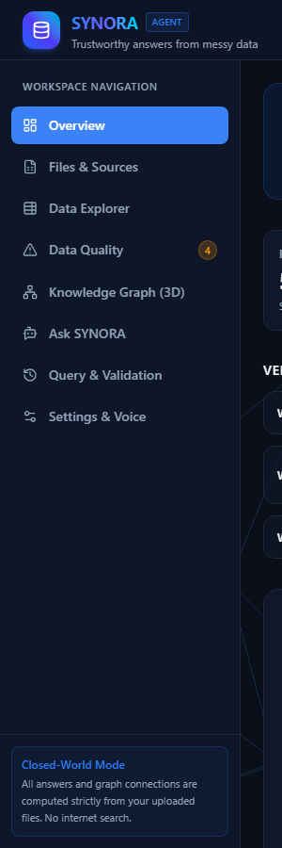
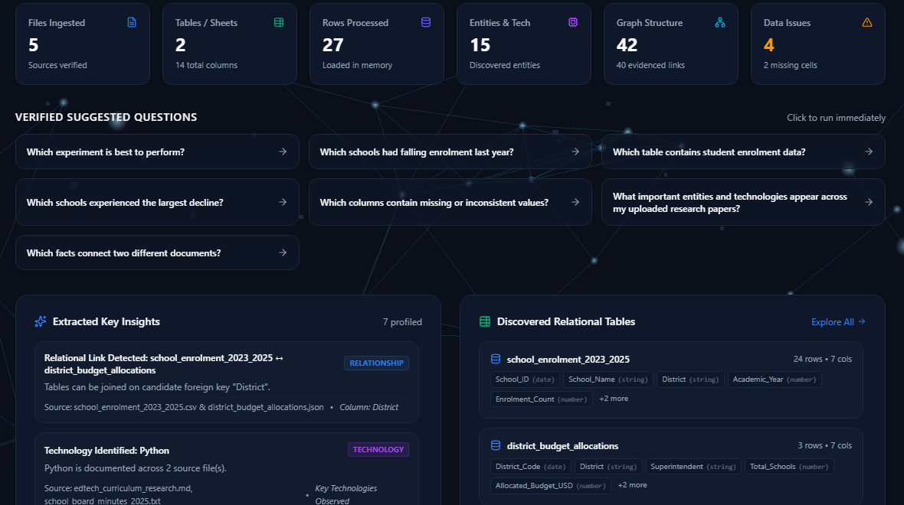
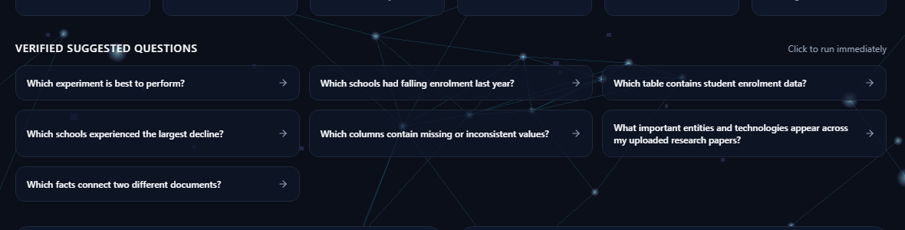
USER EXPERIENCE & DESIGN
BYTE BINDERS | UV19W 67A
USER INTERFACE
USER FLOW
DESIGN GOAL
1
Connect or upload
Make trustworthy data analysis understandable for people who do not write SQL.
The current prototype combines guided upload, natural-language questions, transparent query history, evidence panels, graph exploration, theme options, and persistent sound controls.
2
Ask and analyse
3
Verify and understand
Suggested questions in the labelled demo
Workspace navigation, insights, relational tables, and persistent audio control.

Slide 5
FEASIBILITY AND VIABILITY
BYTE BINDERS | UV19W 67A
TECHNICAL FEASIBILITY
ECONOMIC FEASIBILITY
OPERATIONAL VIABILITY
- Existing React / TypeScript application with Express entry point
- Modular ingestion, profiling, query, evidence, and graph services
- Browser-local AlaSQL keeps the demo reproducible
- Deployable as a Node server with Vite production assets
- Secrets remain server-side for optional providers
- Prototype uses open-source libraries already in the stack
- Main variable costs are optional model inference, OCR, storage, and hosting
- Early deployment can use a labelled institutional pilot workspace
- Commercial pricing is intentionally not claimed yet
- Cost validation requires real usage assumptions
- Messy files and ambiguous questions remain real risks
- Mitigations: bounded queries, role checks, validation, citations, and abstention
- OAuth requires provider-console credentials and exact callbacks
- Large-document and scanned-PDF processing may need optional model services
- Monitor failures rather than masking them
Runtime evidence: extracted insights and tables

Slide 6
IMPACT AND BENEFITS
BYTE BINDERS | UV19W 67A
1
SOCIAL IMPACT
2
ENVIRONMENTAL IMPACT
- Makes structured analysis more approachable for nontechnical users`r- Reduces dependence on manually writing SQL for supported questions`r- Encourages evidence inspection before decisions
- Reuses existing organizational data`r- Favors bounded, on-demand processing`r- Avoids claiming measured savings without a lifecycle study
Evidence starts with a visible question and a bounded workflow
A grounded workspace state is visible to the user
3
TECHNICAL IMPACT
4
EDUCATIONAL IMPACT
- Unifies schema discovery, execution, validation, and explanation`r- Makes query reasoning and source evidence inspectable`r- Treats missing evidence as a first-class result
- Shows users the SQL and result context`r- Supports guided exploration of structured data`r- Helps learners connect questions, evidence, and validation

Slide 7
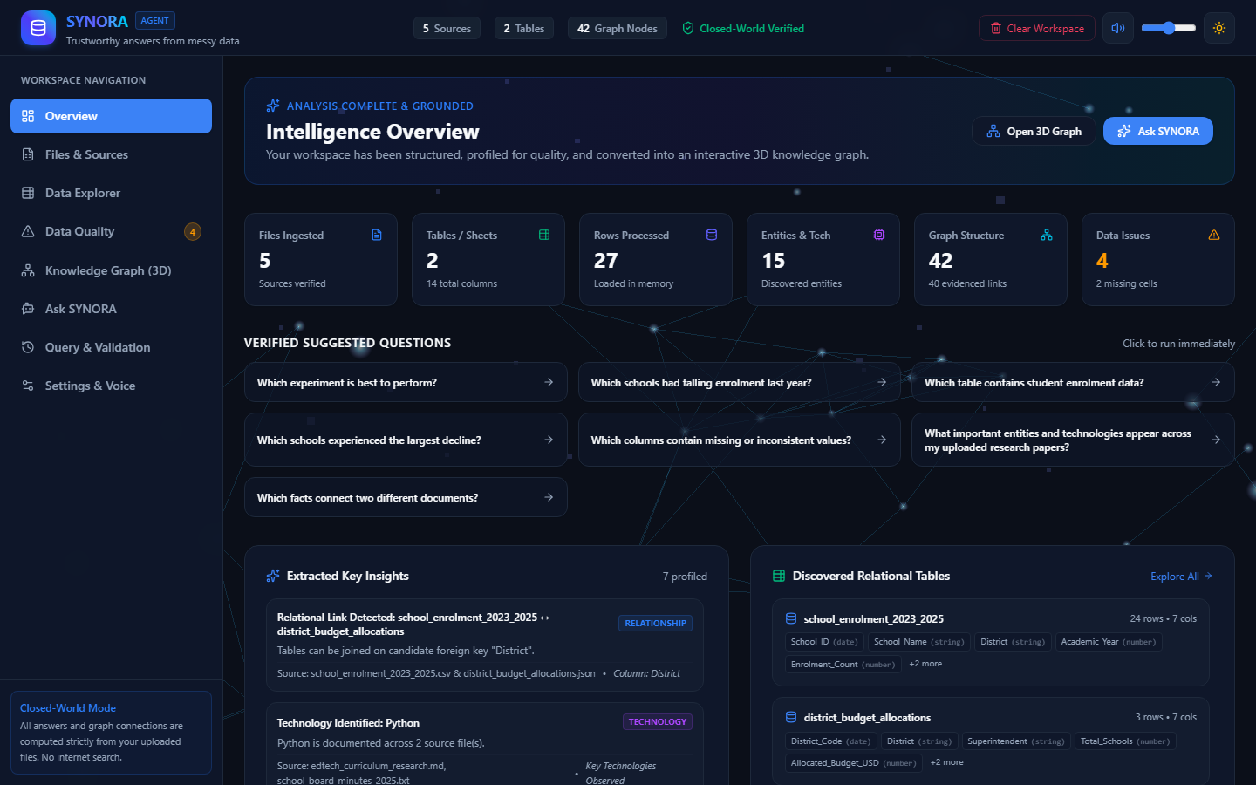
BUSINESS MODEL & SUSTAINABILITY
BYTE BINDERS | UV19W 67A
TARGET USERS
REVENUE & COST MODEL
SUSTAINABILITY
- Educational institutions and academic departments
- Analysts working with spreadsheets and structured data
- Small and medium organisations with fragmented datasets
- Teams needing a safer interface to existing databases
- Free or limited pilot workspace
- Paid team workspaces
- Institutional / enterprise deployment
- Optional managed inference or document processing
- Revenue model requires validation with actual users
- Reusable connectors and modular integrations
- Configurable model providers
- Fits existing organisational workflows
- Expand support from observed user requirements
- Keep the local-first demo reproducible
Working SYNORA dashboard â€¢ synthetic demo

Slide 8
RESEARCH AND REFERENCES
BYTE BINDERS | UV19W 67A
KEY TECH & RESEARCH SOURCES
Problem context
- HYPNEXIS26 AI-02: Data-Analyst Agent on Messy Databases (supplied brief)
Implemented stack
- React: https://react.dev/
- TypeScript: https://www.typescriptlang.org/
- Vite: https://vite.dev/
- Express: https://expressjs.com/
- Three.js: https://threejs.org/
- AlaSQL: https://github.com/AlaSQL/alasql
- SheetJS / XLSX: https://docs.sheetjs.com/
- pdf-parse: https://www.npmjs.com/package/pdf-parse
Optional integrations
- Google GenAI SDK: https://ai.google.dev/gemini-api/docs
- OAuth provider documentation supports server-side redirect configuration; real credentials were not present in this environment.
No benchmark or production-scale performance claim is made in this deck.

Slide 9
SYNORA.
Evidence-backed analysis. More trustworthy decisions.
BYTE BINDERS | UV19W 67A
Aviral Jain | 9258950945
Amit Kumar Jha | 9084658005
Niyati Joshi | 7417159128
Asmi | 9872893988

