Slide 1
Introduction to Neural Networks

Slide 2
Introduction to Neural Networks
Aviral Mansingka
amansin@purdue.edu
https://github.com/aviralmansingka/deep-learning-talks

Slide 3
Logistics (Regression)
Second Talk of the series
Loosely covering Chapter 6 of deeplearningbook.org
Inspired from CS231n, dennybritz/nn-from-scratch
Submit Feedback!

Slide 4
Recap
What is machine learning?
Binary Classification
Sentiment Analysis
Bag of words representations of sentences
Gradient Descent
Logistic Regression

Slide 5
Machine Learning
“The process of building machines that learn”
Loss Functions
Measure of how good out predictions are
Also called objective functions/ cost functions
E.g. log-likelihood, zero-one loss
Models
Generative: models the distribution of inputs and outputs together e.g. p(x,y)
Discriminative: models the distributions of labels conditioned on input e.g. p(y|x)

Slide 6
Binary Classification
Given some data point, determine which of 2 classes it belongs to.
E.g. Generative model: Naïve Bayes
Makes classification based on which is more likely (recall Maximum Likelihood Estimation)
E.g. Discriminative model: Logistic Regression
Makes classification using a decision boundary (more on this later)

Slide 7
Sentiment Analysis
One of the most clearly defined problems in natural language
State of the art is pretty good! (+90% on hard datasets)
Fundamentally, “Given a sentence, tell me whether it has a positive or negative tone”\
An application of binary classification

Slide 8
Bag of Words
Assumption: Words occur independent of one another
Steps:
Given some list of sentences, find all words that occur in them -> vocabulary
Create a vector of size(vocabulary) and set all values to zero
Given a new sentence, increment the value at the position of the word in the vector
Makes no assumption about sentiment in the data, model learns this from a representation

Slide 9
Bag of Words (example)
S1: “Java is horribly terse”
S2: “Python is beautiful”
Vocab: {“python”: 0, “java”: 1, “is”: 2, “horribly”: 3, “beautiful”: 4, “terse”: 5}
0 1 2 3 4 5 S1:[0 1 1 1 0 1] S2:[1 0 1 0 1 0]

Slide 10
Bag of Words (Contd.)
S1: “Cats eat dogs”
S2: “Dogs eat cats”
S3: “Dogs are cute”
Vocab: {“cats”: 0, “dogs”: 1, “eats”: 2, “are”: 3, “cute”: 4}
0 1 2 3 4 S1:[1 1 1 0 0] S2:[1 1 1 0 0] S3:[0 1 0 1 1]
Notice anything?

Slide 11
Gradient Descent
Essential for optimization.
Cornerstone of most machine learning.
Requires loss function to be smooth, differentiable
Convex optimization: Gradient Descent reaches global maximum
Non-convex optimization: ☹

Slide 12
Gradient Descent (example)
f(x) = x^2
We want argmin f

Slide 13
Logistic Regression
“King of production ML”
Makes use of logistic (also called Sigmoid)
Discriminative model
LINEAR (more on this later)
Almost identical to Perceptron (precursor to Neural Networks)

Slide 14
Motivations for Neural Networks
Also called multi-layer perceptron
Take output of first layer and give it to second etc.
How do we leverage linear models for non-linear data?
What are the problems with it?
How are neural networks different?
Learns representation
Not bound by linear models

Slide 15
Difficulties with Neural Networks
Model complexity is a double edged sword
How do we train these complex models with intricate dependencies?
Not convex
Much more computationally intensive

Slide 16


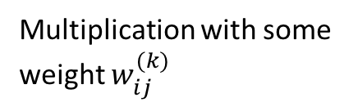
Structure of Neural Networks
Input Units
Hidden Units
Output Units
Multiplication with some weight $w_{ij}^{(k)}$
$$W^{0}$$
$$W^{1}$$
Weights

Slide 17
Structure of Neural Network (Actual Math)
X : input layer
Tanh : hidden activation (basically 2*Sigmoid – 1)
Softmax : output activation
How do we generate a prediction?

Slide 18
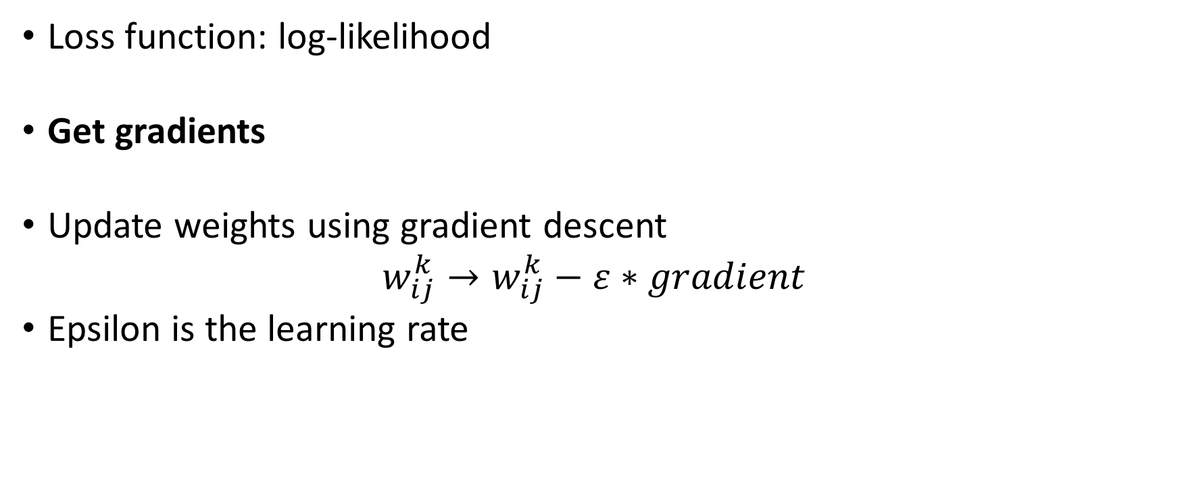
How do we train Neural Networks?
Loss function: log-likelihood
Get gradients
Update weights using gradient descent $w_{ij}^{k}→w_{ij}^{k}−ε∗gradient$
Epsilon is the learning rate

Slide 19
Backpropagation
“Apply chain rule until you die”
Relies on a concept called the computational graph
We will look at a neural network in various abstractions.
Gates: Addition, Multiplication
Activations: Sigmoid, Tanh
Output: Softmax
(optional) Layer: Combination of of the three above
(optional) Model: Comprised of multiple layers

Slide 20
Computational Graph
wx
z
z
Activation/Output
X*
Add
b
w
Mul
wx
x

Slide 21
Computation Graph
Forward Phase
Inputs are computed and move in the direction of the arrows
Can be variable inputs to a gate
Backward Phase
Every gate has exactly one input loss gradient
Loss gradients must move back (back-propagation)

Slide 22
Implementation Time!
We are going to cover neural networks from start to finish
We are going to introduce you to keras (my fav library)
We are going to look at my brother’s chat and tell if he likes me

Slide 23
Questions?
Aviral Mansingka
amansin@purdue.edu
https://github.com/aviralmansingka/deep-learning-talks

