Slide 1
i-health: Remote monitoring of patients

Slide 2
Aim
To connect the Doctors with Patients in remote areas
It can also be used to monitor the critical parameters.

Slide 3
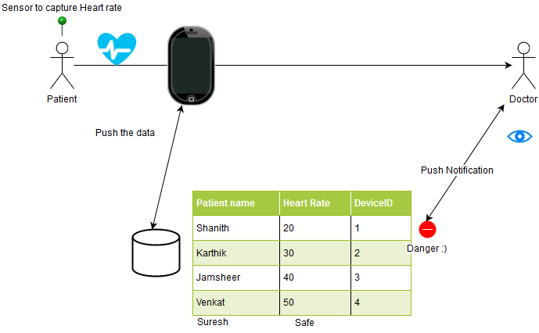
i-Health High Level Flow

Slide 4
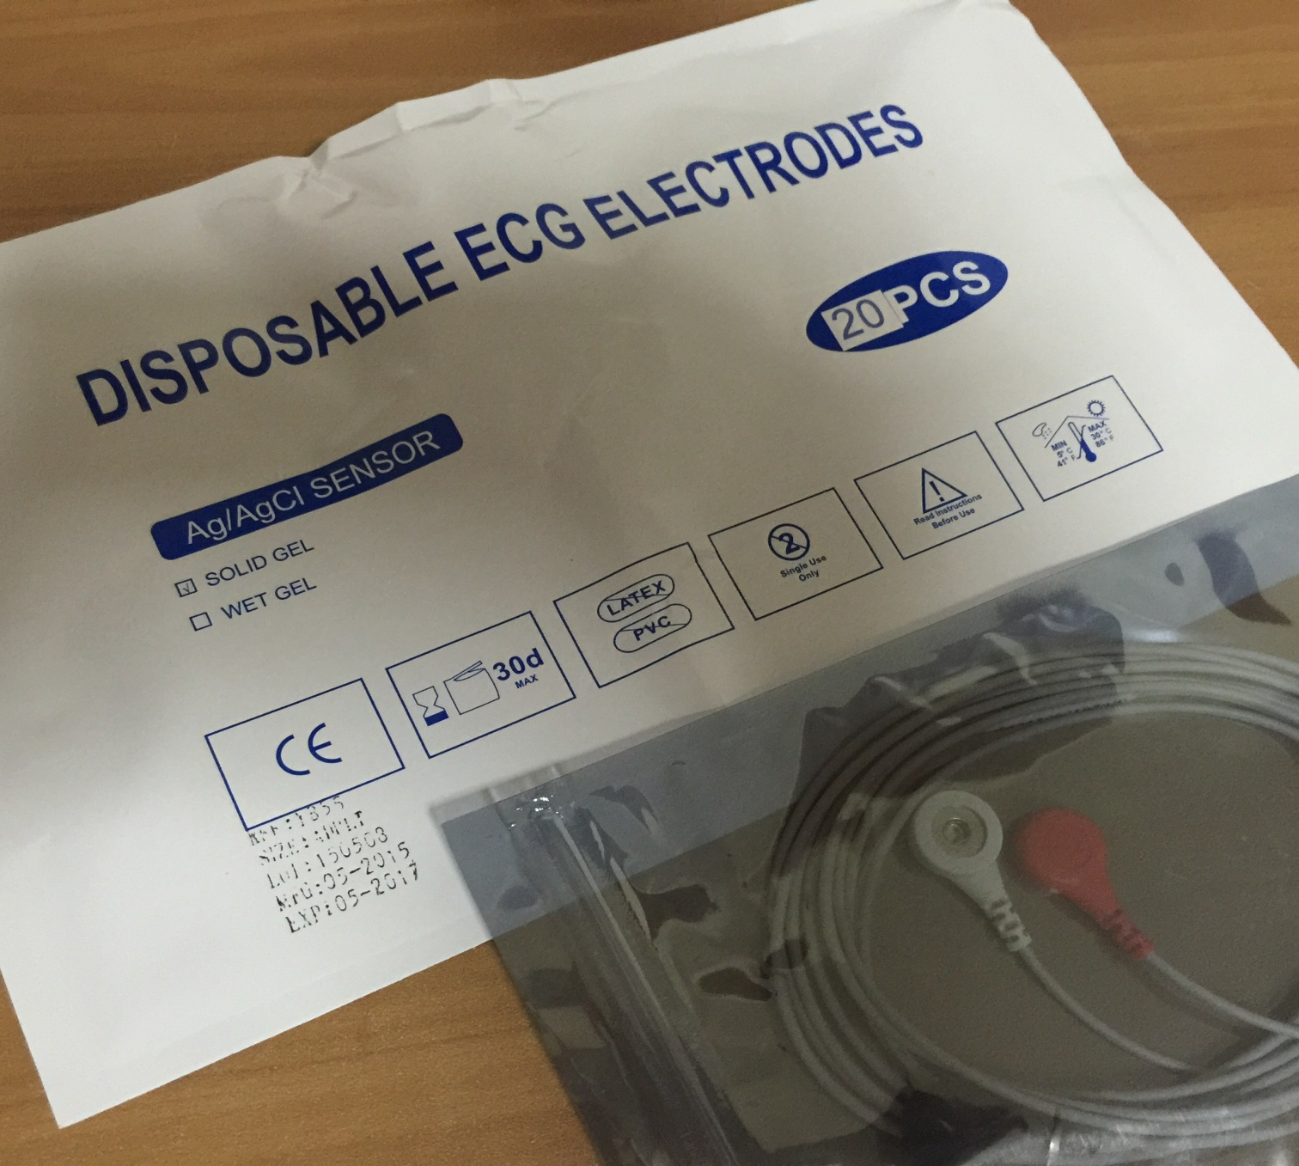
ECG Sensors
ECG Sensors will be connected to patients and other end will be connected to Libelium Circuit shown next slide

Slide 5
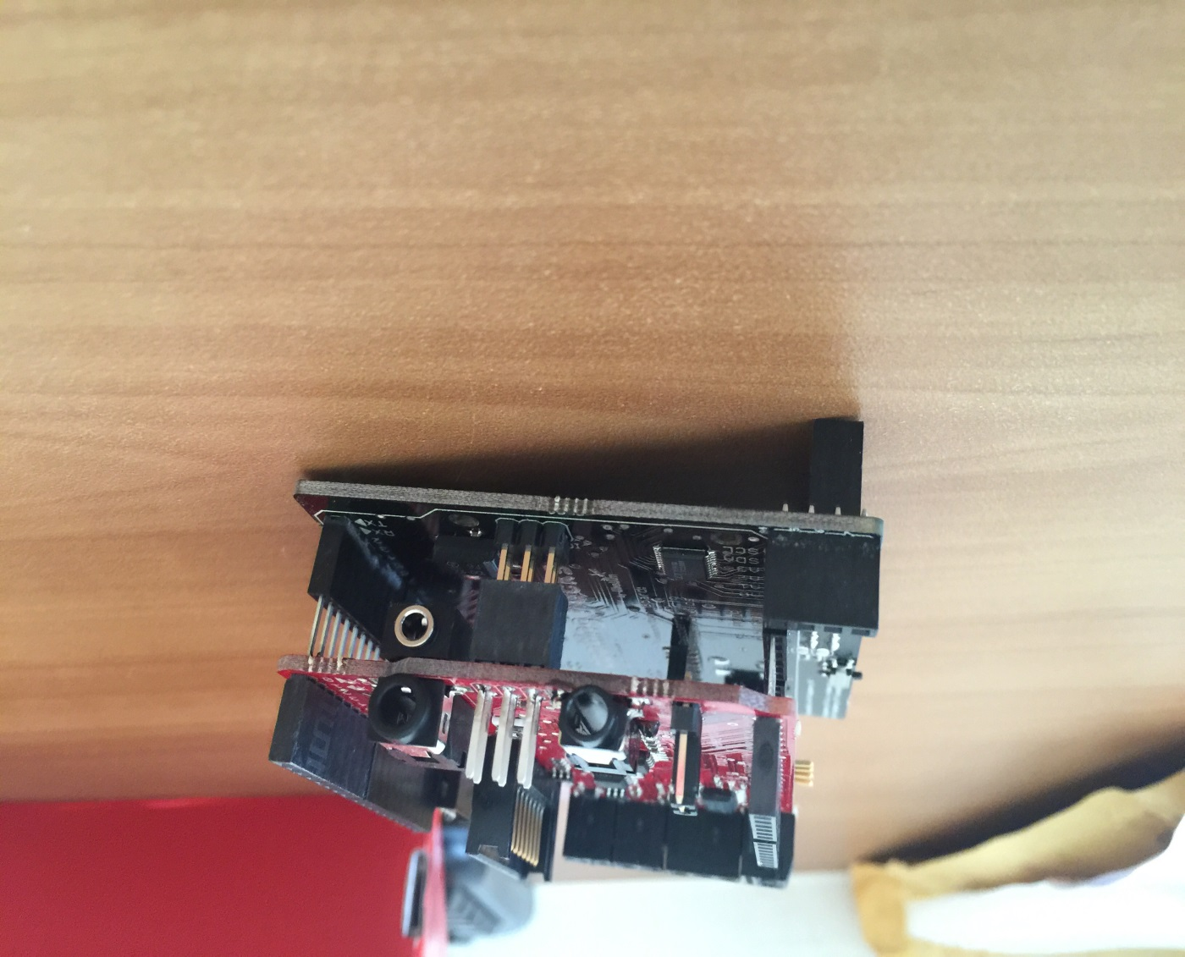
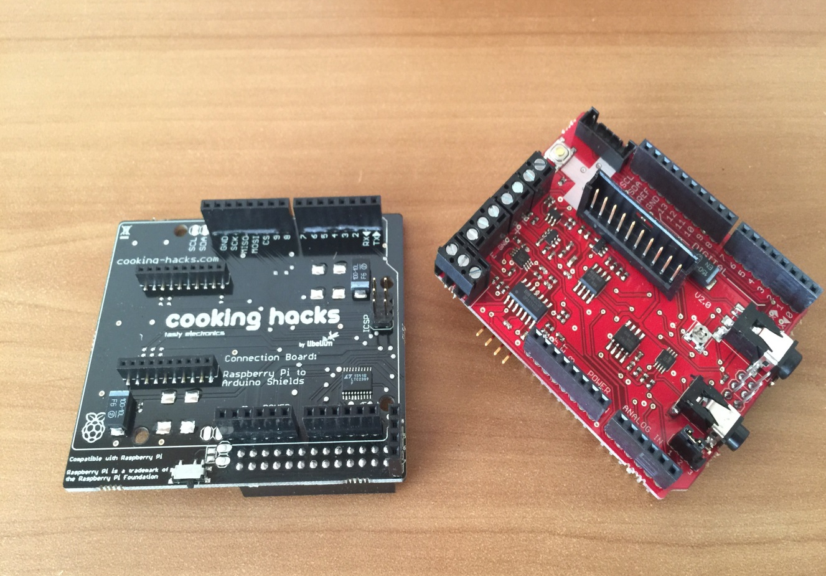
Libelium Circuit to connect with Health Sensors

Slide 6
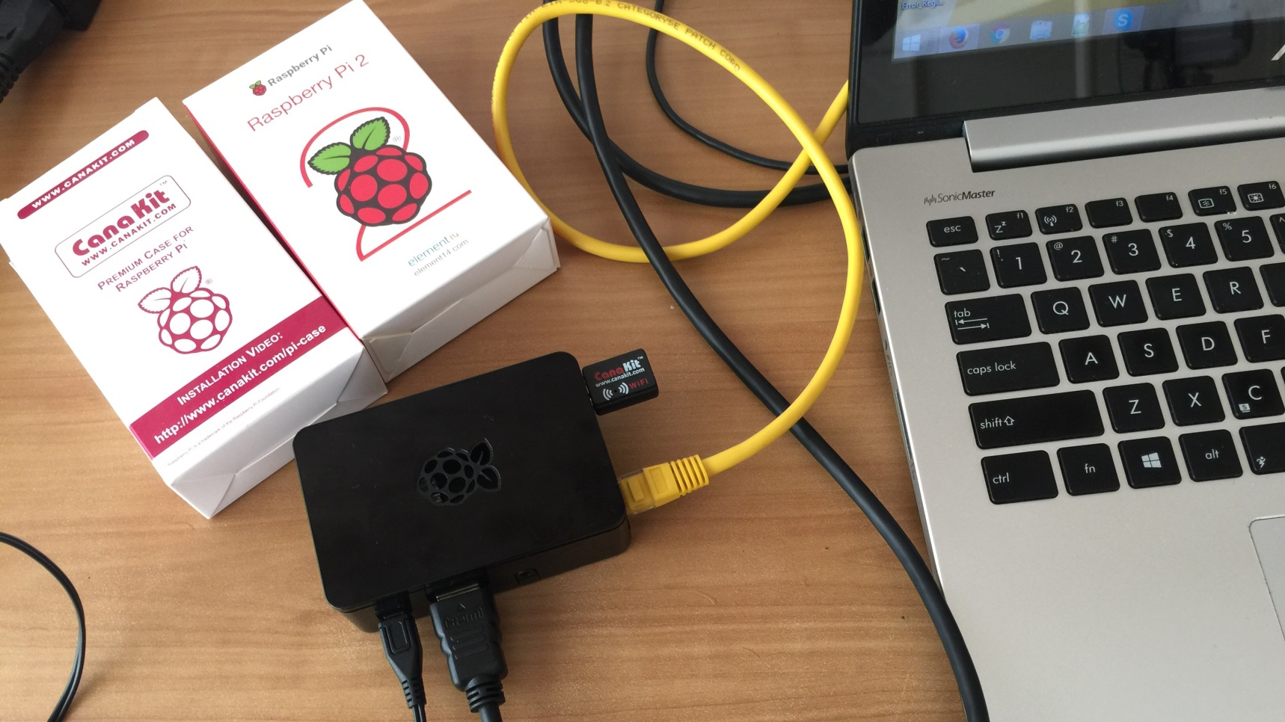
Raspberry Pi
Libelium Circuit will send the data to Raspberry Pi.
Cloud SDK / running on Raspberry Pi will send the signals to Cloud through IoT Core.
Push Notification will be send to Mobile App for further processing.

Slide 7
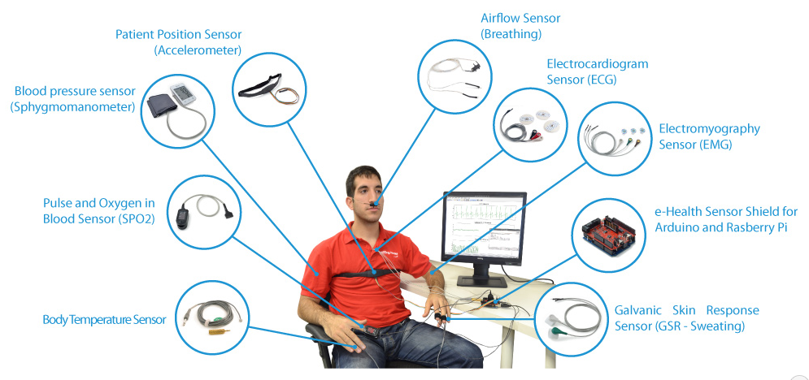
List of all Sensors

