Slide 1
Language Detection
Using NLP
Name - Avireet Kaur
Roll No - 2210990202

Slide 2
Introduction
Language detection is crucial today for global communication, content filtering, search accuracy, multilingual customer support, translation, data analysis, and cybersecurity.
It ensures effective interaction across linguistic boundaries, moderates online content, enhances search relevance, facilitates customer service, enables accurate translation, informs decision-making, and aids in threat detection.

Slide 3
Natural Language Processing
Natural Language Processing (NLP) is a subfield of computer science and artificial intelligence that deals with the interaction between computers and human languages. The primary goal of NLP is to enable computers to understand, interpret, and generate natural language, the way humans do.
NLP involves a variety of techniques, including computational linguistics, machine learning, and statistical modeling. These techniques are used to analyze, understand, and manipulate human language data, including text, speech, and other forms of communication.
Some of the main applications of NLP include language translation, speech recognition, sentiment analysis, text classification, and information retrieval. NLP is used in a wide range of industries, including finance, healthcare, education, and entertainment, to name a few.

Slide 4
Objective
The idea behind language detection is based on the detection of the character among the expression and words in the text. The main principle is to detect commonly used words like to, of in English

Slide 5
Tools and Working
This project includes Python libraries such as pandas, numpy, re, seaborn, matplotlib and scikit-learn, alongside NLP techniques like Bag of Words and Label Encoding.
The workflow encompasses data loading, preprocessing, feature extraction using CountVectorizer, and model training and evaluation with Multinomial Naive Bayes. This approach enables the transformation of raw textual data into a format suitable for machine learning algorithms, ultimately leading to the creation of a robust language detection system.

Slide 6
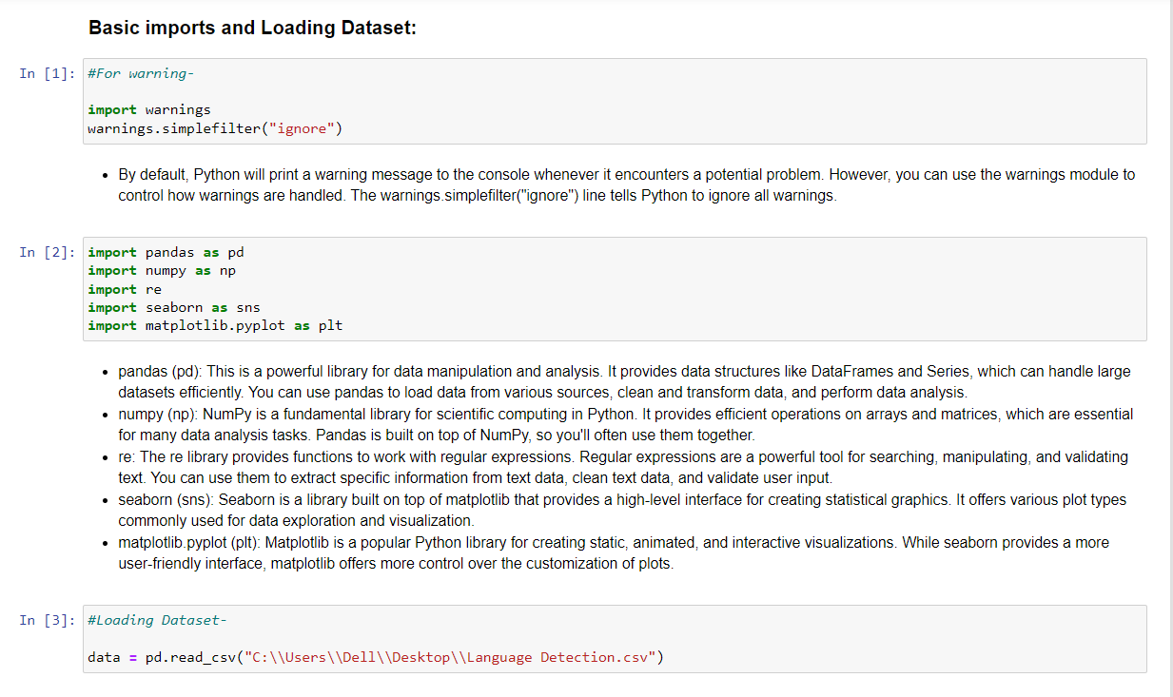
Code Snippet

Slide 7
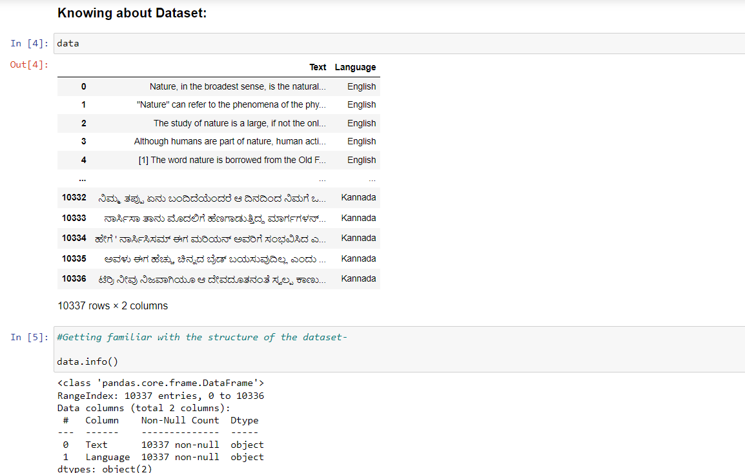

Slide 8


Slide 9
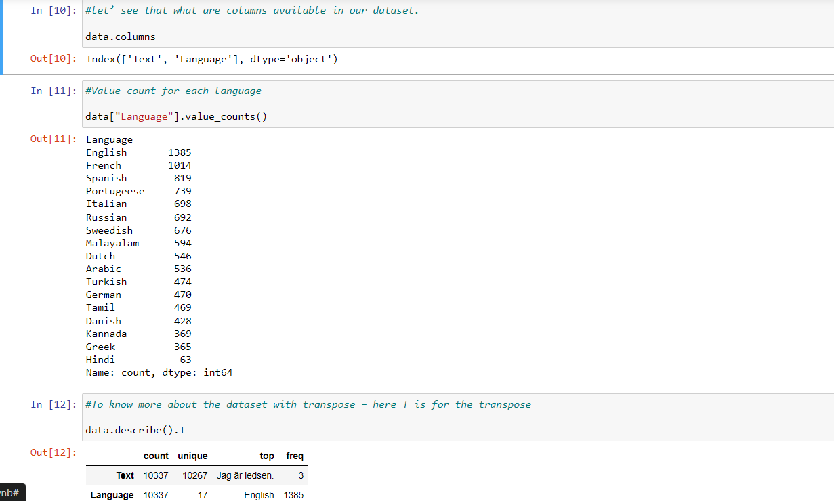

Slide 10
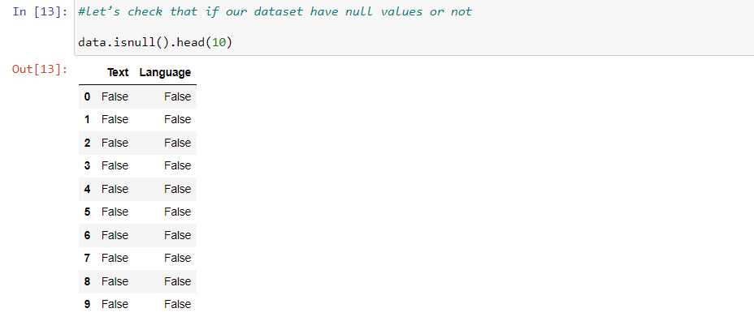

Slide 11
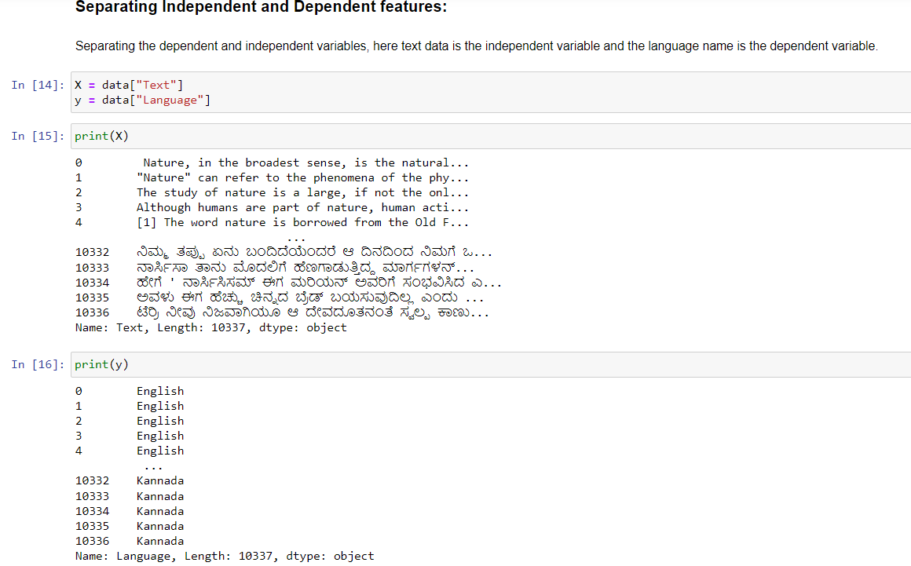

Slide 12
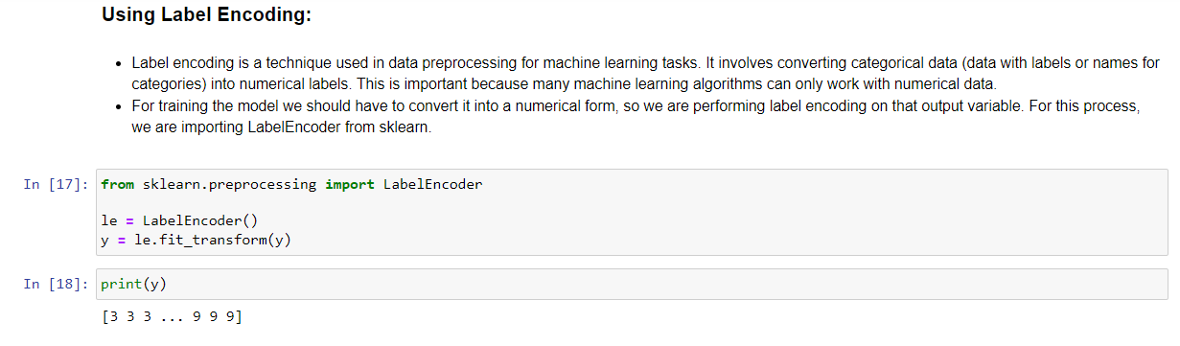

Slide 13
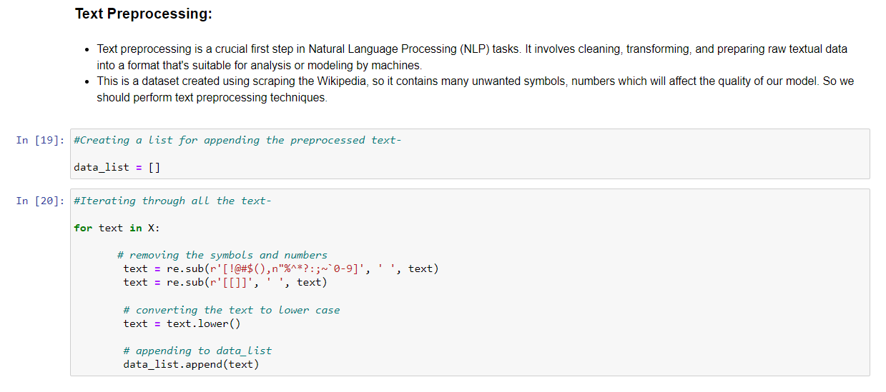

Slide 14


Slide 15
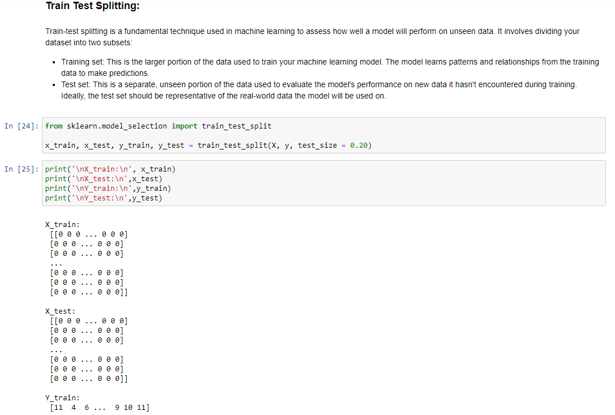

Slide 16
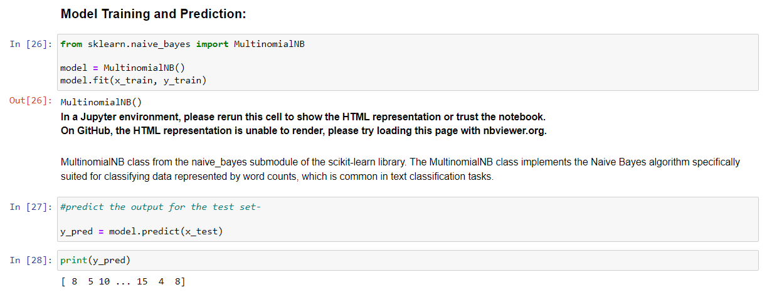

Slide 17
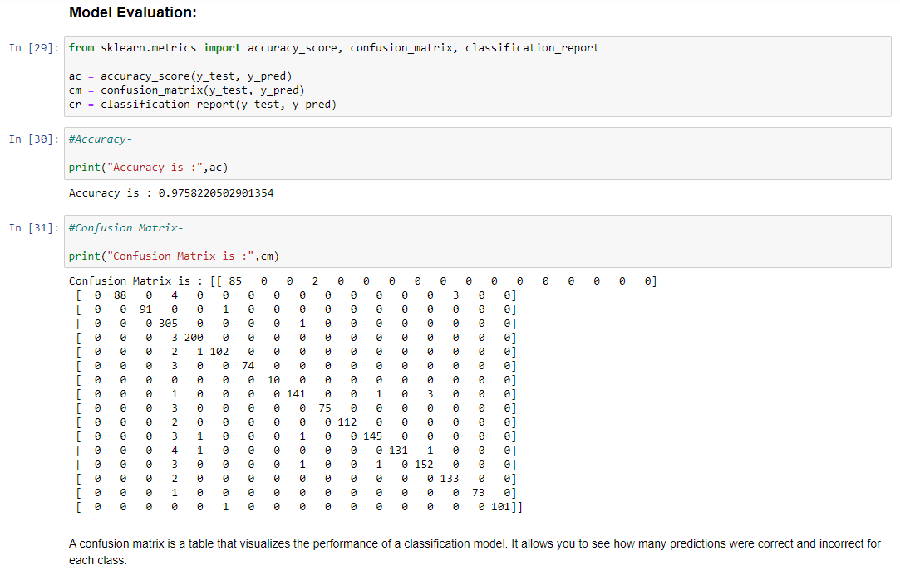

Slide 18
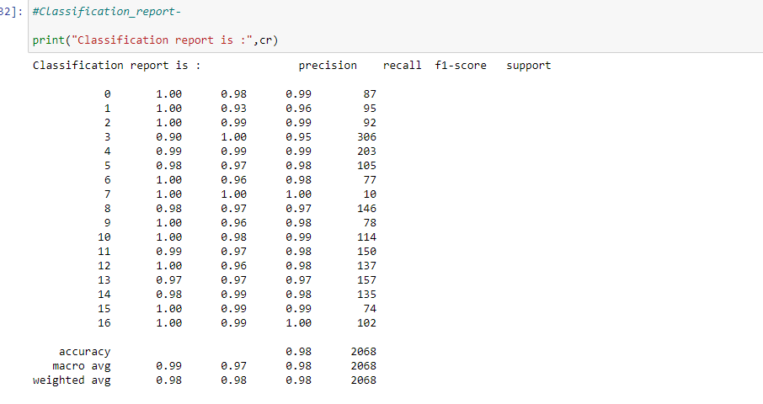

Slide 19
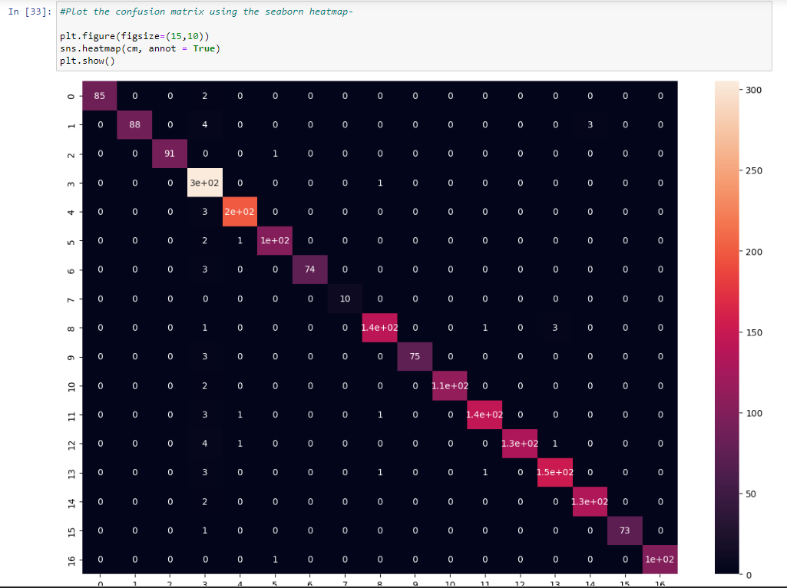

Slide 20
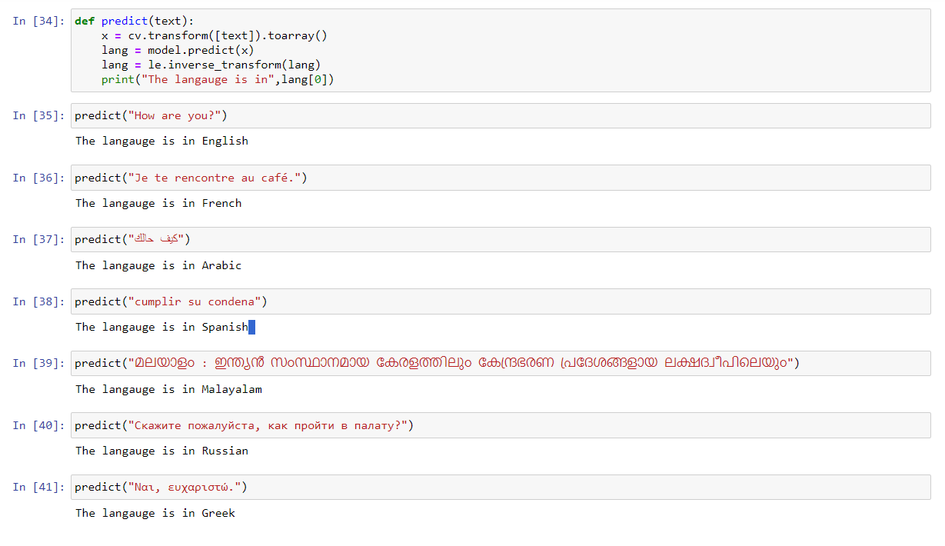
Output

Slide 21
Conclusion
In conclusion, language detection plays a pivotal role in enabling computers to interact with human languages effectively.
Through the utilization of advanced NLP techniques and machine learning algorithms, language detection systems can accurately discern the language of textual data, thereby facilitating a wide array of applications in areas such as translation, sentiment analysis, and information retrieval.
As the digital landscape continues to evolve, the importance of language detection in facilitating cross-cultural communication and fostering linguistic diversity remains paramount.

