Slide 1
Campus Recruitment
Prediction
Team Members and Roll No:
Charvi Bansal(2210990236)
Bhavika Arora (2210990220)
Avireet Kaur(2210990202)
Avantika(2210990197)

Slide 2
INDEX
Objective
Introduction
Problem Statement
Methodology, Approach & Techniques
Algorithm
Result
Reference

Slide 3

OBJECTIVE
Develop a predictive model using machine learning techniques to forecast the outcomes of campus recruitment events.
Main objectives that we have focused on are:
Data Collection and Preprocessing
Model Development
Evaluation and Validation

Slide 4
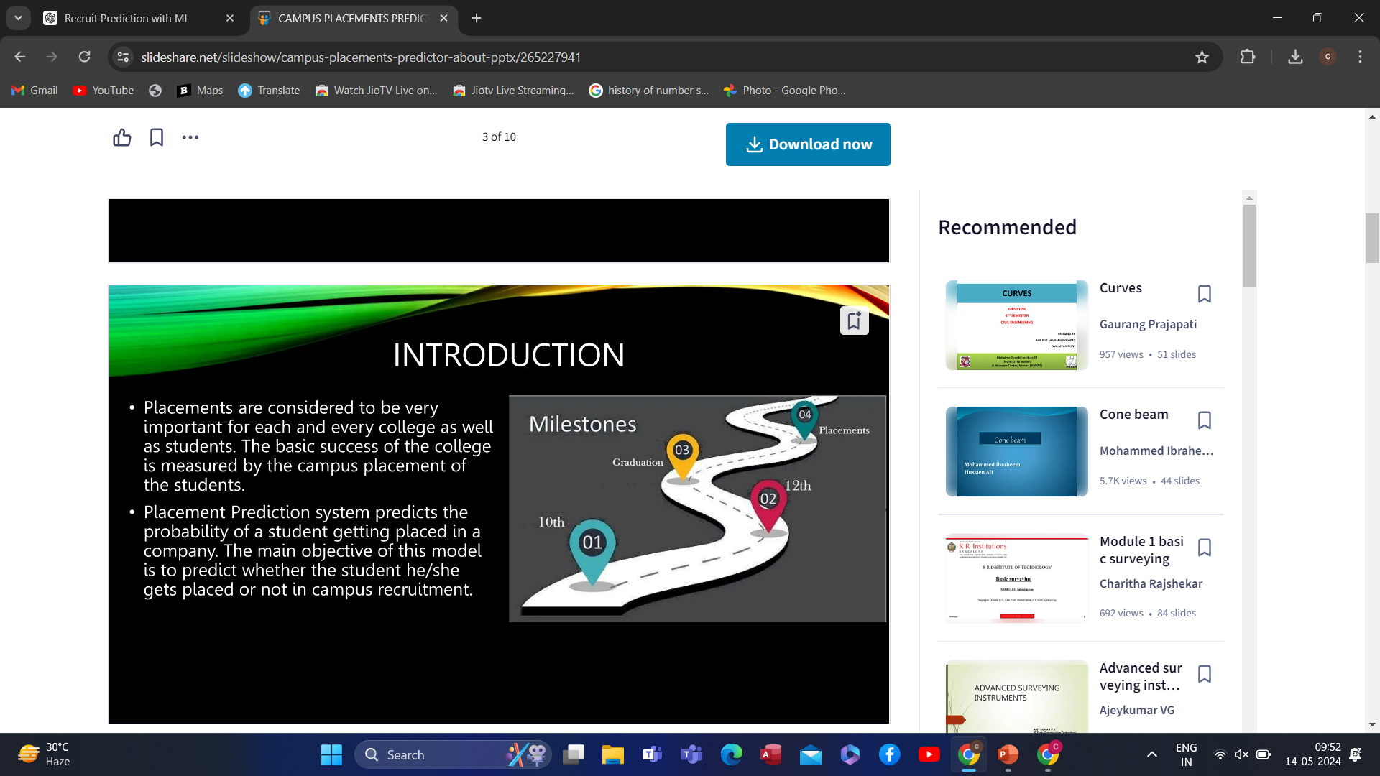
INTRODUCTION
Campus recruitment stands as a pivotal gateway for organizations to identify and engage with promising candidates from educational institutions.
It serves as a bridge between academia and industry and plays a crucial role in shaping the career trajectories of students and meeting the evolving needs of businesses.
Campus recruitment predicts the probability of a student getting placed in the company.

Slide 5
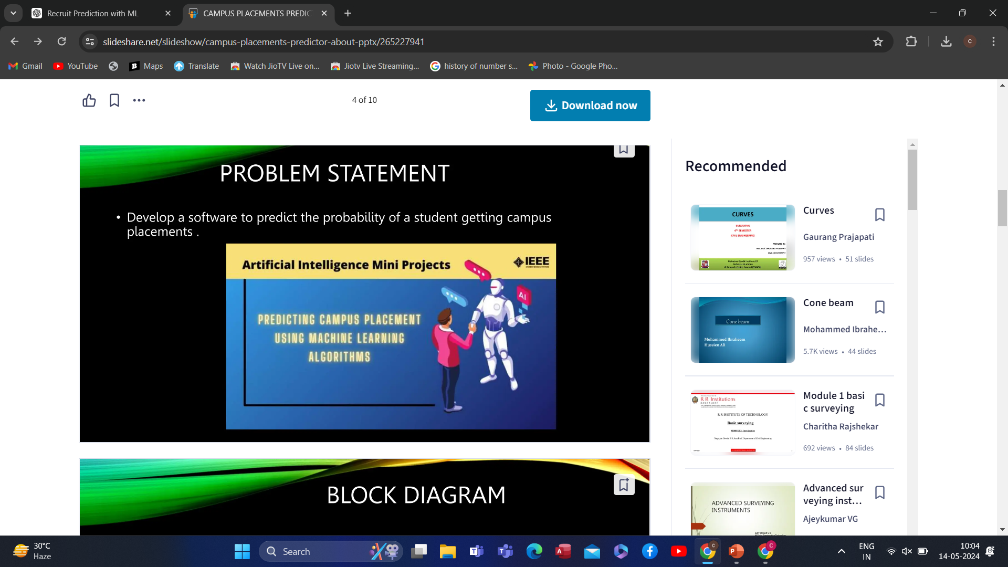
PROBLEM STATEMENT
Develop a model of campus recruitment prediction using machine learning. It tells the ratio of students getting placed in a campus and giving a prediction of how many more can be placed.

Slide 6
METHODOLOGY, APPROACH & TECHNIQUE
Methodology:
Data Collection: Gather data from past campus recruitment drives, including student profiles and recruitment outcomes
Data Preprocessing: Handling missing values, outliers, and encoding categorical variables. Missing values in the salary column are filled with 0, unnecessary columns are dropped, outliers are identified and removed using the interquartile range (IQR) method, and categorical variables are encoded using label encoding and one-hot encoding..
Data Visualization: Visualizations such as count plots and distribution plots are used to understand the distribution of categorical variables and the distribution of salary for placed candidates. Violin plots are used to check for gender bias in salary offers.
Correlation Analysis: A correlation heatmap is plotted to understand the relationship between different variables in the dataset.

Slide 7
Approach:
Data Import and Cleaning:
Imported necessary libraries for data analysis and visualization.
Read the dataset from a CSV file using Pandas.
Made a copy of the dataset for manipulation.
Handling Outliers:
Plotted box plots to visualize outliers in numeric columns like 'ssc_p', 'hsc_p', 'degree_p', and 'etest_p'.
Identified and removed outliers from the 'hsc_p' column using the Interquartile Range (IQR) method.
Model Building and Evaluation:
Train-Test Split: The dataset is split into training and testing sets.
Model Selection and Training: Decision Tree, Random Forest, and Logistic Regression models are chosen for classification. These models are trained on the training data.
Model Evaluation: The accuracy of the models is evaluated using various metrics such as accuracy score and ROC curve analysis.

Slide 8
Techniques:
Pandas and NumPy are used for data manipulation and handling.
Matplotlib and Seaborn are used for data visualization, including plotting box plots, count plots, distribution plots, violin plots, and correlation heatmaps.
Scikit-learn is used for model building, including preprocessing techniques such as train-test split, label encoding, one-hot encoding, and building classification models such as Decision Tree, Random Forest, and Logistic Regression.
Plotly is used for interactive visualization, particularly for the violin plot.

Slide 9
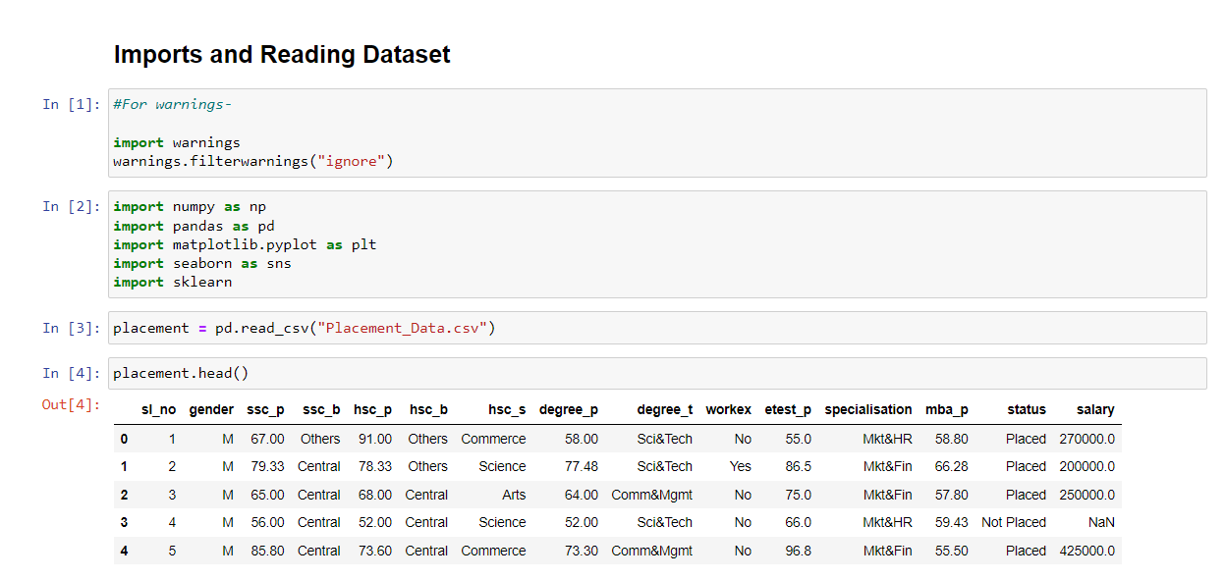
SOURCE CODE

Slide 10
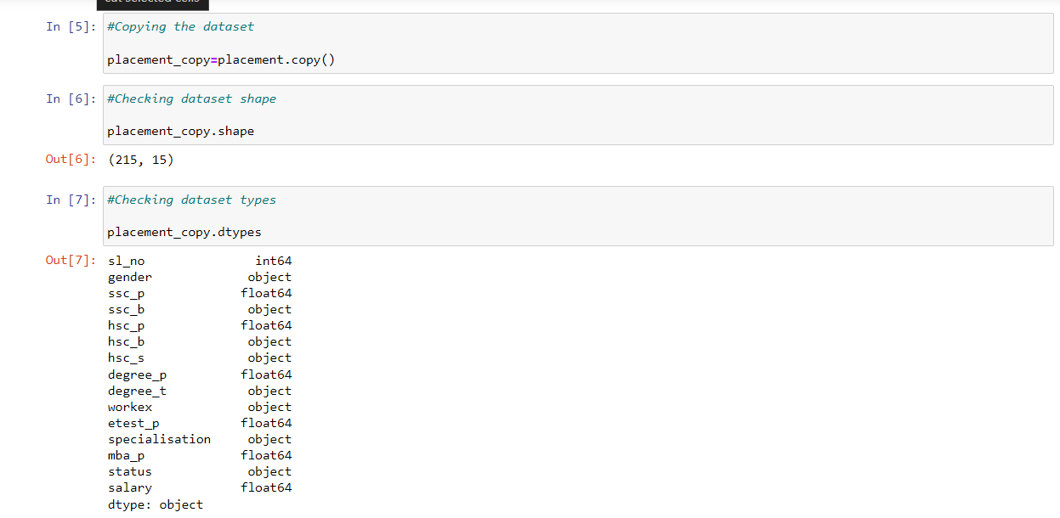

Slide 11
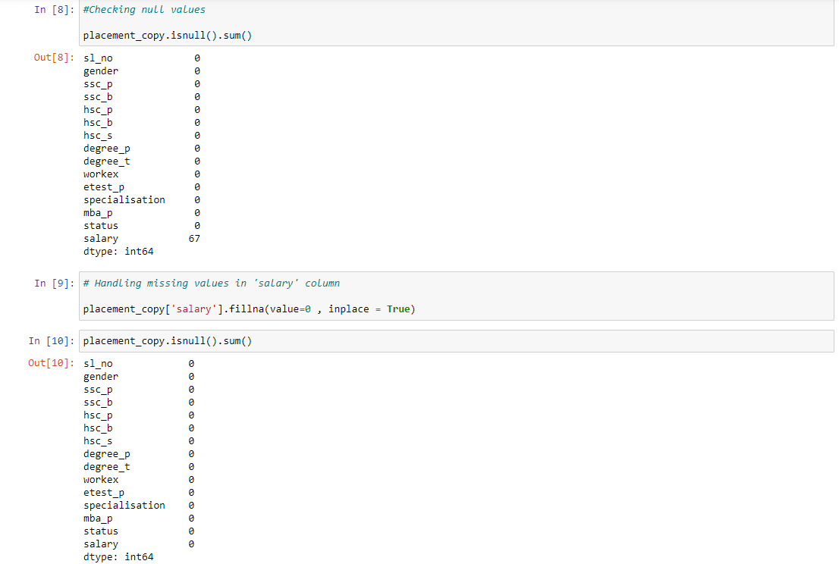

Slide 12
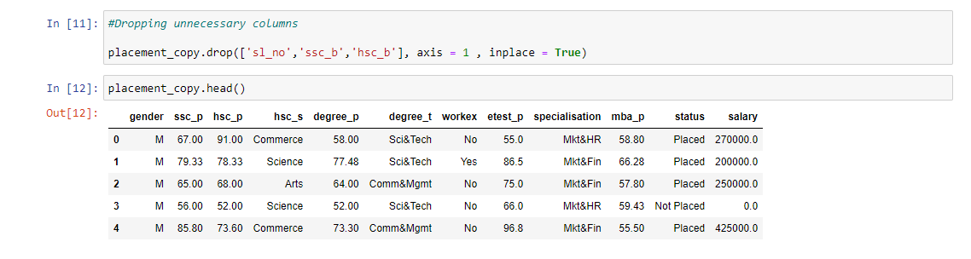

Slide 13
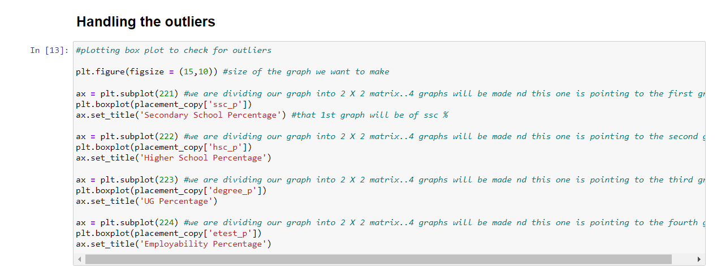

Slide 14
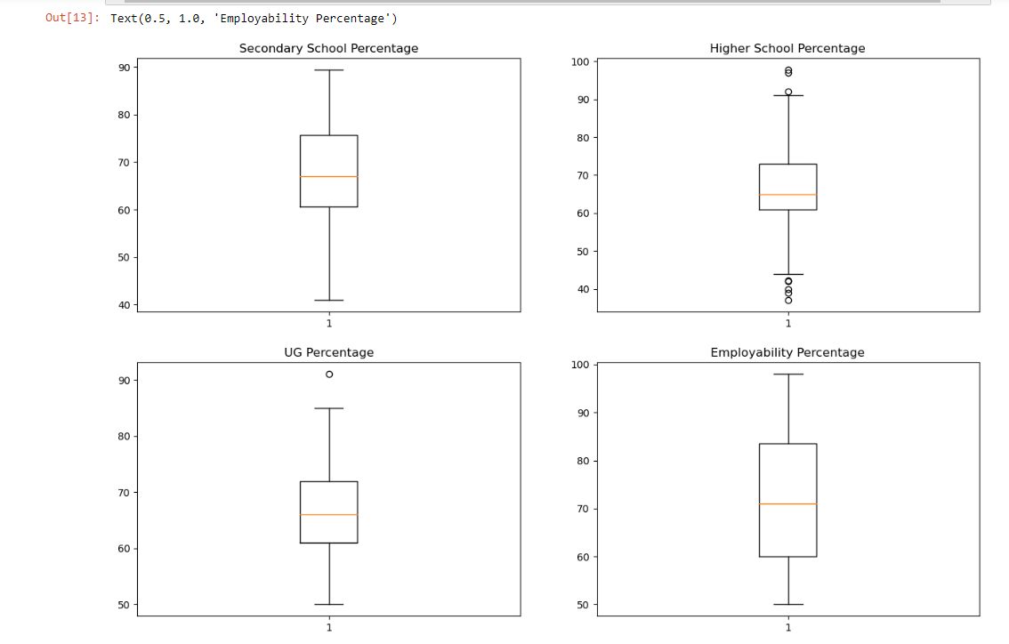

Slide 15
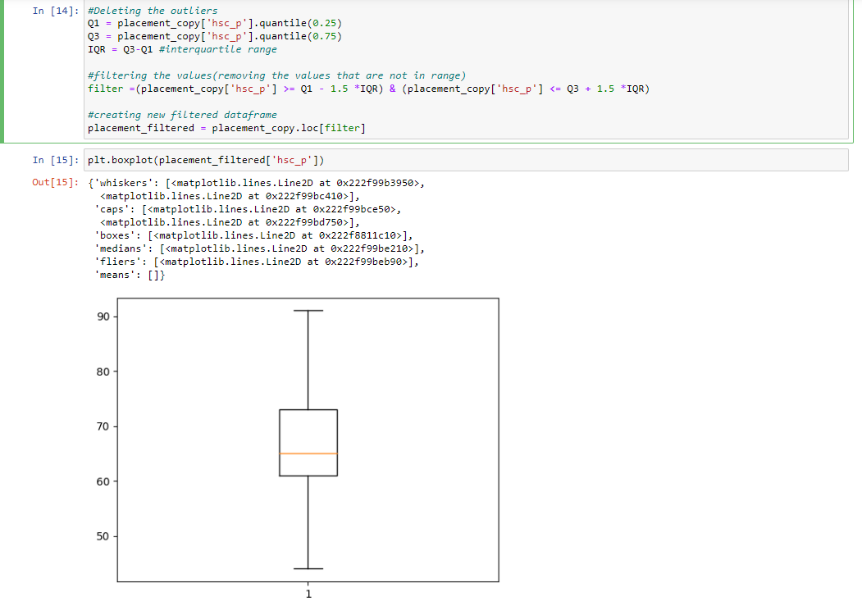

Slide 16
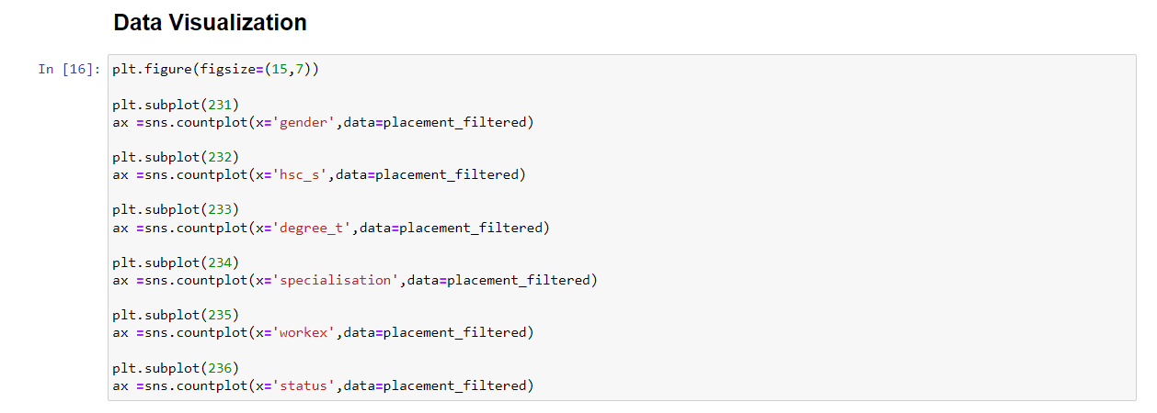

Slide 17
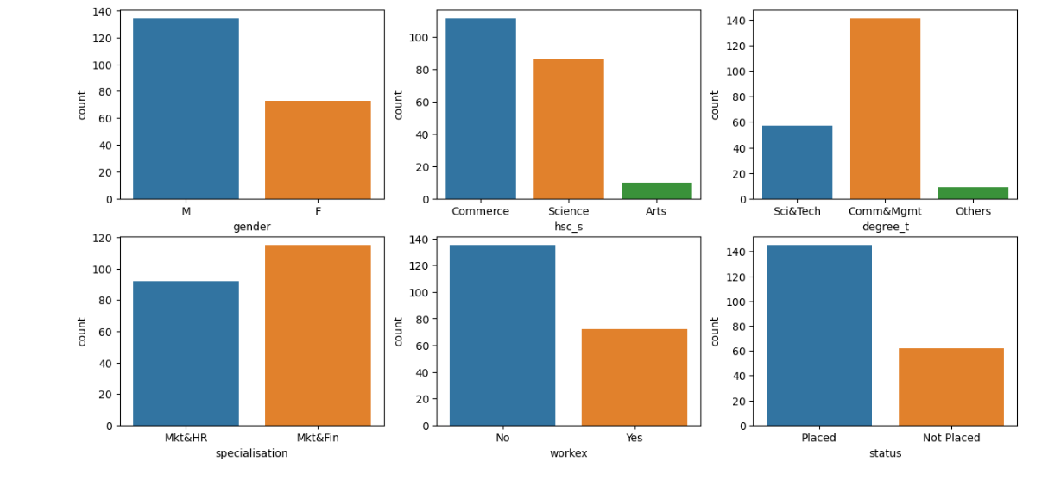

Slide 18
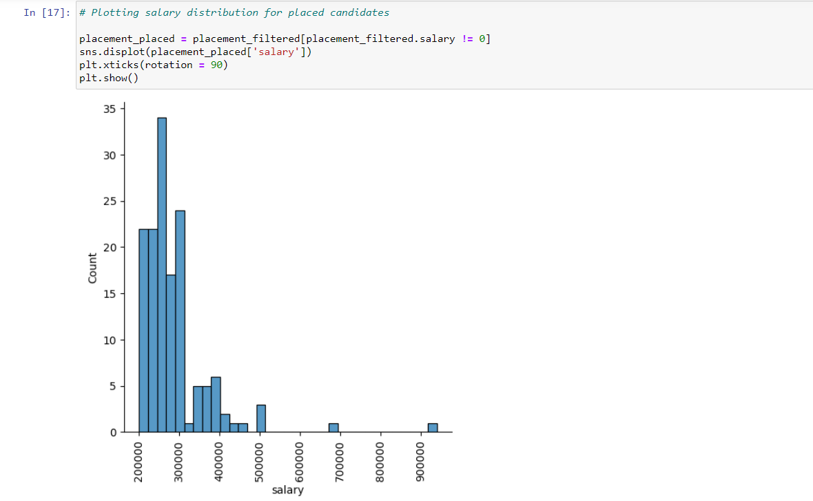

Slide 19
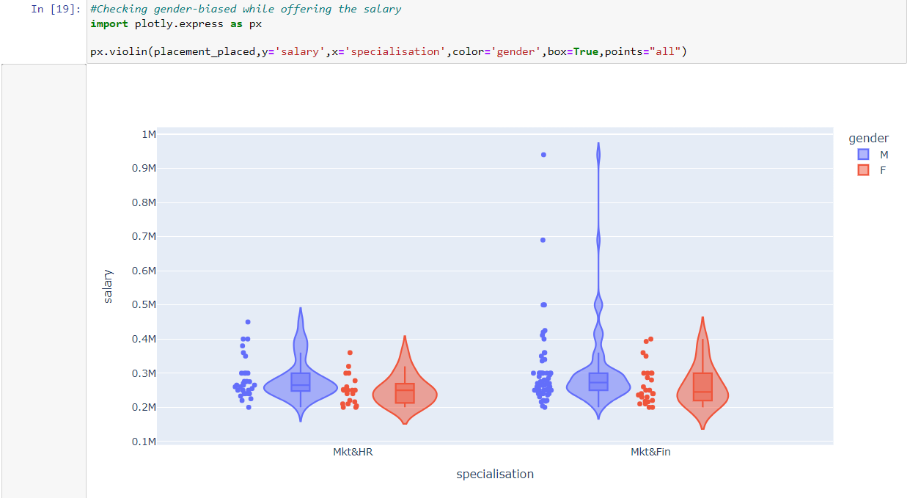

Slide 20
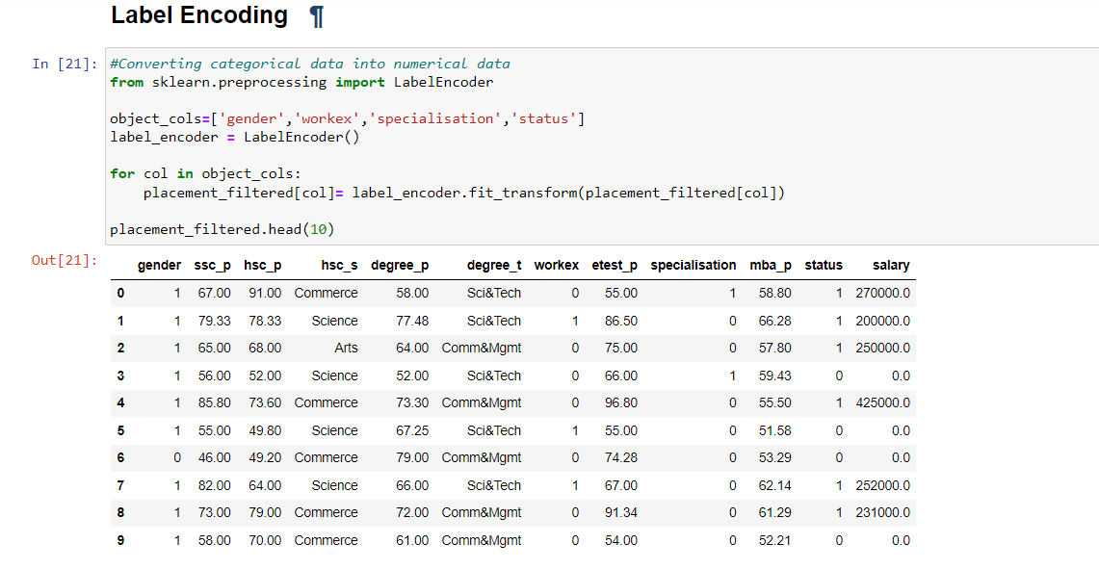

Slide 21
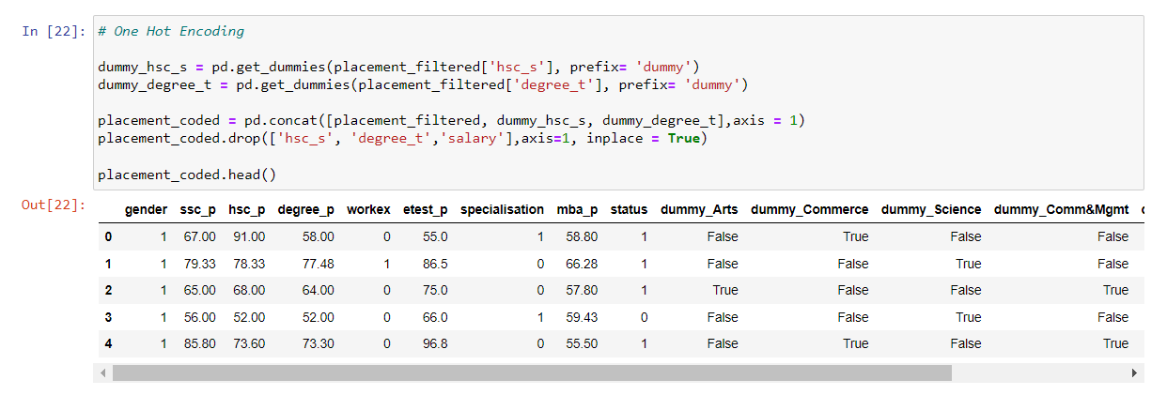

Slide 22
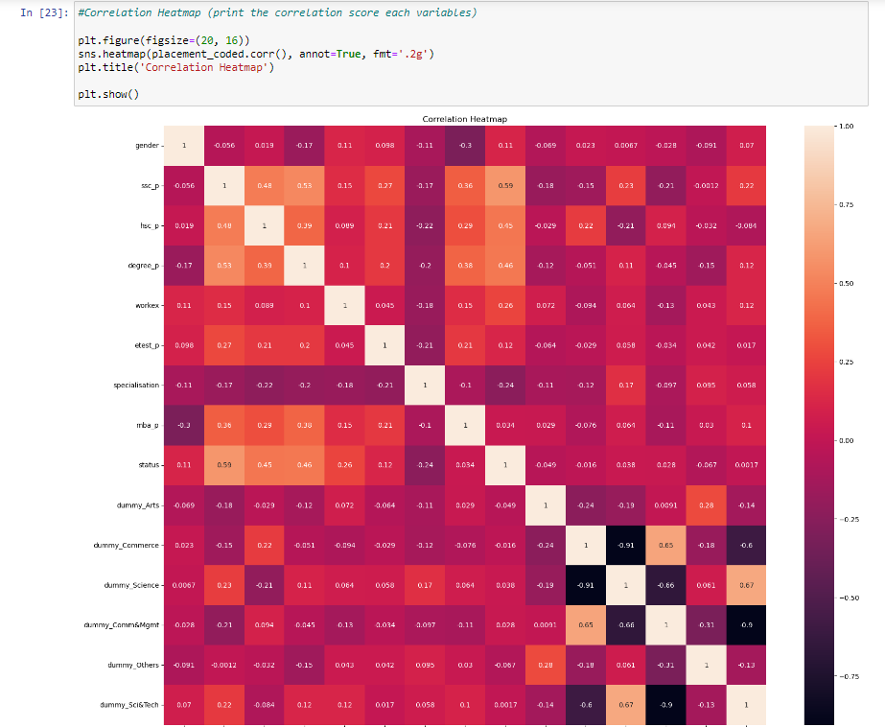

Slide 23
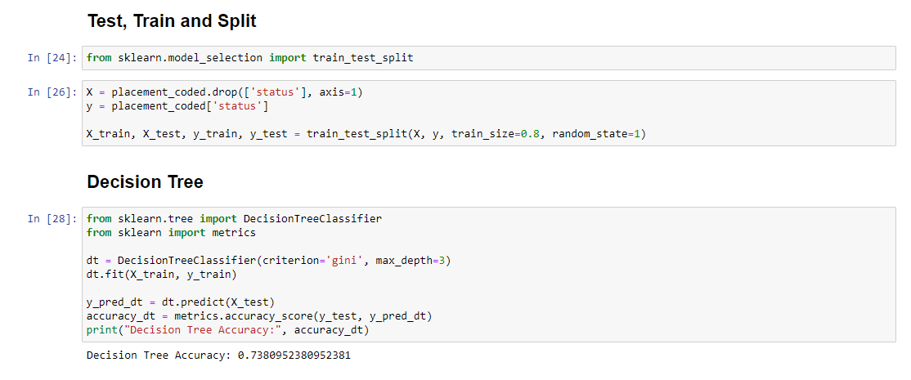

Slide 24
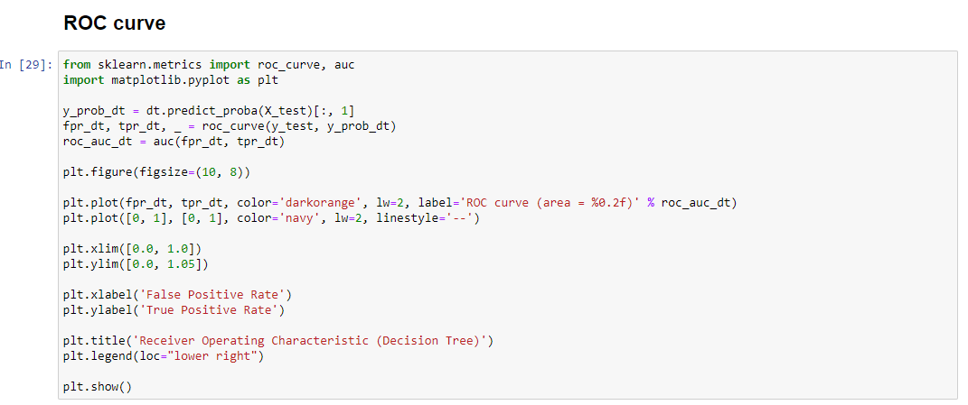
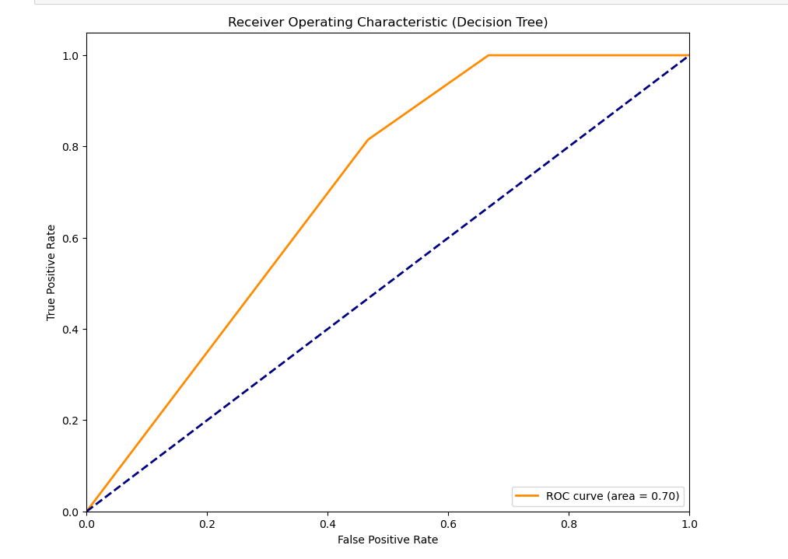

Slide 25
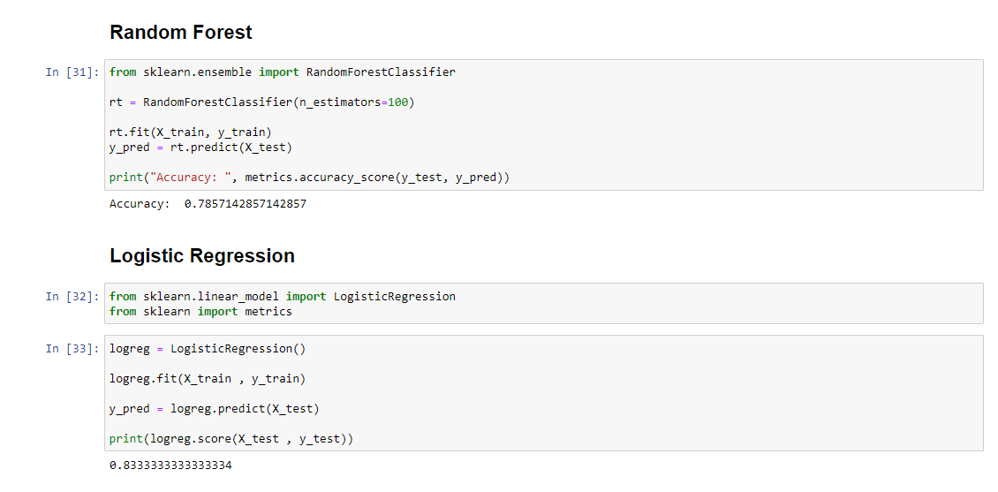

Slide 26
CONCLUSION
In conclusion, this project has successfully developed a predictive model for forecasting student placement status based on a variety of factors. Through data analysis and exploration, important insights into the dataset were uncovered, allowing for a better understanding of the underlying patterns and trends. By preprocessing the data effectively, including handling missing values, outliers, and encoding categorical variables, the dataset was prepared for modeling.
Utilizing classification algorithms such as Decision Tree, Random Forest, and Logistic Regression, accurate predictions of student placement status were achieved.
In the future, the deployed model could be further optimized and integrated into decision-making processes to assist in student placement strategies. Additionally, ongoing monitoring and updating of the model would ensure its continued relevance and accuracy in predicting student placement outcomes. Overall, this project serves as a valuable tool for improving the efficiency and effectiveness of student placement processes in educational institutions.

Slide 27
REFERENCE
[1]https://www.youtube.com/siddhardhan
[2]https://www.geeksforgeeks.com
[3]www.javatpoint.com

Slide 28
The End

