Slide 1
95-702 Distributed Systems
Distributed File Systems
Learning Goals:
Understand a Generic Distributed File System
Understand NFS Network File System Developed at Sun (1984)
Understand AFS Andrew File System Developed at CMU (1980’s)
Compare the above with Google File System (GFS) (2004)
Be able to work with HDFS the Java based open source
Hadoop Distributed File System(2008)
Understand and be able to program with MapReduce

Slide 2
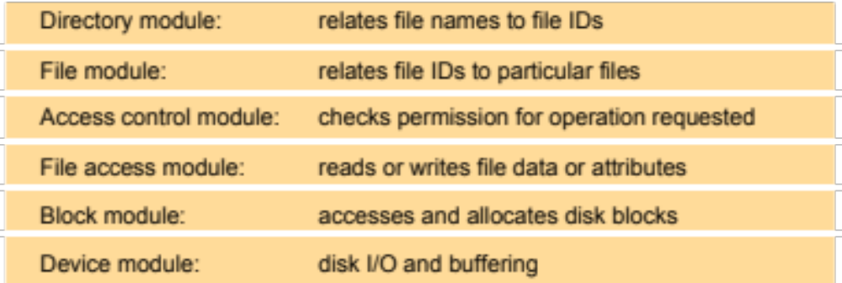
Figure 12.2
File system modules
filedes = open(“CoolData\text.txt”, “r”);
count = read(filedes, buffer, n)
A typical non-distributed file system’s layered organization. Each layer
depends only on the layer below it.
Instructor’s Guide for Coulouris, Dollimore, Kindberg and Blair, Distributed Systems: Concepts and Design Edn. 5
© Pearson Education 2012

Slide 3
Figure 12.3
File attribute record structure
File length
Files contain
both data and
attributes.
The shaded
attributes are
managed by the
file system and
not normally
directly modified
by user programs.
Creation timestamp
Read timestamp
Write timestamp
Attribute timestamp
Reference count
Owner
File type
Access control list
Instructor’s Guide for Coulouris, Dollimore, Kindberg and Blair, Distributed Systems: Concepts and Design Edn. 5
© Pearson Education 2012

Slide 4
Figure 12.4
UNIX file system operations
filedes = open(name, mode)
Opens an existing file with the given name.
filedes = creat(name, mode)
Creates a new file with the given name.
Both operations deliver a file descriptor referencing the open
file. The mode is read, write or both.
status = close(filedes)
Closes the open file filedes.
count = read(filedes, buffer, n)
Transfers n bytes from the file referenced by filedes to buffer.
count = write(filedes, buffer, n)
Transfers n bytes to the file referenced by filedes from buffer.
Both operations deliver the number of bytes actually transferred
and advance the read-write pointer.
pos = lseek(filedes, offset,
Moves the read-write pointer to offset (relative or absolute,
whence)
depending on whence).
status = unlink(name)
Removes the file name from the directory structure. If the file
has no other names, it is deleted.
status = link(name1, name2)
Adds a new name (name2) for a file (name1).
status = stat(name, buffer)
Gets the file attributes for file name into buffer.
These operations are implemented in the Unix kernel. These are
operations available in the non-distributed case. Programs cannot
observer any discrepancies between cached copies and stored data after
an update. This is called strict one copy semantics.
Suppose we want the files to be be located on another machine…
Instructor’s Guide for Coulouris, Dollimore, Kindberg and Blair, Distributed Systems: Concepts and Design Edn. 5
© Pearson Education 2012

Slide 5
Figure 12.5
File service architecture Generic Distributed File System
Client computer
Server computer
Application
Application
Directory service
program
program
Flat file service
Client module
The client module provides
a single interface used by
apps – emulates traditional fs.
Flat file service and dir. service
both provide an RPC interface
used by clients.
Instructor’s Guide for Coulouris, Dollimore, Kindberg and Blair, Distributed Systems: Concepts and Design Edn. 5
© Pearson Education 2012

Slide 6
Figure 12.6
Flat file service operations
Read(FileId, i, n) -> Data
If 1 ≤ i ≤ Length(File): Reads a sequence of up to n items
—
throws
BadPosition
from a file starting at item i and returns it in Data.
Write(FileId, i, Data)
If 1 ≤ i ≤ Length(File)+1: Writes a sequence of Data to a
—
throws
BadPosition
file, starting at item i, extending the file if necessary.
Create() -> FileId
Creates a new file of length 0 and delivers a UFID for it.
Delete(FileId)
Removes the file from the file store.
GetAttributes(FileId) -> Attr
Returns the file attributes for the file.
SetAttributes(FileId, Attr)
Sets the file attributes (only those attributes that are not
shaded in Figure 12.3).
The client module will make calls on these operations and so will the
directory service act as a client of the flat file service. Unique File
Identifiers (UFID’s) are passed in on all operations except create().
Instructor’s Guide for Coulouris, Dollimore, Kindberg and Blair, Distributed Systems: Concepts and Design Edn. 5
© Pearson Education 2012

Slide 7
Figure 12.5
File service architecture Generic Distributed File System
Client computer
Server computer
Application
Application
Directory service
program
program
read(FileID,..
write(FileID,…
fileID create(
delete(FileID,…
getAttributes(FileID
setAttribues(FileID
Flat file service
Client module
Instructor’s Guide for Coulouris, Dollimore, Kindberg and Blair, Distributed Systems: Concepts and Design Edn. 5
© Pearson Education 2012

Slide 8
Figure 12.7
Directory service operations
Lookup(Dir, Name) -> FileId
Locates the text name in the directory and returns the
—
throws
NotFound
relevant UFID. If Name is not in the directory, throws an
exception.
AddName(Dir, Name, FileId)
If Name is not in the directory, adds (Name, File) to the
—
throws
NameDuplicate
directory and updates the file’s attribute record.
If Name is already in the directory: throws an exception.
UnName(Dir, Name)
If Name is in the directory: the entry containing Name is
—
throws
NotFound
removed from the directory.
If Name is not in the directory: throws an exception.
GetNames(Dir, Pattern) -> NameSeq
Returns all the text names in the directory that match the
regular expression Pattern.
Primary purpose: translate text names to UFID’s. Each directory
is stored as a conventional file and so this is a client of the flat file
service.
Once a flat file service and directory service is in place, it
is simple matter to build client modules that look like unix.
Instructor’s Guide for Coulouris, Dollimore, Kindberg and Blair, Distributed Systems: Concepts and Design Edn. 5
© Pearson Education 2012

Slide 9
Figure 12.5
File service architecture Generic Distributed File System
Client computer
Server computer
fileID lookUp(dir,name)
addName(dir,name,fileID)
unNameID(dir,name)
getNames(dir, pattern)
Application
Application
Directory service
program
program
Flat file service
Client module
We have seen this pattern before.
Instructor’s Guide for Coulouris, Dollimore, Kindberg and Blair, Distributed Systems: Concepts and Design Edn. 5
© Pearson Education 2012

Slide 10
Figure 12.5
File service architecture Generic Distributed File System
Client computer
Server computer
Application
Application
Directory service
program
program
name
fileID
Flat file service
Client module
operation fileID
data or status
Instructor’s Guide for Coulouris, Dollimore, Kindberg and Blair, Distributed Systems: Concepts and Design Edn. 5
© Pearson Education 2012

Slide 11
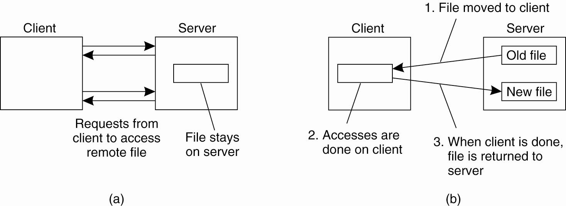
Two models for distributed file system
The remote access model
The upload/download model
Figure 11-1 Tanenbaum & Van Steen, Distributed Systems: Principles and Paradigms, 2e, (c) 2007 Prentice-Hall, Inc. All rights reserved. 0-13-239227-5

Slide 12
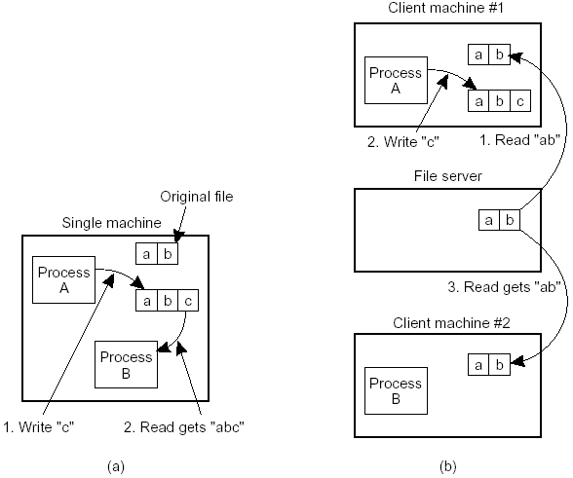
File sharing semantics
UNIX semantics or strict one copy : a read after a write gets the value just written. (Figure a)
For session semantics, you
might adopt “last writer wins”
or transactions. Transactions
makes concurrent access
appear as serial.
Sesssion semantics: changes are initially
visible only to the process that modifies
the file. Changes become visible when
the file is closed. (Figure b)
Tanenbaum and Steen Distributed Systems 10.1

Slide 13
NFS
Goal: Be unsurprising and look like a UNIX FS.
Goal: Implement full POSIX API. The Portable Operating
System Interface is an IEEE family of standards
that describe how Unix like Operating Systems should
behave.
Goal: Your files are available from any machine.
Goal: Distribute the files and we will not have to implement new
protocols.
NFS has been a major success.
NFS was originally based on UDP and was stateless.
TCP added later.
NFS defines a virtual file system. The NFS client pretends to be a real file system but is making RPC calls instead.

Slide 14
Figure 12.8
NFS architecture
Client computer
Server computer
Application
Application
program
program
UNIX
system calls
UNIX kernel
UNIX kernel
Virtual file system
Virtual file system
Local
Remote
UNIX
Other
file system
NFS
NFS
UNIX
file
client
server
file
system
NFS
system
protocol
NFS uses RPC over TCP or UDP.
External requests are translated into
RPC calls on the server. The virtual
file system module provides access transparency.
Instructor’s Guide for Coulouris, Dollimore, Kindberg and Blair, Distributed Systems: Concepts and Design Edn. 5
© Pearson Education 2012

Slide 15
Figure 12.9
NFS server operations (simplified) – 1
lookup(dirfh, name) -> fh, attr
Returns file handle and attributes for the file name in the directory
dirfh.
create(dirfh, name, attr) ->
Creates a new file name in directory dirfh with attributes attr and
newfh, attr
returns the new file handle and attributes.
remove(dirfh, name) status
Removes file name from directory dirfh.
getattr(fh) -> attr
Returns file attributes of file fh. (Similar to the UNIX stat system
call.)
setattr(fh, attr) -> attr
Sets the attributes (mode, user id, group id, size, access time and
modify time of a file). Setting the size to 0 truncates the file.
read(fh, offset, count) -> attr, data
Returns up to count bytes of data from a file starting at offset.
Also returns the latest attributes of the file.
write(fh, offset, count, data) -> attr
Writes count bytes of data to a file starting at offset. Returns the
attributes of the file after the write has taken place.
rename(dirfh, name, todirfh, toname)
Changes the name of file name in directory dirfh to toname in
-> status
directory to todirfh
.
link(newdirfh, newname, dirfh, name)
Creates an entry newname in the directory newdirfh which refers to
-> status
file name in the directory dirfh.
Continues on next slide ...
Instructor’s Guide for Coulouris, Dollimore, Kindberg and Blair, Distributed Systems: Concepts and Design Edn. 5
© Pearson Education 2012

Slide 16
Figure 12.9
NFS server operations (simplified) – 2
symlink(newdirfh, newname, string)
Creates an entry newname in the directory newdirfh of type
-> status
symbolic link with the value string. The server does not interpret
the string but makes a symbolic link file to hold it.
readlink(fh) -> string
Returns the string that is associated with the symbolic link file
identified by fh.
mkdir(dirfh, name, attr) ->
newfh, attr
Creates a new directory name with attributes attr and returns the
new file handle and attributes.
rmdir(dirfh, name) -> status
Removes the empty directory name from the parent directory dirfh.
Fails if the directory is not empty.
readdir(dirfh, cookie, count) ->
entries
Returns up to count bytes of directory entries from the directory
dirfh. Each entry contains a file name, a file handle, and an opaque
pointer to the next directory entry, called a cookie. The cookie is
used in subsequent readdir calls to start reading from the following
entry. If the value of cookie is 0, reads from the first entry in the
directory.
statfs(fh) -> fsstats
Returns file system information (such as block size, number of
free blocks and so on) for the file system containing a file fh.
The directory and file operations are integrated into a single service.
Instructor’s Guide for Coulouris, Dollimore, Kindberg and Blair, Distributed Systems: Concepts and Design Edn. 5
© Pearson Education 2012

Slide 17
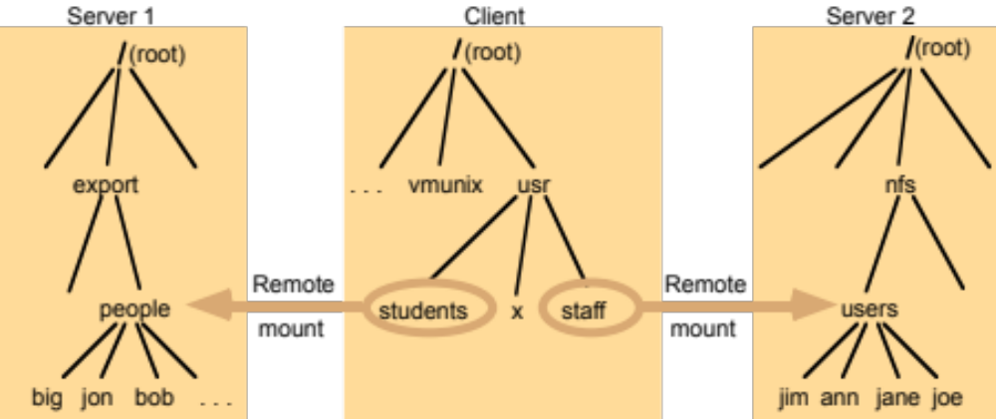
Figure 12.10
Local and remote file systems accessible on an NFS client
Note: The file system mounted at /usr/students in the client is actually the sub-tree located at
/export/people in Server 1; the file system mounted at /usr/staff in the client is actually the sub-tree located at /nfs/users in Server 2. A “mount point” is a particular point in the hierarchy.
Instructor’s Guide for Coulouris, Dollimore, Kindberg and Blair, Distributed Systems: Concepts and Design Edn. 5
© Pearson Education 2012

Slide 18
Andrew File System (See Coda for improvements)
Unlike NFS, the most important design goal is scalability.
To achieve scalability, whole files are cached in client nodes. Why does this help with scalability?
We reduce client server interactions.
A client cache would typically hold several hundreds of files most recently used on that computer.
The cache is permanent, surviving reboots.
When the client opens a file, the cache is examined and used if the file is available there.

Slide 19
Andrew File System - Typical Scenario – Modified from Coulouris
If the client code tries to open a file the client cache is tried first. If not there, a server is located and the server is called for the file.
The copy is stored on the client side and is opened.
Subsequent reads and writes hit the copy on the client.
When the client closes the file - if the files has changed it is sent back to the server. The client side copy is retained for possible more use.
Consider UNIX commands and libraries copied to the client.
Consider files only used by a single user.
These last two cases represent the vast majority of cases.
Gain: Your files are available from any workstation.
Principle: Make the common case fast. See Amdahl’s Law.
Measurements show only 0.4% percent of changed files were
updated by more than one user during one week.

Slide 20
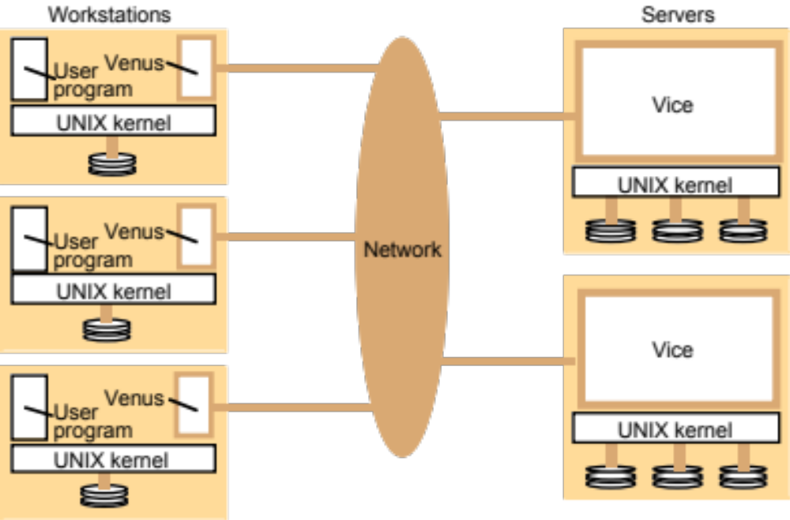
Figure 12.11
Distribution of processes in the Andrew File System
Instructor’s Guide for Coulouris, Dollimore, Kindberg and Blair, Distributed Systems: Concepts and Design Edn. 5
© Pearson Education 2012

Slide 21
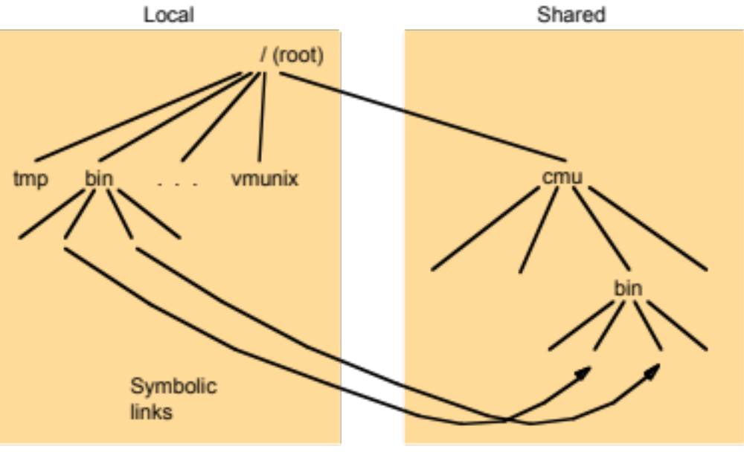
Figure 12.12
File name space seen by clients of AFS
Instructor’s Guide for Coulouris, Dollimore, Kindberg and Blair, Distributed Systems: Concepts and Design Edn. 5
© Pearson Education 2012

Slide 22
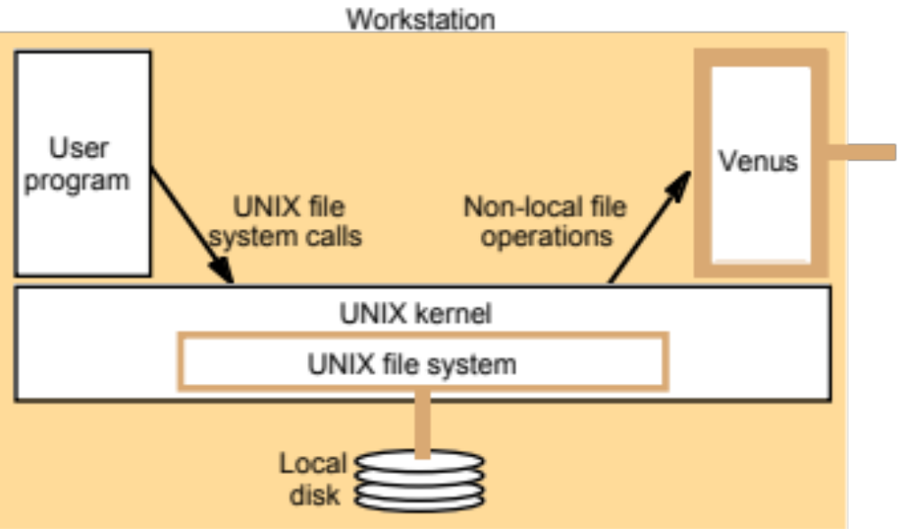
Figure 12.13
System call interception in AFS
Instructor’s Guide for Coulouris, Dollimore, Kindberg and Blair, Distributed Systems: Concepts and Design Edn. 5
© Pearson Education 2012

Slide 23
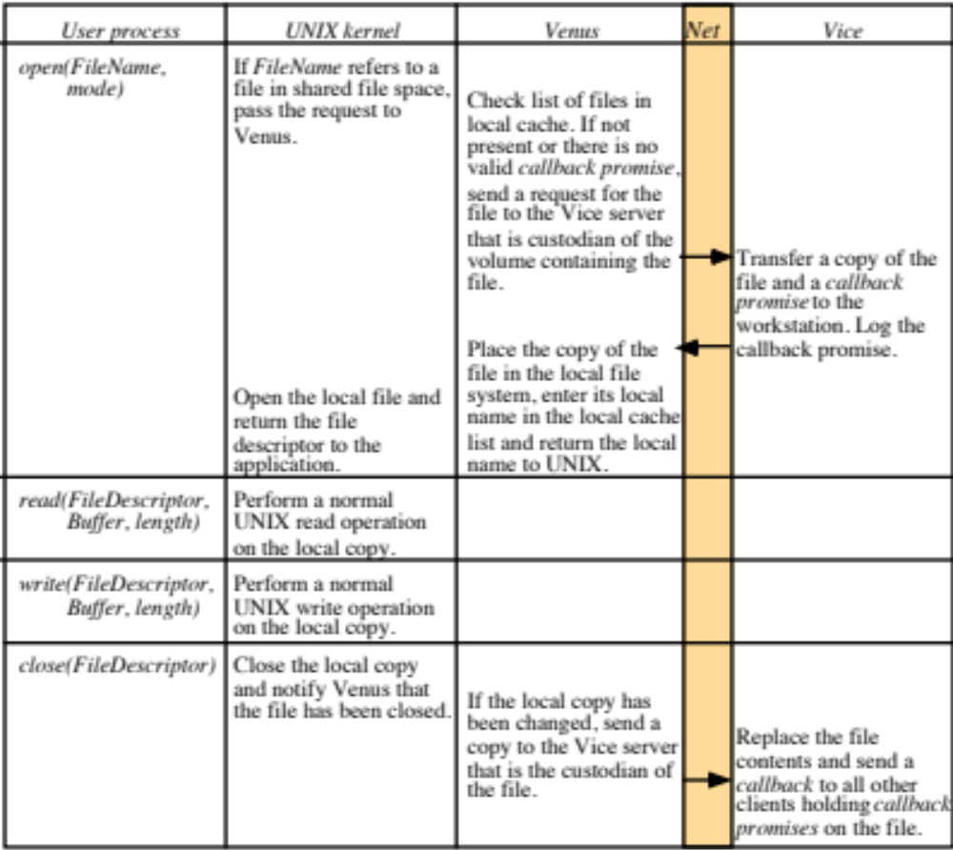
Figure 12.14
Implementation of file system calls in AFS
A callback
promise is a
token stored
with the
cached copy –
either valid
or cancelled
If a client
closes and the
file is changed
then vice makes
RPC calls on all
other clients to
cancel the
callback
promise.
In the event
that two
clients both
write and
then close,
The last
writer wins.
Instructor’s Guide for Coulouris, Dollimore, Kindberg and Blair, Distributed Systems: Concepts and Design Edn. 5
© Pearson Education 2012

Slide 24
Figure 12.15
The main components of the Vice service interface
Fetch(fid) -> attr, data
Returns the attributes (status) and, optionally, the contents of file
identified by the fid and records a callback promise on it.
Store(fid, attr, data)
Updates the attributes and (optionally) the contents of a specified
file.
Create() -> fid
Creates a new file and records a callback promise on it.
Remove(fid)
Deletes the specified file.
SetLock(fid, mode)
Sets a lock on the specified file or directory. The mode of the
lock may be shared or exclusive. Locks that are not removed
expire after 30 minutes.
ReleaseLock(fid)
Unlocks the specified file or directory.
RemoveCallback(fid)
Informs server that a Venus process has flushed a file from its
cache.
BreakCallback(fid)
This call is made by a Vice server to a Venus process. It cancels
the callback promise on the relevant file.
Instructor’s Guide for Coulouris, Dollimore, Kindberg and Blair, Distributed Systems: Concepts and Design Edn. 5
© Pearson Education 2012

Slide 25
Google File System (GFS)
Hadoop (HDFS)
What is Hadoop?
Sort of the opposite of virtual machines where one machine may act like many. Instead, with Hadoop, many machines act as one.
Hadoop is an open source implementation of GFS.
Microsoft has Dryad with similar goals.
At its core, an operating system (like Hadoop) is all about:
(a) storing files
(b) running applications on top of files
From “Introducing Apache Hadoop: The Modern
Data Operating System”, Amr Awadallah

Slide 26
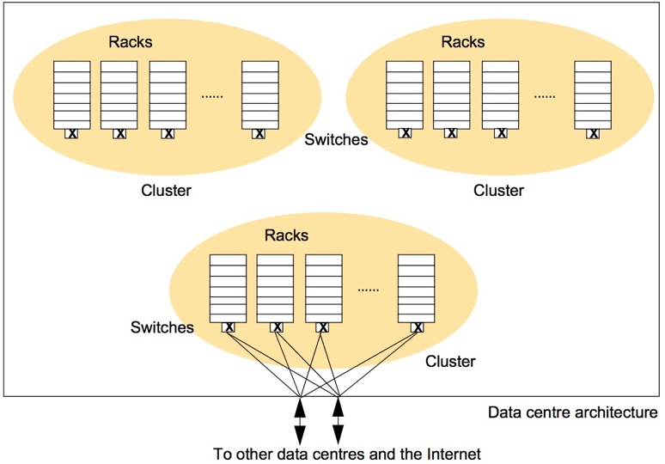
Figure 21.3
Organization of the Google physical infrastructure
Commodity
PC’s which
are assumed
to fail.
40-80 PC’s
per rack.
Racks are
organized
into clusters.
Each cluster
>30 racks.
Each PC has
>2 terabytes.
30 racks is
about 4.8
petabytes.
All of
Google >
1 exabyte
(10^18 bytes).
(To avoid clutter the Ethernet connections are shown from only one of the clusters to the external links)
Instructor’s Guide for Coulouris, Dollimore, Kindberg and Blair, Distributed Systems: Concepts and Design Edn. 5
© Pearson Education 2012

Slide 27
Requirements of Google File System (GFS)
Run reliably with component failures.
Solve problems that Google needs solved – not a massive number of files but massively large files are common.
Access is dominated by long sequential streaming reads and sequential appends. No need for caching on the client.
Throughput more important than latency.
Think of very large files each holding a very large number of HTML documents scanned from the web. These need read and analyzed.
This is not your everyday use of a distributed file system (NFS and AFS). Not POSIX.

Slide 28
GFS
Each file is mapped to a set of fixed size chunks.
Each chunk is 64Mb in size.
Each cluster has a single master and multiple (usually hundreds) of chunk servers.
Each chunk is replicated on three different chunk servers.
The master knows the locations of chunk replicas.
The chunk servers know what replicas they have and are polled by the master on startup.

Slide 29
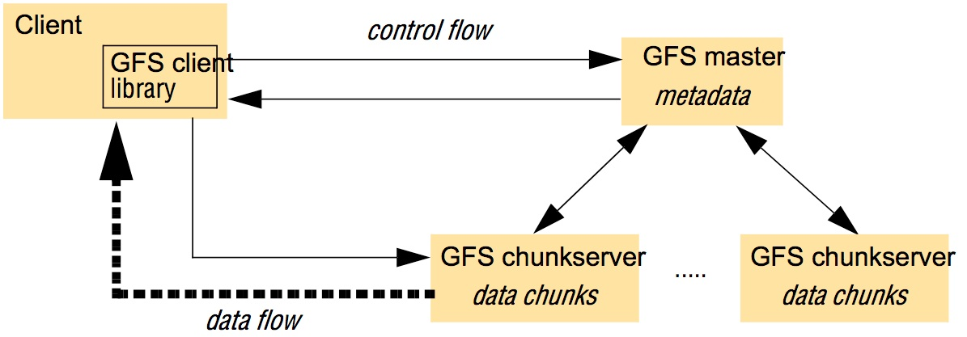
Figure 21.9
Overall architecture of GFS
Each GFS cluster has a single
master.
Manage metadata
Hundreds of chunkservers
Data is replicated on three independent chunkservers.
Locations known by master.
With log files, the master is restorable after failure.
Instructor’s Guide for Coulouris, Dollimore, Kindberg and Blair, Distributed Systems: Concepts and Design Edn. 5
© Pearson Education 2012

Slide 30
GFS – Reading a file sequentially
Suppose a client wants to perform a sequential read, processing a very large file from a particular byte offset.
The client can compute the chunk index from the byte offset.
Client calls master with file name and chunk index.
Master returns chunk identifier and the locations of replicas.
Client makes call on a chunk server for the chunk and it is processed sequentially with no caching. It may ask for and receive several chunks.

Slide 31
GFS – Mutation operations
Suppose a client wants to perform sequential writes to the end of a file.
The client can compute the chunk index from the byte offset. This is the chunk holding End Of File.
Client calls master with file name and chunk index.
Master returns chunk identifier and the locations of replicas. One is designated as the primary.
The client sends all data to all replicas. The primary coordinates with replicas to update files
consistently across replicas.

Slide 32
MapReduce Runs on Hadoop
Provide a clean abstraction on top of parallelization and fault tolerance.
Easy to program. The parallelization and fault tolerance is automatic. Google uses over 12,000 different MapReduce programs over a wide variety of problems. These are often pipelined.
Programmer implements two interfaces: one for mappers and one for reducers.
Map takes records from source in the form of key value pairs.
Map produces one or more intermediate values along with an output key from the input.
When Map is complete, all of the intermediate values for a given output key are combined into a list. The combiners run on the mapper machines.

Slide 33
MapReduce
Reduce combines the intermediate values into one or more final values for the same output key (usually one final value per key)
The master tries to place the mapper on the same machines as the data or nearby.

Slide 34
MapReduce – From the Google Paper
Map, written by the user, takes an input pair and produces a set of output key/value pairs.
The MapReduce library groups together all intermediate values associated with the key I and passes them to the reduce function.
The Reduce function, also written by the user, accepts an intermediate key I and a set of values for that key. It merges together these values to form a possibly smaller set of values. Typically, just zero or one output value is produced per Reduce invocation.

Slide 35
MapReduce – From the Google Paper
Map (k1,v1) --> list(k2,v2)
Reduce (k2, list(v2)) --> list(v3)

Slide 36
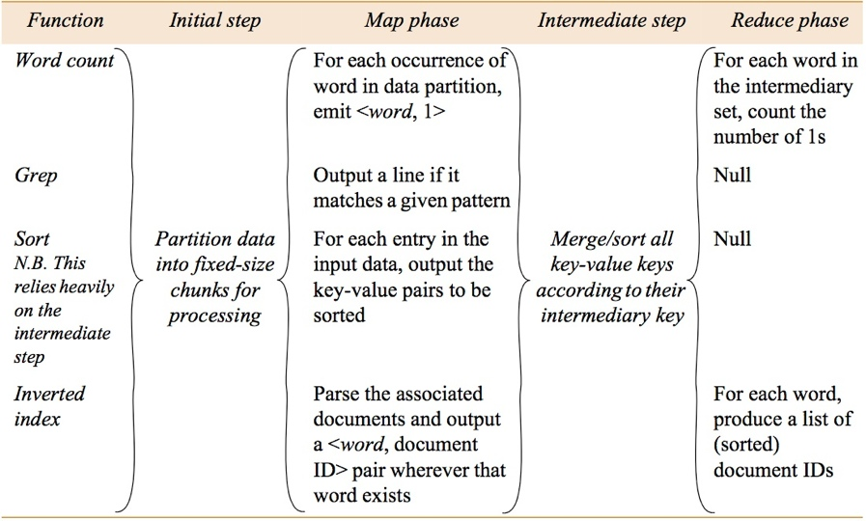
Figure 21.18
Some examples of the use of MapReduce
Instructor’s Guide for Coulouris, Dollimore, Kindberg and Blair, Distributed Systems: Concepts and Design Edn. 5
© Pearson Education 2012

Slide 37
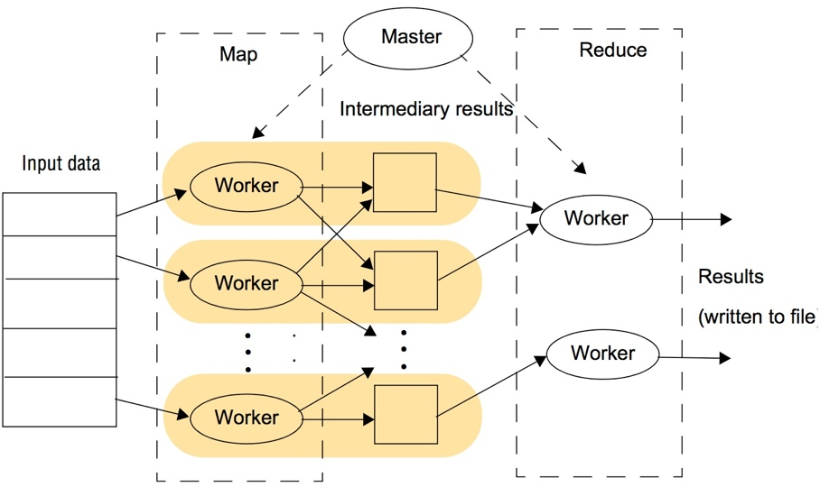
Figure 21.19
The overall execution of a MapReduce program
Instructor’s Guide for Coulouris, Dollimore, Kindberg and Blair, Distributed Systems: Concepts and Design Edn. 5
© Pearson Education 2012

Slide 38
Overall Execution of MapReduce
Maps run in parallel.
Reducers run in parallel.
Map phase must be completely
finished before the reduce
phase can begin.
The combiner phase is run on
mapper nodes after map phase.
This is a mini-reduce
on local map output.
Mappers run on the input data scattered over n machines:
Data on Disk 1 =>( key,value) => map₁
Data on Disk 2 => (key,value) => map₂
:
Data on Disk n => (key,value) => map_{n}
The map tasks produce (key, value) pairs:
map₁ => (key 1, value)
(key 2, value)
map₂ => (key 1, value)
(key 2, value)
(key 3, value)
(key 1, value)
The output of each map task is collected and sorted on the key. These key, value pairs
are passed to the reducers:
(key 1, value list) => reducer1 => list(value)
(key 2, value list) => reducer2 => list(value)
(key 3, value list) => reducer3 => list(value)
For complex activities, best to
pipe the output of a reducer
to another mapper.

Slide 39
MapReduce to Count Word Occurrences in Many Documents
Disk 1 => (Document name,Document) => map₁ On machine near disk 1
Disk 2 => (Document name,Document) => map₂ On machine near disk 2
Disk n => (Document name, Document) => map_{n}
map₁ => (ball, 1)
(game, 1)
map₂ => (ball, 1)
(team, 1)
(ball, 1)
Gather map output and sort by key. Send these pairs to reducers.
(ball, 1,1,1) => reducer => (ball, 3)
(game, 1) => reducer => (game, 1)
(team, 1) => reducer => (team, 1)

Slide 40
Some MapReduce Examples
Count the number of occurrences of each word in a large collection of documents.
Distributed GREP: Count the number of lines with a particular pattern.
From a web server log, determine URL access frequency.
Reverse a web link graph. For a given URL, find URL’s of pages pointing to it.
For each word, create list of documents containing it. (Same as 4.)
Distributed sort of a lot of records with keys.

Slide 41
MapReduce Example (1)
Count the number of occurrences of each word in a large collection of documents.
// (K1,V1) → List(K2,V2)
map(String key, String value)
// key: document name
// value: document contents
for each word w in value
emitIntermediate(w,”1”)
====================================================
// (K2, List(V2)) → List(V2) (bell,[1]), (car,[1,1])
reduce(String key, Iterator values)
// key: a word
// values: a list of counts
result = 0
for each v in values result += v;
emit(key, result) (bell,1),(car,2)
Doc1
car
bell
Doc2
car
(car,1),(bell,1),(car,1)

Slide 42
MapReduce Example (2)
Distributed GREP: Count the number of lines with a particular pattern. Suppose searchString is “th”.
// (K1,V1) → List(K2,V2)
map(fileOffset, lineFromFile)
if searchString in lineFromFile
emitIntermediate(lineFromFile,1)
// (K2, List(V2)) → List(V2)
reduce (K2, iterator values)
s = sum up values
emit (s,k2)
(0, the line) (8, a line) (14, the store)
(22, the line)
(the line, 1), (the store, 1), (the line,1)
(the line, [1,1]), (the store,[1])
(2 the line),(1 the store)

Slide 43
MapReduce Example (3)
From a web server log, determine URL access frequency.
Web page request log:
URL1 was visited
URL1 was visted
URL2 was visted
URL1 was visted
// (K1,V1) → List(K2,V2)
map( offset, url)
emitIntermediate(url,1)
// (K2, List(V2)) → List(V2)
reduce(url, values)
sum values into total
emit(url,total)
(0,URL1),(45,URL1),(90,URL2),(135,URL1)
(URL1,1),(URL1,1),(URL2,1),(URL1,1)
(URL1, [1,1,1]), (URL2, [1])
(URL1, 3),(URL2,1)

Slide 44
MapReduce Example (4)
4) Reverse a web link graph. For a given URL, find
URL’s of pages pointing to it.
// (K1,V1) → List(K2,V2)
map(String SourceDocURL, sourceDoc)
for each target in sourceDoc
emitIntermediate(target, SourceDocURL)
// (K2, List(V2)) → List(V2)
reduce(target, listOfSourceURL’s)
emit(target, listOfSourceURL’s)
(URL1, {P1,P2,P3}) (URL2, {P1,P3})
(P1, URL1), (P2,URL1), (P3, URL1)
(P1, URL2), (P3, URL2)
(P1, (URL1, URL2)), (P2, (URL1)),
(P3,(URL1,URL2))
5. Same as 4.

Slide 45
MapReduce Example (6)
6) Distributed sort of a lot of records with keys.
// (K1,V1) → List(K2,V2) (0, k2, data), (20, k1, data), (30, k3, data)
map(offset, record)
sk = find sort key in record
emitIntermediate(sk, record) (k2,data),(k1,data),(k3,data)
// (K2, List(V2)) → List(V2)
(k1,data),(k2,data),(k3,data)
reduce emits records unchanged

Slide 46
Recall Example 1 Word Count
Count the number of occurrences of each word in a large collection of documents.
// (K1,V1) → List(K2,V2)
map(String key, String value)
// key: document name
// value: document contents
for each word w in value
emitIntermediate(w,”1”)
====================================================
// (K2, List(V2)) → List(V2) (bell,[1]), (car,[1,1])
reduce(String key, Iterator values)
// key: a word
// values: a list of counts
result = 0
for each v in values result += v;
emit(key, result) (bell,1),(car,2)
Doc1
car
bell
Doc2
car
(car,1),(bell,1),(car,1)

Slide 47
Word Counting in Java - Mapper – Using offset into file not document name
public static class MapClass extends MapReduceBase
implements Mapper<LongWritable, Text, Text, IntWritable> {
private final static IntWritable one = new IntWritable(1);
private Text word = new Text();
public void map(LongWritable key, Text value,
OutputCollector<Text, IntWritable> output,
Reporter reporter) throws IOException {
String line = value.toString();
StringTokenizer itr = new StringTokenizer(line);
while (itr.hasMoreTokens()) {
word.set(itr.nextToken());
output.collect(word, one);
}
}
}
Instructor’s Guide for Coulouris, Dollimore, Kindberg and Blair, Distributed Systems: Concepts and Design Edn. 5
© Pearson Education 2012

Slide 48
Word Counting in Java - Reducer
public static class Reduce extends MapReduceBase
implements Reducer<Text, IntWritable, Text, IntWritable> {
public void reduce(Text key, Iterator<IntWritable> values,
OutputCollector<Text, IntWritable> output,
Reporter reporter) throws IOException {
int sum = 0;
while (values.hasNext()) {
sum += values.next().get();
}
output.collect(key, new IntWritable(sum));
}
}
Instructor’s Guide for Coulouris, Dollimore, Kindberg and Blair, Distributed Systems: Concepts and Design Edn. 5
© Pearson Education 2012

Slide 49

Computing π
Can you think of an embarrassingly parallel approach to approximating the value of π ?
Ask 100 monkeys to each throw one thousand darts at 100 square 1 X 1 boards, all with inscribed circles.
Count the number of darts landing inside the circles and those landing outside. Compute the area A = (landing inside)/(landing inside + landing outside). We know that A = π r ² = π (1/2) ² = ¼ π.
So, π = 4A.

