Slide 1
Predicting Medical Appointment Attendance Using XGBoost, CatBoost, and Deep Neural Networks
Ganesh Avirni - MSc Data Science
Student ID - 23092755
Supervisor: Dr. Vandana Das
Github Repo: https://github.com/avirni5259/medical-no-show.git

Slide 2
Aim and Research Question
Aim:
Develop predictive models to accurately forecast patient attendance at medical appointments.
Improve healthcare operational efficiency and reduce resource waste using advanced machine learning techniques.
Research Question:
Can a Deep Neural Network outperform XGBoost and CatBoost in predicting patient no-shows using demographic and scheduling data?

Slide 3
Objectives and Background Summary
Objectives:
Primary
  Develop and compare XGBoost, CatBoost, and Deep Neural Networks for predicting medical appointment attendance.
Secondary
  Identify key features influencing patient no-shows.
  Evaluate the impact of data preprocessing and feature engineering on model performance.
  Provide actionable insights to reduce no-show rates.

Slide 4
Background Summary:
Missed appointments cause inefficiency and resource waste in healthcare.
Predictive modeling helps identify patients likely to miss appointments.
Data includes demographic, scheduling, health, and environmental factors.
Models compared include gradient boosting (XGBoost, CatBoost) and Deep Neural Networks.
Goal: Improve clinic scheduling, resource optimization, and patient outcomes.

Slide 5
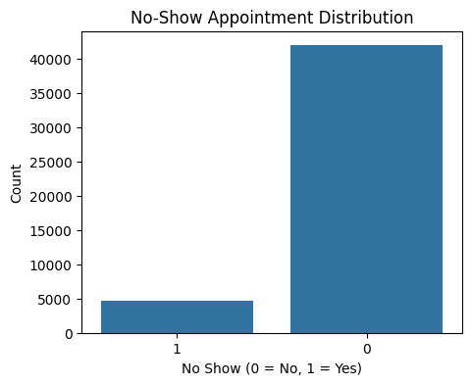
Dataset Overview and Data Collection
Dataset Overview:
Source: Brazilian national healthcare system, outpatient rehabilitation clinic.
Size: 49,593 medical records from 2016 to 2022.
Features: Demographics (gender, age, disability), appointment details (date, time, specialty), health info (ICD codes), environmental factors (temperature, rainfall).
Target: No-show status (Yes/No).

Slide 6
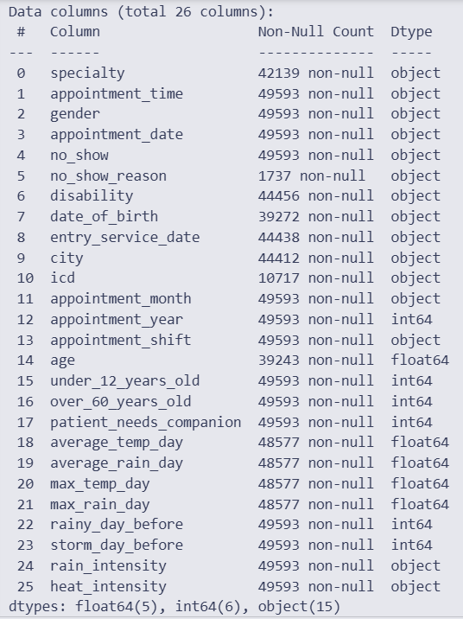
Data Collection:
Data combined from electronic medical records and external databases.
Fully anonymized and GDPR compliant.
Captures patient-level and contextual factors influencing appointment attendance.

Slide 7
Data Preparation and Feature Engineering
Data cleaning:
handled missing values, removed duplicates, standardized categorical variables.
Feature engineering:
Created utilization and payment ratios to capture patient behavior.
Derived recency features emphasizing recent appointment behavior.
Data split: stratified 80/20 train-validation split with fixed random seed for reproducibility.
Preprocessing: scaling numerical features, encoding categorical variables.

Slide 8
Model Development and Training
Models used:
Logistic Regression, XGBoost, CatBoost, Deep Neural Networks (MLP).
Training:
Logistic Regression as interpretable baseline.
XGBoost and CatBoost for handling non-linearity and categorical variables.
Deep Neural Network with early stopping for best performance.

Slide 9
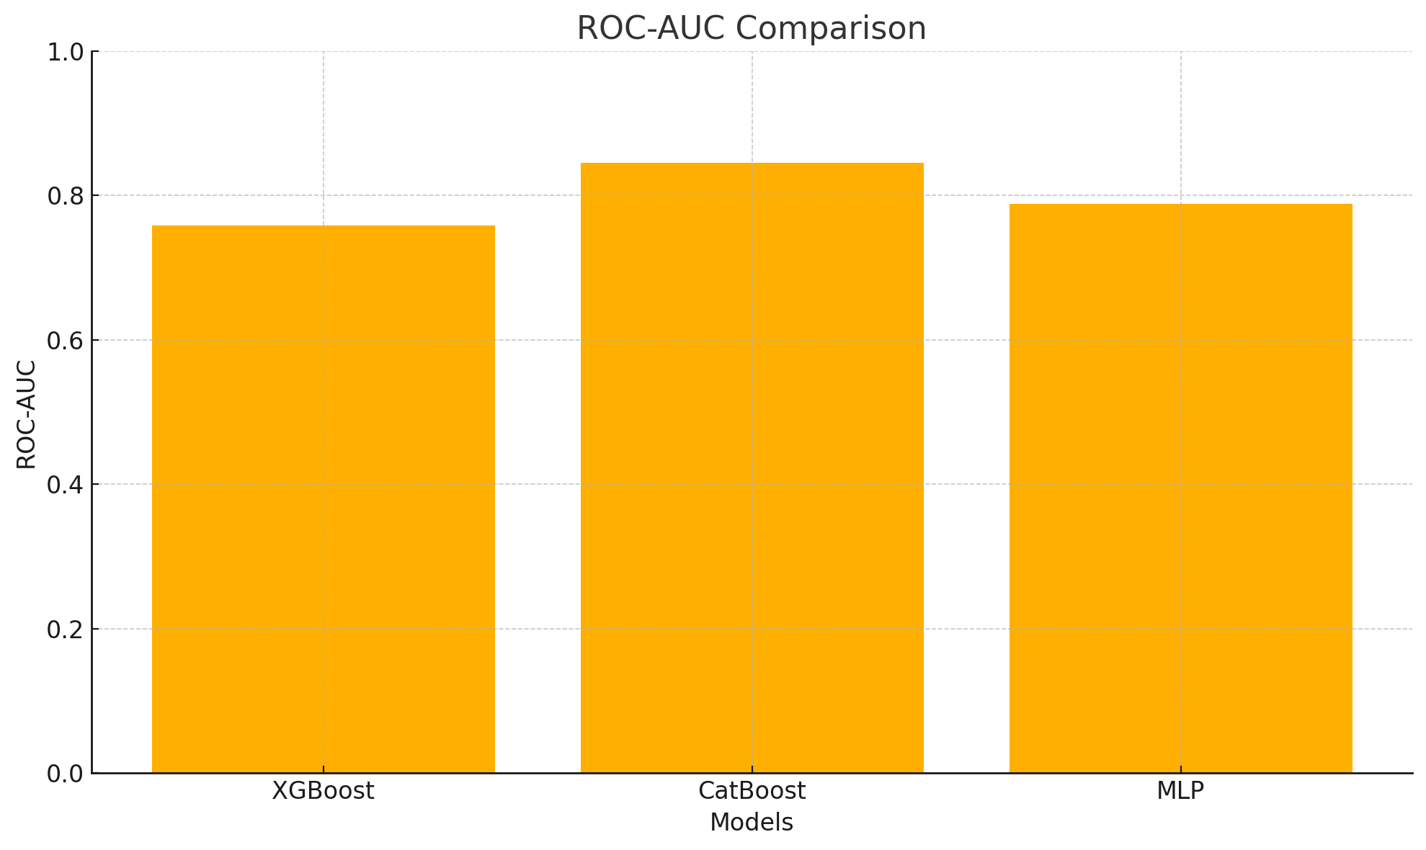
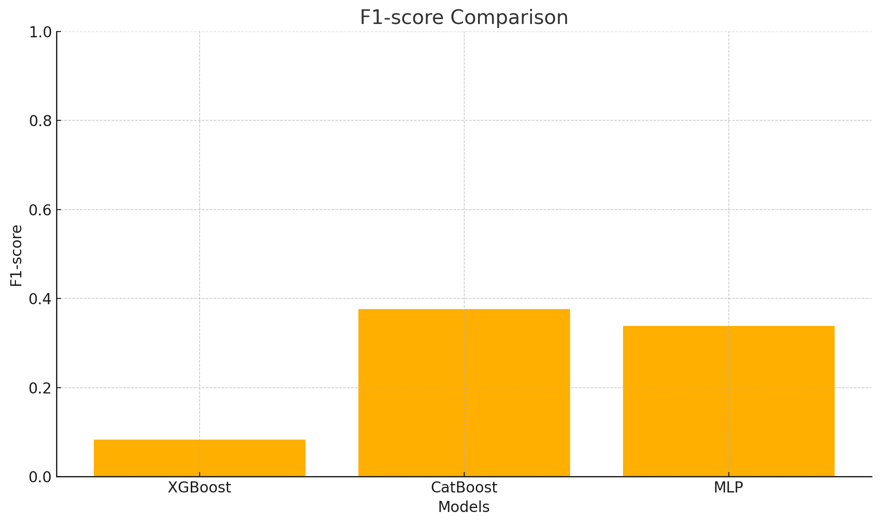
Evaluation metrics:
Accuracy, Precision, Recall, F1-score, ROC-AUC.
Reproducibility ensured with fixed random seeds.

Slide 10
Results and Evaluation
Logistic Regression baseline: Accuracy ~ 0.901125
XGBoost and CatBoost: Improved performance with ROC-AUC ~ 0.7585 (XGBoost) and 0.8450 (CatBoost).
Deep Neural Network (MLP): Comparable or better accuracy and ROC-AUC, with Accuracy 0.9018 and ROC-AUC 0.7881.
Evaluation metrics: Accuracy, Precision, Recall, F1-score, and ROC-AUC were computed for each model.Confusion matrices and calibration curves were used for detailed analysis.

Slide 11
Contributions and Future Work
Contributions:
Developed a decision-focused predictive model minimizing business loss.
Provided calibrated probabilities for trustworthy risk assessment.
Identified high-signal, interpretable features influencing no-shows.
Established a reproducible baseline with clear preprocessing and validation.
Future Work:
Add factors like transport reliability, clinic distance, local events, and abnormal weather.
Include neighborhood metrics such as income, literacy, and infrastructure.
Test the model on data from other regions or medical specialties.
Use generative models to create rare appointment types and improve coverage.

Slide 12
References
Kler et al., 2024. Predicting Patient No-shows in Medical Appointments Using Demographic and Health Data. IEEE.
Toffaha et al., 2024. Predicting Hospital No-Shows: Interpretable Machine Learning Models Approach. IEEE Access.
Abushaaban & Agaoglu, 2022. Medical Appointment No-Show Prediction Using Machine Learning Techniques.
Lovatte et al., 2024. Comparative Methods for Addressing Imbalanced Datasets in Predicting Medical Appointment No-Shows.
Chen et al., 2021. Application of Machine Learning to Predict Patient No-Shows in Pediatric Ophthalmology. Journal of Healthcare Engineering.

Slide 13
Thank You

