Slide 1
Industrial Internet of Things - Workshop
Developer Weekend, Bangalore

Slide 2


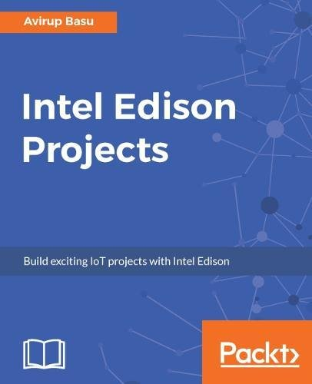
Avirup Basu
IoT Developer, Prescriber360
Intel Software Innovator
Author: Intel Edison Projects
Independent researcher

Slide 3
Agenda
Typical IoT Architecture
Edge devices
Sensors, sensors and SENSORS
IoT platform and Azure IoT hub
Communication protocols
Data flow (Sensors-Dashboard)
MQTT protocol (Mosquito broker and deploying in Azure VM)
Home automation (Typical IoT example)
Controlling devices using IoT
Concept of IIoT

Slide 4
Internet of Things (IoT) Architecture
SENSORS
IOT PLATFORM
or
CLOUD
(on or off premise)
DASHBOARD
&
ALERTS
CONTROLLER
ACTUATORS

Slide 5
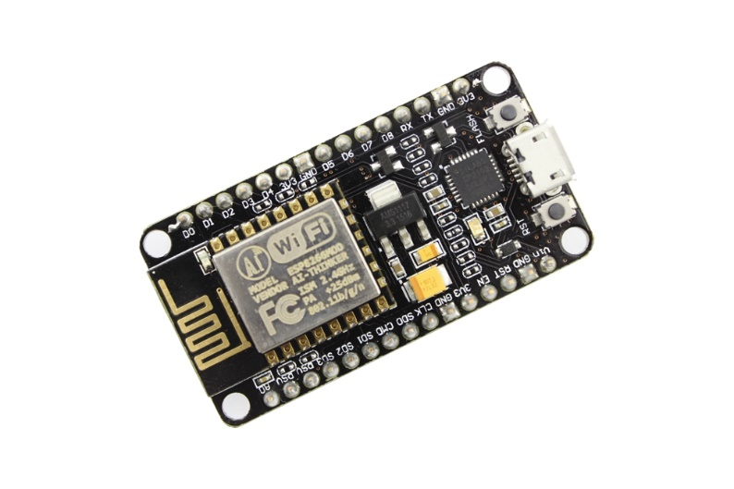
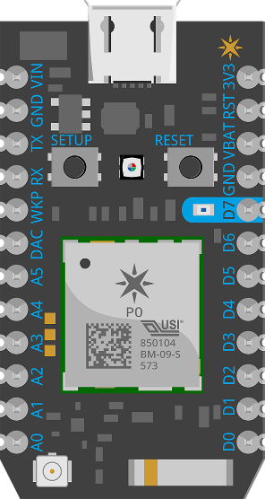
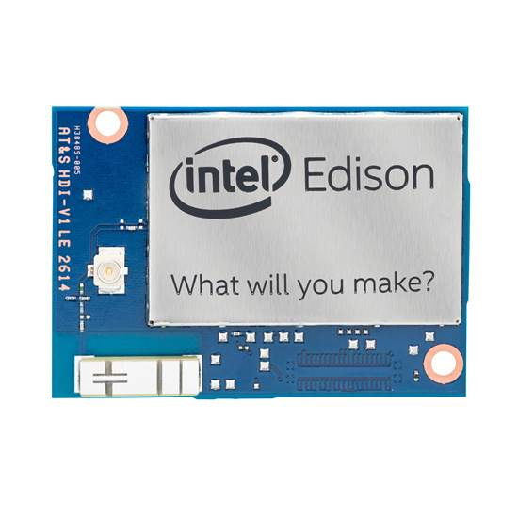
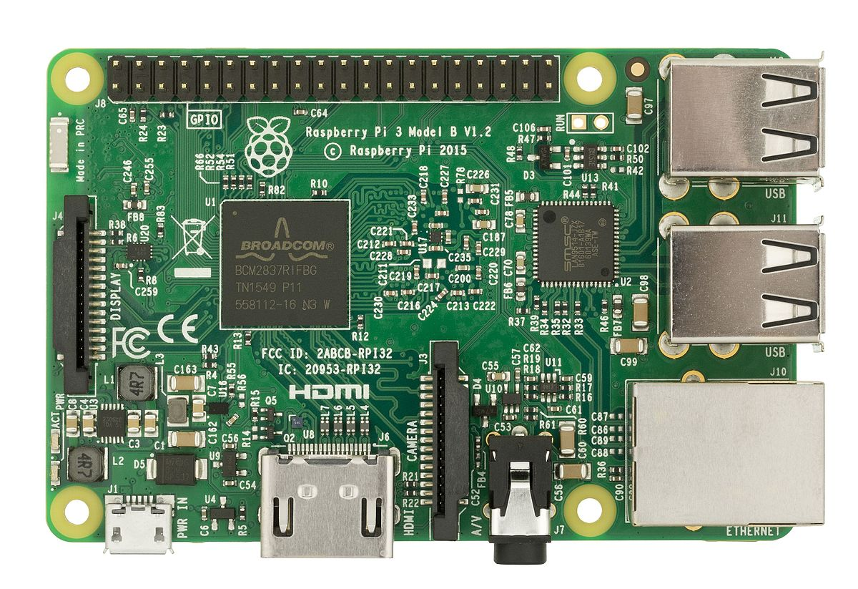
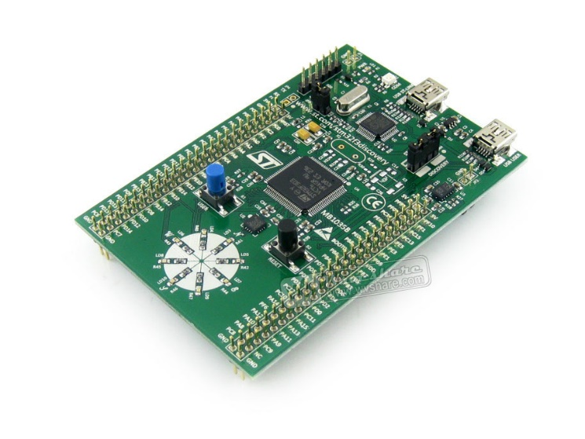
Edge Devices (Part-1)

Slide 6
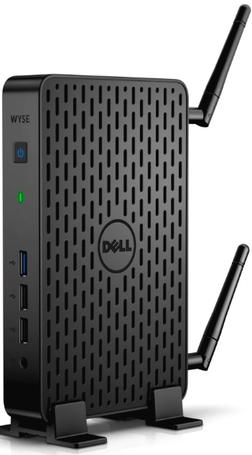
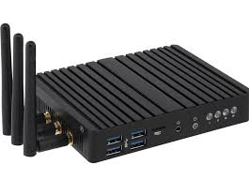
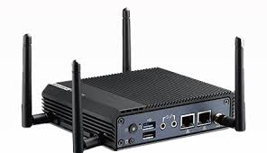
Edge Devices (Part-2)

Slide 7
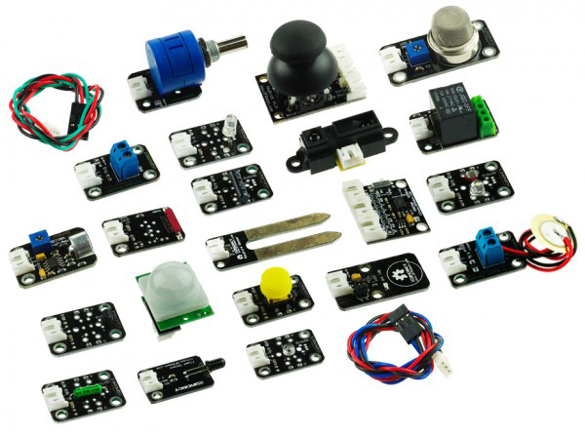
Sensors
Perception of the entire system
Digitalize the physical characteristics or parameters of the system
Temperature, Humidity, Pressure, Moisture, Magnetic field, Light intensity, Acceleration, Direction, Position, Vision, Sound, Gas, Colour, infrared, rotational, pulse, speed,

Slide 8
Azure IoT hub
Bi-Directional Communication
Familiar protocols (HTTP, MQTT, AMQP)
Enhanced security
Scalable
SDKs available across multiple platforms

Slide 9
Demo Stream sensor data to Azure IoT hub

Slide 10
Communication Protocols
Device to Device (M2M)
Device to platform
Platform to device
Platform to dashboard and vice versa

Slide 11
M2M
Name | Frequency | Range | Data transfer rate
Bluetooth | 2.4GHz | 50-150m | 1Mbps (Smart/BLE)
Zigbee | 2.4GHz | 10-100m | 250kbps
Wi-Fi | 2.4GHz-5GHz | 50m | 600 Mbps, 150-200Mbps(latest 802.11-ac standard should offer 500Mbps to 1Gbps)
Z-wave | 900MHz | 30m | 9.6/40/100kbit/s
NFC | 13.56MHz | 10cm | 100–420kbps
Sigfox | 900MHz | 30-50Kms(rural environment) 3-10Kms(urban environment) | 10-1000bps
Neul | 900MHz (ISM), 458MHz (UK), 470-790MHz (White Space) | 10Km | Few bps up to 100kbps
LoRaWAN | 865-867 MHz | 2-5Km | 0.3-50 kbps

Slide 12
Device to platform and dashboard and vice versa
HTTP
MQTT
AMQP

Slide 13
Data flow
SENSORS
IOT PLATFORM
or
CLOUD
(on or off premise)
http/amqp/mqtt
RF/BLE/ZigBee etc.
DASHBOARD
&
ALERTS
http/amqp/mqtt
CONTROLLER
GPIO based control
ACTUATORS

Slide 14
Message Queue Telemetry Transport
MQTT Broker
Topic
Subscriber
Publisher

Slide 15
Home automation
Light
Edge device
Relay
Port 1
Web app
MQTT
Broker
Relay
Port 2
Application
Fan
Mobile app

Slide 16
Controlling devices through IoT
Similar to home automation
More parameters may be required
Real time, lag-free control

Slide 17
Industrial Internet of Things (IIoT)
Real time system
Secured architecture
Efficient lag free communication protocols
Usually deployed in high sensitive areas
Hook up IIoTs to existing PLCs

Slide 18
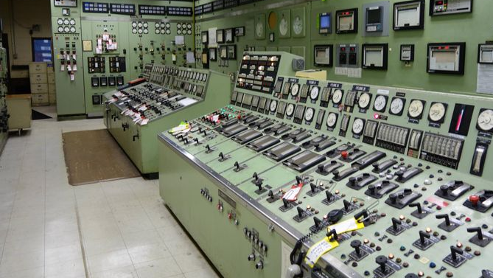
Industrial Internet of Things (IIoT)
Real time system
Secured architecture
Efficient lag free communication protocols
Usually deployed in high sensitive areas
Hook up IIoTs to existing PLCs

Slide 19
Demo Real time control using mqtt

Slide 20




Thank you
@avirup171

