Slide 1
AI Agent for Smart Farming Advice
Problem Statement No.9
Presented By:
1. Avirup Karmakar
- Government College of Engineering & Textile Technology Serampore – Computer Science & Engineering

Slide 2
OUTLINE
Problem Statement
Proposed System/Solution
System Development Approach
Algorithm & Deployment
Result (Output Image)
Conclusion
Future Scope
References

Slide 3
Problem Statement
Example: The Challenge – An AI Agent for Smart Farming Advice, powered by RAG (Retrieval-Augmented
Generation), supports small-scale farmers by delivering real-time, localized agricultural guidance.
It retrieves trusted data on weather forecasts, soil conditions, crop recommendations, pest control
measures, and current market prices from agricultural departments, meteorological sources, and agri-
tech platforms.
Farmers can interact in their local language and ask questions like “What crop is best for this season?”
or “What is today’s mandi rate for tomatoes?”
The agent ensures timely, data-driven decisions that reduce risk, increase yield, and boost income.
This AI-driven assistant bridges the knowledge gap and brings smart farming to the grassroots.

Slide 4
Proposed Solution
We propose a smart AI Agent, built using Retrieval-Augmented Generation (RAG), that provides localized and actionable farming advice to small-scale farmers.
Key Features:
Natural Language Understanding – Accepts user queries in plain language (e.g., “What crop should I grow this month?”).
Document Retrieval – Pulls data from trusted sources like:
Weather APIs
Soil condition databases
Agricultural research documents
Market price feeds
Contextual Response Generation – Uses IBM Granite LLM to generate accurate and helpful answers.

Slide 5
System Approach
Technologies Used:
IBM Watsonx.ai / Granite LLM: For language generation
IBM Cloud Functions: For serverless API execution
IBM Cloudant / DB2: For structured data storage
Python (Flask): Backend development
LangChain or Haystack: RAG pipeline integration
HTML + JavaScript: Frontend chatbot interface
RAG Architecture Flow:
Query from user → Document Retrieval (weather, soil, etc.) → Prompt formatting → LLM generation → Response to user

Slide 6
Algorithm & Deployment
Core Algorithm: Retrieval-Augmented Generation (RAG)
RAG is a hybrid framework that retrieves external knowledge and combines it with large language model (LLM) capabilities to generate intelligent, grounded answers.
How It Works:
User Query Input: Natural language query from farmer (e.g., “Best crop for loamy soil in July?”)
Vector Similarity Search:
The query is encoded into a vector using sentence embeddings.
The system searches a vector database (e.g., FAISS) to find semantically similar documents (weather, soil data, crop info).
Document Retrieval:
Top relevant documents are retrieved and ranked.
These may include recent weather forecasts, soil analysis, and government agricultural advisories.
Context Fusion: Retrieved documents + the original query are combined into a single prompt.
LLM Response Generation:
Prompt is passed to IBM Granite (LLM via Watsonx.ai).
The model generates a response based on real data, ensuring both fluency and accuracy.

Slide 7
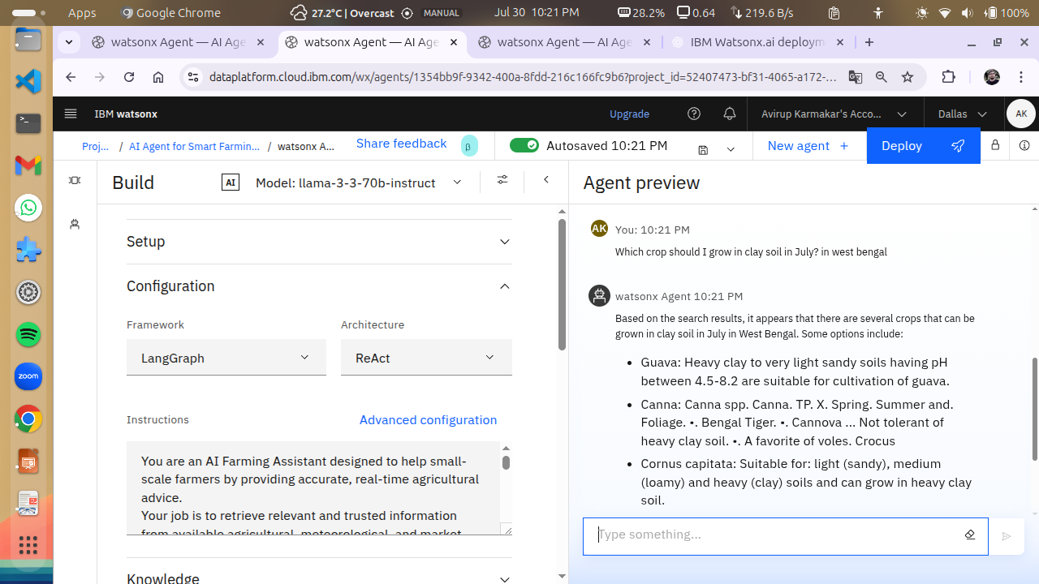
Result

Slide 8
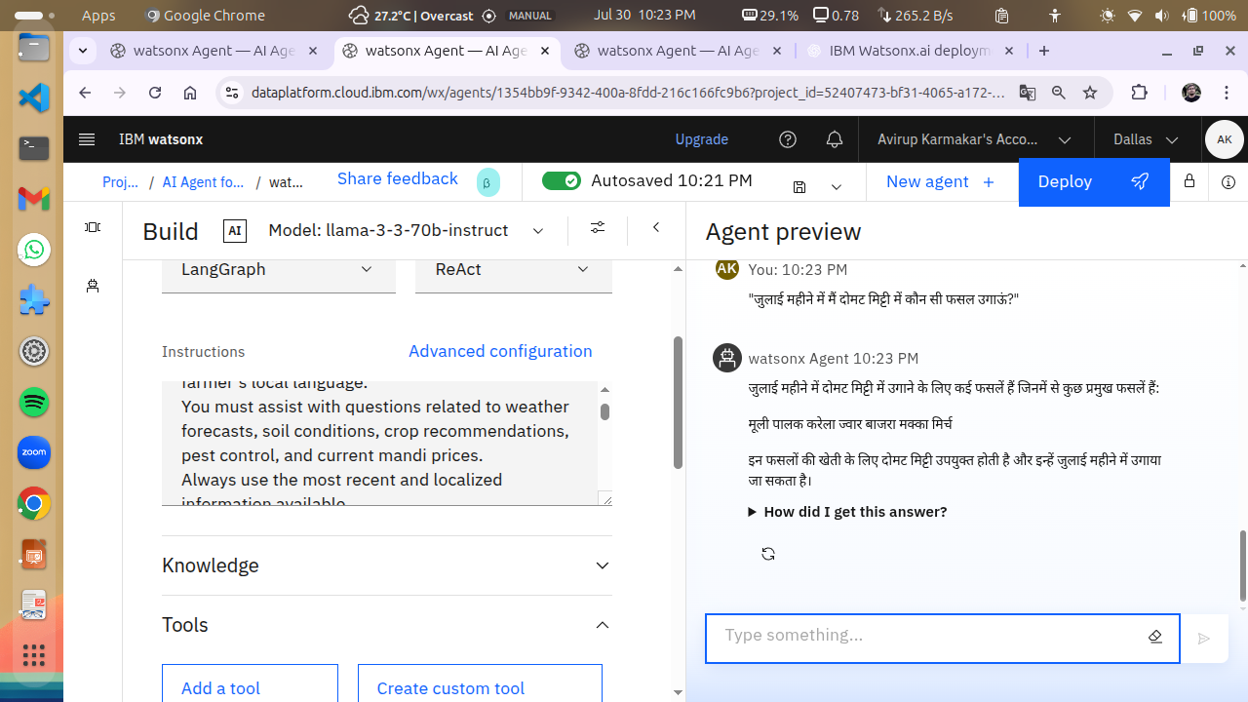
Result

Slide 9
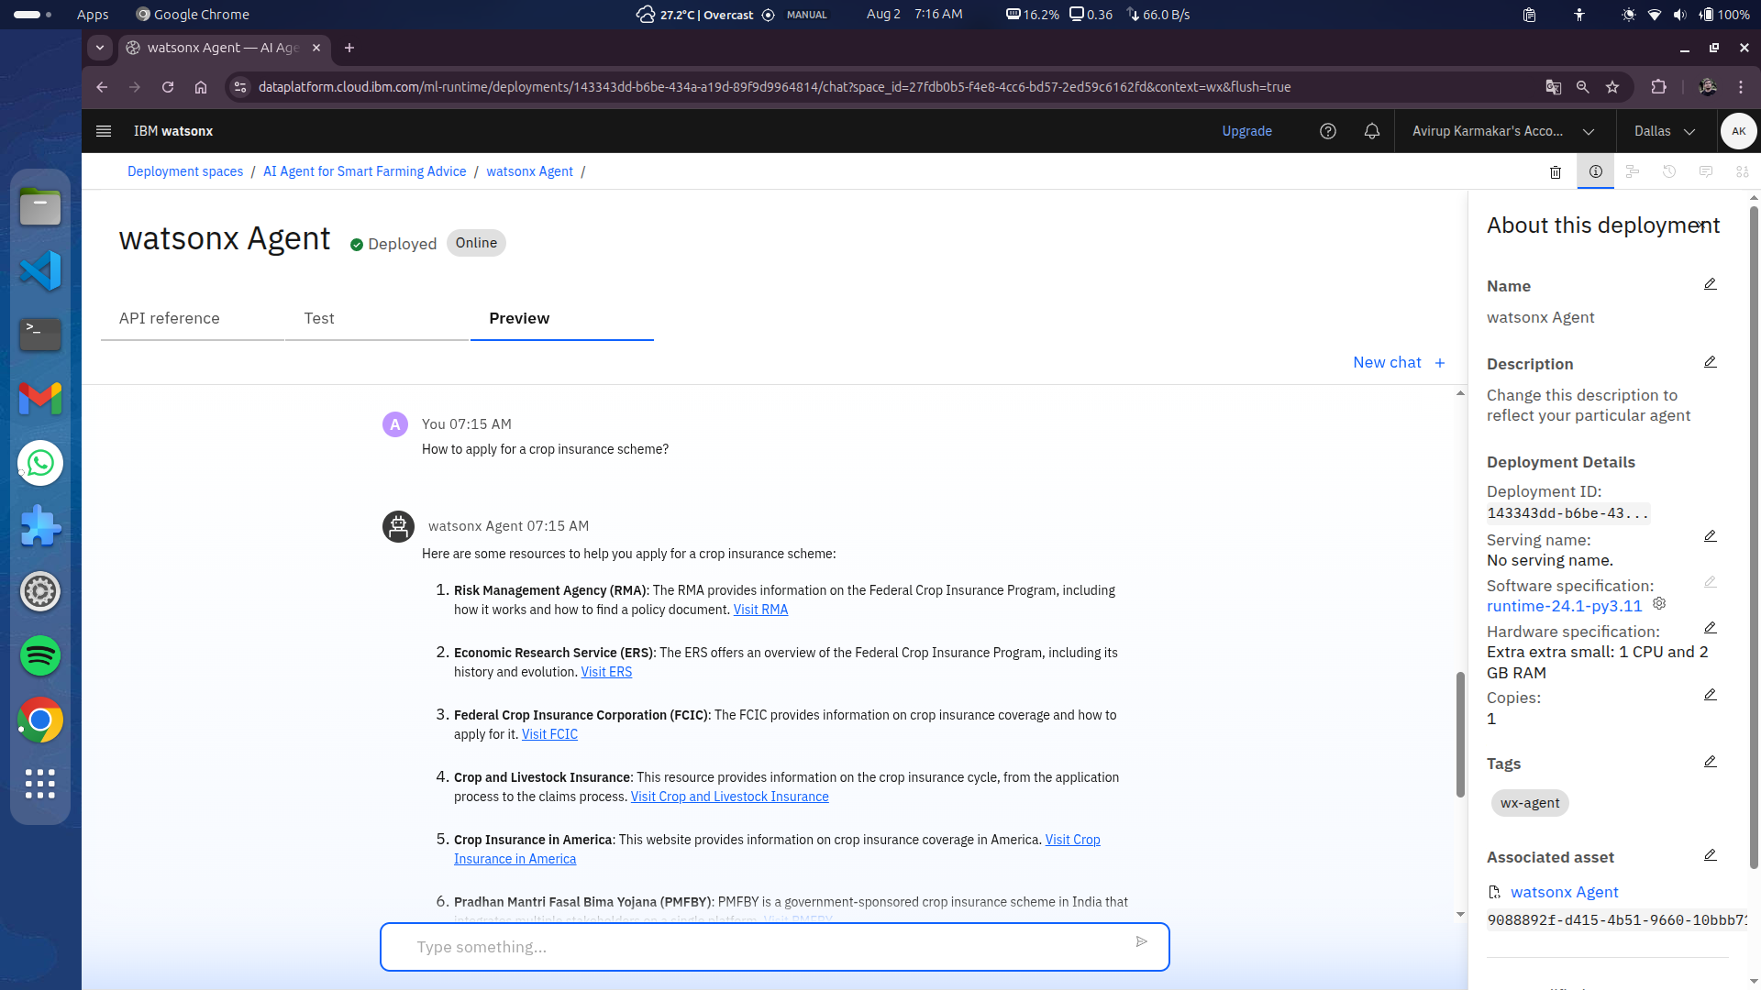
Result

Slide 10
Conclusion
The AI agent empowers farmers by enabling data-driven decision-making through real-time, localized agricultural insights. It enhances access to expert-level knowledge, even in remote or underserved regions, by delivering context-aware responses in natural language. The system’s design is scalable and adaptable to various languages and geographies, making it suitable for widespread use. By integrating Retrieval-Augmented Generation (RAG) with large language models on IBM Cloud, the solution achieves a balance of accuracy, affordability, and scalability, offering a practical path forward for smart and sustainable farming.

Slide 11
Future scope
The AI agent can be further enhanced to serve a broader range of farmers and agricultural needs. Future improvements include:
– Expanding to multiple Indian languages to ensure accessibility across diverse regions;
– Integrating with IoT soil sensors for real-time, data-driven crop recommendations;
– Using drone imagery to assess crop health and detect diseases early;
– Adding a voice-based assistant to support illiterate or elderly users; and
– Implementing real-time alerts for pest outbreaks, extreme weather, or market price changes.
These advancements will make the system smarter, more inclusive, and aligned with the goals of precision and sustainable farming.

Slide 12
References
IBM Watsonx.ai Documentation
IBM Cloud Lite Functions
LangChain – RAG Framework
Kaggle, Indian Meteorological Dept. for weather APIs
Government agriculture portal (e.g., https://mkisan.gov.in)

Slide 13
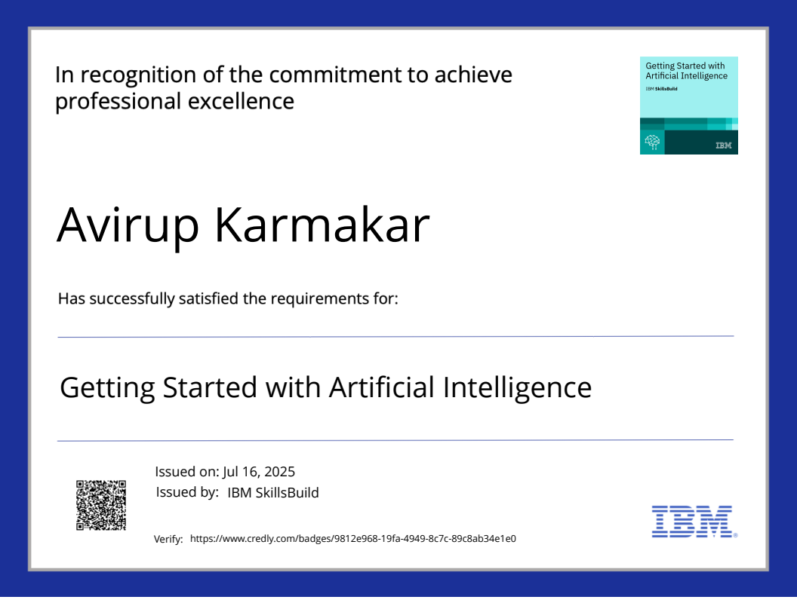
IBM Certifications
Screenshot/ credly certificate( getting started with AI)

Slide 14
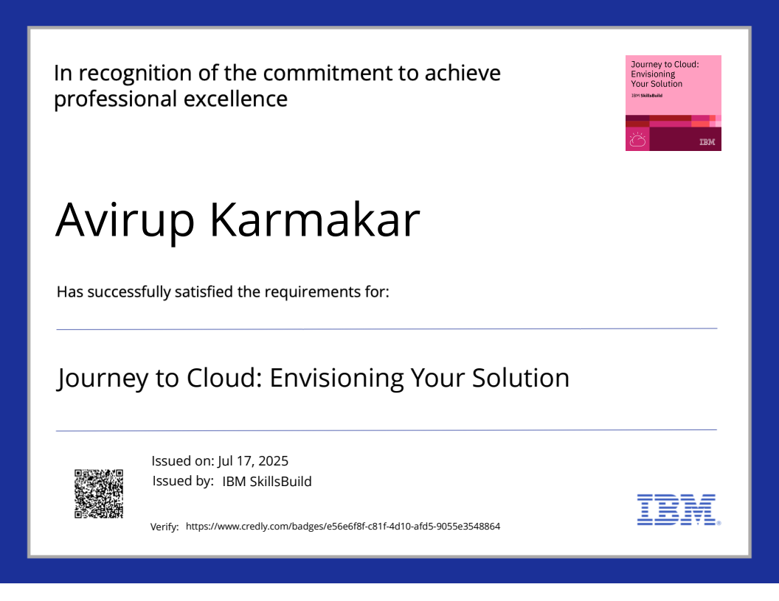
IBM Certifications
Screenshot/ credly certificate( Journey to Cloud)

Slide 15
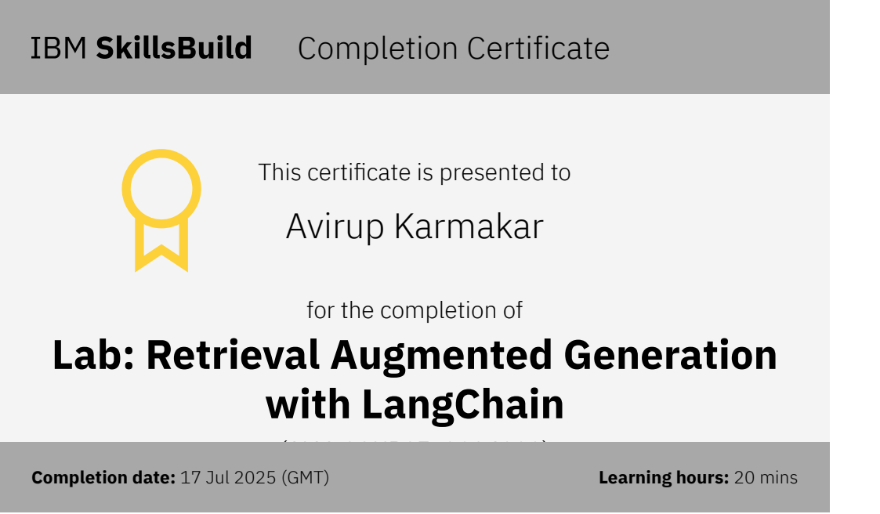
IBM Certifications
Screenshot/ credly certificate( RAG Lab)

Slide 16
THANK YOU

