Slide 1



TIES
Education System Perspective
International STEM Skills Round Table
Phase III – 2nd meeting
Jan Morrison, CEO, TIES
www.tiesteach.org
www.stemecosystems.org
www.tiesteach.org
All Rights Reserved, December, 2026

Slide 2



Proposal for this session: We propose the next guidelines for this topic, as a shift from "no alternative" towards a strategic approach to defining the profile of the future lecturer/teacher: 1. Openness to recruiting individuals from diverse backgrounds (including industry) not as a temporary solution but as part of systemic strategy. 2. Looking at team-based models in which teachers/lecturers with different strengths complement one another, rather than full uniformity.
What problem/issue are we trying to solve?

Slide 3


Defining the profile of a future teacher…strategic approach.
What does success look like?
What are the constraints or orthodoxies to reach success?
What are the evidence-based processes to achieve success?
www.tiesteach.org
www.tiesteach.org
All Rights Reserved, November 2026

Slide 4

What does success look like?
EDUCATION to WORKFORCE
to ECONOMIC DEVELOPMENT
Transdisciplinary approach to teaching STEM
Career Connected Learning is infused and not laminar and with real-world experiences/expertise
Teaching becomes the focus, not education and earns an industry-level or sector status
Teaching is a team-driven cross-sector endeavor
Recruitment is incentivized and multi-dimensional
www.tiesteach.org
All Rights Reserved, February 2025

Slide 5


Constraints or Orthodoxies
Leave the Yellow Brick Road behind and adopt an Interstate Road model…ramps on and off.

Slide 6

Constraints or Orthodoxies
Teaching is a “calling” and not a profession accomplished by the top achieving talent.

Slide 7
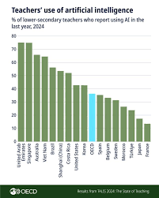
Constraints or Orthodoxies
Emerging Technologies are not part of teaching competencies, are optional and are not currently prized by teaching standards and certifications. .

Slide 8





Evidence-based Processes to achieve Career-Connected Learning…Externships
Makerspace
Pre-K through 5th grade Instructional spaces for tinkering and inventing
www.tiesteach.org
www.tiesteach.org
All Rights Reserved, February 2025

Slide 9

Evidence-based Processes Incentivized and Multidimensional …Talent Recruitment
Disaffected Workers, retrained
Post-Military Options
Industry/Business Worker-incentives
NGO/Non-profit Incentives for employees
University Incubation of Innovative Options for Talent Recruitment
Head-hunters: Hedrick Struggles, Isaacson and Miller, ex.

Slide 10
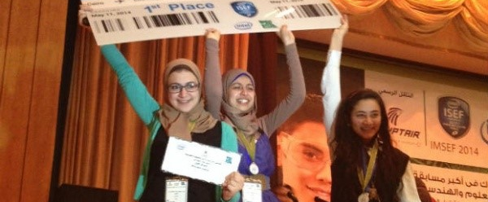

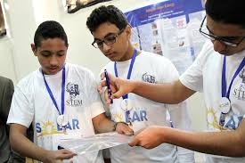
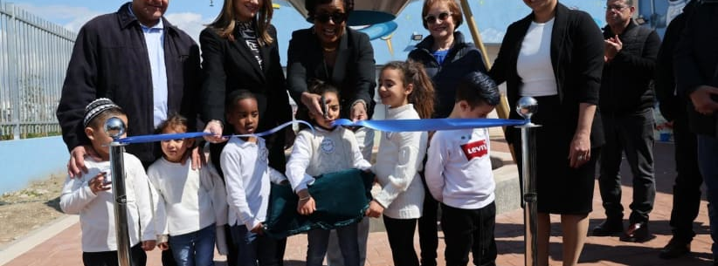

Slide 11

Evidence-based Processes to achieve
Transdisciplinary Instruction…Team-based and connected to real-life problems/issues
Ex: STEM Model Schools, Egypt Post- Arab Spring

Slide 12

Teachers who have real impact: Requires a complete global system shift where countries learn from each other.
www.tiesteach.org
All Rights Reserved, February 2025

