Slide 1
International STEM Skills Round Table Phase III
3rd meeting
10.03.2026

Slide 2
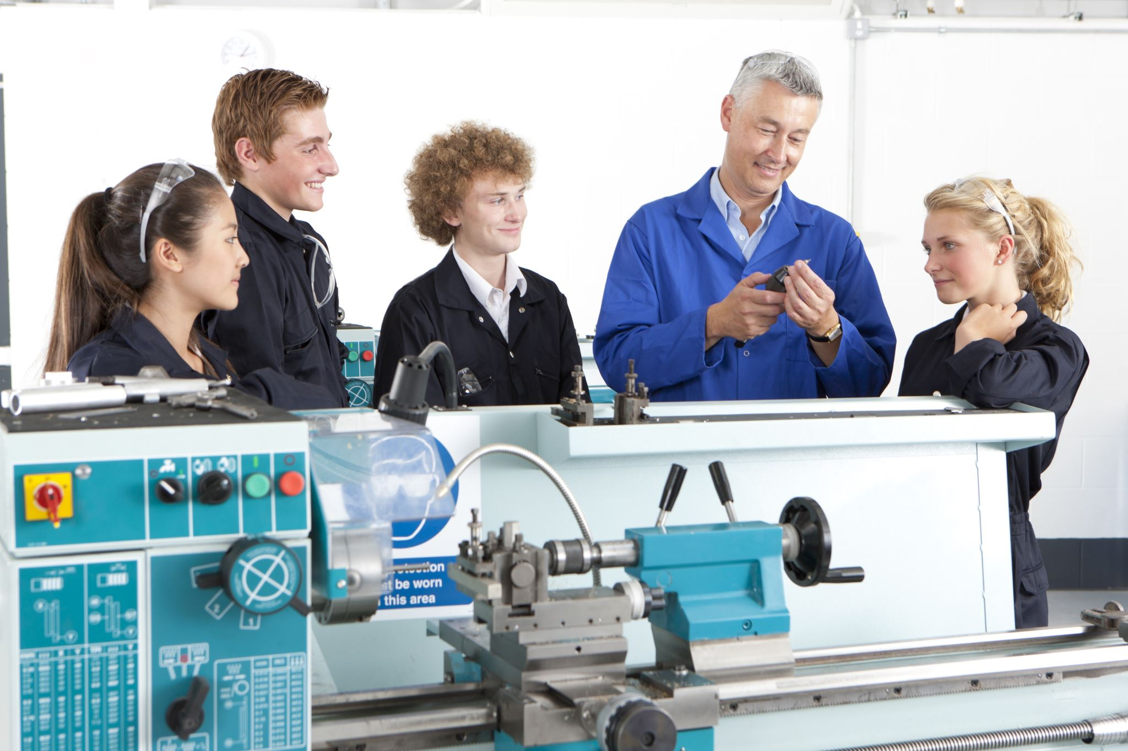
Subject/Dilemma
Should lecturers and teachers themselves possess the required skills and competencies, or should their primary expertise lie in the ability to cultivate these skills among their students and pupils?

Slide 3
Program Outline
Time | Topic | Speakers
15:00 - 15:15 | Opening remarks | Dr. Eli Eisenberg
15:15 - 15:35 | Addressing the dilemma of this meeting | Prof. Sigal Tifferet
15:35 - 15:40 | Q&A | Moderated by Dr. Eli Eisenberg
15:40 – 16:00 | Addressing the dilemma of this meeting | Dr. Olena Bekh
16:00 – 16:05 | Q&A | Moderated by Dr. Eli Eisenberg
16:05 - 16:45 | Discussion | Moderated by Dr. Yael Granot-Bein and Dr. Revital Duek
16:45 - 16:55 | Summary of the meeting | Dr. Avigdor Zonnenshain
16:55 - 17:00 | Introducing the topic/dilemma of the next meeting | Dr. Eli Eisenberg

Slide 4
The Issues to be Discussed in the Meetings
Meeting No. | Date | Content
1 | 02.12.2025 | Introduction, Presentation of roundtable participants, Lecture and Discussion on “Skills and Competencies in the Era of Artificial Intelligence".
2 | 20.01.2026 | Should the profile of lecturers and teachers become uniform or similar, or should there be a diversity of lecturer and teacher profiles within higher education faculties and secondary schools?
3 | 10.03.2026 | Should lecturers and teachers themselves possess the required skills and competencies, or should their primary expertise lie in the ability to cultivate these skills among their students and pupils?
4 | 28.04.2026 | Is it the lecturer or teacher alone who should lead the educational process within their field of knowledge, or should an educational triangle be formed among the lecturer/teacher, the student/pupil and artificial intelligence?
5 | 09.06.2026 | How can the professional development of lecturers and teachers be ensured? Who holds the responsibility and the capacity to sustain such development systematically and continuously over time (for example: centers for advancing teaching and learning, a national center for skills development, teacher educators…)?
6 | 21.07.2026 | What is the appropriate balance between physical environments and virtual ones (such as XR and VR)? What forms of experiential learning in relevant workplaces are most suitable, and how can mentors from industry be effectively integrated into the learning process?

Slide 5
נתונים
ניתן לסכם את המודל הגרמני כשלושה מעגלים מחוברים:
(1) ייצור ידע
מחקר אקדמי + מכוני מדיניות
שימוש בנתונים אדמיניסטרטיביים
(2) תיווך ידע
גופי brokerage
סינתזות ידע
רשתות בין שחקנים
(3) שימוש במדיניות
יחידות ממשלתיות
תהליכי evaluation
התאמות מדיניות

Slide 6
We appreciate your time and attention
For any questions or further discussion > elieizenberg@gmail.com
Explore our recent publications > www.neaman.org.il

