Slide 1

Sigal Tifferet
Translated from Hebrew to English - www.onlinedoctranslator.com
Professor of psychology at the Ruppin Academic Center, Department of Business Administration
Teaching skills for over 20 years
Lecturer on skill acquisition and AI literacy

Slide 2


How to train teachers to impart skills?
Prof. Sigal Tifferet
Ruppin Academic Center
March, 2026

Slide 3
How effective is teacher training?
What characterizes effective teacher training?
Which types of knowledge do teachers need to impart skills?
What pedagogic knowledge do they need?
How specific should skill instruction be?
Which decisions need to be made?

Slide 4
What are the desired effects of teacher training?
Training program
Increased teacher competencies
Change in instruction
Increased student achievement
Improved student learning
Desimone, 2009

Slide 5
What is the effectiveness of teacher training?
A meta-analysis of 128 (quasi-) experimental, high-quality studies with 356 effect sizes. Results showed an average effect size of 0.09, 95% CI [0.07, 0.11](Visscher et al., 2025, p. 1)
The association between teachers' PD participation and student achievement failed to reach statistical significance (r = .06, p = .11; CI[-.02,.13]) (Lindvall et al., 2025, p. 9)
Across our full sample, the precision-weighted average impact of PD is equal to an effect size of .05 (p < .01). Average effect sizes are approximately twice as large (.09) in early years (prekindergarten) settings as they are in school settings (.04) (Sims et al., 2025, p. 231)

Slide 6
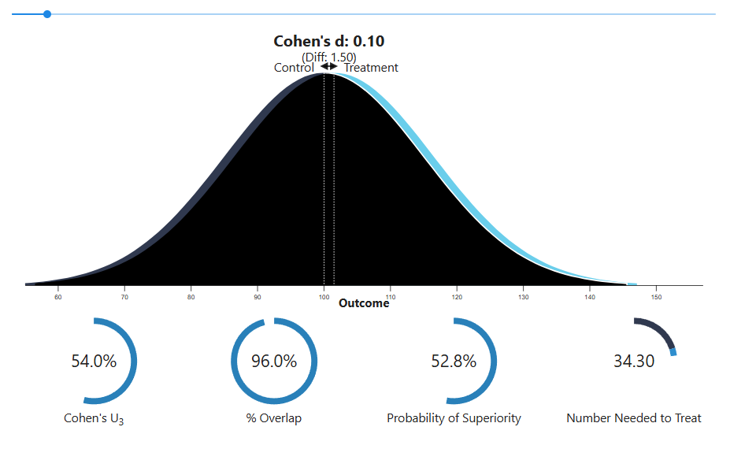
With a Cohen'sdof 0.10, 54.0% of the "treatment" group will be above the mean of the "control" group (Cohen's U₃), 96.0% of the two groups will overlap, and there is a 52.8% chance that a person picked at random from the "treatment" group will have a higher score than a person picked at random from the "control" group (probability of superiority). Moreover, in order to have one more favorable outcome in the "treatment" group compared to the "control" group, we need to treat 34.3 people on average. This means that if there are 100 people in each group, and we assume that 20 people have favorable outcomes in the "control" group, then 20 + 2.9 people in the "treatment" group will have favorable outcomes.¹

Slide 7
Small effects are important, as they can support them incremental improvement of educational practice. Moreover, if thousands or even millions of students can benefit from such effective TPD interventions, when they are implemented on a large scale, then the impact will be enormous. (Visscher et al., 2025, p. 13)
Effects varied greatly, with the 95% prediction interval (PI) ranging from 0.15 to 0.32 (Visscher et al., 2025, p. 1)
Notes:
CI: Where is the population mean
PI: Where would be the mean of a new case

Slide 8
How effective is teacher training?
What characterizes effective teacher training?
Which types of knowledge do teachers need to impart skills?
What pedagogic knowledge do they need?
How specific should skill instruction be?
Which decisions need to be made?

Slide 9




What characterizes effective training?
Focused knowledge
Support
Transfer
Evidence-based practice
Disciplinary knowledge
Specific techniques
Collaborations
Peer learning
Organizational support
Culture of innovation
Action plan for implementation
Built-in reminders
Reflection and self-monitoring
Explicit instruction
Active learning
Rehearsals
Scaffolding
Feedback
Darling-Hammond et al., 2017; Hubers et al., 2022; Hughes et al., 2020; Sims et al., 2025

Slide 10
How effective is teacher training?
What characterizes effective teacher training?
Which types of knowledge do teachers need to impart skills?
What pedagogic knowledge do they need?
How specific should skill instruction be?
Which decisions need to be made?

Slide 11
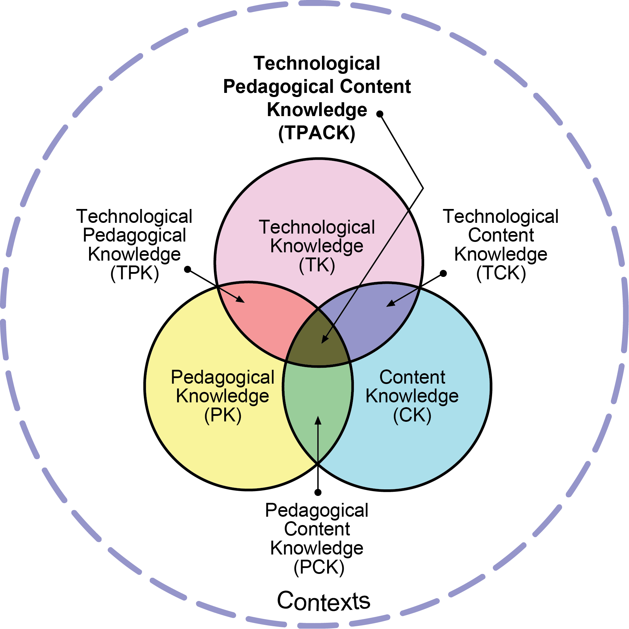
What knowledge is taught in teacher training?
Fabian et al., 2024; Teo et al., 2021; Valtonen et al., 2017

Slide 12
TSPACK
I know / am familiar with...
Content
Pedagogy
Content area
How to teach
Skill
Pedagogy for the content area
Technology
C
P
Skill
S
T
Digital tools
Content proficiency
SC
PC
TP
Techno-pedagogical tools
Pedagogy for imparting content-related skills
SPC
TPC
Techno-pedagogy for the content area
Pedagogy for imparting the skill
SP
TSPC
TC
Content technology
Techno-pedagogy for skill acquisition
TSP
TSC
Technology for imparting content skills
Technology for skill acquisition
TS
Techno-pedagogy for imparting content-related skills

Slide 13
Examples: Critical thinking
Content
Pedagogy
Collaborative learning
Skill
Business
Technology
C
P
Argument analysis
S
T
Digital boards
Business Argument Analysis
SC
PC
TP
Collaborative boards
SPC
TPC
Analyzing arguments in pairs
SP
TSPC
TC
Collaborative argument analysis using Kialo
TSP
TSC
Chatbot For argument analysis
TS
Collaborative analysis of business arguments using Kialo

Slide 14
How effective is teacher training?
What characterizes effective teacher training?
Which types of knowledge do teachers need to impart skills?
What pedagogic knowledge do they need?
How specific should skill instruction be?
Which decisions need to be made?

Slide 15
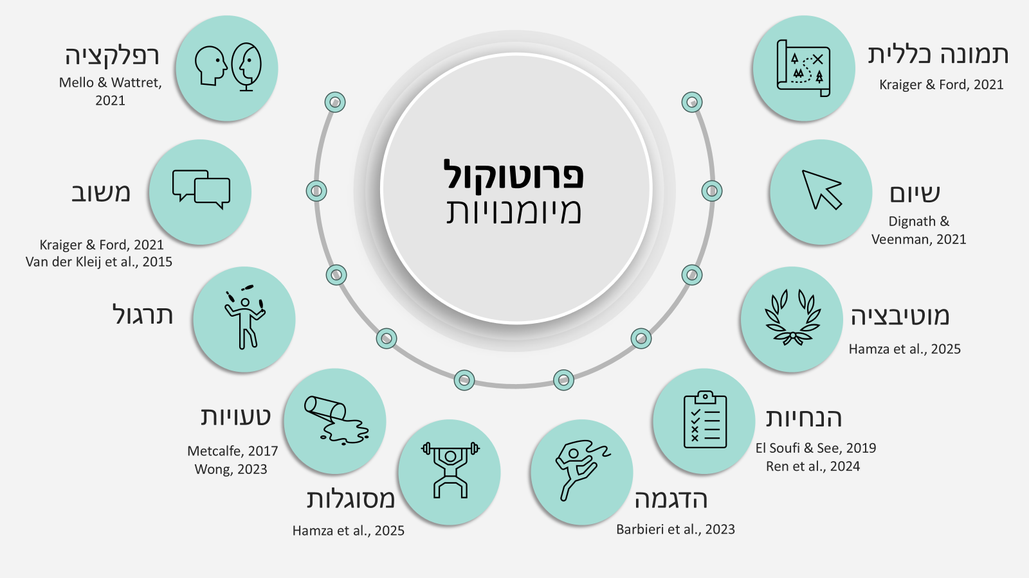


Slide 16
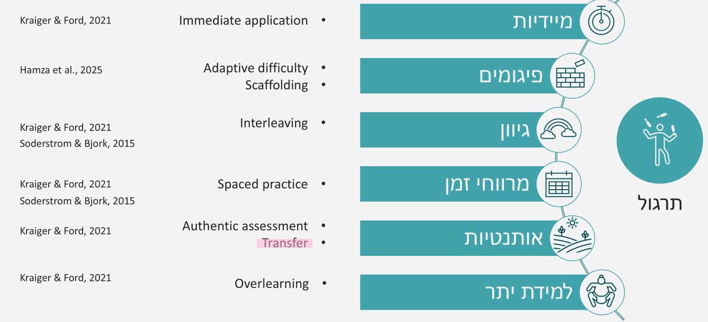

Slide 17
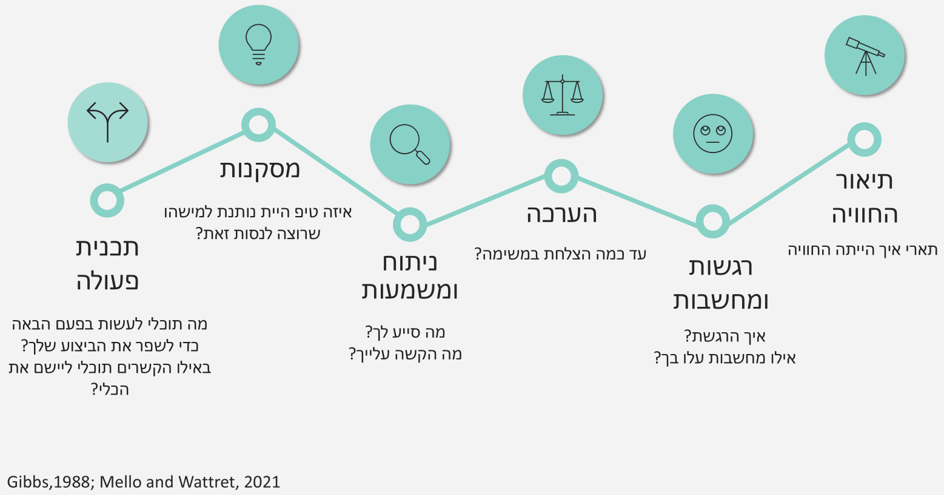

Slide 18
How effective is teacher training?
What characterizes effective teacher training?
Which types of knowledge do teachers need to impart skills?
What pedagogic knowledge do they need?
How specific should skill instruction be?
Which decisions need to be made?

Slide 19



Traits
Enduring skills that are less susceptible to change
Characteristics of the lower competencies
Specific, narrow
Concrete
Multiple
Change over time
Learnable
Measurable
Contextual
Risk of overfitting
Skills
Skills that can be developed
Knowledge
Understanding facts and principles in a specific content area
Olesen et al., 2021, p. 617

Slide 20
Traits
Core skills
Teamwork
Creativity
Subskills
Skills
Characteristics of the lower competencies
Coordination
Fluency
Specific, narrow
Concrete
Multiple
Change over time
Learnable
Measurable
Contextual
Risk of overfitting
Tools
RACI
Brainstorming
Knowledge
The tools are used as aids for learning and performance

Slide 21
Creativity
Core skills
Elaboration
Flexibility
Fluency
Subskills
Design thinking
SIT
Tools
Integrative tools
Brainstorming
Focused tools

Slide 22
Disciplinary skills
Generic skills
Teaching
Creativity
Super skills
Classroom management
Building assignments
Making knowledge accessible
Elaboration
Flexibility
Fluency
Subskills
Tools
Backward Design
Design thinking
SIT
Integrative
Bloom
Brainstorming
Focused

Slide 23
How to choose the level of abstraction?
Generic skills
Creativity
Core skills
Experienced learners
Experienced teachers
Complex task
Project-based teaching
Flexible execution is required, in different contexts, while exercising discretion
Elaboration
Flexibility
Fluency
Subskills
Beginner learners
Less experienced teachers
Structured and explicit teaching
Short-term execution required
A sense of success
Tools
Design
thinking
SIT
Integrative
Brainstorming
Focused

Slide 24
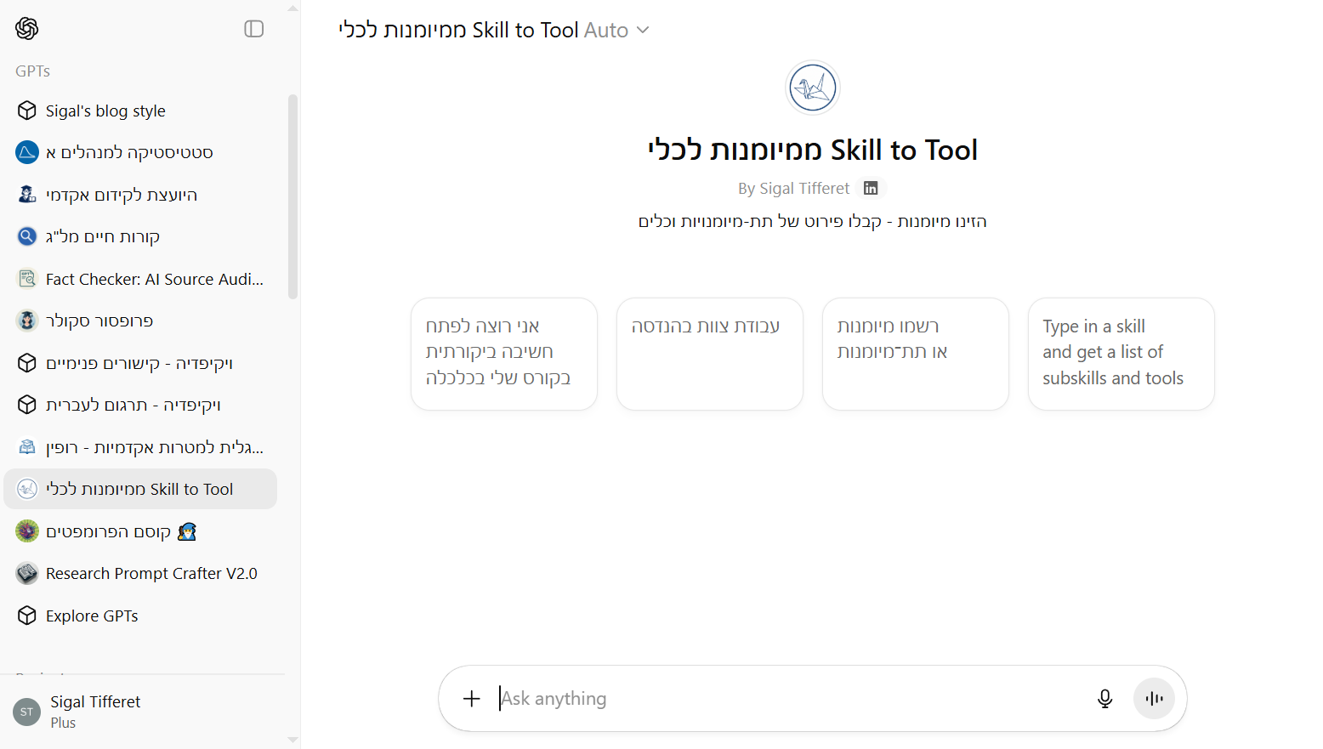


Slide 25
How effective is teacher training?
What characterizes effective teacher training?
Which types of knowledge do teachers need to impart skills?
What pedagogic knowledge do they need?
How specific should skill instruction be?
Which decisions need to be made?

Slide 26
Who will plan?
Teacher
Single activity
Who will teach?
Motivated
Proficient in the skill
Proficient in the pedagogy
External counselor
Full course
Online unit
Teacher team
Teaching and learning center
What to plan?
Planning and teaching

Slide 27
Social and Emotional Learning (SEL) is more than content; how SEL is taught also has powerful influences on its effectiveness
Zieheret al., 2024, p. 4

Slide 28

Modeling
Teachers should model the skills they aim to develop
This is particularly important for skills that are expressed through classroom behavior
Examples include curiosity, critical thinking, and social–emotional skills
When teachers promote a skill but behave in ways that contradict it, the instruction loses credibility and may be counterproductive

Slide 29
Who will plan?
Teacher
Single activity
Who will teach?
Motivated
Proficient in the skill
Proficient in the pedagogy
External counselor
Full course
Online unit
Teacher team
Teaching and learning center
What to plan?
Planning and teaching
Which skill?
Market demands
Core skill
How much time?
One time
Which level of abstraction?
Subskill
Job demands
Educational vision
Tool
Weekly
Skill and practice
Who evaluates?
Self
When to evaluate?
Class execises
What to evaluate?
Peer
Outcome
Process
Teacher
Homework
Assignment
Evaluation

Slide 30
Abrami, PC, Bernard, RM,Borokhovsky, E., Waddington, DI, Wade, CA, & Persson, T. (2014). Strategies for Teaching Students to Think Critically: A Meta-Analysis.Review of Educational Research,85(2), 275–314. https://doi.org/10.3102/0034654314551063
Barbieri, CA, Miller-Cotto, D., Clerjuste, SN, & Chawla, K. (2023). A Meta-analysis of the Worked Examples Effect on Mathematics Performance.Educational Psychology Review,35(1), 11. https://doi.org/10.1007/s10648-023-09745-1
Barnett, SM, & Ceci, SJ (2002). When and where do we apply what we learn?: A taxonomy for far transfer.Psychological Bulletin,128(4), 612–637.https://doi.org/10.1037/0033-2909.128.4.612
Blume, BD, Ford, JK, Baldwin, TT, & Huang, JL (2010). Transfer of Training: A Meta-Analytic Review.Journal of Management,36(4), 1065–1105.https://doi.org/10.1177/0149206309352880
Chadha, D. (2006). A curriculum model for transferable skills development.Engineering Education,1(1), 19–24.https://doi.org/10.11120/ened.2006.01010019
Ciarocco, NJ, &Strohmetz, DB (2018). The Employable Skills Self-Efficacy Survey: An assessment of skill confidence for psychology undergraduates.Scholarship of Teaching and Learning in Psychology,4(1), 1–15.https://doi.org/10.1037/stl0000102
Darling-Hammond, L., Hyler, M., & Gardner, M. (2017).Effective Teacher Professional DevelopmentLearning Policy Institute.https://doi.org/10.54300/122.311
Desimone, LM (2009). Improving Impact Studies of Teachers' Professional Development: Toward Better Conceptualizations and Measures.Educational Researcher,38(3), 181–199.https://doi.org/10.3102/0013189X08331140
Dignath, C., &Veenman, MVJ (2021). The Role of Direct Strategy Instruction and Indirect Activation of Self-Regulated Learning—Evidence from Classroom Observation Studies.Educational Psychology Review,33(2), 489–533. https://doi.org/10.1007/s10648-020-09534-0

Slide 31
El Soufi, N., & See, BH (2019). Does explicit teaching of critical thinking improve critical thinking skills of English language learners in higher education? A critical review of causal evidence.Studies in Educational Evaluation,60, 140–162.https://doi.org/10.1016/j.stueduc.2018.12.006
Fabian, A., Backfisch, I., Kirchner, K., & Lachner, A. (2024). A systematic review and meta-analysis on TPACK-based interventions from a perspective of knowledge integration.Computers and Education Open,7, 100200.https://doi.org/10.1016/j.caeo.2024.100200
Ghielen, STS, VanWoerkom, M., & Christina Meyers, M. (2017). Promoting positive outcomes through strengths interventions: A literature review.The Journal of Positive Psychology, 1–13.https://doi.org/10.1080/17439760.2017.1365164
Gobet, F., & Sala, G. (2023). Cognitive Training: A Field in Search of a Phenomenon.Perspectives on Psychological Science, 18,125-141. https://doi.org/10.1177/17456916221091830
Hamzah, HA, Marcinko, AJ, Stephens, B., & Weick, M. (2025). Making soft skills 'stick': A systematic scoping review and integrated training transfer framework grounded inbehavioralscience.European Journal of Work and Organizational Psychology,34(2), 237–250.https://doi.org/10.1080/1359432X.2024.2376909
Hiemstra, D., & VanYpres, NW (2015). The effects of strength-based versus deficit-based self-regulated learning strategies on students' effort intentions.Motivation and Emotion,39(5), 656–668.https://doi.org/10.1007/s11031-015-9488-8
Hughes, AM, Zajac, S., Woods, AL, & Salas, E. (2020). The Role of Work Environment in Training Sustainment: A Meta-Analysis.Human Factors: The Journal of the Human Factors and Ergonomics Society,62(1), 166–183.https://doi.org/10.1177/0018720819845988

Slide 32
Kalen, A.,Bisagno, E., Musculus, L., Raab, M., Pérez-Ferreiros, A., Williams, A.M., Araújo, D., Lindwall, M., & Ivarsson, A. (2021). The role of domain-specific and domain-general cognitive functions and skills in sports performance: A meta-analysis.Psychological Bulletin,147(12), 1290–1308. https://doi.org/10.1037/bul0000355
Kaminske, AN, Kuepper-Tetzel, CE, Nebel, CL,Sumeracki, MA, & Ryan, SP (2020). Transfer: A Review for Biology and the Life Sciences.CBE—Life Sciences Education,19(3), es9. https://doi.org/10.1187/cbe.19-11-0227
Kraiger, K., & Ford, JK (2021). The Science of Workplace Instruction: Learning and Development Applied to Work.Annual Review of Organizational Psychology and Organizational Behavior.
Li, Z., & Oon, PT (2024). The transfer effect of computational thinking (CT)-STEM: A systematic literature review and meta-analysis.International Journal of STEM Education,11(1), 44.https://doi.org/10.1186/s40594-024-00498-z
Lindvall, J., Kirsten, N.,Ryve, A., & Gustafsson, J.-E. (2025). A critical review and meta-analysis of studies investigating the effects of the professional development teachers typically receive.Studies in Educational Evaluation,86, 101482.https://doi.org/10.1016/j.stueduc.2025.101482
Marin-Zapata, SI, Román-Calderón, JP, Robledo-Ardila, C., & Jaramillo-Serna, MA (2022). Soft skills, do we know what we are talking about?Review of Managerial Science,16(4), 969–1000. https://doi.org/10.1007/s11846-021-00474-9
Mello, L.V., &Wattret, G. (2021). Developing transferable skills through embedding reflection in the science curriculum.Biophysical Reviews,13(6), 897–903. https://doi.org/10.1007/s12551-021-00852-3
Metcalfe, J. (2017). Learning from Errors.Annual Review of Psychology,68(1), 465–489. https://doi.org/10.1146/annurev-psych-010416-044022
National Center for O*NET Development. (2025).The O*NET Content Modelhttps://www.onetcenter.org/content.html#cm2
Olesen, KB, Christensen, MK, & O'Neill, LD (2021). What do we mean by "transferable skills"? A literature review of how the concept is conceptualized in undergraduate health sciences education.Higher Education, Skills and Work-Based Learning,11(3), 616–634. https://doi.org/10.1108/HESWBL-01-2020-0012
Ren, J., Wang, M., & Conway, CM (2024). Can explicit instruction boost statistical learning? A meta-analytical review.Journal of Educational Psychology,116(7), 1215–1237. https://doi.org/10.1037/edu0000897
Sala, G., & Gobet, F. (2017). Does Far Transfer Exist? Negative Evidence From Chess, Music, and Working Memory Training.Current Directions in Psychological Science,26(6), 515–520.https://doi.org/10.1177/0963721417712760
Schutte, NS, & Malouff, JM (2019). The Impact of Signature Character Strengths Interventions: A Meta-analysis.Journal of Happiness Studies,20(4), 1179–1196.https://doi.org/10.1007/s10902-018-9990-2

Slide 33
Sims, S., Fletcher-Wood, H., O'Mara-Eves, A., Cottingham, S., Stansfield, C., Goodrich, J., VanHerwegen, J., & Anders, J. (2025). Effective Teacher Professional Development: New Theory and a Meta-Analytic Test.Review of Educational Research,95(2), 213–254.https://doi.org/10.3102/00346543231217480
Soderstrom, NC, & Bjork, RA (2015). Learning Versus Performance: An Integrative Review.Perspectives on Psychological Science,10(2), 176–199.https://doi.org/10.1177/1745691615569000
Teo, T., Unwin, S., Scherer, R., & Gardiner, V. (2021). Initial teacher training for twenty-first century skills in the Fourth Industrial Revolution (IR 4.0): A scoping review.Computers & Education,170, 104223.https://doi.org/10.1016/j.compedu.2021.104223
Valtonen, T., Sointu, E., Kukkonen, J., Kontkanen, S., Lambert, MC, & Mäkitalo-Siegl, K. (2017). TPACK updated to measure pre-service teachers' twenty-first century skills.Australasian Journal of Educational Technology,33(3).https://doi.org/10.14742/ajet.3518
Van Der Kleij, FM,Feskens, RCW, & Eggen, TJHM (2015). Effects of Feedback in a Computer-Based Learning Environment on Students' Learning Outcomes: A Meta-Analysis.Review of Educational Research,85(4), 475–511.https://doi.org/10.3102/0034654314564881
Vincent-Lancrin, S., González-Sancho, C., Bouckaert, M., De Luca, F., Fernández-Barrera, M., Jacotin, G.,Urgel, J., & Vidal, Q. (2019).Fostering Students' Creativity and Critical Thinking: What it Means in SchoolOECD.https://doi.org/10.1787/62212c37-en
Visscher, A.J.,Dmoshinskaya, N., Pellegrini, M., & Rey-Naizaque, A. (2025). (When) do teacher professional development interventions improve student achievement? A meta-analysis of 128 high-quality studies.Educational Research Review,49, 100742.https://doi.org/10.1016/j.edurev.2025.100742
Wong, SSH (2023). Deliberate Erring Improves Far Transfer of Learning More Than Errorless Elaboration and Spotting and Correcting Others' Errors.Educational Psychology Review,35(1), 16. https://doi.org/10.1007/s10648-023-09739-z
World Economic Forum. (2025).Future of Jobs Report 2025https://www.weforum.org/publications/the-future-of-jobs-report-2025/digest/
Ye, J., Lai, X., & Wong, GK (2022). The transfer effects of computational thinking: A systematic review with meta-analysis and qualitative synthesis.Journal of Computer Assisted Learning,38(6), 1620–1638.https://doi.org/10.1111/jcal.12723
Zieher, AK, Bailey, CS, Cipriano, C., McNaboe, T., Smith, K., & Strambler, MJ (2024). Considering the "How" of SEL: A framework for the pedagogies of social and emotional learning.Social and Emotional Learning: Research, Practice, and Policy,3, 100030.https://doi.org/10.1016/j.sel.2024.100030

Slide 34



@SigalTifferet
sigtif.wordpress.com

