Slide 1
Default or Design
Why the Teacher's Role in the AI Era
Is a System Architecture Problem
Danielle Eisenberg
Ignite/Ed Consulting
International STEM Skills Roundtable — Meeting 4

Slide 2
Danielle
Eisenberg
A system designer — not a theorist
1
A commitment to ensuring that the tools, strategies, and interventions we put in front of ALL students are evidence-based and impactful.
25 years working in education systems
14 years running research, evaluation, data, and assessment for the US’s largest Charter School network (KIPP)
Consulting clients include Walton Foundation, Charter School Growth Fund, ETS, and many school networks.
Founder, Ignite/Ed Consulting
Executive Director, Product Strategy: Skills for the Future, ETS
2
Research & Evaluation Strategy, Innovative Program Design, Data and Assessment Systems, Far Future Measurement
3
Durable skills assessment systems,
AI-assisted scoring, Competency
based transcripts
4

Slide 3
THREE QUESTIONS FOR OUR DISCUSSION
We'll return to these at the end.
01
What does it look like for a teacher to govern the student–AI layer — not just permit or prohibit it?
02
We can see AI use. We cannot yet see the thinking around it. What would it take — in assessment, policy, practice — to make that learning visible?
03
Privileged students augment with AI; disadvantaged students replace thinking. If equity depends on design, who is responsible — and what authority do they have?

Slide 4
AI is not a tool we insert into a system.
It is a role-fluid agent — and the system is already layered.
AI can simultaneously act as:
The system is layered — not triangular
Content
Student ↔ AI
Unavoidable — happening now, with or without school's permission
the material being learned
Tutor
explaining & scaffolding
Teacher ↔ Student
Irreplaceable — trust, mentorship, identity, motivation
Evaluator
assessing & giving feedback
Teacher ↔ AI
Underspecified — this is the new professional role
Collaborator
co-creating with the student
he system only works if the interaction between the layers.
Wang & Fan meta-analysis (2025), Nature H&SS — teacher-scaffolded AI use → stronger outcomes; independent use → dependency

Slide 5
Without intentional design, three failure modes are already observable.
01
Cognitive Offloading — Higher confidence in AI → less critical thinking effort, not more.
Lee et al., Microsoft Research / CHI 2025
02
Relationship Erosion — 50% of students feel less connected to teachers when using AI — preferring AI because "it's not going to judge you."
CDT / Education Week 2025 · Univ. of Pittsburgh / Fast Company 2025
03
Hidden Inequity — Privileged students augment. Disadvantaged students replace thinking. Same tool — opposite outcome.
Brookings Global Task Force (2026) · brookings.edu
Case: Khan Academy's own founder on Khanmigo: "For a lot of students, it was a non-event. They just didn't use it much." His pivot: "Our biggest lever is investing in the human systems." — Barnum, Chalkbeat, April 9 2026

Slide 6
The hardest part isn't the AI. It's seeing what learning is actually happening inside it.
WHY THIS MATTERS
WHAT BUILDING IT REVEALS (SFF Project)
1
All three models — teacher-led, triangle, direct — lose the same thing without new assessment: visibility into process, not just products.
1
Context is signal, not noise. Skills only exist meaningfully in context — our AI engine is built to ingest it, not strip it.
2
Traditional assessment measures outputs. It cannot detect shallow AI use, equity gaps, or whether the triangle is actually producing learning.
2
AI proposes. Teachers decide. AI surfaces skill evidence with confidence ratings. The teacher — who knows this student — is the interpretive layer.
3
What you cannot see, you cannot improve — and you cannot hold accountable for equity.
3
Patterns beat single artifacts. One essay is weak signal. A notebook + reflection + peer review, read together, produce something defensible.
Zheng (2021) Frontiers in Psychology — teacher credibility directly predicts learning outcomes | doi.org/10.3389/fpsyg.2021.712419

Slide 7
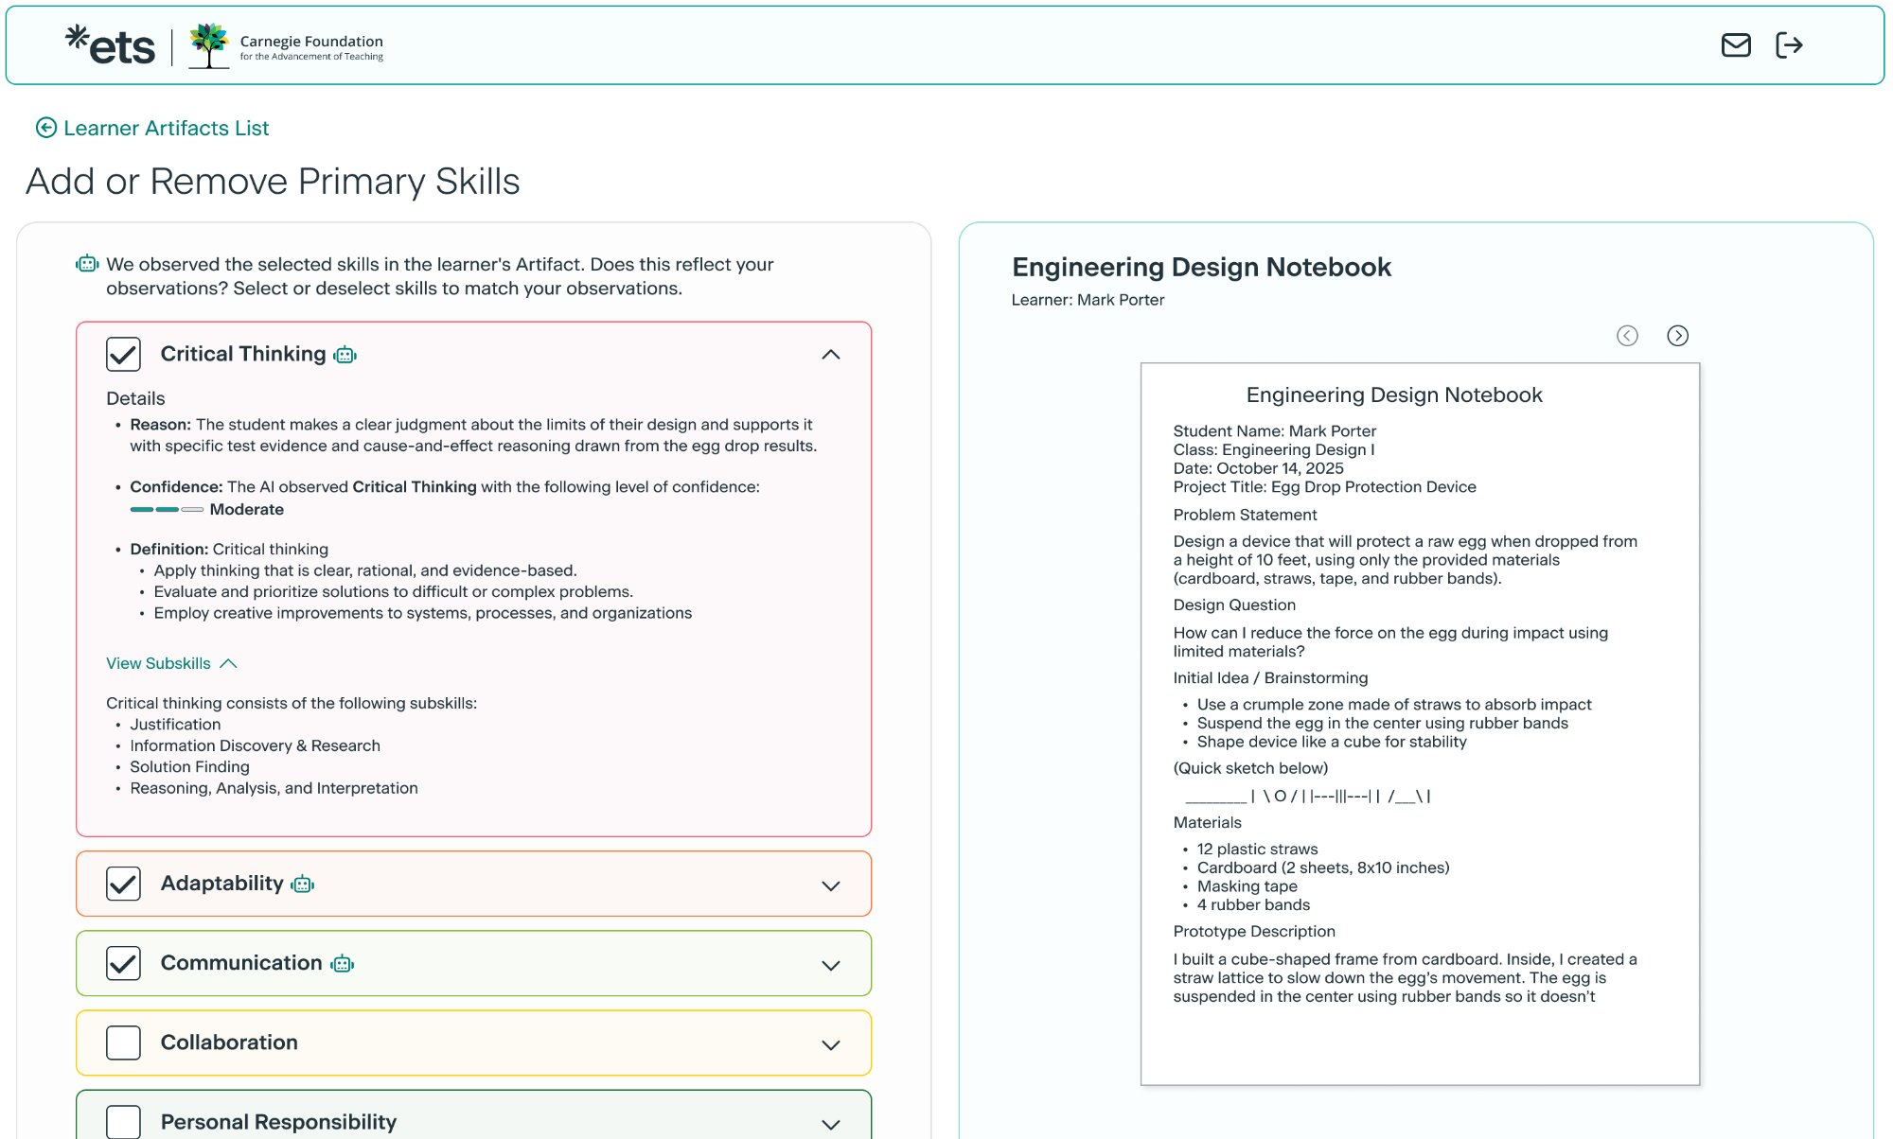
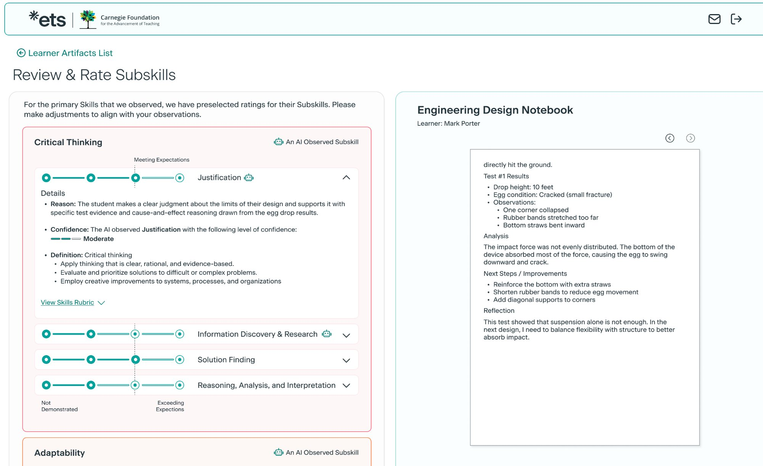
What this looks like in practice – SFF Example
AI proposes. The teacher — who knows the student and the context — decides.
1
Authentic student work enters as evidence — artifact type shapes evidential weight
2
AI proposes skills with confidence ratings — teacher accepts, overrides, or adjusts
3
Subskill ratings flagged AI-observed — teacher judgment is structurally required
AI proposes → educator confirms or overrides
AI reducing cognitive load of evidence review so teachers invest judgment where it matters most.
AI simulations or “direct assessments” w/ students used to boost evidence & validity signal and elicit more evidence and context for student skill development
AI-observed flag on subskills → educator adjusts

Slide 8
There are two triangles — and they must be designed together.
LEARNING TRIANGLE
MEASUREMENT TRIANGLE
Student ↔ AI
Direct learning interaction — already happening
AI proposes
Identifies evidence, rates confidence — explicit audit trail
→
Teacher ↔ Student
Mentorship, trust, motivation — irreplaceable
Teacher interprets
Applies contextual knowledge AI cannot hold — calibrates meaning
Teacher ↔ AI
Governing the interaction — the underspecified layer
System aggregates
Cross-artifact patterns build defensible cumulative evidence
This is how we keep humans in the loop where context matters most — by design, not default.

Slide 9
THREE QUESTIONS FOR OUR DISCUSSION
01
What does it look like for a teacher to govern the student–AI layer — not just permit or prohibit it?
02
We can see AI use. We cannot yet see the thinking around it. What would it take — in assessment, policy, practice — to make that learning visible?
03
Privileged students augment with AI; disadvantaged students replace thinking. If equity depends on design, who is responsible — and what authority do they have?

Slide 10
Appendix
1
2
3
4

Slide 11
Equity, Implications, and Where We End
The Promise
The Reality
Bloom's Two Sigma (1984): 1:1 tutoring = 2 SD improvement. AI as personal tutor could be the most democratizing force in education history.
Privileged students augment. Disadvantaged students replace thinking. Same tool — opposite outcome. This is a design failure.
Brookings Global Task Force (2026) · 50 countries · brookings.edu
POLICY
PRODUCT
EDUCATION SYSTEMS
→ Fund the teacher's role as system designer → Require assessment infrastructure that sees inside learning → Define AI as a policy lever — with equity guardrails
→ Human-in-the-loop as core architecture, not compliance → Build for the margins first → Separate demonstration from confidence level
→ Train teachers in evidence design, not just AI tools → Create time for contextual judgment → Treat AI navigation as a core STEM competency

