Slide 1
STEM skills for teachers
Russell Tytler Professor of Science Education Deakin University
Notes:
Accessibility requirements for template users
This PowerPoint template has been created with a number of in-built accessibility options.
When working with this template, there are a few things you will need to do within the file to ensure that it meets Deakin’s accessibility requirements when documents, or exported pdf files, are shared with others or placed online.
Font styles
Only use the provided heading styles and text styles as pre-set in the template
ALT text
All images and graphics, backgrounds, logo and brand shapes need to have ALT text added to describe the image or be indicated as decorative. Elements provided within the template have had this added, but if you make any changes or add your own images/replace any default imagery, you will need to ensure ALT text is added.
If an image is also a hyperlink provide the destination in writing, for example an image of a ‘Hand holding a pen writing in a notebook’ that hyperlinks to Deakin homepage should also explain that the link goes to that page.
ALT text can be added by right clicking on the image/graphic and selecting ‘Edit alt text’ from the window.
Tables
All tables are required to include alt text.
The first row in a Word table can be identified as a header row/table title which can help screen reader users identify what the table content is about and whether they want to read it.
Where tables are already included, a basic form of ALT text will have been added, but you will need to add your own by going into the ‘table properties’ for each table, and clicking on the’ Alt text’ tab, and then completing the fields to provide a suitable description of your content.
Accessibility checker
Word has an inbuilt accessibility checker which can help to flag issues – go to ‘Review > Check accessibility’ in the toolbars.
Saving as a pdf
When saving your file as a pdf, note that using the ‘Print to PDF’ option doesn’t keep any inbuilt accessibility features. Instead use the ‘Save As > PDF’ option, and check that “Document structure tags for accessibility” is selected

Slide 2
The STEM skills I will focus on
The main skills:
Self-directed learning and lifelong learning;
Teamwork, cooperation/collaboration and interpersonal communication;
Complex problem solving and critical thinking.
Other core generic competencies:
Innovation, creativity and entrepreneurship;

Slide 3
The argument
The question of teachers’ STEM skills is very different for primary vs. secondary teachers.
Secondary teachers’ STEM commitments and skills are developed through prior experience and through their STEM degrees and subsequent careers.
In teacher education the main focus is on translating these skills and dispositions into classroom practice – on pedagogical content knowledge and unpacking the nature of these skills.
This is particularly important given the ‘practice turn’ in STEM curricula
Doing this effectively involves having high level skills, dispositions and PCK

Slide 4
Characterising and developing teachers’ STEM skills

Slide 5
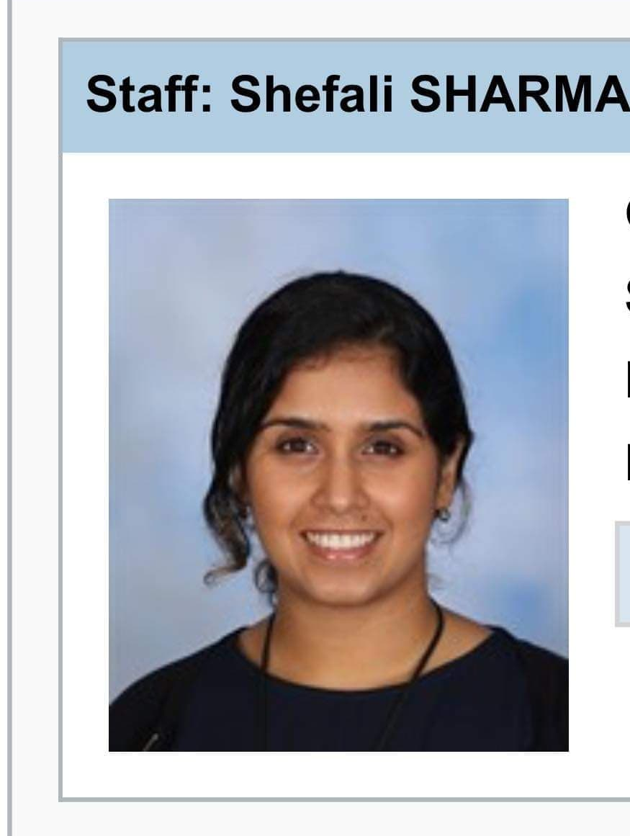
Dimensions of STEM Teacher Identity
Values and beliefs
Mindsets
Personal
Teacher
Disciplinary
STEM
Educational views Commitment to pedagogy What they deem important in young people’s development
Sense of knowledge and epistemic practices of the discipline
Sense of self-efficacy
Commitment to discipline and student’s learning of the discipline
Notes:
A quick recap.
Theoretically, these distinctions were all great, and they made sense. Practically, though, when I tried to “dissect” my participant’s identities, it was far more complex. And I’ll expand on this further by going through three teacher examples.

Slide 6
Teachers teaching integrated STEM subjects
Teachers were committed to teaching this curriculum because it freed them from the constraints of the mono- disciplinary subjects and focused on the competencies they themselves valued and felt they could effectively impart.
For example: Amelia -
“…but I’m really interested in learning about new things, and it’s what excites me about STEM or other ways of education- it’s about how we can do things differently and look at what is of interest to students and what can.. you know, what skills they can develop, and capabilities they can develop, to take them into their future.”

Slide 7
Amelia
STEM
“…in society when we see STEM people automatically, or from my experience, it’s around more technology, design thinking aspect of it. Whereas I also think of STEM as developing empathy and understanding and care for and connection with, rather than just solving a problem. And I know design thinking thinks about empathy but I would like to see STEM more broadly based…
...I mean, you’ve got literacy and you know, like it’s holistic, so I think the acronym of STEM perhaps is becoming a bit outdated and needs to be thought of in a more holistic way about what education is, not just focusing on STEM.”
“it’s about good teaching and knowing your students and, you know, helping them to be who they want to be and to realise some success.”
“I suppose there’s lots of things to consider that’s different to perhaps a traditional classroom that may have students sitting in rows copying notes down. So I think, for me, a STEM activity, which is very different from perhaps a more transmissive approach to teaching.”
Personal
“I’m really interested in learning about new things, and it’s what excites me about STEM or other ways of education”
Teacher
“I think we’re a teacher of not just a subject, we’re a teacher of life skills”
“It’s not just about teaching content, it's about these people being good citizens and showing an interest in science and care for their country.”
Disciplinary
“what underlies it all is my passion for science”
Notes:
Her view of STEM very much connects with how she was initially trained to teach, when she started teaching in the early 90s (approximately). Throughout her interview, she mentioned that the teaching style at her school used to be more integrated and so they had been doing STEM without calling it STEM. However, her use of the word “transmissive” highlights this contrast in her preferred approach vs what she notices in specific discipline or subject classes.
This is not to say that their discplinary identity isn’t shaping their STEM identity or preferences at all, but it seems, at least from the time I spent with her, that more is being drawn from her personal and teacher identities.

Slide 8
Deborah de Ridder University of Technology, Sydney Expert teachers guiding a Year 12 “Depth Study” in NSW, Australia

Slide 9
Teacher Guidance During Conceptualisation
Regulation Practices (Dobber et al., 2017)
Levels of Guidance (Lazonder and Harmsen, 2016)
Regulation Practices
Levels of Guidance
Explanations
Scaffolds
Heuristics
Prompts
Status overviews
Process constraints
Metacognitive regulation
Social regulation
Conceptual regulation
Notes:
Expert teachers in this study wanted their students to be able to regulate their own learning. They also realised that some guidance was required to ensure that learning was progressing. Each study participant regularly interacted with their students and their interactions had a purpose and a specific level of guidance to challenge their students. They ensured that all students were able to progress their projects.
Collected data of teacher guidance was analysed according to two known typologies: Regulation practices which provides the purpose of teacher guidance and Levels of guidance which differentiates the practices of teachers. In this study both were observed together so it made sense to use dual typologies.
Regulation practices include metacognitive regulations which was dominant during the conceptualisation phase of the inquiry which involved guiding students to think about their learning and think critically. Of lower importance was social regulation which required teachers to guide the social aspects of learning and conceptualization which was mostly about guidance related to procedure. Levels of guidance differentiated this guidance.

Slide 10
Metacognitive Regulation
Interrupting student work: How are you going? (Megan)
Heuristic
“Why don’t you try…?” (Megan)
Prompt
“That might work, keep developing that question…” (Erin)
Status overview
A checkpoint of student work (Megan)

Slide 11
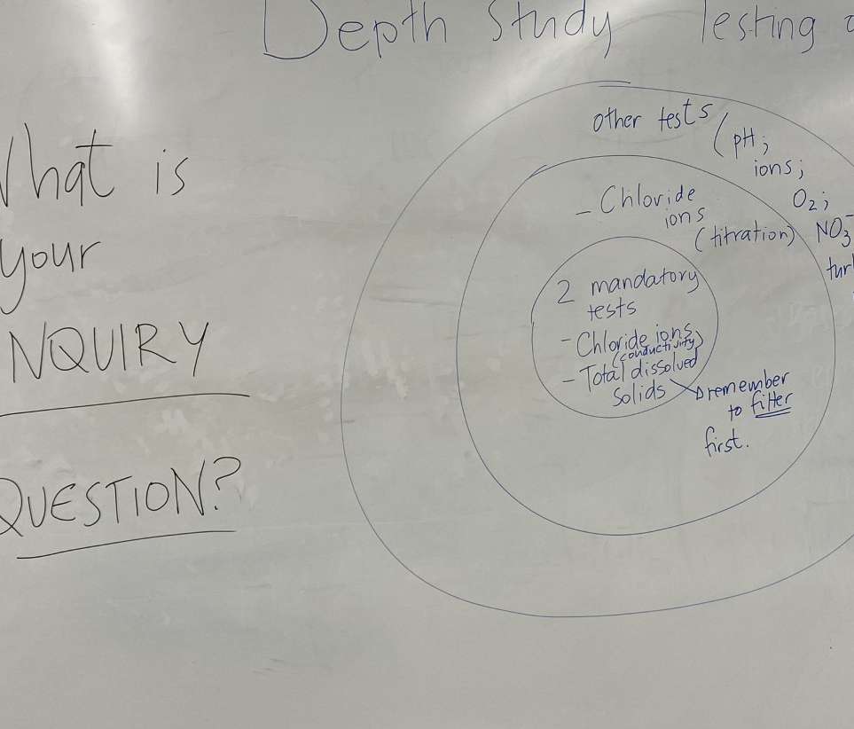
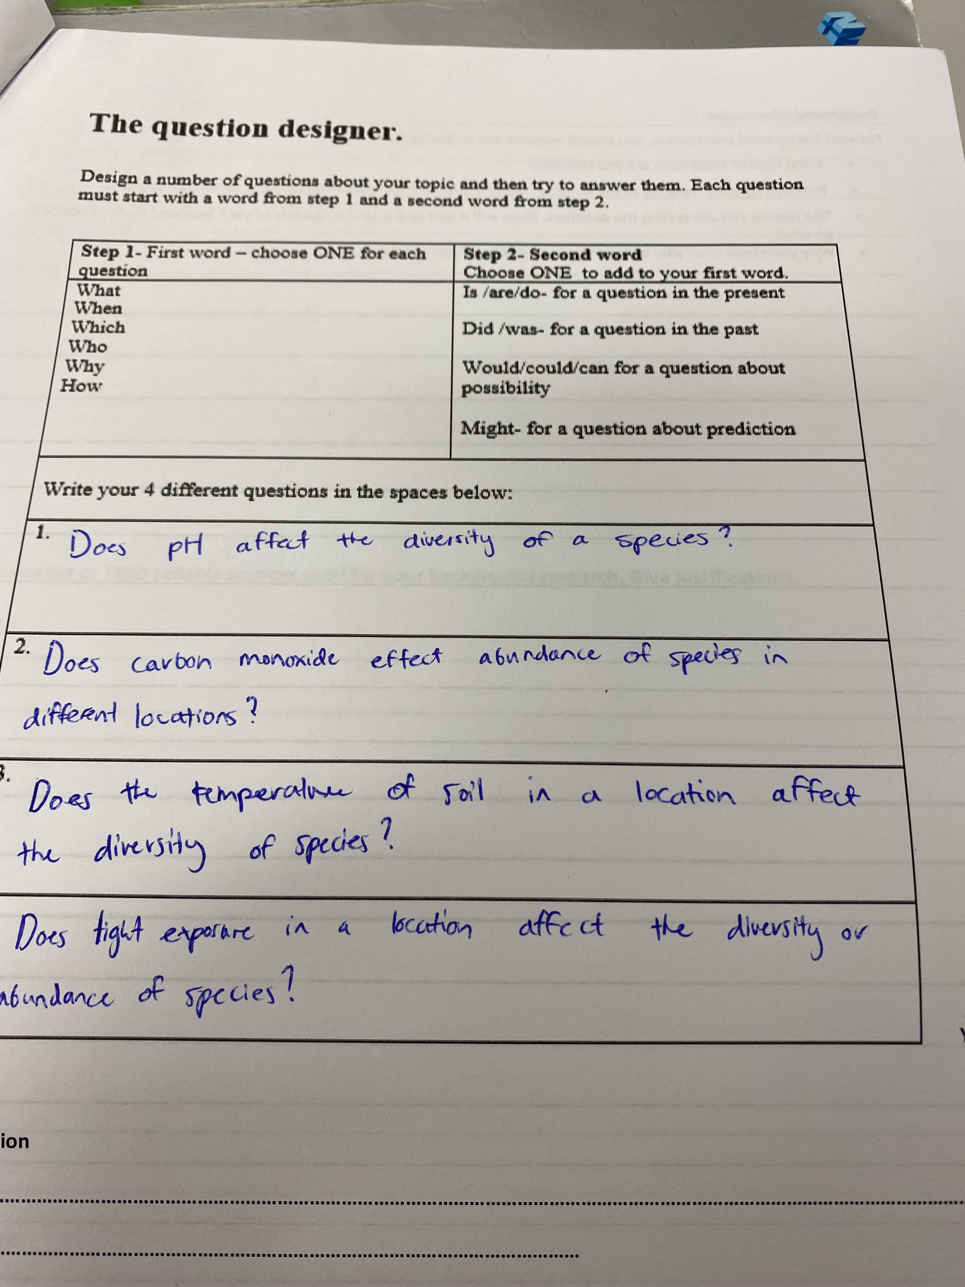
Conceptual Regulation
Procedural Guidance
Explanation, Cockatoo High School
“What are you going to measure?” (Erin)
Prompt, Currawong High School
Scaffold, Currawong High School

Slide 12
Social Regulation
Regulation of the Social Aspects of Learning
Explanation
communicated expectations about laboratory safety for group work
Heuristic Verbal hints relating to group member roles
Prompt Robin smiled and nodded at a student group that had organised group roles
Notes:
Explanations explicit instruction at the start of the lesson to communicate expectations and provide laboratory safety expectations for group work
Heuristics Verbal hints relating to group member roles
Prompts Robin smiled and nodded at a student group that had organised group roles.

Slide 13
Rising to the Challenge
Expert Teachers Approaches to Pedagogical Challenges
Phased instructional practice
Adaptive and differentiated
Interrupted students to ask questions
A focus on metacognitive regulation
Explicit instruction supports procedure
Notes:
Phased instructional practice: 5 distinct phases were observed. Students were provided with explicit lesson intentions at the start of every lesson and every phase.
Adaptive pedagogical approaches: Being able to make spontaneous, yet informed decisions. Vygotsky’s zone of proximal development was evident with teachers supporting students to develop their practices beyond their current level of comfort
Differentiated practice: Being able to decide on an appropriate level of guidance and regulation practice suited to each student. All teachers knew their students well and had formed a supportive relationship with their students
Use of high press questions: Teachers asked many high press questions as questions that ignited thinking and discussion. Rarely used closed questions or answered students questions directly
Interrupting students to ask questions: They didn’t wait until students came to them, they circulated from group to group and asked them questions to ignite discussion.
They focused on requiring the students to think through their approached and focused on metacognitive regulation.
Surprisingly, explicit instruction was used to provide lesson intentions, convey safety information, and to provide a suggested process for developing inquiry questions.

Slide 14
How does a science degree develop these skills? The case of Deakin

Slide 15
Evolution toward authenticity in learning, focused on skill development
Significant shift over past two decades to increase work-integrated learning and authentic assessment in science degrees
Push from 2014-2015 toward more hands-on, on-site experiences and tasks students perform outside the university
Accreditation of environmental science courses by peak body, validating industry-relevant skill development

Slide 16
Deakin’s program to develop STEM skills within undergraduate degrees
There was a renewed focus on
career and employability outcomes.
work-Integrated Learning and employable skills.
work-related and transferable skills and authentic experience and assessment.
Deakin embarked on a program to develop assessments that
1) demonstrated skills that will be used in future workplaces,
2) tested scientific concepts (not memorisation),
3) involved using critical thinking or problem-solving skills, and
4) included student choice or input into the assessment.

Slide 17
Pattern of units within the faculty
Professional practice
Core unit for six of seven science courses requiring students to self-source industry placements aligned with career goals
Students must complete 80+ hours in research institutes, pathology labs, or organizations like CSIRO or Parks Victoria
Community Science project
Students work in multidisciplinary groups on client projects, delivering products like websites, marketing materials, teaching resources, or program evaluations
Assessment includes team goal-setting, individual goals, client communication, and final presentations
Strong emphasis on teamwork, coordination, and professional communication with external clients

Slide 18
Pattern of units within the faculty
Research Methods and Data Analysis
Core unit for five of seven courses teaching statistical methods using contemporary software, coding
Students hypothesise, analyze real or online datasets, form conclusions, and write up findings
Applications of Biomedical Science
Students design and execute their own research projects in groups on assigned topics
Communicating Science
Focuses on science communication through blogs, critiques of articles, and potentially video production
Includes both group and individual work components

Slide 19
Deakin Talent Freelancing Hub
Multidisciplinary student teams are assembled for external client projects over trimester duration
Deakin Talent recruits, screens, and interviews students based on project needs (IT, business, arts, science students)
Professional project managers mentor teams through deliverables; clients attend final presentations
Recently expanded to include Creative Hub for Faculty of Arts

Slide 20
Review of STEM skills
The main skills:
Self-directed learning and lifelong learning;
Teamwork, cooperation/collaboration and interpersonal communication;
Complex problem solving and critical thinking.
Other core generic competencies:
Innovation, creativity and entrepreneurship;

Slide 21
Teacher Education: Primary Science Education representing Deakin semiotic research Kirk, M., Tytler, R., & White, P. (2023). Critical thinking in primary science through a guided inquiry pedagogy: A semiotic perspective. Teachers and Teaching, 29(6), 615–637. https://doi.org/10.1080/13540602.2023.2191181

Slide 22
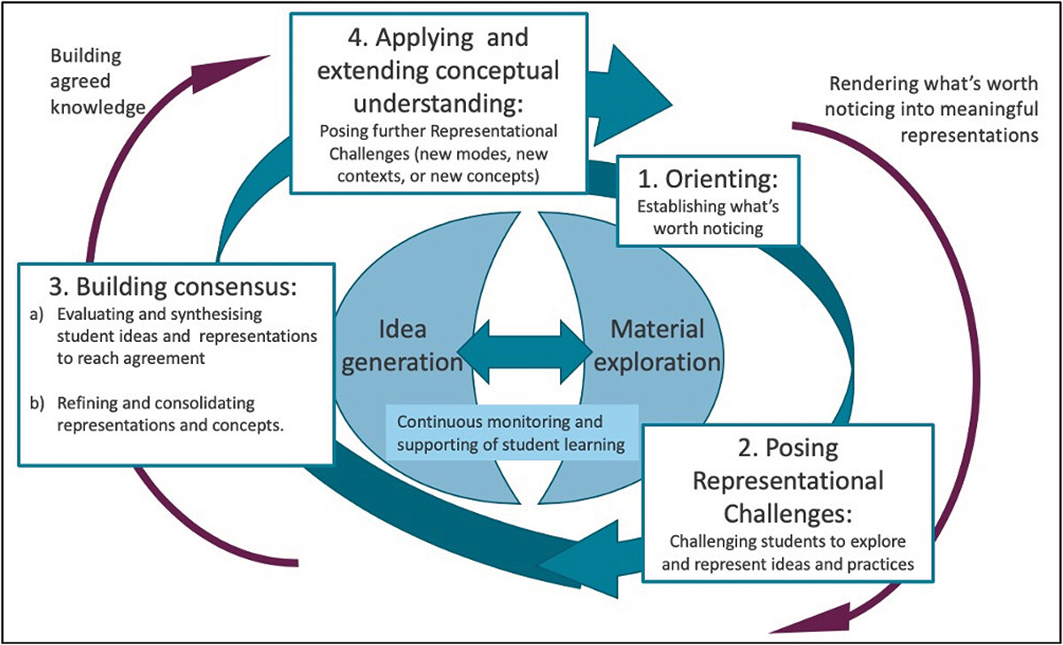
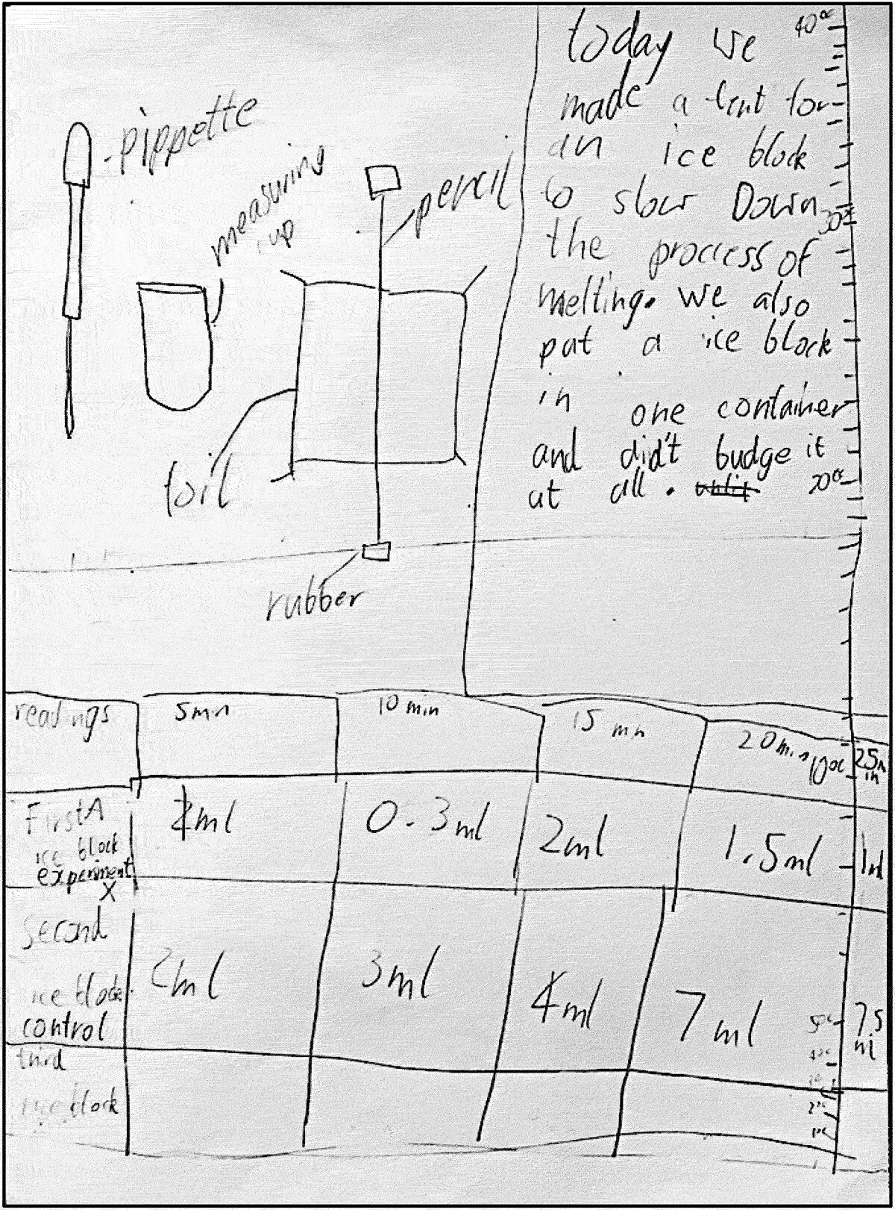
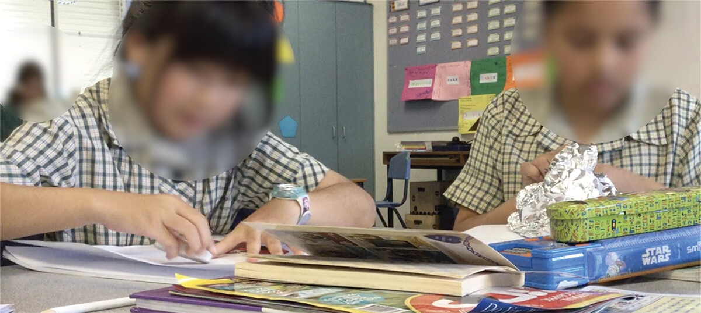
Grade 3: Designing a method of slowing down ice melt

Slide 23
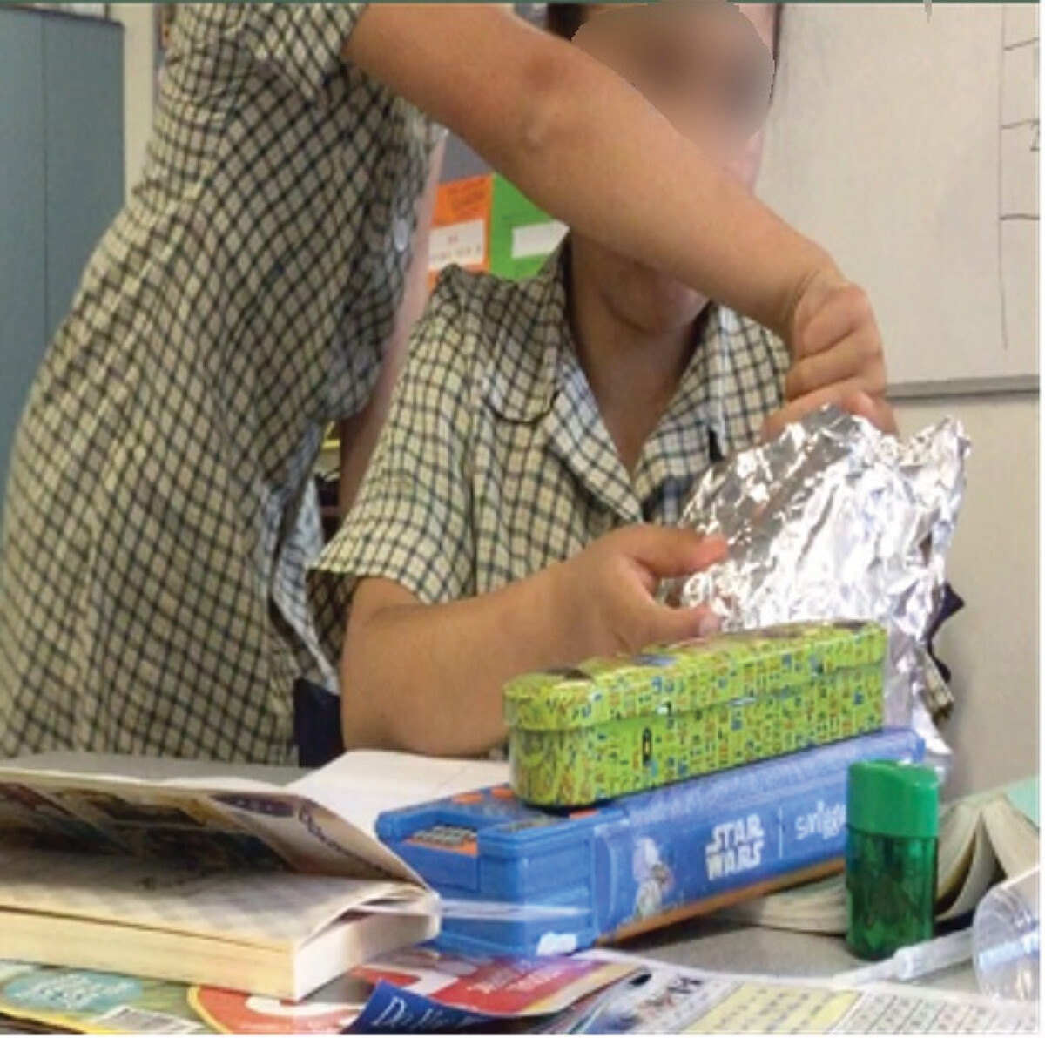
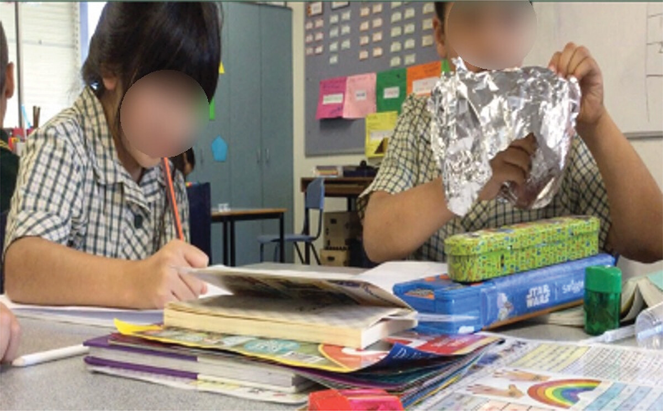
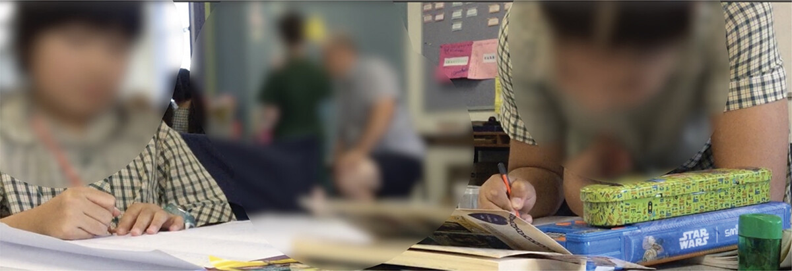
Embodied and visual modes, collaboration

Slide 24
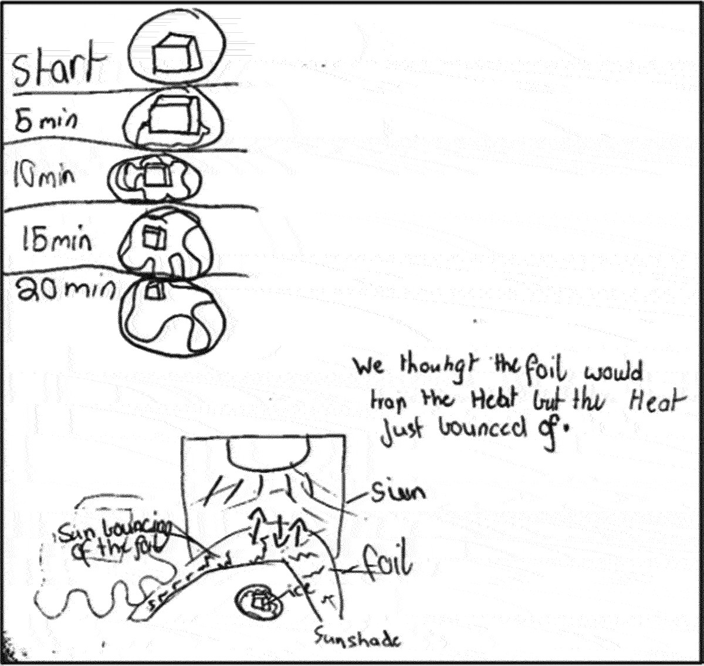
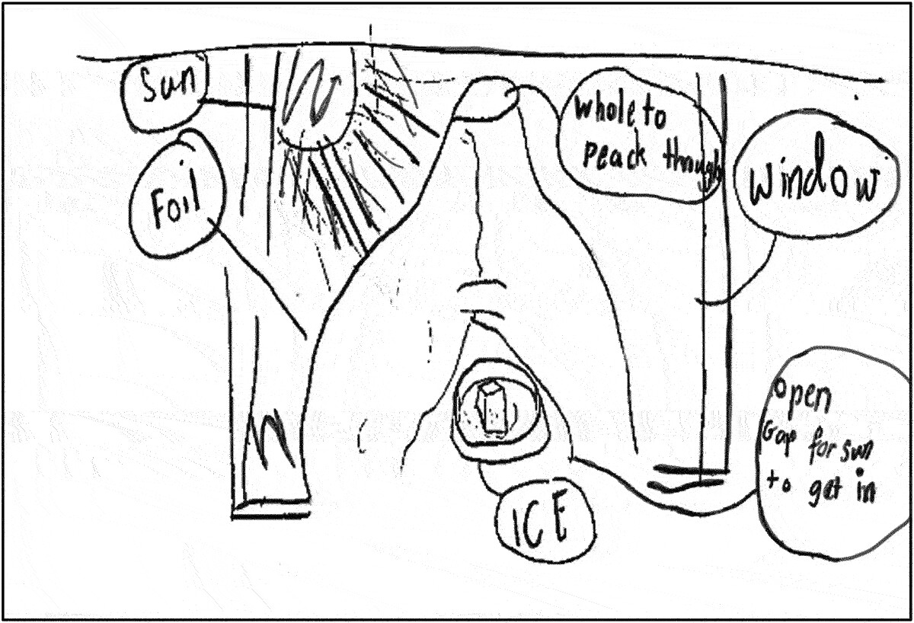
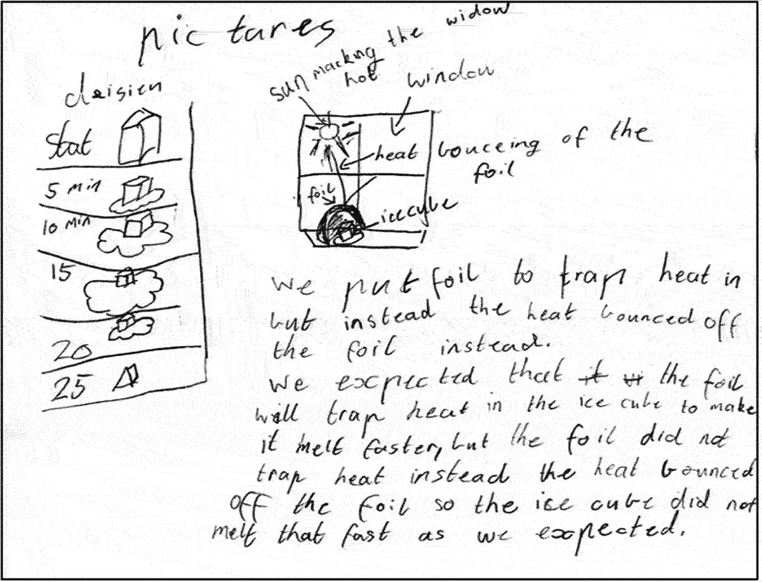
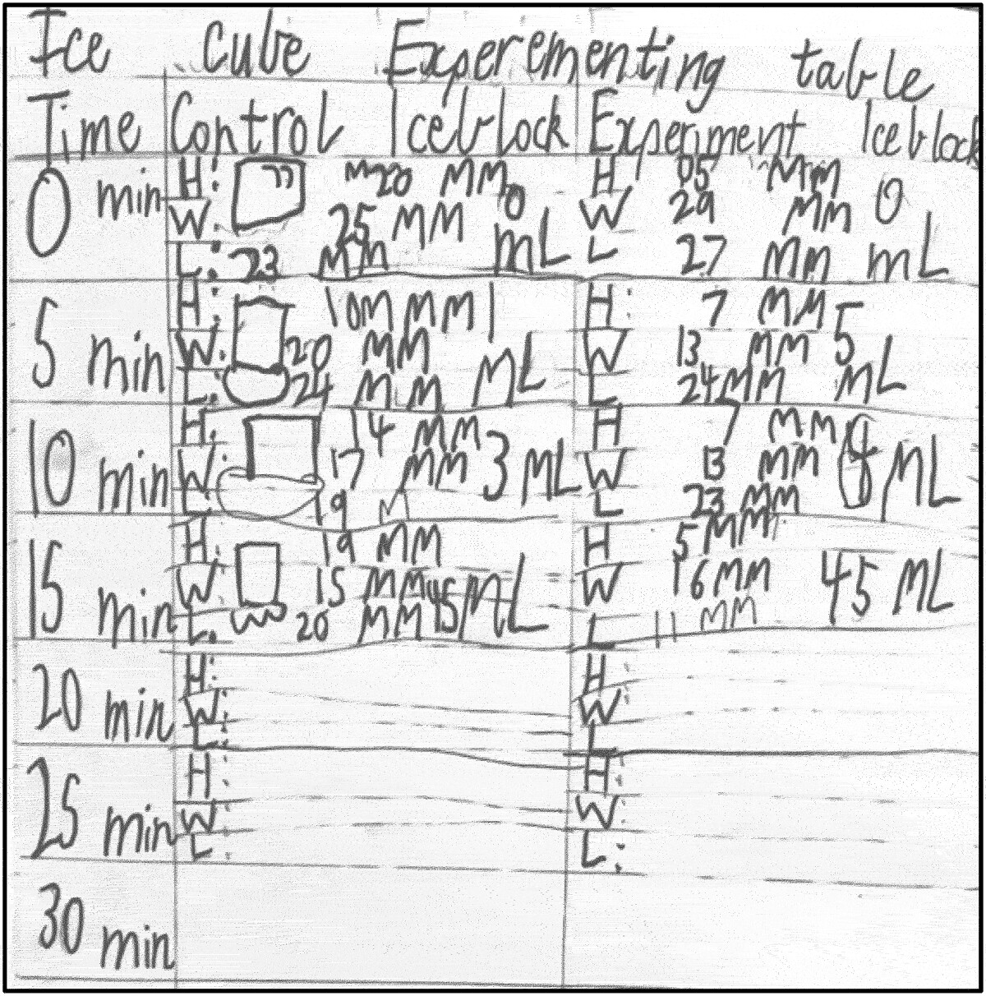
Visual, written explanatory text

Slide 25
Critical thinking is grounded in the disciplinary specific semiotic systems of the discipline
In this learning sequence a range of representational tools specific to science are evident; annotated diagrams with arrows representing heat exchange, spatial visualisations of the sun in relation to the models, causal statements with evidence grounded in material observation, structural models following engineering principles, sequenced diagrams showing the process of ice melting, and tables showing patterns of measures. Thus, while the critical thinking literature is cast in general terms implying logical relations such as analysis, evaluation, synthesis, inference, and explanation, inevitably it must draw on the disciplinary specific semiotic systems through which reasoning proceeds, and evidence is related to ideas. While critical thinking can be characterised as a general capability, its educative expression must lead to competence with the specific representational forms of the discipline.

Slide 26

Thank you

