Slide 1
Balancing In-Person vs. Computer-Based & AI Experiences in Education
S. Emlen Metz
University of California, Berkeley

Slide 2
Roadmap
Contrast of Virtual to Real Environments
Affordances of genAI in Education
Dangers of Computers & AI in Education
Challenges in Adaptation to genAI
Best Uses of genAI
Guiding Principles for Education in AI Era
Recommendations
Discussion Questions

Slide 3
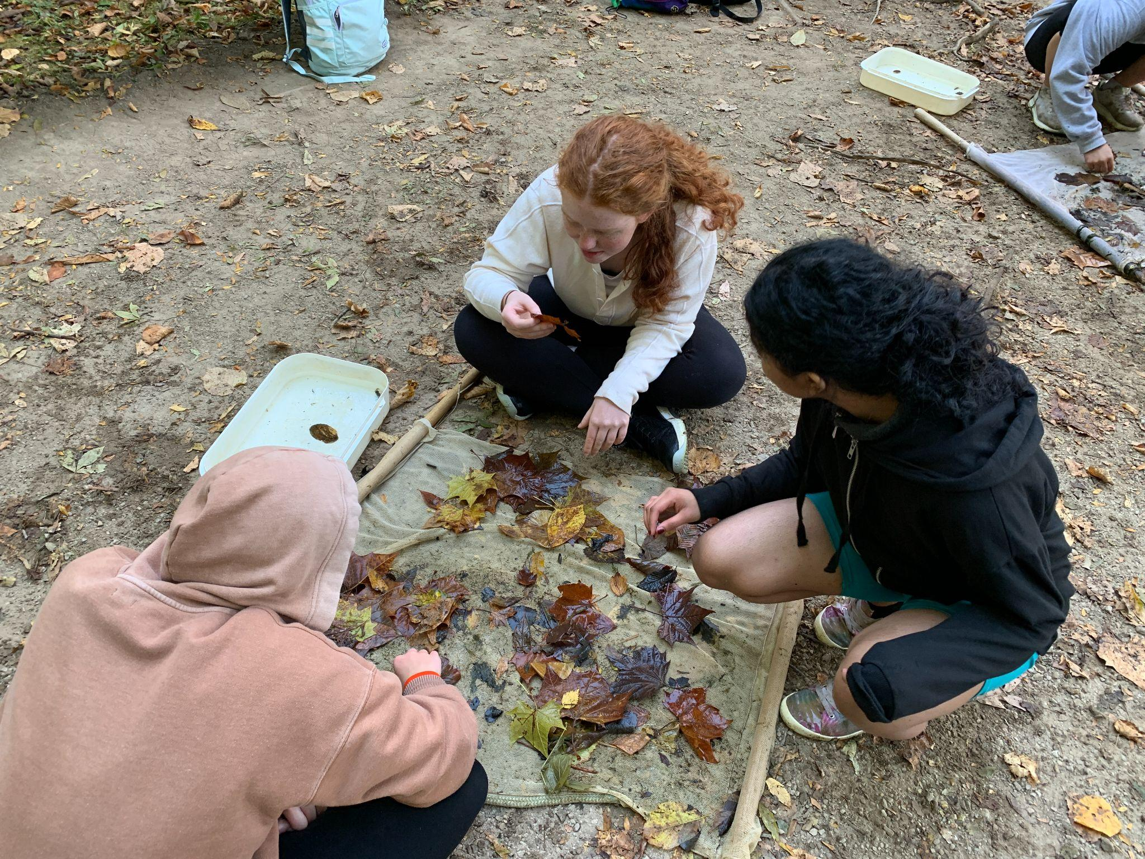

Virtual vs. Real
Virtual
Real
Opens possibilities
Adaptable
Easier to control
Easier to observe
But:
Removed from reality
Removed from other people
Shallower sensory & embodied experiences
Real objects to explore by hand
Real people to collaborate with face-to-face
Full sensory & embodied experiences possible
But:
Limited by available materials & spaces
Results of labs & social interactions are unpredictable
Typically poor teacher-student ratio

Slide 4
Affordances of Computers & genAI in Education
Personalization
Individualized start
Individualized pace
Performance tracking
Reading level translation
Flexibility
Of time and space
Modified systems for students with disabilities
Of learning pathways
Teacher Aid
Auto-scoring
Rapid feedback on writing (genAI)
Faster materials (genAI)
Notes:
Critical conversation with AI supports critical thinking if used to generate counterarguments & questions, not supporting arguments and answers

Slide 5

Dangers of AI in Education
Social Erosion
Motivation (Kapur, Sharkey, & Ren, 2026)
Trust between student and teacher
Academic integrity
Social connectedness

Slide 6
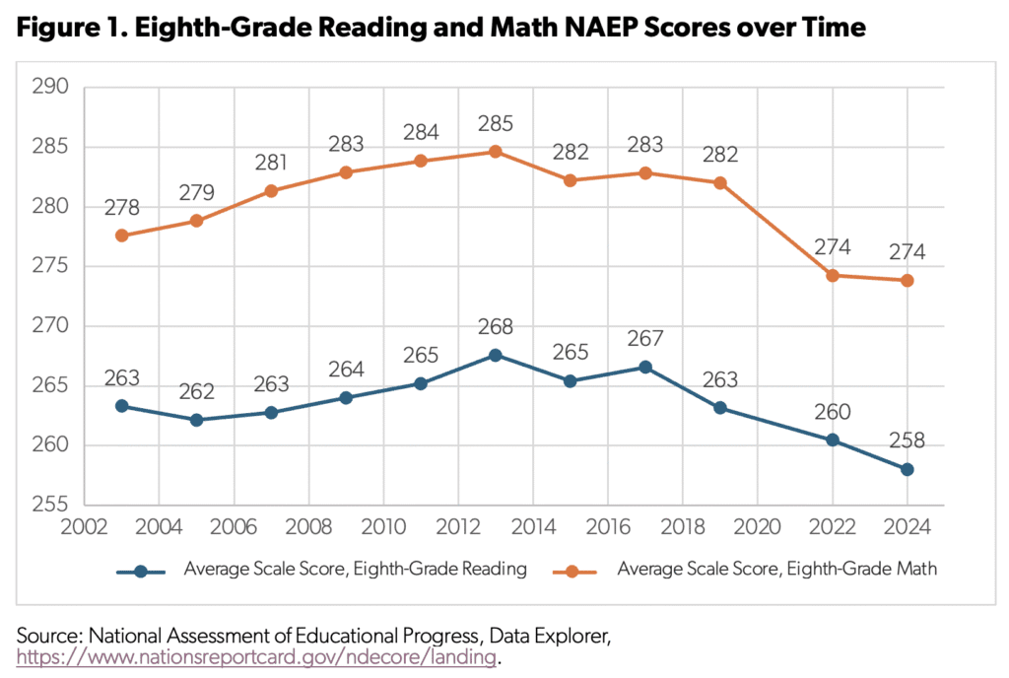
Dangers of AI in Education
Social Erosion
Trust between student and teacher
Academic integrity
Motivation (Kapur, Sharkey, & Ren, 2026)
Social connectedness
Cognitive Erosion
Literacy
Cognitive offloading
Critical thinking
exacerbated by technophilia and technological self-efficacy
experience with AI and prior academic standing do not necessarily help
False sense of understanding (Nygren et al., 2026)

Slide 7
Challenges to Address
Social Wedges
Social Erosion: Students worry about losing genuine empathy and social connections.
Cheating Pressure: Fear of classmates using AI to get ahead forces others to do the same.
Thinking & Learning
Dependency Trap: Cognitive effort is needed to learn; outsourcing tasks stops student development.
Illusion of Quality: Polished surface masks AI's unreliability.
Systemic Issues
Rapid Pace: AI is changing too fast for policies and experts to keep up.
Digital Divide: Exacerbates regional inequalities in electricity and internet access.

Slide 8
Productive Uses of AI
Dialogic Learning.
Example: In preparation for a debate or discussion, ask genAI for counterarguments to your position.
Translation. Translation into level & language, for informational or technical texts
Notes:
Well-scaffolded, dialogic AI adapted for individual learners can increase learning and self-efficacy, especially in the sciences; however, unguided use of chatbots does not (cite: 31, 32)

Slide 9
Productive Uses of AI
Dialogic Learning. Use genAI dialogically.
Translation. Translation into level & language, for informational or technical texts
Example: On finding a scientific article as a source, ask AI to summarize the results at your reading level. Check its answer against the figures and tables.
Notes:
Well-scaffolded, dialogic AI adapted for individual learners can increase learning and self-efficacy, especially in the sciences; however, unguided use of chatbots does not (cite: 31, 32)

Slide 10
Productive Uses of AI
Dialogic Learning. Use genAI dialogically.
Translation. Translation into level & language, for informational or technical texts
Active Evaluation. When accuracy matters, practice active evaluation of claims and sources given by AI, rather than accepting all claims at face value.
Example: Lateral reading is a key skill for evaluating sources. But it is difficult when no sources are given. Ask AI for its sources, and check the sources for reliability and relevance.
Notes:
Well-scaffolded, dialogic AI adapted for individual learners can increase learning and self-efficacy, especially in the sciences; however, unguided use of chatbots does not (cite: 31, 32)

Slide 11
Productive Uses of AI
Dialogic Learning. Use genAI dialogically.
Translation. Translation into level & language, for informational or technical texts
Active Evaluation. When accuracy matters, practice active evaluation of claims and sources given by AI, rather than accepting all claims at face value
Think First. Brainstorm independently before asking AI to generate new ideas, to avoid scope narrowing.
Example: When deciding on an essay topic for civics class, first handwrite a list of favorite events, people, and themes, and use that to come up with several ideas for essay topics. If unsatisfied, then and only then ask AI for variations on your ideas.
Notes:
Well-scaffolded, dialogic AI adapted for individual learners can increase learning and self-efficacy, especially in the sciences; however, unguided use of chatbots does not (cite: 31, 32)

Slide 12

AI-Robust Tasks
Hands-on materials whenever possible
Labs
Drawing or building models
Card sorts
Hand-writing
Social Interaction
Pairwise, group, and class discussions
Collaborative work
Scaffold activities for social interaction - e.g., roles for each student
Jigsaw groups
Limit phone use

Slide 13
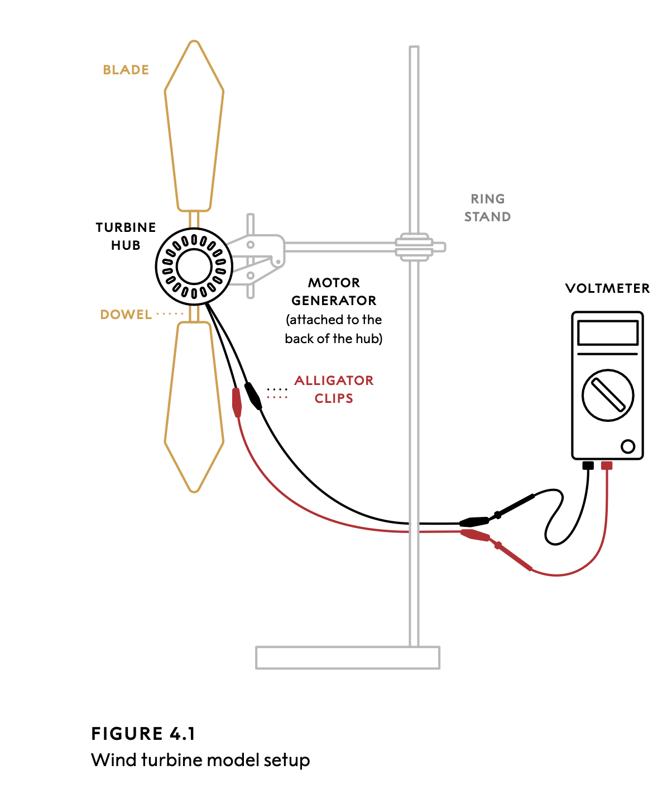

Scientific Thinking for All: A Toolkit

Slide 14
Guiding Principles for Education in AI Era
Effort & Offline Practice
Core Effort: Difficulty and effort are crucial for learning
Practicing is Learning: Students need to practice all steps of tasks like writing an essay, and should not outsource any skill they have not mastered.
No-AI Practice: Students must practice reading, writing, and math using pen & paper, oral exams, or locked PCs.
Critical Evaluation
Active Reading: Critically evaluate outputs for bias, plausibility, misinterpretations, and lacunae.
Limits of LLMs: Counter "cognitive surrender" by ensuring students know LLMs are not superintelligent.
Systems Thinking: Teach students how AI fits wider contexts to help them identify safe, proper use,
Flipped Classroom
Active Classroom: In class, focus on social and hands-on work
Computer Tutors: Utilize computer work at home for structured support & self-pacing

Slide 15

Recommendations
Teacher Literacy
Balanced Perspective: Training that includes both benefits and risks of AI.
Strategic vs. Counterproductive: Knowing when AI helps and when it hinders learning.
Ethical Issues: Engage teachers and students in critical discussions about deception, bias, environmental costs, and integrity.
Metacognition: Engage teachers in reflection about why AI misuse is so tempting
No-AI Practice: Ensuring students get plenty of practice reading, writing, and problem-solving offline.
Informed Policies
Multi-level governance from school to global standards.
Student Safeguards: Helping students make the most of genAI while protecting them from harmful temptations.
Privacy Protection: Strictly defending student data security.
Transparency: Maximizing open practices and accountability in AI input and training.

Slide 16
Discussion

