Slide 1
Training by experience
Avi Salmon
Intel – Innovation lead. July 2026
Notes:
My name is Avi Salmon, and in this presentation I will share how we use experiential learning at Intel Israel, where I lead innovation activities.
Our work includes maker activities, technical innovation campaigns, hackathons, and other hands-on learning experiences. Through these initiatives, participants do not only learn concepts—they apply them, experiment, solve real problems, and learn from both success and failure.
The main message of this presentation is the importance and value of learning through experience.

Slide 2
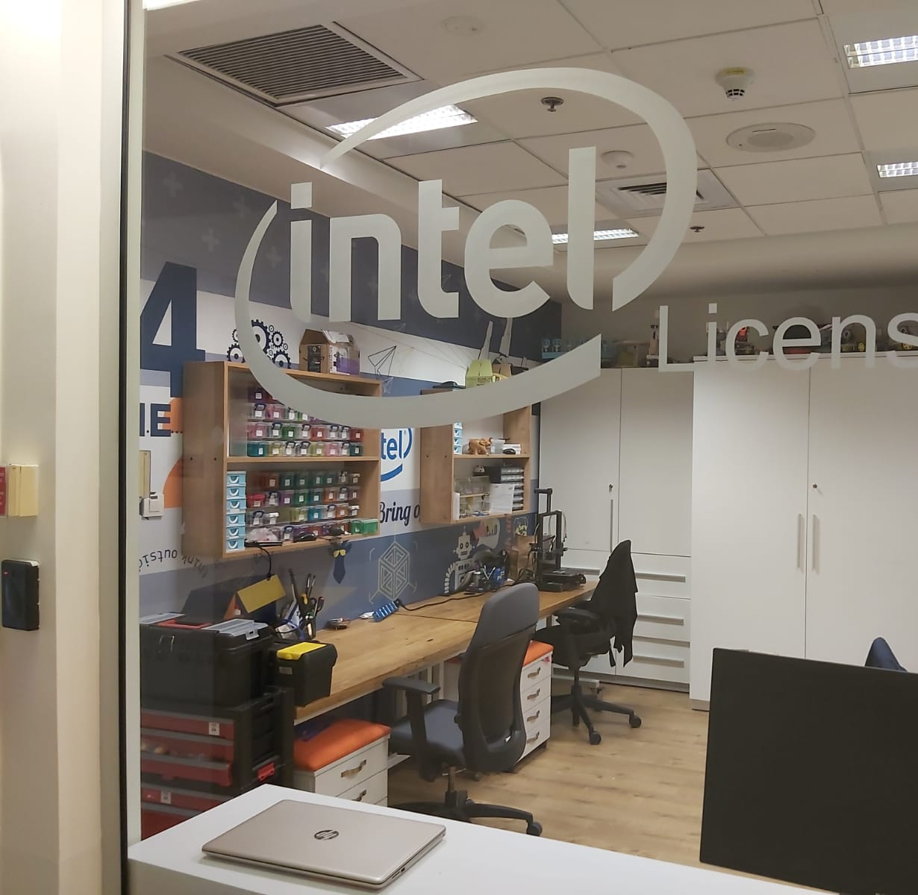
Haifa
Notes:
Here is a clear version for the PowerPoint speaker notes:
We have three Intel sites in Israel that support maker and innovation activities: Haifa, Petah Tikva, and Jerusalem.
The Haifa site operates more as an innovation hub than as a traditional makerspace. People do not usually come there to sit and build their projects. Instead, they can access equipment, print parts, borrow components, and take what they need to continue working elsewhere.
The hub includes many 3D printers, electronic components, controllers, FPGAs, sensors, actuators, and a wide range of additional equipment. Employees can use these resources to experiment, prototype, and build new ideas.
Similar maker facilities and resources are also available at the Petah Tikva and Jerusalem sites.

Slide 3
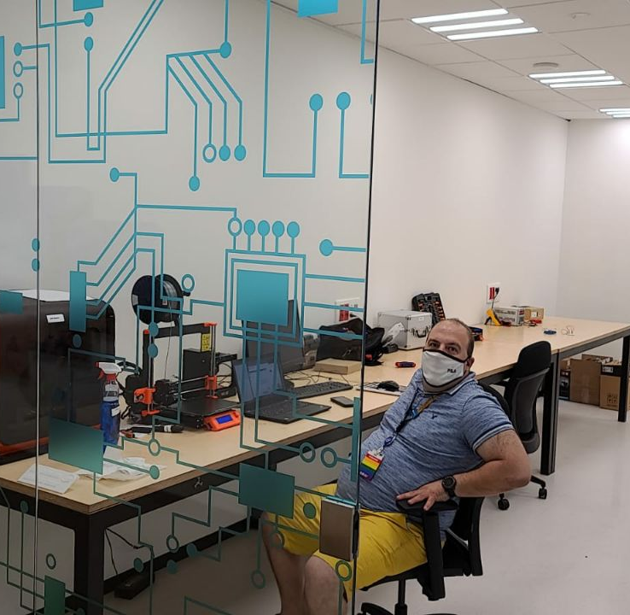
JER

Slide 4
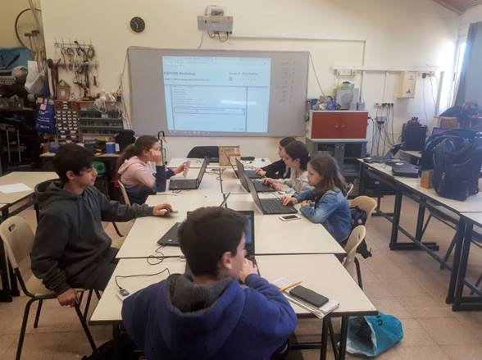
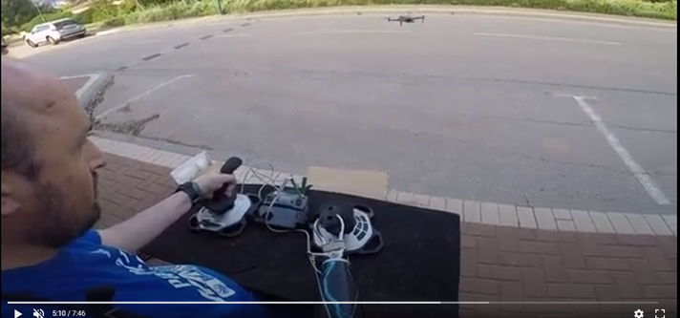
PTK

Slide 5
Why?
Employee engagement
Employer brand and PR
Braking barriers between orgs; synergies.
Innovation mindset
Business solutions.
Notes:
Here is a polished version for the PowerPoint speaker notes:
At first glance, maker activities may not seem to make business sense. Employees may be 3D printing, experimenting with electronics, or building projects that appear unrelated to Intel’s core business. Managers may reasonably ask why the organization should invest time, space, and budget in activities that do not create an immediate business result.
There are several important answers.
First, maker activities strengthen employee engagement. Employees who participate in these activities often show greater connection to the workplace, stronger curiosity, and a higher motivation to learn.
Second, they contribute to employer branding and public relations. They help position Intel as an innovative organization and as a great place to work.
Third, maker activities break down barriers inside a large organization. They connect people from different teams and disciplines who might otherwise never meet, creating new relationships, collaboration, and unexpected synergies.
Fourth, the makerspace helps employees exercise the muscle of an innovation mindset. It gives them a safe environment in which to experiment, explore, take risks, and learn through trial and error.
Finally, we see an important practical outcome. After employees practice innovation through projects that may initially seem unrelated to the business, they often return to their regular work with new ideas and solutions that are directly connected to business needs, engineering challenges, and internal processes.
The maker activity may begin as experimentation, but it can ultimately create real business value.

Slide 6
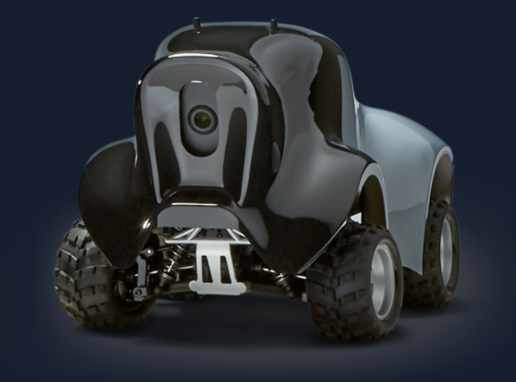
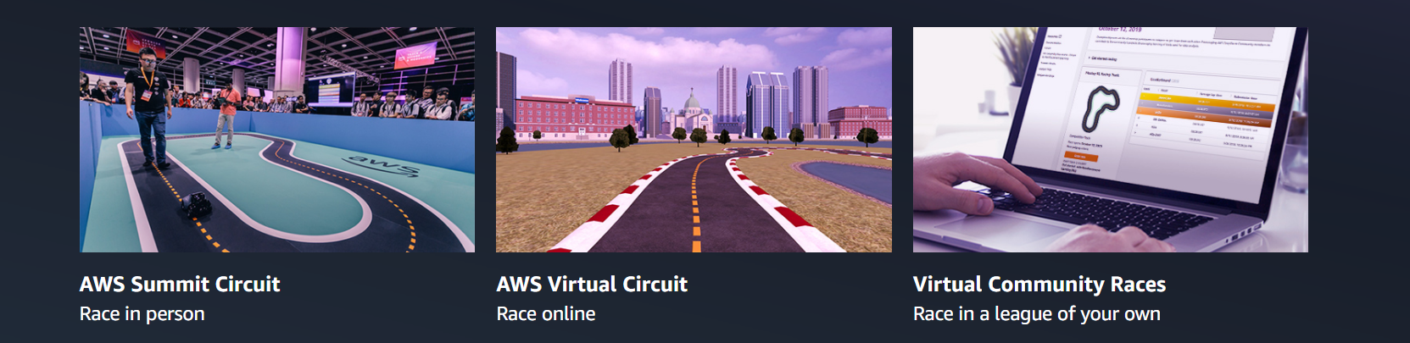
Deep Racer

Slide 7
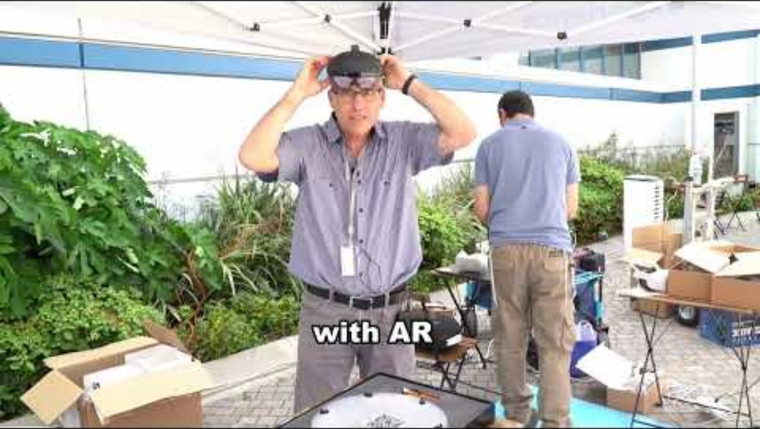

Slide 8
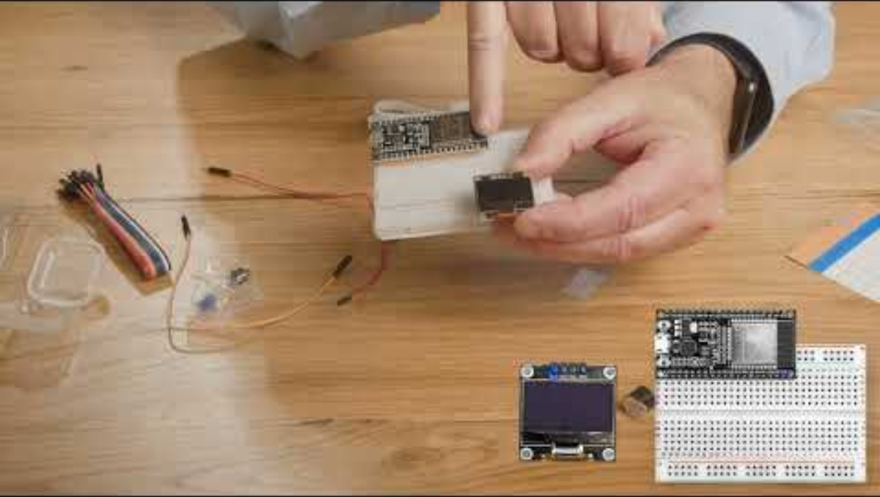

Slide 9
Education – Breaking paradigms.
Matazim (Young Technology Leadership)
Adopt a kid
Parent / kid
Space proj

Slide 10
Engineering upskilling – Breaking paradigms
HW Ninja
CPU Garage
Crash Tech

Slide 11
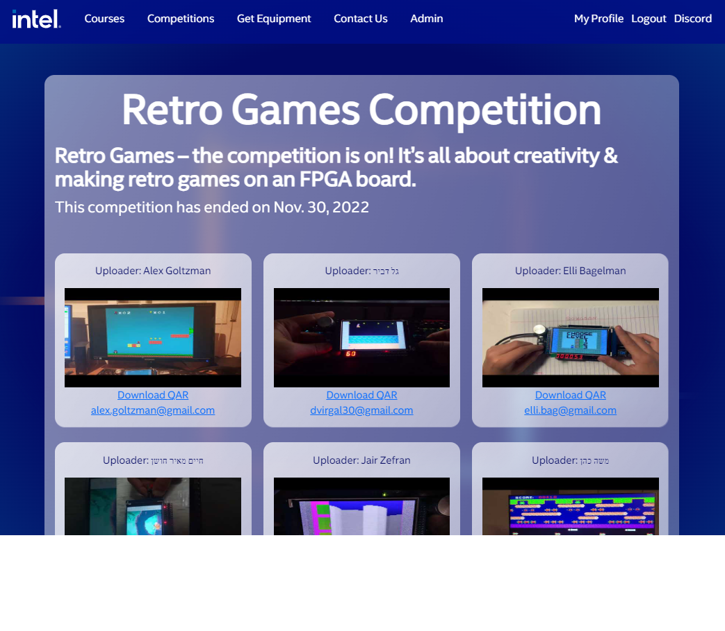
CPU garage www.cpugarage.co.il

Slide 12
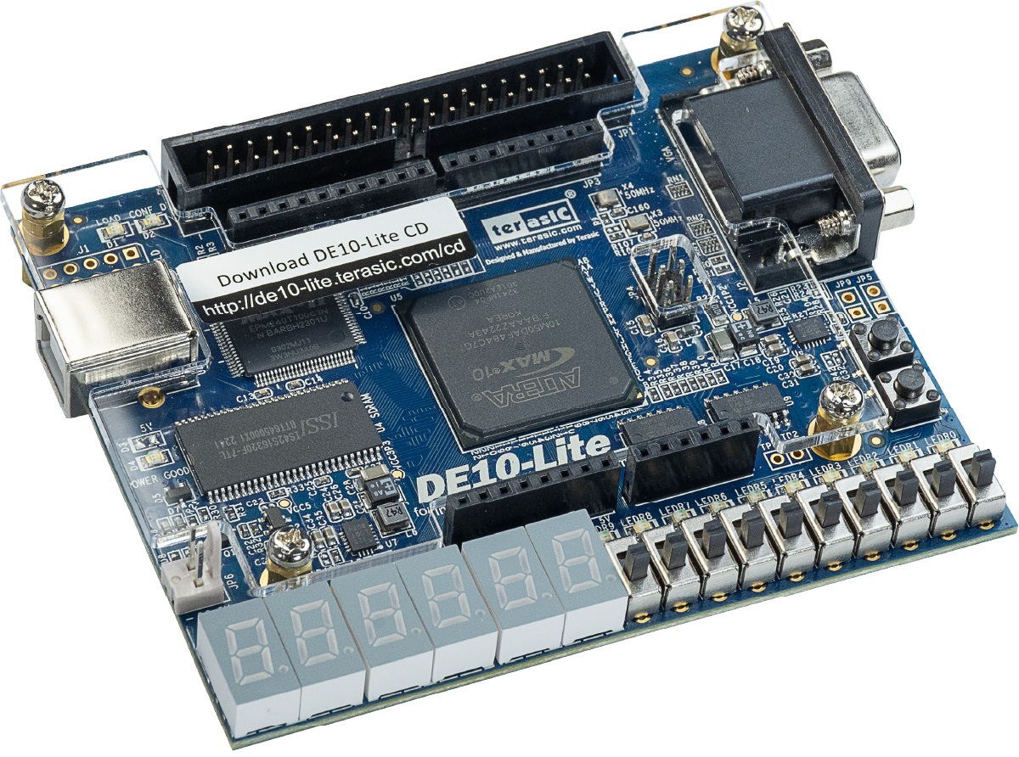
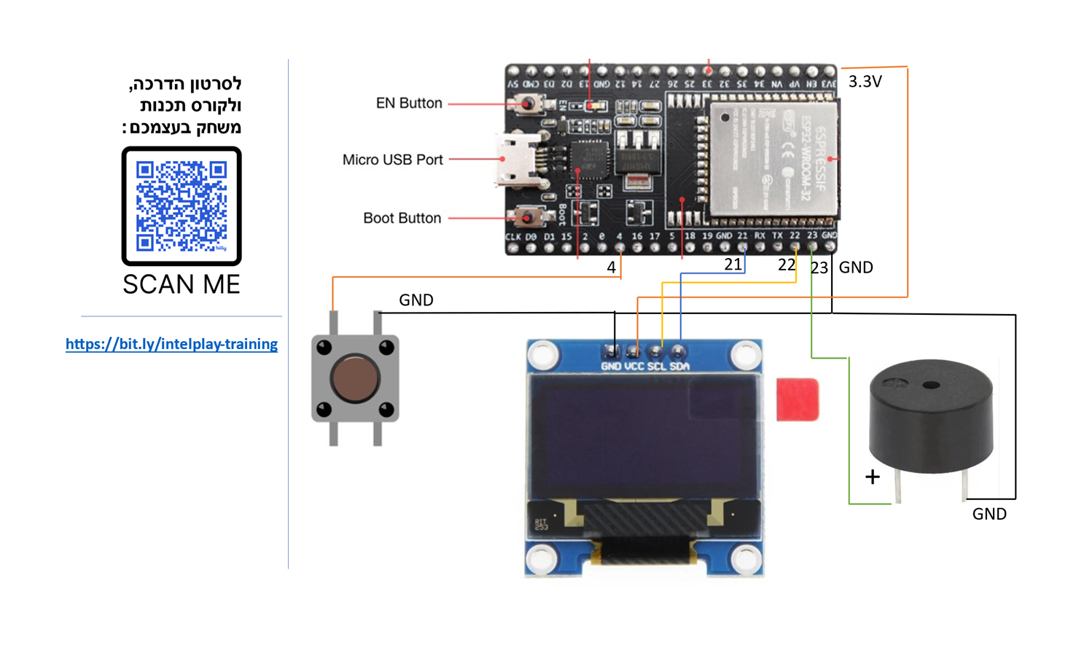
CrashTech
https://avisalmon.github.io/TechCrash2026/

Slide 13
Learning by experience
Curiosity
Determination
Humility

