Slide 1
International STEM Skills Round Table Phase III
6th meeting
21.07.2026

Slide 2
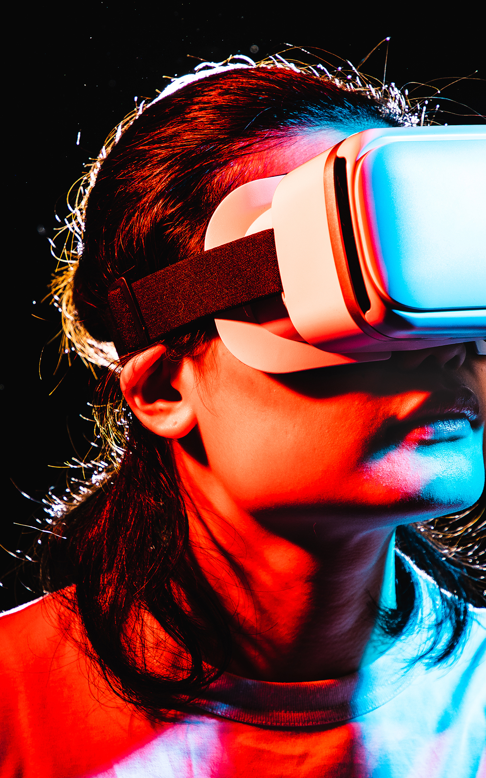
Topic/Dilemma
What is the appropriate balance between physical environments and virtual ones (such as XR and VR)? What forms of experiential learning in relevant workplaces are most suitable, and how can mentors from industry be effectively integrated into the learning process?

Slide 3
Program Outline
Time | Topic | Speakers
15:00 - 15:15 | Opening remarks | Dr. Eli Eisenberg
15:15 - 15:35 | Addressing the dilemma of this meeting | Emlen Metz
15:35 - 15:40 | Q&A | Moderated by Prof. Arnon Bentur
15:40 – 16:00 | Addressing the dilemma of this meeting | Avi Salmon
16:00 – 16:05 | Q&A | Moderated by Prof. Arnon Bentur
16:05 - 16:45 | Discussion | Moderated by Dr. Revital Duek and Dr. Yael Granot-Bein
16:45 - 16:55 | Summary of the meeting | Dr. Avigdor Zonnenshain
16:55 - 17:00 | Closing remarks and first insights of the International STEM Skills Round Table Phase III What Next? | Dr. Eli Eisenberg

Slide 4
The Issues to be Discussed in the Meetings
Meeting No. | Date | Content
1 | 02.12.2025 | Introduction, Presentation of roundtable participants, Lecture and Discussion on “Skills and Competencies in the Era of Artificial Intelligence".
2 | 20.01.2026 | Should the profile of lecturers and teachers become uniform or similar, or should there be a diversity of lecturer and teacher profiles within higher education faculties and secondary schools?
3 | 10.03.2026 | Should lecturers and teachers themselves possess the required skills and competencies, or should their primary expertise lie in the ability to cultivate these skills among their students and pupils?
4 | 28.04.2026 | Is the lecturer or teacher alone who should lead the educational process within their field of knowledge, or should an educational triangle be formed among the lecturer/teacher, the student/pupil and artificial intelligence?
5 | 09.06.2026 | How can the professional development of lecturers and teachers be ensured? Who holds the responsibility and the capacity to sustain such development systematically and continuously over time (for example: centers for advancing teaching and learning, a national center for skills development, teacher educators…)?
6 | 21.07.2026 | What is the appropriate balance between physical environments and virtual ones (such as XR and VR)? What forms of experiential learning in relevant workplaces are most suitable, and how can mentors from industry be effectively integrated into the learning process?

Slide 5
We appreciate your time and attention
For any questions or further discussion > elieizenberg@gmail.com
Explore our recent publications > www.neaman.org.il

