Slide 1
ESP32 Micro Python
Single button challenge

Slide 2
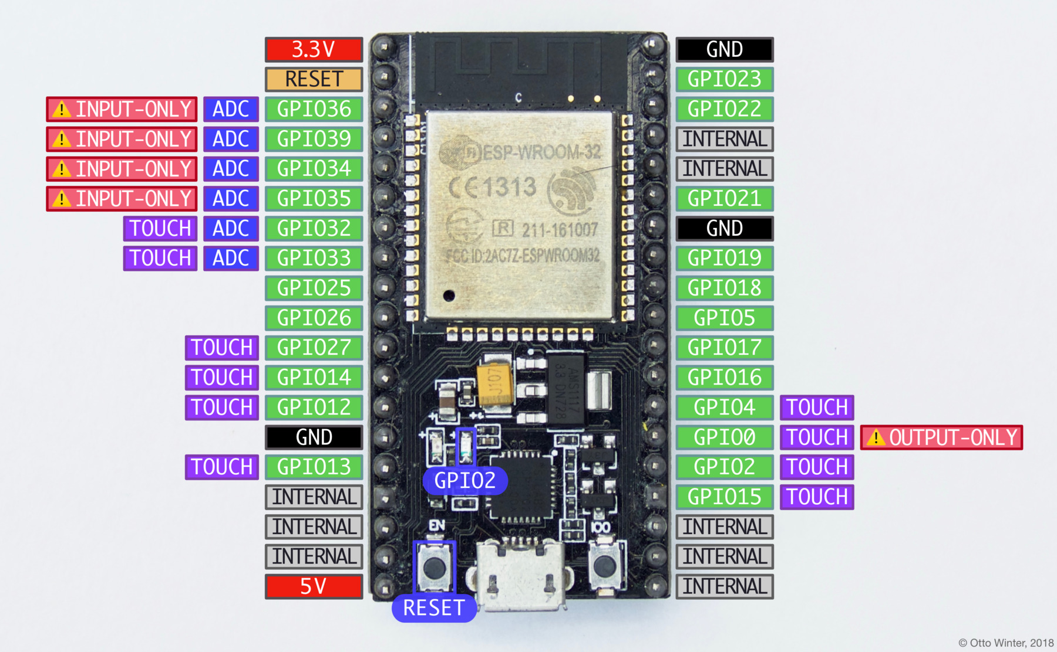
ESP32

Slide 3
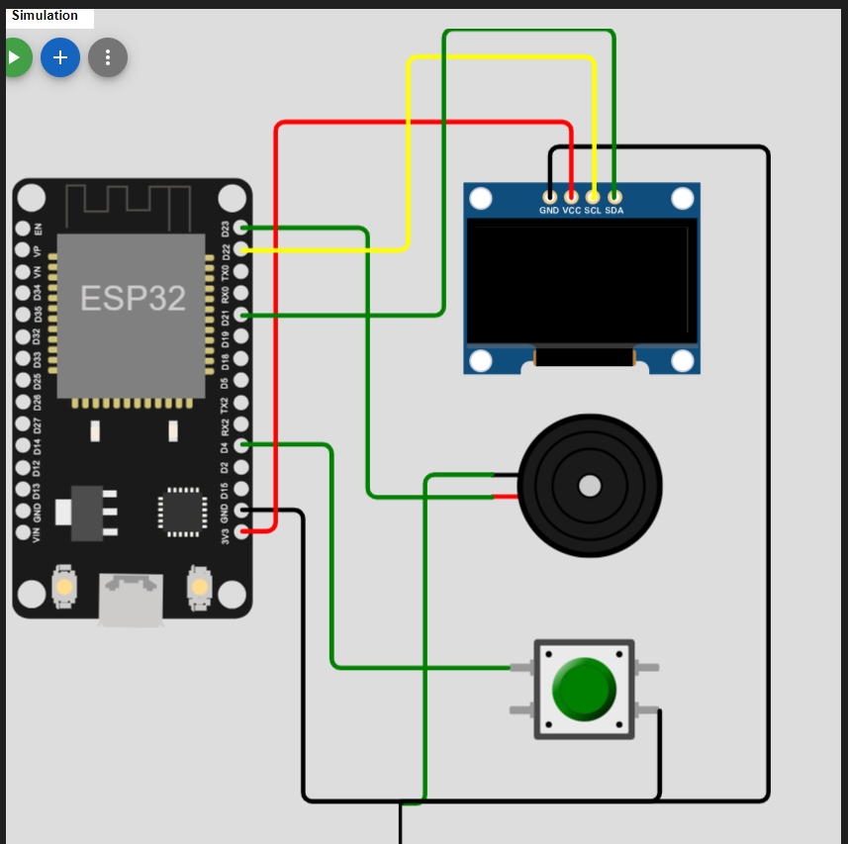
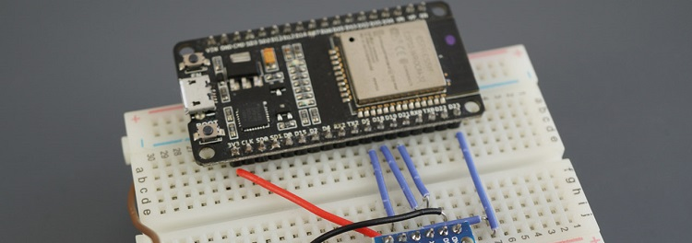
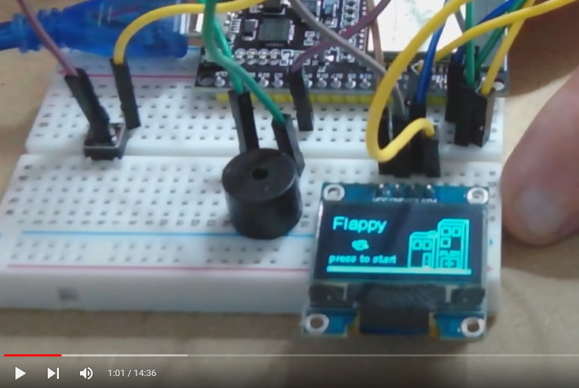
Our project
Power Pin
USB connection
Boot

Slide 4
What need to be done to start.
Make sure you have the single button kit working and connected to the PC. We support windows 10 and above.
Download course from GitHub
ESP32 Driver.
Python
Thonny
Load Micro Python
Jupyter notebook
Let’s Rock!

Slide 5
What need to be done to start.
Make sure you have the single button kit working and connected to the PC. We support windows 10 and above.
Download course from GitHub

Slide 6
What need to be done to start.
Make sure you have the single button kit working and connected to the PC. We support windows 10 and above.
Download course from GitHub
ESP32 Driver.
Python
Thonny
Load Micro Python
Jupyter notebook
Let’s Rock!

Slide 7
What need to be done to start.
Make sure you have the single button kit working and connected to the PC. We support windows 10 and above.
Download course from GitHub
ESP32 Driver.
Python
Thonny
Load Micro Python
Jupyter notebook
Let’s Rock!

Slide 8
What need to be done to start.
Make sure you have the single button kit working and connected to the PC. We support windows 10 and above.
Download course from GitHub
ESP32 Driver.
Python
Thonny
Load Micro Python
Jupyter notebook
Let’s Rock!

Slide 9
What need to be done to start.
Make sure you have the single button kit working and connected to the PC. We support windows 10 and above.
Download course from GitHub
ESP32 Driver.
Python
Thonny
Load Micro Python
Jupyter notebook
Let’s Rock!

Slide 10
What need to be done to start.
Make sure you have the single button kit working and connected to the PC. We support windows 10 and above.
Download course from GitHub
ESP32 Driver.
Python
Thonny
Load Micro Python
Jupyter notebook
Let’s Rock!

