Slide 1
ESP32 Micro Python
Single button challenge

Slide 2
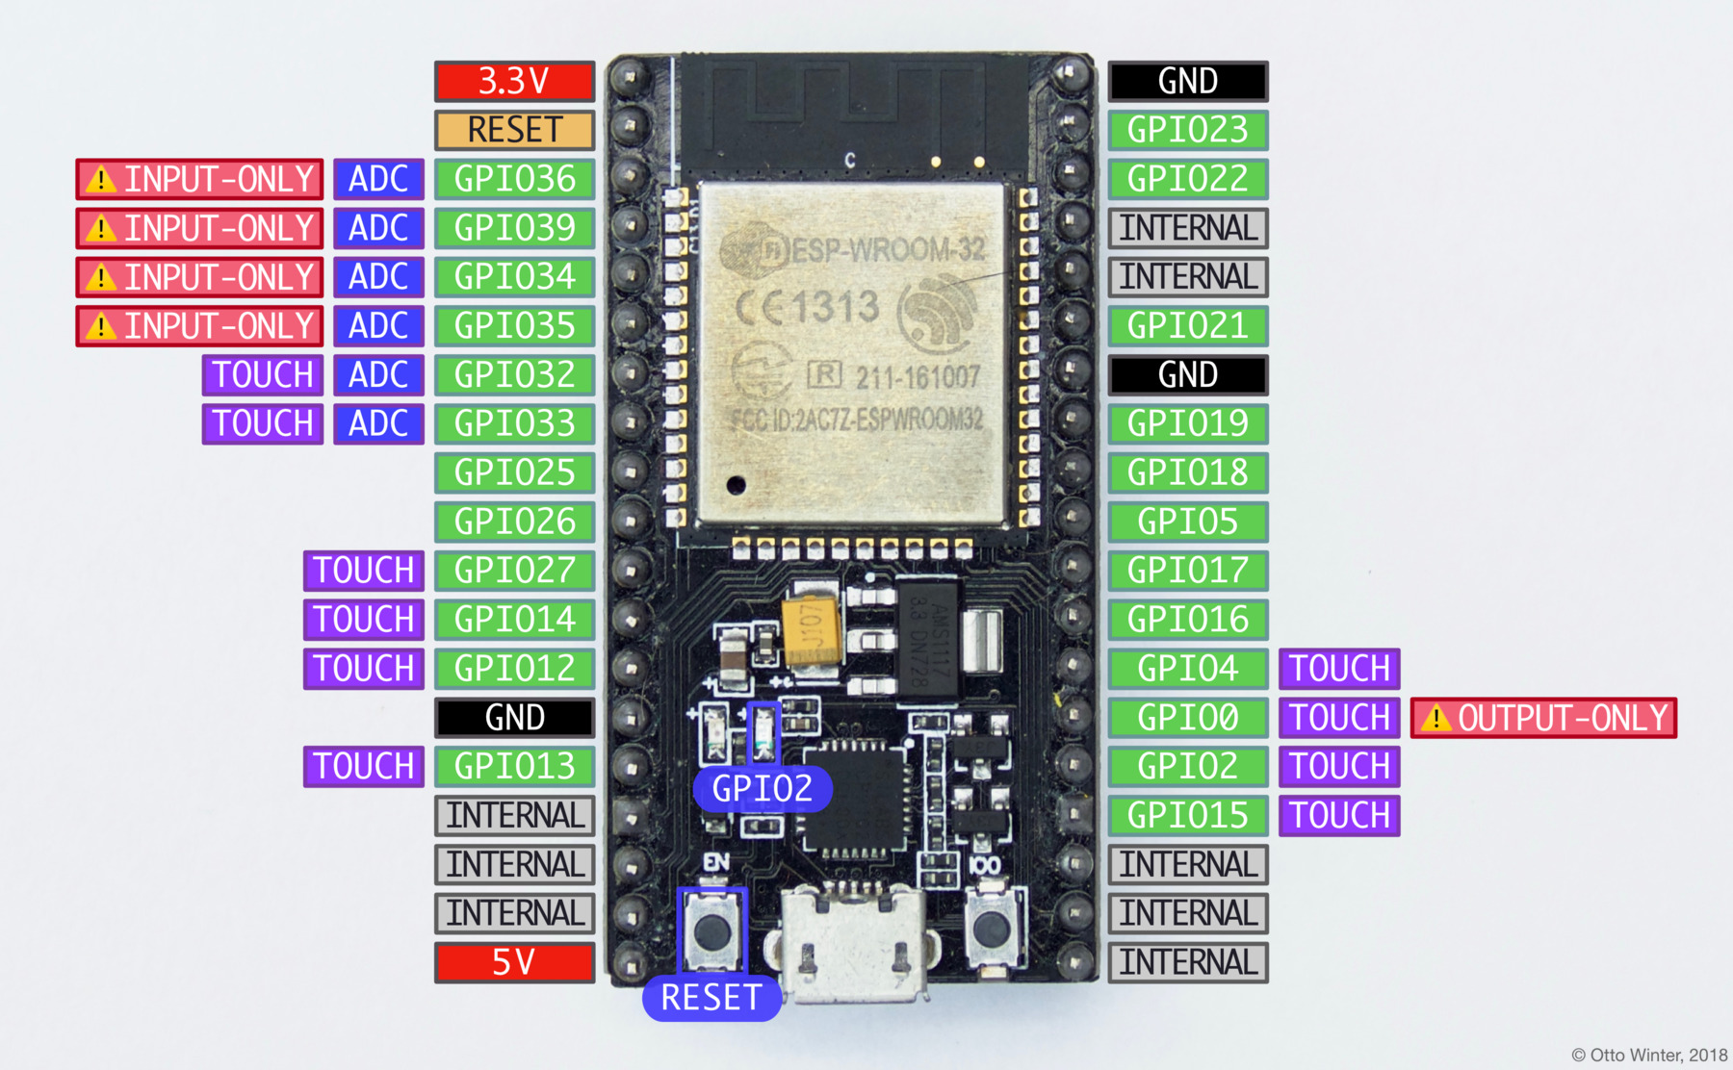
ESP32

Slide 3
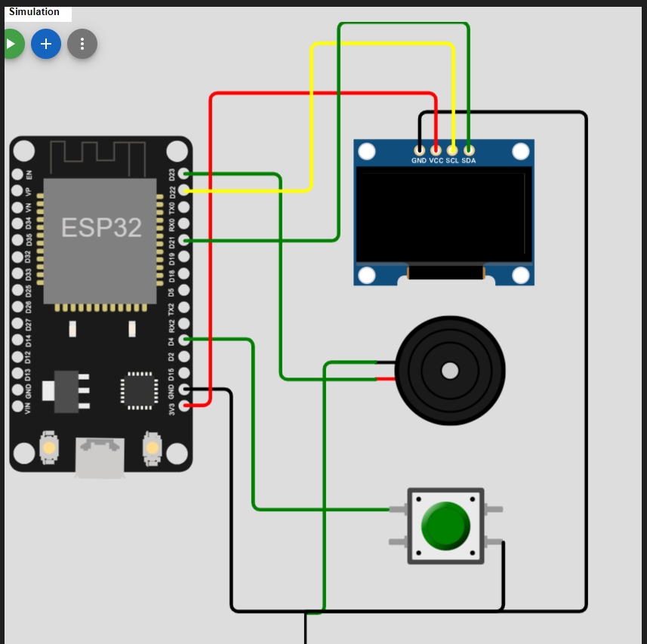
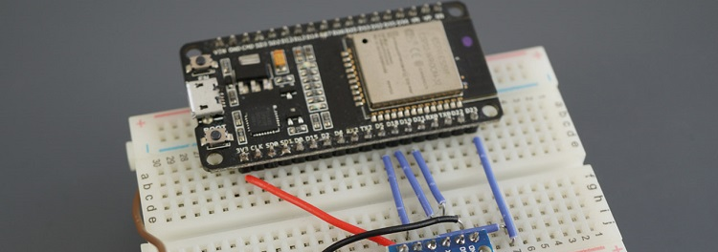
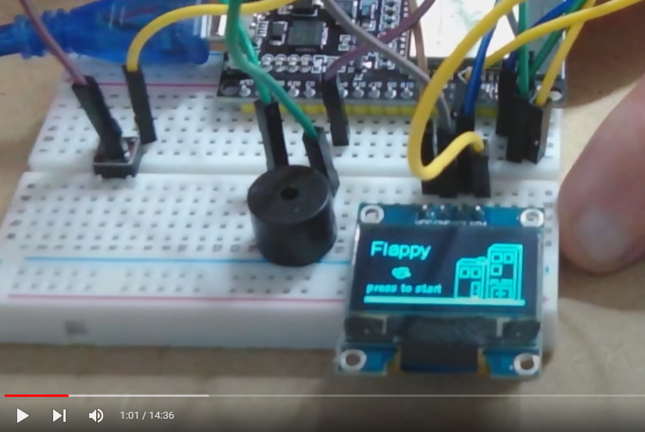
Our project
Power Pin
USB connection
Boot

Slide 4
What need to be done to start.
Make sure you have the single button kit working and connected to the PC. We support windows 10 and above.
Download course from GitHub
ESP32 Driver.
Python
Thonny
Load Micro Python
Jupyter notebook
Let’s Rock!

Slide 5
What need to be done to start.
Make sure you have the single button kit working and connected to the PC. We support windows 10 and above.
Download course from GitHub
https://github.com/avisalmon/single_button

Slide 6
What need to be done to start.
Make sure you have the single button kit working and connected to the PC. We support windows 10 and above.
Download course from GitHub
ESP32 Driver.

Slide 7
What need to be done to start.
Make sure you have the single button kit working and connected to the PC. We support windows 10 and above.
Download course from GitHub
ESP32 Driver.
Python
python.org

Slide 8
What need to be done to start.
Make sure you have the single button kit working and connected to the PC. We support windows 10 and above.
Download course from GitHub
ESP32 Driver.
Python
Thonny.org

Slide 9
What need to be done to start.
Make sure you have the single button kit working and connected to the PC. We support windows 10 and above.
Download course from GitHub
ESP32 Driver.
Python
Thonny
Load Micro Python

Slide 10
What need to be done to start.
Make sure you have the single button kit working and connected to the PC. We support windows 10 and above.
Download course from GitHub
ESP32 Driver.
Python
Thonny
Load Micro Python
Jupyter notebook
Let’s Rock!

Slide 11
X=0
X=127
(x, y)
y=0
(0,0)
(127,0)
y=63
(0, 63)
(127, 63)

Slide 12
display.line(0, 0, 63, 0, 1)
X=0
X=127
(x, y)
y=0
(0,0)
(127,0)
X=0
display.line(63, 0, 63, 32, 1)
y=63
(0, 63)
(127, 63)

Slide 13

23
23
23
23
22
22
22
22
21
21
21
21
4
4
4
4
+
+
+
+
GND
GND
GND
GND
Visit www.matazim.co.il
Course: Single Button Game
Visit www.matazim.co.il
Course: Single Button Game
Visit www.matazim.co.il
Course: Single Button Game
Visit www.matazim.co.il
Course: Single Button Game
23
23
23
23
22
22
22
22
21
21
21
21
4
4
4
4
+
+
+
+
GND
GND
GND
GND
Visit www.matazim.co.il
Course: Single Button Game
Visit www.matazim.co.il
Course: Single Button Game
Visit www.matazim.co.il
Course: Single Button Game
Visit www.matazim.co.il
Course: Single Button Game

Slide 14
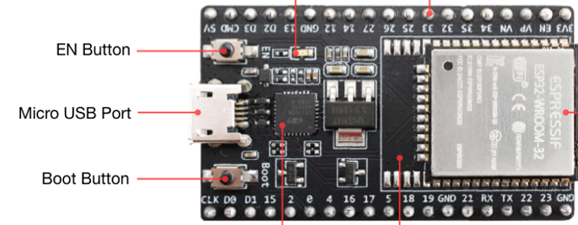
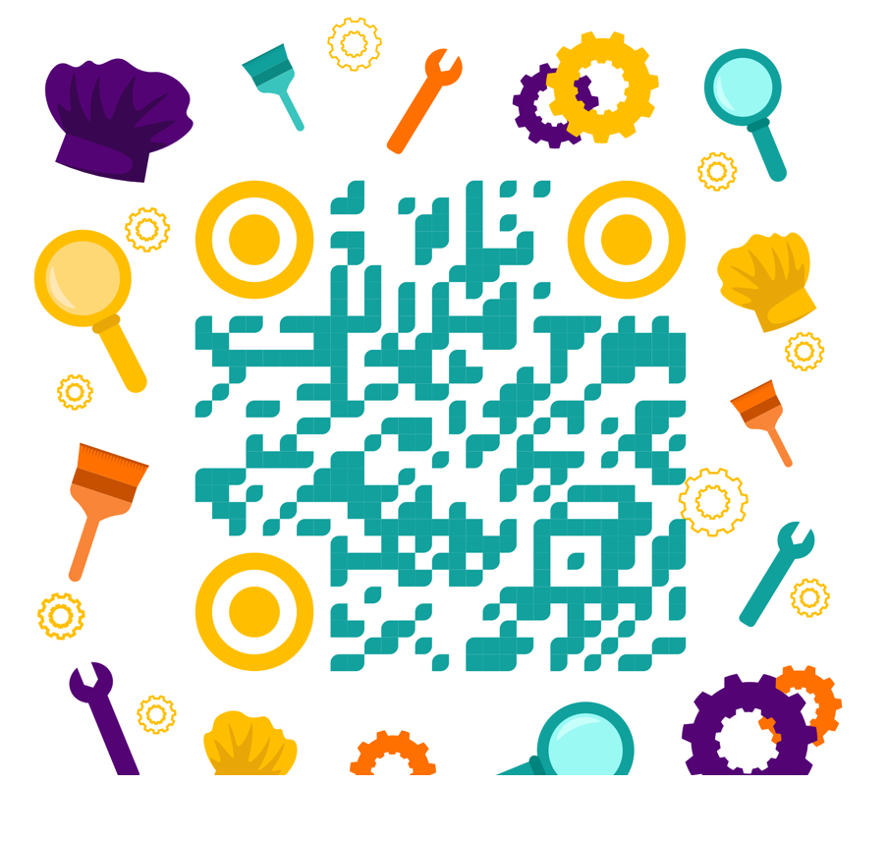

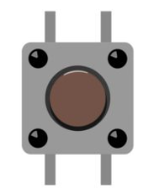
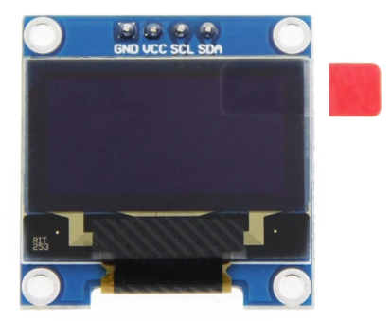
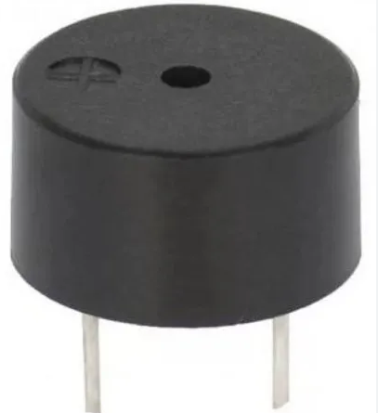
לסרטון הרכבה:
3.3V
לקורס תכנות משחק בעצמכם:
4
21
22
23
GND
GND
https://bit.ly/3H1GU7C
+
GND

