Slide 1
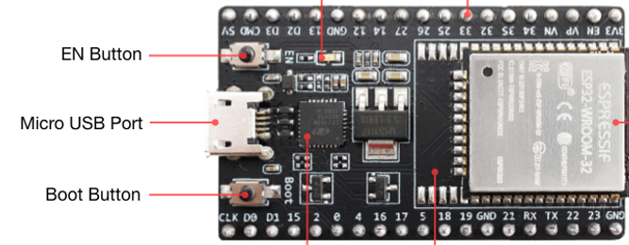

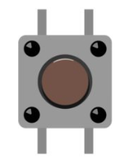
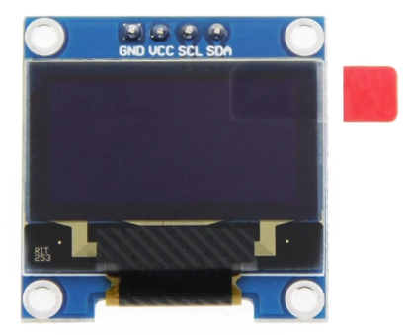
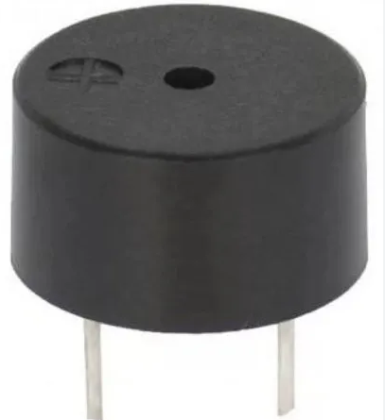
לסרטון הדרכה,
ולקורס תכנות משחק בעצמכם:
3.3V
4
21
22
23
GND
GND
https://bit.ly/intelplay-training
לקורסים נוספים:
matazim.co.il
+
GND

Slide 2
ESP32 Micro Python
Single button challenge

Slide 3
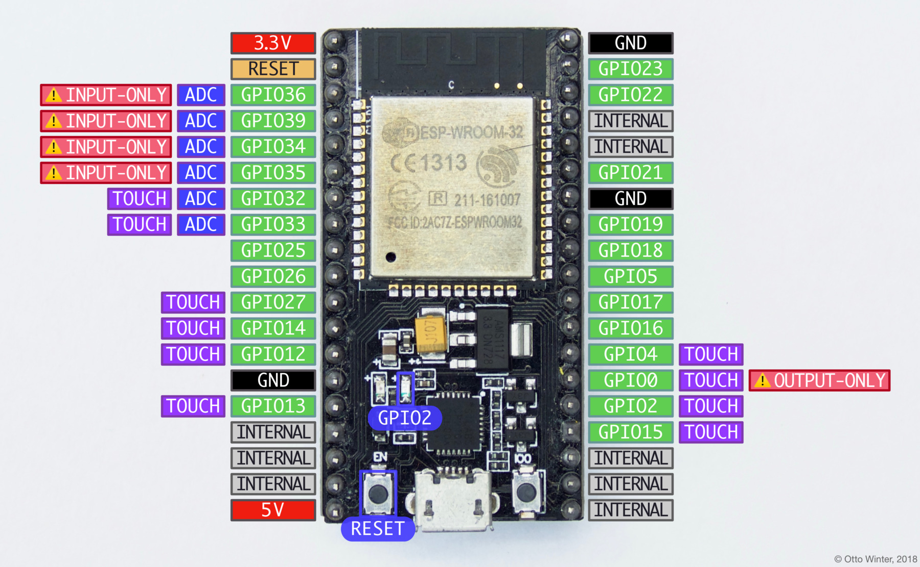
ESP32

Slide 4
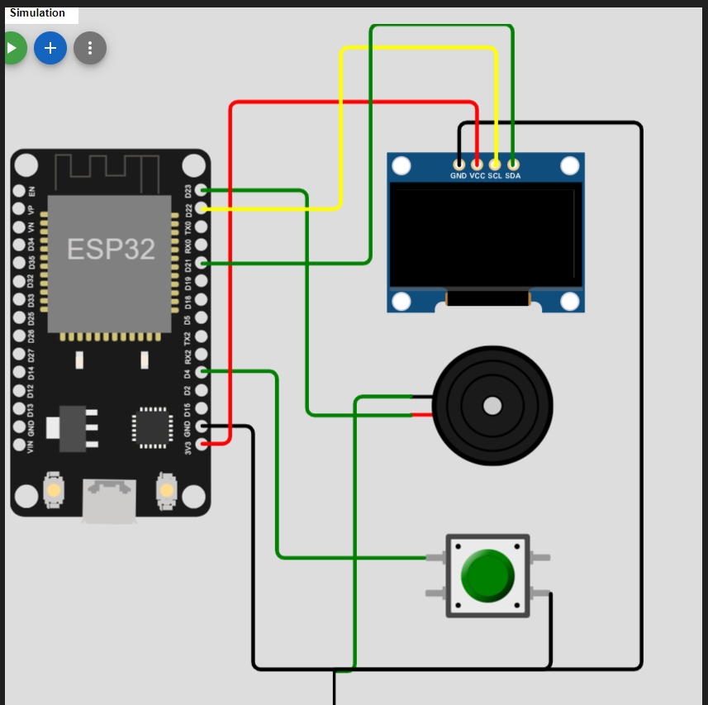
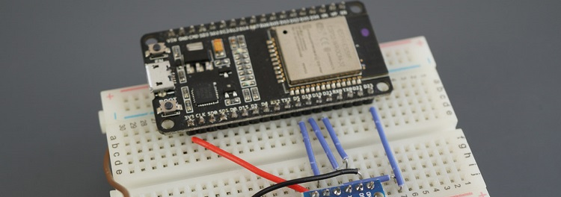
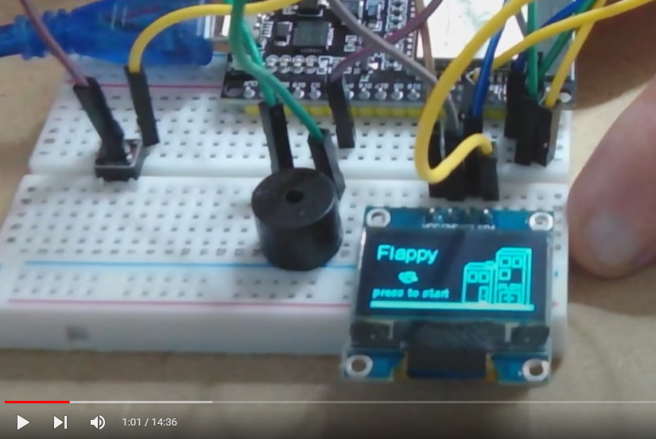
Our project
Power Pin
USB connection
Boot

Slide 5
Installation:
https://bit.ly/intel-play
Training:
https://bit.ly/intelplay-training
Github:
https://bit.ly/avisalmon-git

Slide 6
What need to be done to start.
Make sure you have the single button kit working and connected to the PC. We support windows 10 and above.
Download course from GitHub
ESP32 Driver.
Python
Thonny
Load Micro Python
Jupyter notebook
Let’s Rock!

Slide 7
X=0
X=127
(x, y)
y=0
(0,0)
(127,0)
y=63
(0, 63)
(127, 63)

Slide 8
display.line(0, 0, 63, 0, 1)
X=0
X=127
(x, y)
y=0
(0,0)
(127,0)
X=0
display.line(63, 0, 63, 32, 1)
y=63
(0, 63)
(127, 63)

