Slide 1
Design TinyURL

Slide 2

Introduction
URL shortening is used to create shorter aliases for long URLs.

Slide 3
Requirements and Goals of the system
Functional Requirements:
Given a URL, our service should generate a shorter and unique alias of it. This is called a short link. This link should be short enough to be easily copied and pasted into applications.
When users access a short link, our service should redirect them to the original link.
Users should optionally be able to pick a custom short link for their URL.
Links will expire after a standard default timespan. Users should be able to specify the expiration time.
Non-Functional Requirements:
The system should be highly available. This is required because, if our service is down, all the URL redirections will start failing.
URL redirection should happen in real-time with minimal latency.
Shortened links should not be guessable (not predictable).
Extended Requirements:
Analytics; e.g., how many times a redirection happened?
Our service should also be accessible through REST APIs by other services.

Slide 4
Capacity Estimation and Constraints
Our system will be read-heavy. There will be lots of redirection requests compared to new URL shortenings. Let’s assume a 100:1 ratio between read and write.
Traffic estimates -
  Queries Per Second - Lets assume we create 1000 new short urls per sec.
  Since read write ratio is 100:1 so we will have 1000*100 = 1,00,000 read requests per second.
  Total number of new urls in a sec = 1000
  Total number of new urls in a min = 1000 * 60
  Total number of new urls in 1 hr = 1000 * 60 * 60
  Total number of new urls in 1 day = 1000 * 60 * 60 * 24
  Total number of new urls in 1 month = 1000 * 60 * 60 * 24 * 30
  = 2,59,20,00,000
  ~ 2*10^9
  = 2 Billion

Slide 5
Storage estimates:
Long URL - 2 KB (2048 chars)
Short URL - 7 Bytes (7 chars) [Why 7 chars? will discuss later]
Created_at - 8 bytes (19 positions. in Sql server the size is 8bytes).
Expired_at - 8 bytes
UserId - 4 bytes
Total size of an object = 2075 bytes
Let’s assume we store every URL shortening request (and associated shortened link) for 5 years. Since we expect to have 2 Billion new URLs every month, the total number of objects we expect to store will be:
(2 * 10^9) * (5 years * 12 months) = 120 billion
Total storage needed in 5 years :
120 billion * 2075 bytes = 120*10^9 * 2075 bytes
= 2,49,000‬ * 10^9 = 249 * 10^12 bytes
= 249 * (10^3 KB) * (10^3MB) * (10^3GB) * (10^3TB)
= 249 TB

Slide 6
Bandwidth estimates
Since we expect 1000 new URLs per second, total incoming data for our service will be:
2074 bytes * 1000 = 2074 KB/s
~ 2 MB/s
For read requests since every second we expect 1,00,000 url redirections total outgoing data will be: 2074 bytes * 1,00,000 = 2* 10^8 bytes
~ 200 MB/s
Memory estimates
If we want to cache some of the hot URLs that are frequently accessed, how much memory will we need to store them? If we follow the 80-20 rule, meaning 20% of URLs generate 80% of traffic, we would like to cache these 20% hot URLs.
Url redirections we have in a day : 100K * 60sec * 60min * 24hr = 864 * 10^7 = 8.6 billion
To cache 20% of these requests, we will need
0.2 * 8.6 billion * 2074 bytes ~ 3.5 TB
One thing to note here is that since there will be a lot of duplicate requests (of the same URL), therefore, our actual memory usage will be less than 3.5 TB.

Slide 7
High level estimates
Assuming 2 billion new URLs per month and 100:1 read:write ratio, following is the summary of the high level estimates for our service:
New URLs | 1000/s
URL Redirections | 100K/s
Incoming data | 200MB/s
Outgoing data | 2MB/s
Storage for 5 years | 249 TB
Memory for cache | 3.5 TB

Slide 8
APIs
We can have SOAP or REST APIs to expose the functionality of our service. Following could be the definitions of the APIs for creating and deleting URLs:
createURL(api_dev_key, original_url, custom_alias=None, user_name=None, expire_date=None)
api_dev_key (string): The API developer key of a registered account. This will be used to, among other things, throttle users based on their allocated quota.
original_url (string): Original URL to be shortened.
custom_alias (string): Optional custom key for the URL.
user_name (string): Optional user name to be used in the encoding.
expire_date (string): Optional expiration date for the shortened URL.
Returns: (string)
A successful insertion returns the shortened URL; otherwise, it returns an error code.

Slide 9
getURL(api_dev_key, url_key)
Where “url_key” is a string representing the shortened URL to be retrieved. A successful retrieval returns ‘OK’.
How do we detect and prevent abuse?
A malicious user can put us out of business by consuming all URL keys in the current design. To prevent abuse, we can limit users via their api_dev_key. Each api_dev_key can be limited to a certain number of URL creations and redirections per some time period (which may be set to a different duration per developer key).

Slide 10
Basic System Design and Algorithm
The problem we are solving here is, how to generate a short and unique key for a given URL.
In the TinyURL example in Section 1, the shortened URL is “http://tinyurl.com/jlg8zpc”. The last seven characters of this URL is the short key we want to generate.

Slide 11
What should be the length of our shortUrl?
It depends. If we encode the short url, we can use base62 or base64 encoding. If we want our short url to have characters [a-z],[A-Z],[0-9] we will have 26+26+10 = 62 possible characters. This makes it base62. If we want to have base64, we will add +,/ and = to our character set (= is used for padding).
Let us assume, the length of the short url is 7 characters.
With base62 encoding, we can have 62^7 = 3.5 trillion possibilities.
With base64 encoding, we can have 64^7 = 4.3 trillion possibilities.
With 3.5 trillion possibilities and 1000 urls/sec, we will exhaust the set in
(4.3*10^12) / (1000*3600*24*365) = 139years.
Hence we will use 7 characters for our short url and have base64 as the encoding algorithm.
What is base64? In base64, we take a block of 6 bits and convert it to a character from the character set. Why 6 bits? 64 = 2^6.

Slide 12
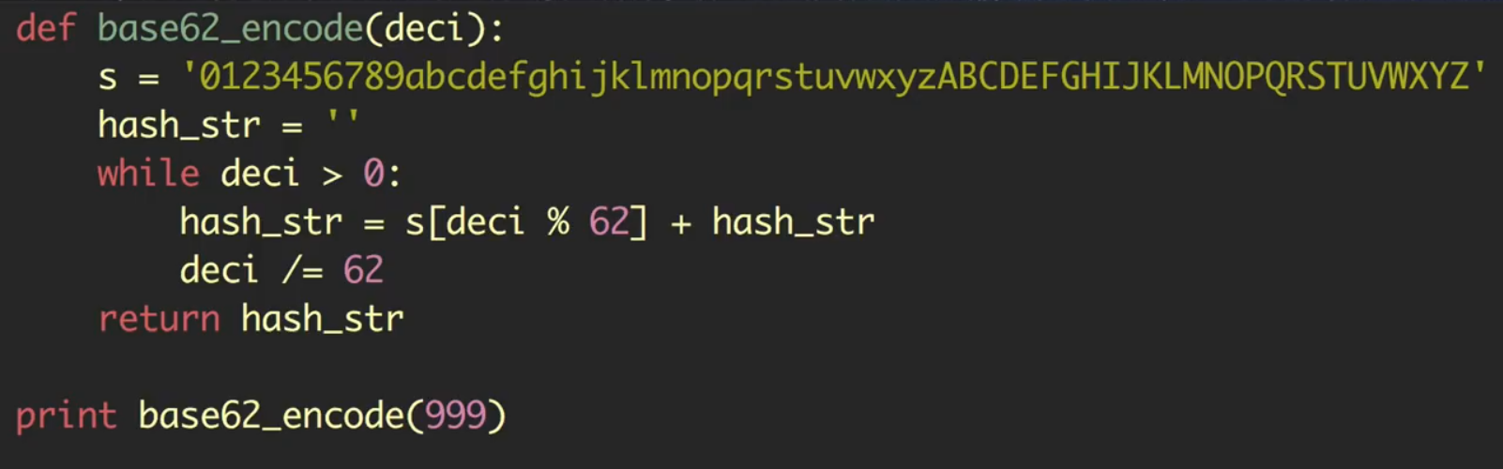
Base62 code.

Slide 13
How to generate the 7 character short url?
Approach1: Generate random tiny url and check db.
Step 1: Request comes to the worker process.
Step 2: It generates a random number and then encodes it with base62 and takes only first 7 characters.
Step 3: After the url generation, the process can do one of the following things here:
1. Get then Put
a. Get(tinyUrl) from DB
b. If it doesnot exist in DB, it puts(tinyUrl, longUrl). If it exists in DB then regenerate another tinyUrl.
What is the problem with this approach? - While the process get(), another process for another request can also get() and try to write the value, thus causing an error.
2. Put if absent
This requires support from the database. For dbs like mysql, mssql, oracle which supports ACID properties, this is trivial. For nosql dbs they might or mightnot support this feature.
3. Put - Get - Put
First Put(tinyUrl, longUrl). Then get(tinyUrl) and check if the longUrl attached to this tinyUrl is same to this longUrl. If not then regenerate a new tinyUrl and put it again.

Slide 14
Approach2: Using a hash function like MD5
If we use the MD5 algorithm as our hash function, it’ll produce a 128-bit hash value. After base64 encoding, we’ll get a string having more than 21 characters (since each base64 character encodes 6 bits of the hash value). From this 21 characters, we choose the first 7 characters as our tinyUrl.
This could result in key duplication, to resolve that, we can choose some other characters out of the encoding string or swap some characters.
What are the different issues with our solution? We have the following couple of problems with our encoding scheme:
If multiple users enter the same URL, they can get the same shortened URL, which is not acceptable.
What if parts of the URL are URL-encoded? e.g., http://www.educative.io/distributed.php?id=design, and
http://www.educative.io/distributed.php%3Fid%3Ddesign are identical except for the URL encoding.
Workaround for the issues: We can append an increasing sequence number to each input URL to make it unique, and then generate a hash of it. We don’t need to store this sequence number in the databases, though. Possible problems with this approach could be an ever-increasing sequence number. Can it overflow? Appending an increasing sequence number will also impact the performance of the service.
Another solution could be to append user id (which should be unique) to the input URL. However, if the user has not signed in, we would have to ask the user to choose a uniqueness key. Even after this, if we have a conflict, we have to keep generating a key until we get a unique one.

Slide 15
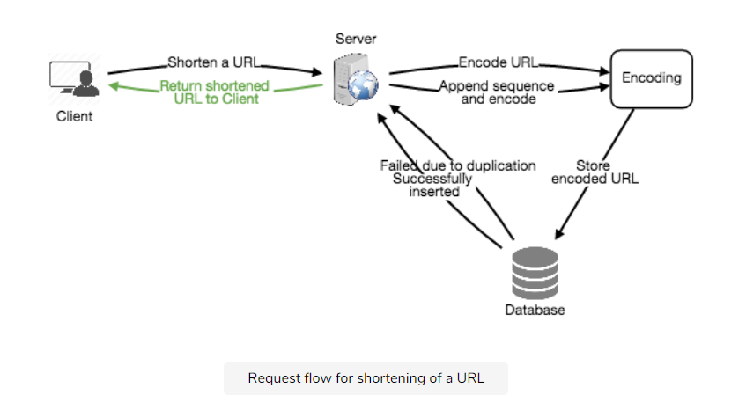

Slide 16
Approach 3 - Counter
Lets have a counter which is thread protected and pass it to Base64 to get a tinyUrl and insert into DB. This works really well until we scale.
This is because 1 counter doesnot work well with multiple app servers. It becomes a single pointe of failure. Also if the app servers are in different data centers, then we need to have different counters, one for each data center. Each counter will have a bounded limit[lowerlimt and upperlimit]. The problem here is how what will we do if the limit of one DC is exhausted. How to find another limit?
To overcome this issue, we need a coordination service. We can have Zookeeper as our coordination service. The zookeeper will hold the metadata of the counter ranges and assign them to the app servers. When a new app server is added to the cluster, it first registers itself with the zk and asks for a counter range. After a range is assigned, if the server dies, we will not reuse the range.

Slide 17
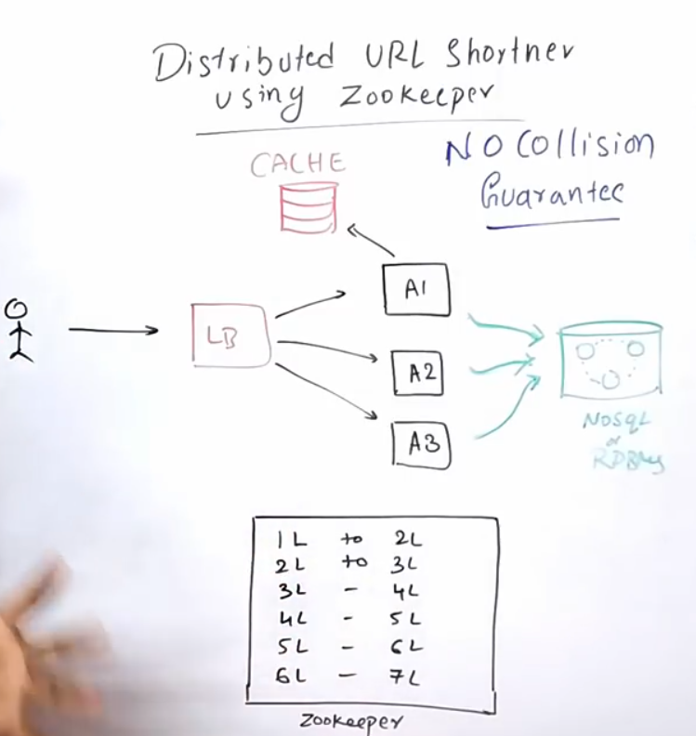

Slide 18
Caching
We can cache URLs that are frequently accessed. We can use some off-the-shelf solution like Memcached, which can store full URLs with their respective hashes. The application servers, before hitting backend storage, can quickly check if the cache has the desired URL.
How much cache memory should we have? We can start with 20% of daily traffic and, based on clients’ usage pattern, we can adjust how many cache servers we need. As estimated above, we need 170GB memory to cache 20% of daily traffic. Since a modern-day server can have 256GB memory, we can easily fit all the cache into one machine. Alternatively, we can use a couple of smaller servers to store all these hot URLs.
Which cache eviction policy would best fit our needs? When the cache is full, and we want to replace a link with a newer/hotter URL, how would we choose? Least Recently Used (LRU) can be a reasonable policy for our system. Under this policy, we discard the least recently used URL first. We can use a Linked Hash Map or a similar data structure to store our URLs and Hashes, which will also keep track of the URLs that have been accessed recently.
To further increase the efficiency, we can replicate our caching servers to distribute the load between them.
How can each cache replica be updated? Whenever there is a cache miss, our servers would be hitting a backend database. Whenever this happens, we can update the cache and pass the new entry to all the cache replicas. Each replica can update its cache by adding the new entry. If a replica already has that entry, it can simply ignore it.

Slide 19
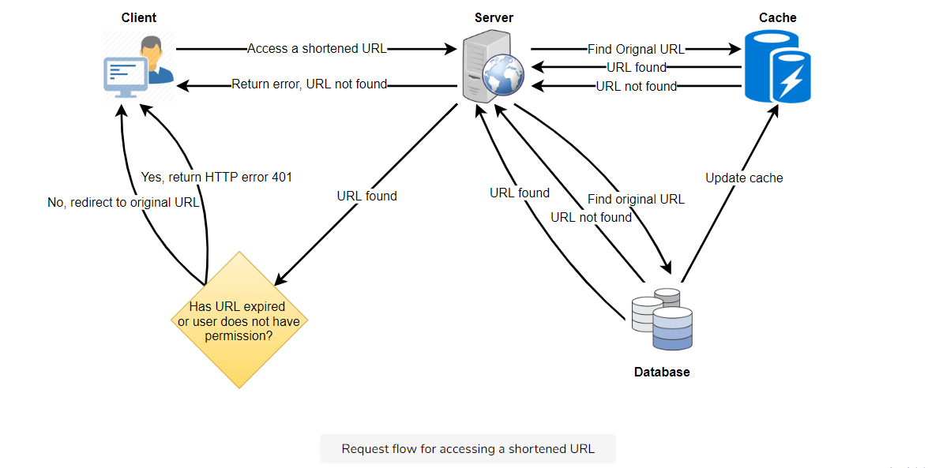

Slide 20
Load Balancer (LB)
We can add a Load balancing layer at three places in our system:
  Between Clients and Application servers
  Between Application Servers and database servers
  Between Application Servers and Cache servers
Initially, we could use a simple Round Robin approach that distributes incoming requests equally among backend servers. This LB is simple to implement and does not introduce any overhead. Another benefit of this approach is that if a server is dead, LB will take it out of the rotation and will stop sending any traffic to it.
A problem with Round Robin LB is that we don’t take the server load into consideration. If a server is overloaded or slow, the LB will not stop sending new requests to that server. To handle this, a more intelligent LB solution can be placed that periodically queries the backend server about its load and adjusts traffic based on that.

Slide 21
Purging or DB cleanup
Should entries stick around forever or should they be purged? If a user-specified expiration time is reached, what should happen to the link?
If we chose to actively search for expired links to remove them, it would put a lot of pressure on our database. Instead, we can slowly remove expired links and do a lazy cleanup. Our service will make sure that only expired links will be deleted, although some expired links can live longer but will never be returned to users.
Whenever a user tries to access an expired link, we can delete the link and return an error to the user.
A separate Cleanup service can run periodically to remove expired links from our storage and cache. This service should be very lightweight and can be scheduled to run only when the user traffic is expected to be low.
We can have a default expiration time for each link (e.g., two years).
After removing an expired link, we can put the key back in the key-DB to be reused.
Should we remove links that haven’t been visited in some length of time, say six months? This could be tricky. Since storage is getting cheap, we can decide to keep links forever.

Slide 22
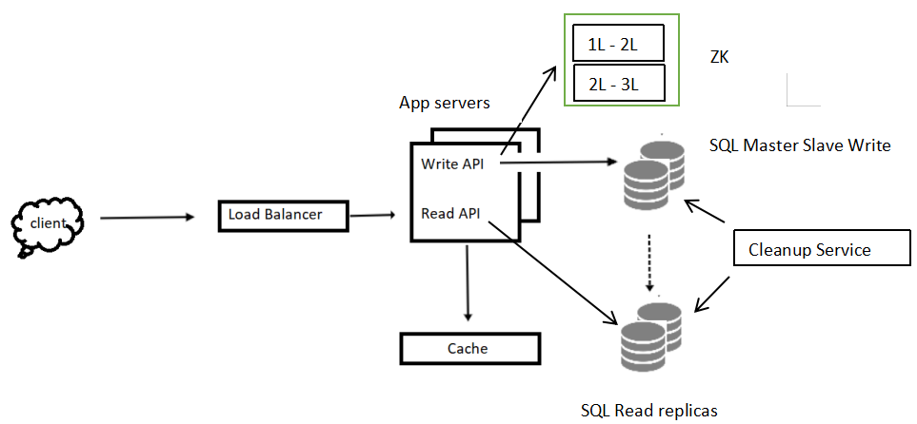

Slide 23
DataBase
A few observations about the nature of the data we will store:
  We need to store billions of records.
  Each object we store is small (approx 2KB).
  There are no relationships between records—other than storing which user created a URL.
  Our service is read-heavy.
Database Schema: #
We would need two tables: one for storing information about the URL mappings, and one for the user’s data who created the short link.

Slide 24
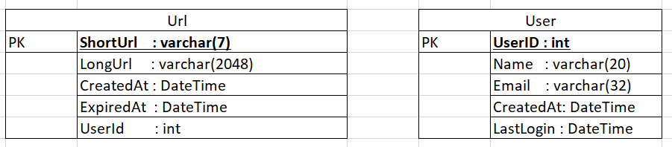
What kind of database should we use? Since we anticipate storing billions of rows, and we don’t need to use relationships between objects – a NoSQL store like DynamoDB, Cassandra or Riak is a better choice. A NoSQL choice would also be easier to scale. Please see SQL vs NoSQL for more details.

