Slide 1
PasteBin
The user can uses the service to save data(text, image) and get a url back. This url is used to share and access the data.

Slide 2
Requirements and Goals
Functional Requirements
  Saving data returns a short url
  When users access a short url, our service should redirect them to the data saved.
  Users should optionally be able to pick a custom short link for their URL.
  Links will expire after a standard default timespan. Users should be able to specify the expiration time.
Non-Functional Requirements
  High availability - The system should be highly available. This is required because, if our service is down, all the URL redirections will start failing.
  High Reliability - The uploaded data cannot be lost
  URL redirection should happen in real-time with minimal latency.
  Shortened links should not be guessable (not predictable).
Extended Requirements:
  Analytics; e.g., how many times a redirection happened?

Slide 3
Design Considerations
Can we limit the amount of data saved?
  Yes - the limit is 10mb
What will the size of the short url generated?
  7 chars

Slide 4
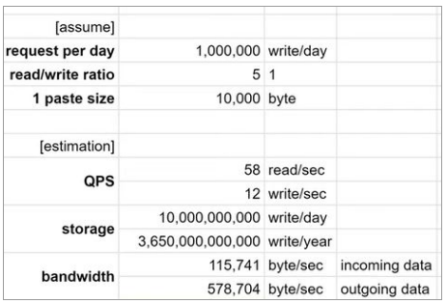
Capacity Estimation and Constraints

Slide 5
APIs
1. addPaste (api_dev_key, paste_data, custom_url=none, user_name=none, expire_date=none)
returns string: paste_url/error_code
api_dev_key - (string): The API developer key of a registered account. This will be used to, among other things, throttle users based on their allocated quota.
paste_data(string): the text that needs to be saved.
custom_alias (string): Optional custom key for the URL.
user_name (string): Optional user name to be used in the encoding.
expire_date (string): Optional expiration date for the shortened URL.
2. getPaste (api_dev_key, paste_url)
returns string: paste_data/error_code
3. deletePaste (api_dev_key, paste_url)
return (string) : success / error code

Slide 6
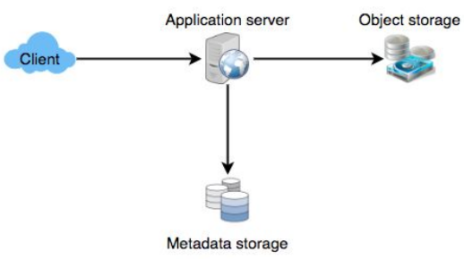
High Level Design
a. application layer
i. Handling read / write requests
ii. Communicate with backend storage
b. storage layer
i. metadata storage
This contains the user to paste_url mapping and other metadata. Less relationship and joins. NoSql like cassandra or hbase.
ii. contents storage
Large Capacity. Object Storage like Amazon S3.

Slide 7
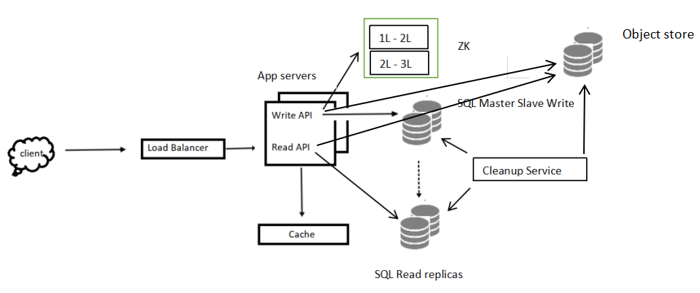
Detailed Design
Metadata Server is splitted intp SQL Master/Slave Write and Read replicas.

Slide 8
Few more talking points
Purging or DB cleanup
Caching
  Write Through
  Write Around
  Write Back
Load Balancer
  between client and server
  between app server / cache

