Slide 1
System Design
Chat App (WhatsApp)

Slide 2
Contents
1. Requirement Gathering
2. Capacity Estimation
3. High-Level Design
4. Database Design
5. Deep Dive into Key Components
1. Real time 1:1 message Delivery.
2. Message sync across multiple devices.
3. Message_Id generation.
4. Message Delivery Indicators.
5. Group Messages.
6. Address Key Issues and Bottlenecks

Slide 3
1. Requirement Gathering
Functional Requirements
  1:1 real-time messaging
  online/offline status
  last seen time
  message delivery status (sent, delivered, read)
  share images, videos, and audio clips.
  group conversations with up to 100 members.
  Push notifications for new messages if the receiver is offline.
  Store and retrieve chat history for each user.

Slide 4
Non-Functional Requirements:
  Scalability: Handle millions of concurrent users.
  High Availability: Ensure minimal downtime and resilience to server failures.
  Low Latency: Deliver messages in real-time with minimal delay.
  Reliability: Ensure messages are not lost.

Slide 5
2. Capacity Estimation
Total Users: 1 billion registered users.
Daily Active Users (DAU): 500 million
Peak Concurrent Connections: 50 million
Avg number of messages sent by 1 user = 10.
Total messages sent in a day = 500 million * 10
= 5*10^2*10^6 * 10
= 5 * 10^9
= 5 billion messages per day

Slide 6
Storage Capacity Estimation:
  Assuming each message size to be 1kB
  5 billion message size = 5*10^9 * 1kB
  = 5 * 1000 * 1000 * 1000 * 1kB
  = 5 * 1000 * 1000 mB
  = 5 * 1000 gB
  = 5 tB (approx)
  Daily storage size = 5 tB
  Annaul storage size = 365 * 5 tB
  = 1725 tB
  = 1.7 * 1000 tB
  = 1.7 pB (petaByte) approx.

Slide 7
Bandwidth Estimation (for Real-Time Communication):
With 10 million users connected concurrently during peak times.
Average Bandwidth per Connection: Assuming an average of 10 KB/s per connection, we would need a total of 100 GB/s of bandwidth to support real-time messaging at peak usage.

Slide 8
3. High Level Design

Slide 9
1. Chat Servers
The Chat Servers manage a large number of concurrent connections, facilitate real-time communication, and ensure that messages are delivered efficiently between users with minimal latency.
To support seamless two-way messaging, a protocol like WebSockets—designed for native bidirectional communication between clients and servers—is ideal. (We'll delve into this in more detail later.)
2. API Servers
API servers handle everything including user login, signup, change profile, etc. They use a SQL db named Profile Db.
3. Load Balancer
The load balancer efficiently distributes incoming traffic from users across multiple instances of chat servers and user-facing services, such as the media service.
Here’s how the connection is established between the user and chat servers via the load balancer:
  Initial Connection: The client initiates an HTTP(S) request to set up a WebSocket connection. This request passes through the load balancer, which routes it to an appropriate chat server based on factors like user’s location and the load-balancing algorithm in use (e.g., round-robin, least connections).
  Connection Upgrade: Once the request reaches the selected server, the connection is upgraded from HTTP to WebSocket, establishing a persistent, bidirectional WebSocket link between the client and the selected chat server via the load balancer.
  Session Persistence: To ensure that the client remains connected to the same chat server, load balancer uses sticky sessions. This can be achieved through IP hashing, where the load balancer consistently routes the user to the same server based on the hash of their IP address.
WebSocket connections generally work even if a firewall is in place. This is because they use port 80 or 443 which are also used by HTTP/HTTPS connections.

Slide 10
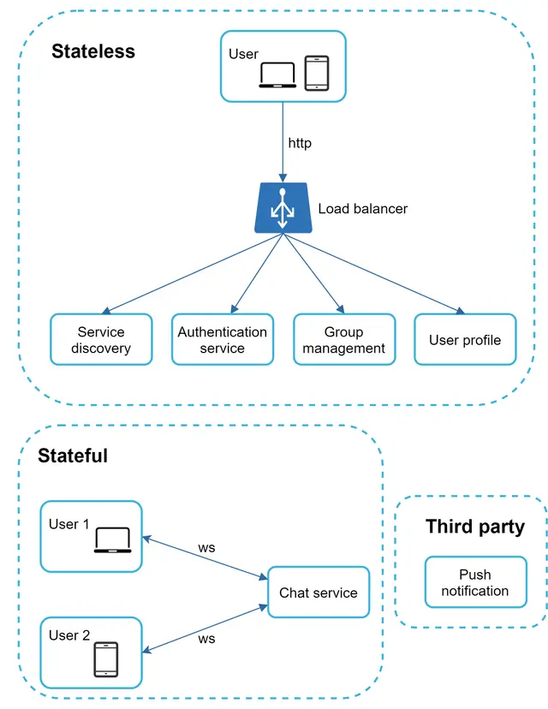
Just now we mentioned that WebSocket was chosen as the main communication protocol between the client and server for its bidirectional communication, it is important to note that everything else does not have to be WebSocket. In fact, most features (sign up, login, user profile, etc) of a chat application could use the traditional request/response method over HTTP. Let us drill in a bit and look at the high-level components of the system.
As shown in Figure 7, the chat system is broken down into three major categories:
  stateless services,
  stateful services,
  third-party integration.
Stateless services are traditional public-facing request/response
services, used to manage the login, signup, user profile, etc.
These are common features among many websites and apps.
Stateful Service - The only stateful service is the chat service.

Slide 11
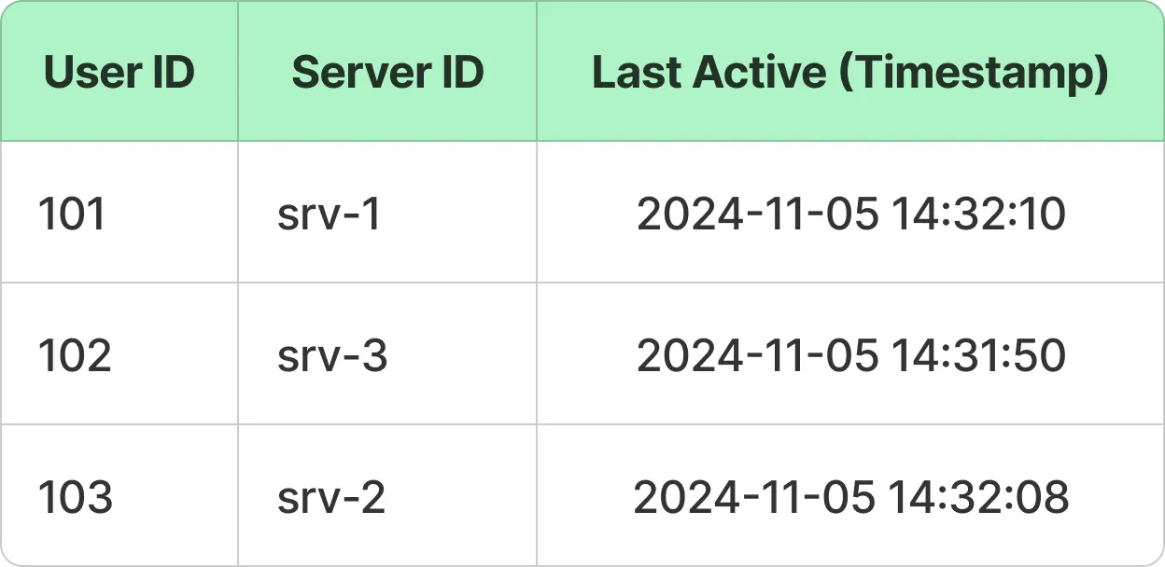
3. 1. Alternative with Service Discovery
An alternative approach is to use service discovery, which enables users to connect directly to chat servers.
In this case, users first connect to the service discovery layer to identify the chat server they should connect to and then establish a WebSocket connection directly with that server.
4. Presence Servers & User Connection Cache
Presence servers manage online/offline status. They use User Connection Cache. It is a fast, in-memory cache (e.g., Redis) that stores each user's active connection details, such as the chat server they’re connected to and their last_active timestamp.
Clients periodically send heartbeat signals to their connected server,
and each heartbeat updates the user’s last_active timestamp in the
cache.
This setup enables efficient support for online/offline status and last
seen functionality.
If the difference between the current time and the last_active timestamp is
within a defined threshold (e.g., 3 seconds), the user is shown as online;
otherwise, they are marked as offline.

Slide 12
5. Notification Service
The Notification Service is responsible for delivering real-time notifications to users, especially when they are offline or not actively using the application.
When a user is offline, the chat server forwards the message to the Notification Service.
To enhance efficiency, the chat server can send this message to a message queue rather than directly interacting with the Notification Service and waiting for a response.
The Notification service integrates with external push notification providers like Firebase Cloud Messaging (FCM) and Apple Push Notification Service (APNS) to deliver messages as push notifications to offline users.
6. Message Queue
The Message Queue is a distributed, high-throughput queue (e.g., Kafka, RabbitMQ) that temporarily stores messages before they are consumed by the Message Storage Service.
By acting as an intermediary, the Message Queue decouples message storage from real-time message handling on chat servers, reducing latency and enhancing the scalability of the application.

Slide 13
7. Message DB
The Message DB stores all chat messages in a reliable and efficient manner, ensuring users can access past messages.
This database is designed for high-write throughput and efficient retrieval (e.g., Cassandra) to handle the large volume of messages in real-time chat applications.
8. Group Service
The Group Service is responsible for handling all group-related functionalities, including creating groups, updating group details and managing group memberships.
When a message needs to be delivered to a group conversation, the Chat Servers query the Group Service to retrieve the current list of group members.
9. Group DB
The Group DB stores and retrieves all data associated with group chats, including group IDs, member lists, admin roles, and group setting.

Slide 14
10. Media Service
The Media Service handles the uploading and management of multimedia content, such as images, videos, and audio files.
It securely stores media files in a blob storage system, while maintaining metadata—such as file type, size, and upload timestamps—in a separate database for easy access and organization.
By offloading media storage from the main chat servers, the Media Service reduces bandwidth usage on the chat servers and enhances overall app performance.
11. Blob Store
The Blob Store is the storage backend for a chat application’s multimedia content, including images, videos, audio files, and documents.
It’s designed to handle large volumes of media content while ensuring fast, secure, and reliable access.
The Media Store typically leverages cloud-based object storage solutions (such as Amazon S3, Google Cloud Storage, or Azure Blob Storage) that provide high durability, scalability, and cost-effectiveness.

Slide 15
12. CDN
To reduce latency when uploading or downloading multimedia content, files are distributed to locations geographically closer to users via a Content Delivery Network (CDN).
When a user shares a multimedia file, the client application uploads it directly to the CDN, storing it in a location close to the recipient.
Instead of sending the file itself, the client sends the file’s URL to the chat server as part of the message, allowing other users to download and access the content quickly and efficiently from the nearest CDN location.
Once files are uploaded to the CDN, the Media Service retrieves them and stores them in a blob store for long-term storage.
This approach reduces the load on chat servers, minimizes latency, and significantly improves media delivery speed for users.

Slide 16
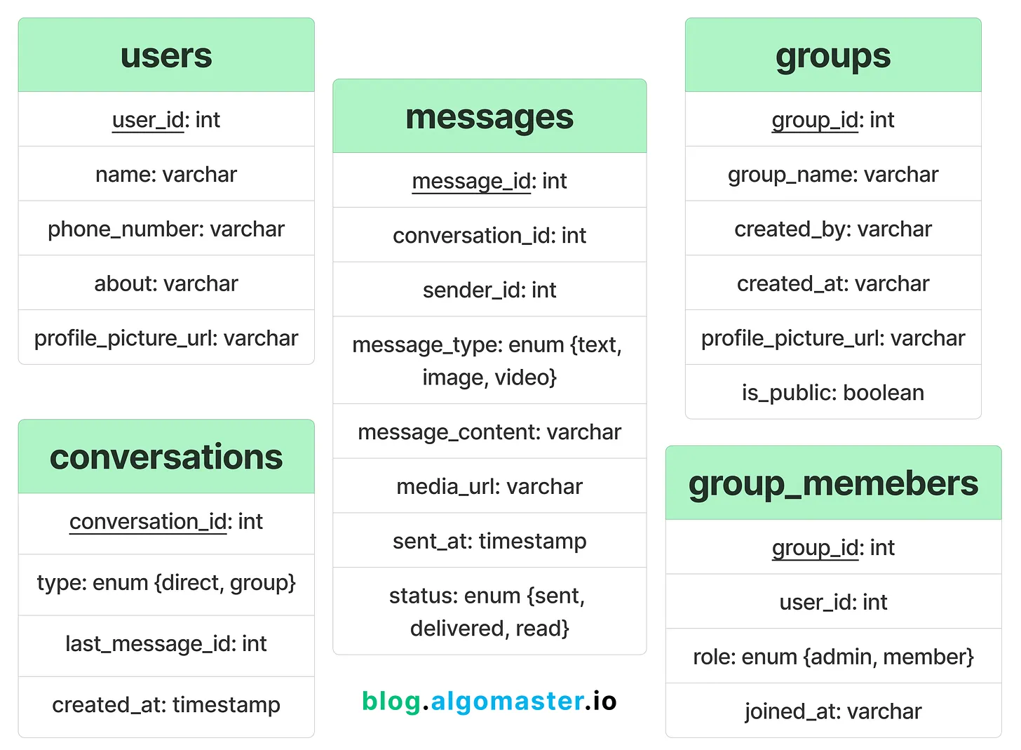
4. Database Design

Slide 17
To store the user, group and conversations data, we can use a SQL database like PostgreSQL.
For message data, it’s preferred to use a NoSQL database like Cassandra due to high-write throughput.
For media files, an object store like AWS S3 provides scalable and secure storage.

Slide 18
5. Design Deep Dive
Real-time Message Delivery
1. Establishing the Connection
2. Connection data is stored in user connection cache.
3. User A sends a chat message to Chat server 1.
4. Chat server 1 obtains a message ID from the ID generator.
5. Chat server 1 sends the message to the message sync queue.
6. The message is stored in a key-value store.
7.a. If User B is online, the message is forwarded to Chat server 2 where User B is connected.
7.b. If User B is offline, a push notification is sent from push notification (PN) servers.
8. Chat server 2 forwards the message to User B. There is a persistent WebSocket connection between User B and Chat server 2.

Slide 19
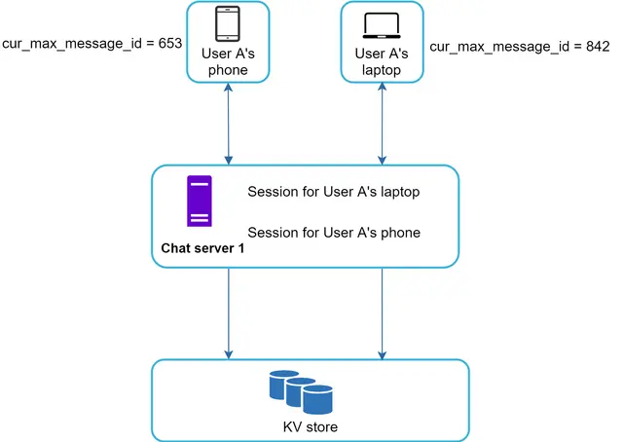

Message synchronization across multiple devices
Many users have multiple devices.
User A has two devices: a phone and a laptop.
When User A logs in to the chat app with her phone, it establishes a WebSocket connection with Chat server 1. Similarly, there is a connection between the laptop and Chat server 1.
Each device maintains a variable called cur_max_message_id, which keeps track of the latest message ID on the device. Messages that satisfy the following two conditions are considered as news messages:
  The recipient ID is equal to the currently logged-in user ID.
  Message ID in the key-value store is larger than cur_max_message_id.
With distinct cur_max_message_id on each device, message synchronization is easy as each device can get new messages from the KV store.

Slide 20
How to generate Message ID?
To retrieve recent messages efficiently, we can use a time-based message ID.
A time-based message ID typically combines a timestamp with a unique identifier for each message.
This allows us to order messages by timestamp, retrieve messages within a specific time range and support pagination (“load more“) where you retrieve messages before or after a specific timestamp without re-sorting the dataset.
A common format might include:
[Timestamp in milliseconds][Unique Sequence/Random Component]
Timestamp (in milliseconds): The first part of the ID is the timestamp at which the message is created. This allows messages to be sorted chronologically by their creation time.
Unique Sequence or Randomized Component: Appending a unique component (like a random or incremental sequence) ensures each message ID is unique, even if multiple messages are sent at the same millisecond.
For instance, a message sent at 2024-11-05 12:34:56.789 with a sequence 001 could have an ID: 20241105123456789001.

Slide 21
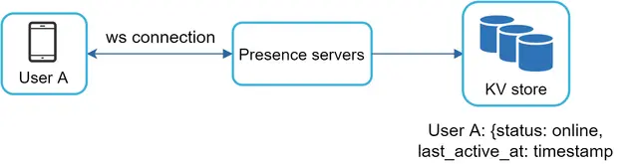
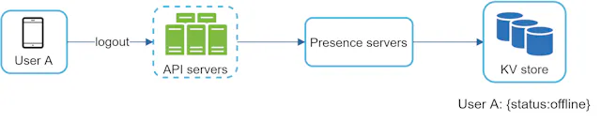
Online Presense (online/offline status) and lastSeen
Presence servers are responsible for managing online status and communicating with clients through WebSocket. There are a few flows that will trigger online status change. Let us examine each of them.
User login
The user login flow is explained in the “Service Discovery” section. After a WebSocket connection is built between the client and the real-time service, user A’s online status and last_active_at timestamp are saved in the KV store. Presence indicator shows the user is online after she logs in.
User logout
When a user logs out, it goes through the user logout flow. The online status is changed to offline in the KV store. The presence indicator shows a user is offline.

Slide 22
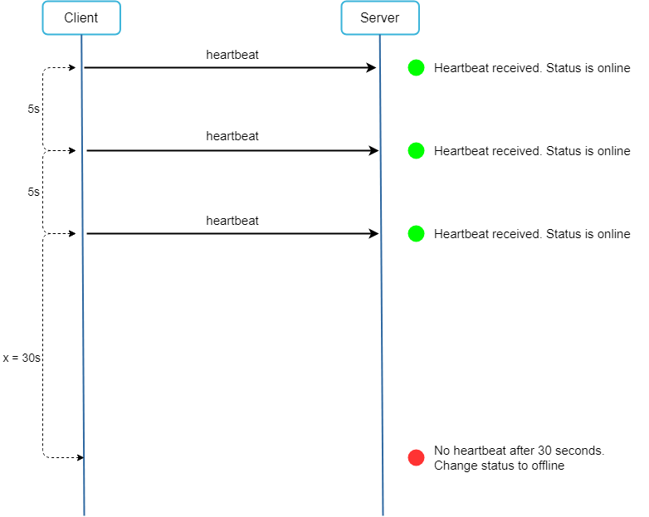
User disconnection
We all wish our internet connection is consistent and reliable. However, that is not always the case; thus, we must address this issue in our design. When a user disconnects from the internet, the persistent connection between the client and server is lost. A naive way to handle user disconnection is to mark the user as offline and change the status to online when the connection re-establishes. However, this approach has a major flaw. It is common for users to disconnect and reconnect to the internet frequently in a short time. For example, network connections can be on and off while a user goes through a tunnel. Updating online status on every disconnect/reconnect would make the presence indicator change too often, resulting in poor user experience.
We introduce a heartbeat mechanism to solve this problem. Periodically, an online client sends a heartbeat event to presence servers. If presence servers receive a heartbeat event within a certain time, say x seconds from the client, a user is considered as online. Otherwise, it is offline.
The client sends a heartbeat event to the server every 5 seconds. After sending 3 heartbeat events, the client is disconnected and does not reconnect within x = 30 seconds (This number is arbitrarily chosen to demonstrate the logic). The online status is changed to offline.

Slide 24
Message Delivery Indicators
WebSockets enable real-time status updates for messages (e.g., “message sent,” “message delivered,” “message read”), providing users with instant feedback on message states.
Message Sent
When User A sends a message, it is transmitted over their WebSocket connection to the server handling their connection (Server A).
Server A receives the message, pushes it to the message queue for storage, and sends an acknowledgment back to User A.
Upon receiving this acknowledgment, User A’s app updates the message status to “sent.”
If User A is offline when attempting to send a message, the message won’t be sent until they are back online. The message remains in a pending state on User A's device until it reconnects and successfully sends the message to Server A.

Slide 25
Message Delivered
Once the User B receives the message, it sends an acknowledgment to Server B.
Server B sends a delivery acknowledgment to Server A.
Server A sends the message status “delivered” to the message queue for permanent storage and then relays this update to User A’s app, which reflects the message as “delivered.”
If User B is offline, Server A will not receive an acknowledgment of delivery from Server B, so the message remains in the “sent” state for User A until User B reconnects.
When User B comes online, the client app sends the updates to Server B, at which point it sends a “delivered” acknowledgment to Server A. User A’s app is then updated to reflect the “delivered” status.

Slide 26
Message Read
When User B opens the chat window and views the message, their app sends a “read” acknowledgment to Server B.
Server B logs this event in the message queue and forwards the “read” status to Server A.
Server A pushes this update to User A’s device, allowing User A’s app to display the message as “read.”
If User B is offline, they cannot view the message, so it will not trigger a “read” status. When User B reconnects and opens the chat, their app will send a “read” acknowledgment to Server B.
The Server B logs the “read” status in the message queue and forwards it to Server A. User A’s app then receives this update, marking the message as “read.”

Slide 27
Group Messages
When User A sends a message in a group chat, the message travels through User A’s WebSocket connection to the server managing that connection (Server A).
Server A queries the Group Service to retrieve a list of all active members in the group.
Server A checks the user connection cache to determine which group members are currently online and the specific servers they are connected to.
For Each Online Member:
  If a member is connected to Server A, it delivers the message directly over the existing WebSocket connection.
  If a member is connected to a different server (e.g., Server B), Server A forwards the message to Server B, which then delivers the message to the user over their WebSocket connection.
For offline group members, Server A sends the message to the Notification Service. The Notification Service triggers push notifications for each offline group member, alerting them of the new message.
In a group chat, every message sent must be distributed (or "fanned out") to each group member.
As group size increases, so does the fan-out workload. For instance, in a group of 500 members, each message requires 500 individual message deliveries, which can quickly overwhelm the server.
That’s why, most chat applications put limits on the number of members a group can have (WhatsApp currently has 1024).

Slide 28
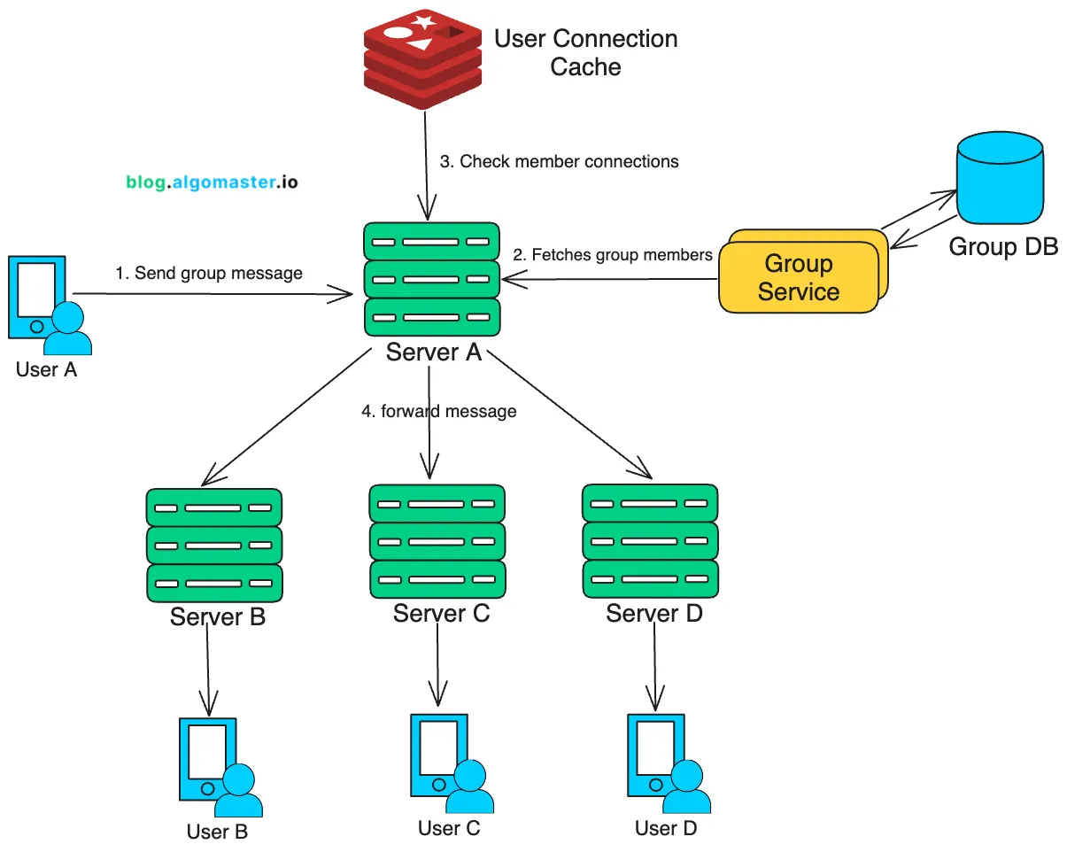

Slide 29
6. Address Key Issues and Bottlenecks
Chat Server Failure
  In the event of a chat server failure, all clients connected to that server will lose their connection.
  To recover, clients automatically attempt to reconnect, this time establishing a new connection with a different available server.
  The load balancer continuously monitors the health of each chat server through regular health checks.
  If a server goes down, the load balancer immediately stops directing traffic to it, ensuring new connections are routed to healthy servers only.

Slide 30
Sharding
To support horizontal scaling and efficient data access, we can implement sharding across different data types:
  User Data Sharding: Shard user data based on user_id. This will allow us to distribute user records across multiple servers and enable us to scale as the user base grows.
  Message Data Partitioning: Partition messages based on message_id, using a timestamp-based message_id to enable efficient time-based searches. This structure allows recent messages to be accessed quickly and older messages to be located based on timestamp.

Slide 31
Optimizing Storage Cost
With large volumes of messages and multimedia content, optimizing storage costs is essential.
Here are some effective strategies:
Compress Multimedia Files: Compressing large files (e.g., images, videos) can reduce storage requirements and cuts costs significantly.
Archive Older Messages: Most users only access recent messages, which can be cached locally on their devices. Older messages can be moved to lower-cost, cold storage (e.g., Amazon Glacier), reducing expenses while still allowing access if needed.
Deduplicate Files: Avoid storing multiple copies of identical files by implementing deduplication, which can save significant space when the same media is shared across multiple users or groups.
Efficient Metadata Storage: Store metadata (e.g., file type, size, timestamps) separately from the media itself to reduce the load on primary storage and make searches faster and more efficient.

