Slide 1
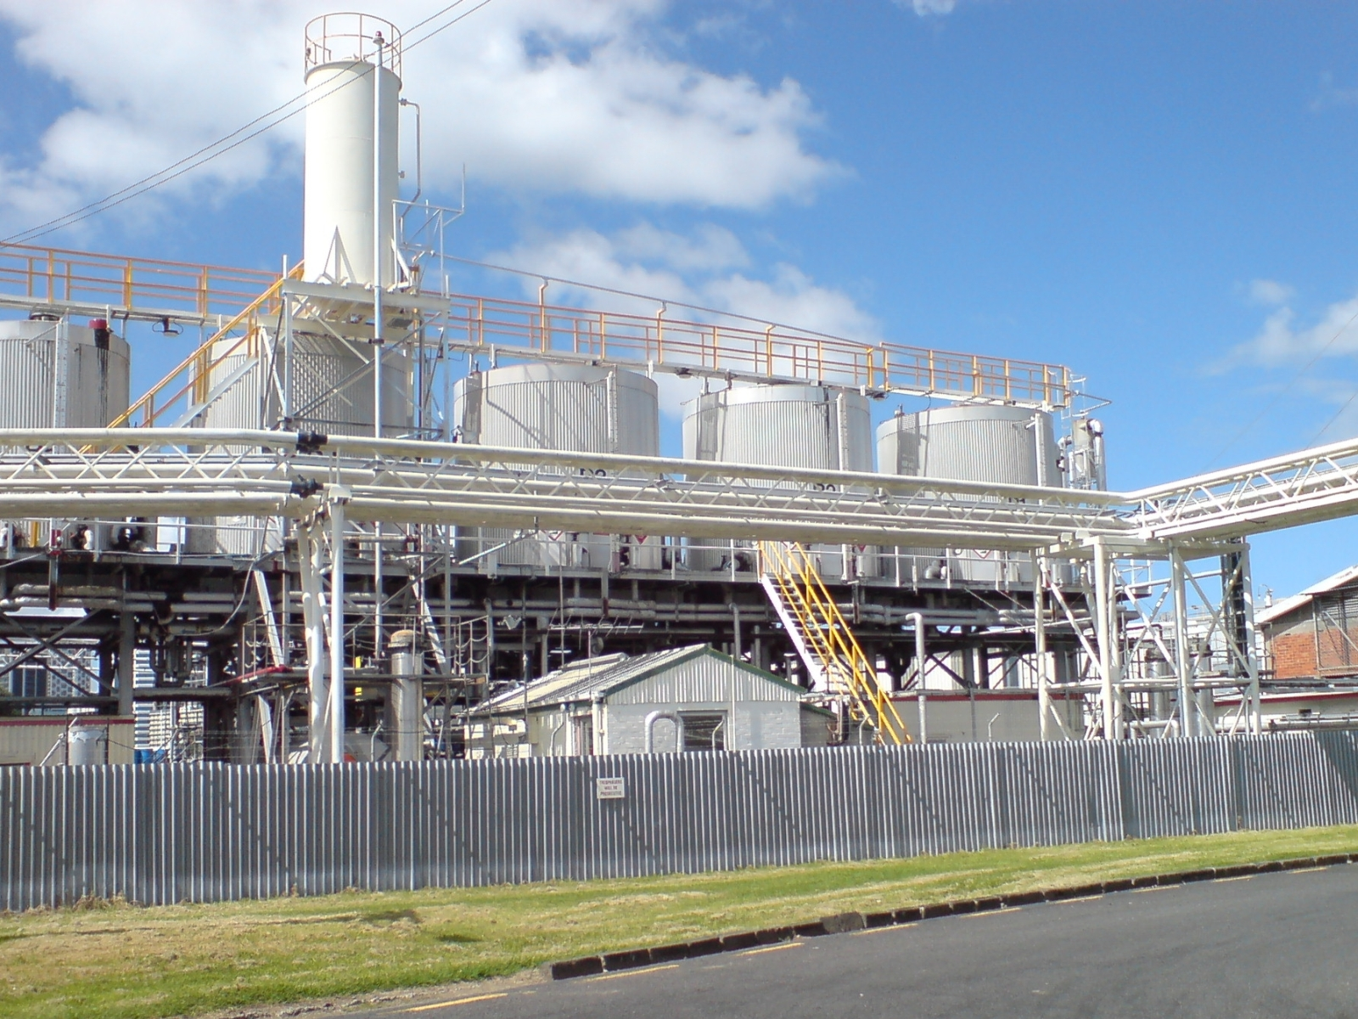
MANFACTURE OF
Cyclo Hexane

Slide 2

Manufacture of
Cyclohexane (40tons/day)
by
Ravindher G(160110802048)
Sai Kumar L(160110802050)
(4/4),Department of Chemical Engineering

Slide 3
CONTENTS
INTRODUCTION
HISTORY
USES
MARKET SURVEY
PROPERTIES
SELECTION OF PROCESS
PROCESS FLOW SHEET
PROCESS DESCRIPTION
MATERIAL AND ENERGY BALANCE
DESIGN OF EQUIPMENT
PLANT ECONOMICS

Slide 4

Why CYCLO HEXANE?
INTRODUCTION

Slide 5
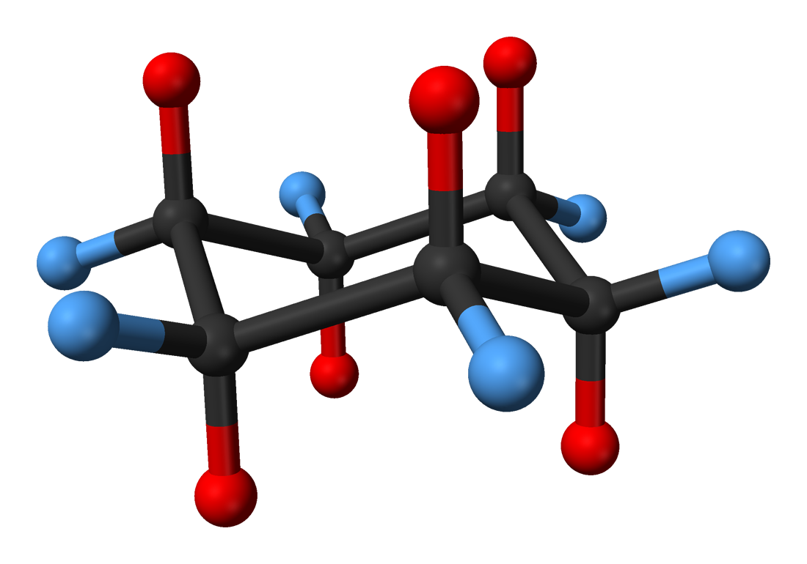
INTRODUCTION
.Cyclohexane is a cycloalkane.
Cycloalkanes are types of alkanes, which have one or more
rings of carbon atoms in the chemical structure of their molecules.
Alkanes are types of organic hydrocarbon compounds which have only single chemical bonds in their chemical structure.
Cycloalkanes consist of only carbon (C) and hydrogen (H) atoms and are saturated.

Slide 6
CYCLOHEXANE SYNONYMS
1.Benzenehexahydride
2.Ciclohexano,
3.Hexahidrobenceno
4. Hexahydrobenzene
5. Hexamethylene
6.Hexametileno
7. Hexanaphthene
8.Naphthene.

Slide 7
Nylon growth, which is the main driver in the cyclohexane market, has stagnated in many applications to below GDP levels although there is still some growth in nylon plastics for automotive and other resin applications.
One of the better performing markets for nylon is engineering thermoplastics.These materials have tough physical properties such as high tensile strength, excellent abrasion, chemical and heat resistance, which allow them to replace metals.
Automotive applications have been growing strongly where there has been a drive to replace metals with plastics to reduce the weight of motor vehicles.

Slide 8
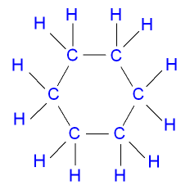
Structure of Cyclohexane

Slide 9
Cycloalkanes (also called naphthenes , especially if from petroleum sources) are types of alkanes which have one or more rings of carbon atoms in the chemical structure of their molecules.
Alkanes are types of organic compounds which have only single chemical bonds in their chemical structure.
Cycloalkanes consist of only carbon (C) and hydrogen (H) atoms and are saturated because there are no multiple C-C bonds to hydrogenate (add more hydrogen to).
A general chemical formula for cycloalkanes would be CnH2(n+1-g) where n = number of C atoms and g = number of rings in the molecule. Cycloalkanes with a single ring are named analogously to their normal alkane counterpart of the same carbon count: cyclopropane, cyclobutane, cyclopentane, cyclohexane, etc. The larger cycloalkanes, with greater than 20 carbon atoms are typically called cycloparaffins.

Slide 10


Slide 11
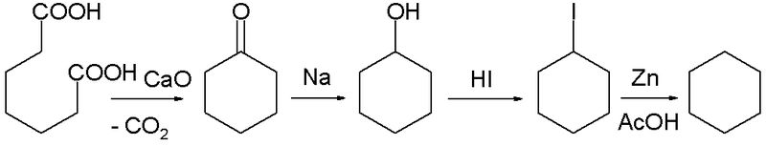
1867 | Marcellin Berthelot reduced benzene with hyderoiodic acid at eleveted temeperatures. He incorrectly identified the reaction product as n-hexane ,but not only because of the convinient matching in boiling point @69C, but also he didn’t believe benzene was a cyclic molecule but rather some sort of association of acetylene .
1870 | Adolf von Baeyer repeated the reaction and pronounced the same reaction product hexahydrobenzene
1890 | Vladimir Markovnikov believed he was able to distill the same compound from Caucasus petroleum calling his concoction hexanaphtene.
1894 | 1. Baeyer synthesized cyclohexane starting with a Dieckmann condensation of pimelic acid followed by multiple reductions 2. In the same year E. Haworth and W.H. Perkin Jr. did the same in a Wurtz reaction of 1,6-dibromohexane.
DIECKMANN CONDENSATION

Slide 12


Wurtz reaction of 1,6-dibromohexane
Surprisingly their cyclohexanes boiled higher by 10°C than either hexahydrobenzene or hexanaphtene but this riddle was solved in 1895 by Markovnikov, N.M. Kishner and Nikolay Zelinsky when they re-diagnosed hexahydrobenzene and hexanaphtene as methylcyclopentane, the result of an unexpected rearrangement reaction

Slide 13
APPLICATIONS:
1.Commercially, most of cyclohexane produced is converted into cyclohexanone, is the organic compound with the formula 5CO. The molecule consists of six-carbon cyclic molecule with a ketone functional group. This colorless oil has an odour reminiscent of pear drop sweets as well as acetone.
2.Cyclohexanol ("KA oil") is the organic compound and is formed by
catalytic oxidation. KA oil is then used as a raw material for adipic acid. Adipic acid is the organic compound with the formula 4(CO2H)2.From the industrial perspective, it is the most important dicarboxylic acid.
3.Cyclohexane is also an important organic solvent.
Used in Electroplating - Vapor Degreasing Solvents,
Laboratory Chemicals,
Solvents – Extraction,
Machinery Mfg and Repair ,
Rubber Manufacture,
Solvents - Rubber Manufacture,
Wood Stains &Varnishes.

Slide 14
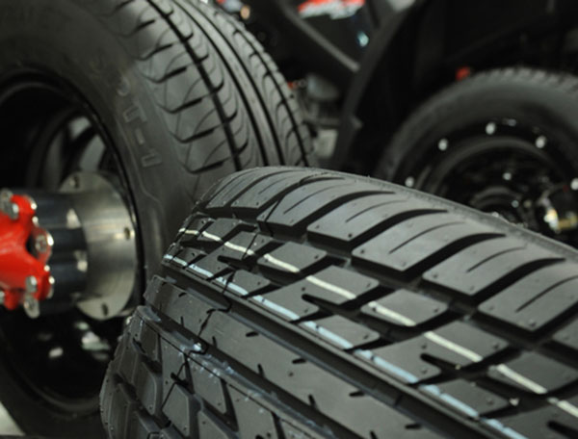
1.Cyclohexane used in manufacture of rubber.

Slide 15
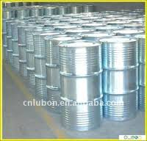
1.Used in electroplating –vapor degreasing solvents
USED IN ELECTROPLATING-VAPOR DEGREASING SOLVENTS

Slide 16
IDENTIFIERS
S.no | Identifier | Number
1 | CAS number | 98-95-3
2 | PubChem | 7416
3 | ChemSpider | 7138
4 | UNII | E57JCN6SSY
5 | KEGG | C06813
6 | RTECS number | DA6475000

Slide 17
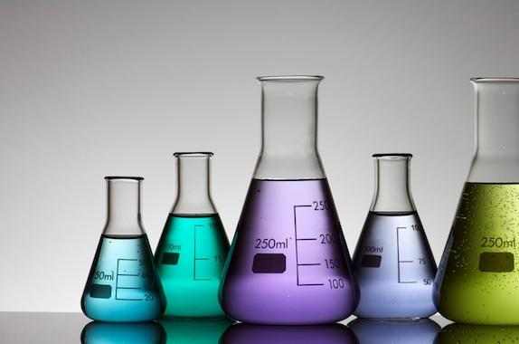
PROPERTIES

Slide 18
Molecular weight | 84.16
Boiling point | 80.72°C
Vapor pressure | 77.5 Torr at 20°C
Freezing point | 6.54°C
Refractive index | 1.4262 at 20°C
Density | 0.7785 g/mL (6.497 lb/gal) at 20°C 0.7739 g/mL (6.457 lb/gal) at 25°C
Viscosity | 1.0 cP at 20°C
Surface tension | 24.98 dyn/cm at 20°C
Solubility in water | 0.006% at 25°C
Solubility of water in cyclohexane | 0.01% at 20°C
Flash point | -4°F (-20°C) by closed cup
Lower explosive limit | 1.3%
Upper explosive limit | 8.0%

Slide 19
THERMODYNAMIC PROPERTIES
Property | Value
Specific Heat at 30º C J/g | 1.509
Latent Heat of Vaporization J/g | 331
Latent Heat of fusion J/g | 94.2
Heat of combustion MJ/mol | 3.074

Slide 20
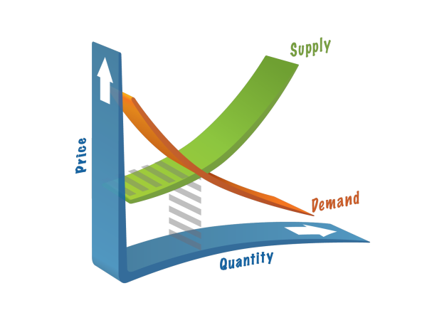
Market Survey

Slide 21
INDIAN MANUFACTURERS OF CYCLOHEXANE

Slide 22
COMPANY | LOCATION
1.TRIVENI AROMATICS AND PERFURMERY LIMITED | GUJARATH
2.LEO CHEMO PLAST PVT LTD | MUMBAI
3.CHOICE ORGANICS PVT LTD | THANE
4.A.S .JOSHI AND COMPANY | MUMBAI

Slide 23
GLOBAL MANUFACTURERS OF CYCLOHEXANE

Slide 24
Company | Location | Capacity
Azot Cherkassy | Cherkassy, Ukraine | 60
Cepsa | Huelva, Spain | 150
Chemko AS | Strazske, Slovakia | 90
Erdol-Raffinerie-Emsland | Lingen, Germany | 260
ExxonMobil | Botlek, Netherlands | 270
Fina Antwerp Olefins | Antwerp, Belgium | 110
Huntsman Petrochemicals | Wilton, UK | 330
JSC Kuibyshevazot | Togliatti, Russia | 120
Kemerovo Azot | Kemerovo, Russia | 155
PKN Orlen | Plock, Poland | 120
Rivneazot | Rivne, Ukraine | 30
Shchekinoazot | Shchekino, Russia | 65
SSME Azot | Severodonetsk, Ukraine | 50
ZA Pulawy | Pulawy, Poland | 60
Source: ECN/CNI

Slide 25
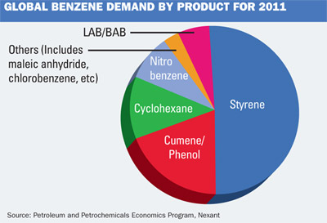

Slide 26
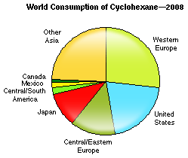
World consumption of cyclohexane

Slide 27
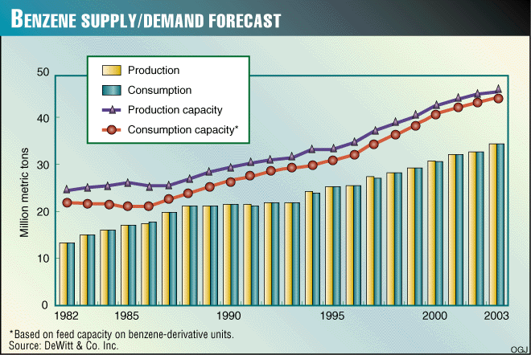
Cyclohexane demand / supply forecast

Slide 28
DIFFERENT MANUFACTURING PROCESS
AND
SELECTION OF PROCESS

Slide 29
Commercially cyclohexane is synthesized by various processes. Each process has its
own merits and demerits. Categorizing various processes we can differentiate
among them on following characteristics;
OPERATING CONDITIONS
There exist two types of processes
liquid phase process
vapor phase process.
The phase to be handled dictates the operating conditions of process.
In liquid phase processes the operating temperature is comparatively low.
Hence is less costly process.
Vapor phase processes yield an undesirable low output per unit volume of
reactor zone. This is not only due to low density of treated products but also due
to difficulties encountered in cooling of said reactor zone.
It is necessary to use bulky apparatus comprising critical and costly cooling coils.
2. CATALYST TYPE
Liquid phase :Nickel & noble metals (rhodium, ruthenium and Platinum)
vapor phase: Nickel oxide (NiO) supported on alumina (Al2 03) is used.

Slide 30
LIQUID PHASE PROCESSES
Process Name | Operating cond. | Catalyst
UPO (Universal oil | Temp: 200 - 300°C | Fixed bed of of
products) Hydrar | Press: 3xl0⁶Pa abs | pt based catalyst
Process
Houdry Process | Temp: 160 - 235°C | Pt-based catalyst
 | Press: several atms | in fixed beds.
Sinclair/engelhard | Temp; 250°C | Noble metal
process |  | fixed bed.
IFP (Institut | Temp: 200 - 240°C | Raney 'Nickel in
Francais du Petrole) | Press: 35 atm | Suspension

Slide 31
LIQUID PHASE PROCESSES
Bexane DSM: |  | Temp. 370°C | Pt-based catalyst | By a coolant
Nederlandse |  | Pressure 3xl0⁶pa
 |  | Abs
Hytoray Process |  | Temp. 370°C | Pt-based | By a coolant
 |  | Pressure 3xl0⁶pa abs | Catalyst

Slide 32
SELECTED PROCESS
Liquid phase process (MANUFACTURING OF CYCLOHEXANE FROM BENZENE) is selected.
This process is a mixed phase process; i.e. it is a hybrid of liquid phase and vapor phase process.
This process enjoys the benefits of both process and makes it economical.
Majorly it converts benzene in liquid phase at low temperature after that it eliminates the inherited drawback of liquid phase process of low purity by converting rest of the benzene in vapor phase
Hence, also relaxes the need of costly reactor

Slide 33
The main features of this process are
It is a liquid phase process that is a stable system with respect to control point of view.
Better heat removal system i.e., by outer-recirculation cooler, so an isothermal reaction is achieved.
Pressure is high which give higher yields at a particular temperature.
Lower temperatures can be selected in liquid phase which give higher equilibrium constant values as the process is exothermic

Slide 34
TEMPERATURE SELECTION At 260ºC, thermal cracking of benzene begins. At 248ºC, isomerization of cyclohexane to methyl cyclopentane begins. So upper temperature range is 248.88ºC
At 260ºC, thermal cracking of benzene begins.
At 248ºC, isomerization of cyclohexane to methyl cyclopentane begins. So upper temperature range is 248.88ºC
TEMPERATURE(C) | EQUILIBRIUM CONSTANT
93 | 2.29 XlO¹⁰
149 | 2 . 6x 10 ⁶
204 | 2.18X10³

Slide 35
PRESSURE SELECTION
High pressure i.e., 35 atmosphere" is chosen due to following reasons.
At 204°C, the vapor pressure of benzene is very high, so to get a liquid phase reaction, high pressure must be specified.
higher Pressure favours higher C6 H12 yield.
The stoichiometric equation for reaction is
C6H6 + 3H2→ C6H12
According to Le' chattier principle, high pressure will favour more benzene inversion.

Slide 36
Our choosen conversion is 99.998% equivalent to 5-10 ppm equilibrium benzene so 25% excess benzene is used.
ASSUMPTIONS AND THEIR JUSTIFICATION
All the sulfur in benzene feed is converted to H2S.
S + H2 —> H2S
1.The H2S in ppm is discarded in purge stream from liquid/gas separator. Although for purge, concentration of CO is cared about, low ppm H2S is assumed to be blown - off.
2. Pressure effects on solubility is neglected because total condensed cyclohexane flashed from separator is recycled back via over-head condenser.
3.Steady state equimolar flow of cyclohexane (vapor and liquid) is assumed in stabilizer because both streams are fed when they are saturated.
4.For some heat exchangers, average transfer coefficients are used which are justified for preliminary design.

Slide 37
FLOW SHEET

Slide 38
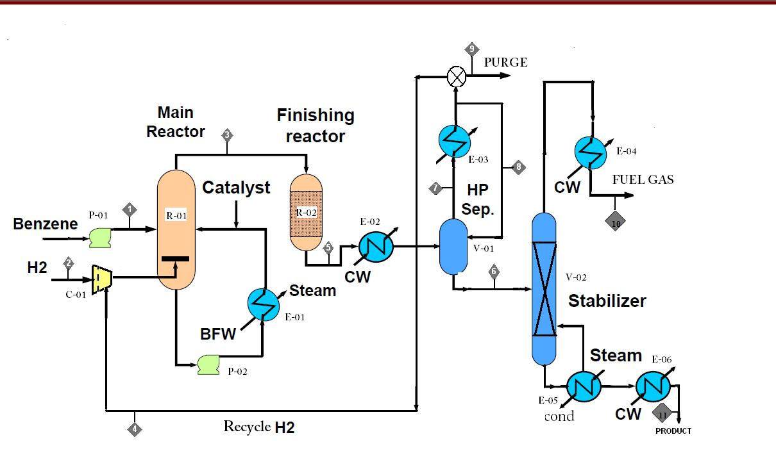

Slide 39
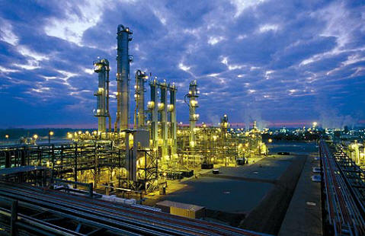
PROCESS DESCRIPTION
PROCESS DESCRIPTION

Slide 40
PROCESS DETAILS:
(I)BASIC CHEMISTRY
The hydrogenation of benzene proceeds according to:
C6H6 +3H2 → C6H12
One mole of benzene reacts with three moles of hydrogen to produce one mole of cyclohexane. The reaction is highly exothermic, liberating 91500 btu/lb-mol of benzene converted at 300 ºF.
REACTION KINETICS
The kinetics are first order in hydrogen partial pressure, zero order of benzene, and independent of the pressure of cyclohexane.

Slide 41
Fresh benzene from storage tank at 25ºC and 1 atm, make-up hydrogen, and recycle hydrogen are heated to reaction temperature,
benzene in heat exchanger and hydrogen is heated by compressing adiabatically and fed to the slurry reactor.
Slurry phase reactor is an isothermal reactor in which benzene in liquid form and hydrogen in gas phase is introduced and reaction takes place on Raney nickel catalyst.
The conversion in this reactor is 95%.
Slurry phase reactor is provided with an outer-recirculation heat exchange/cooler which removes the heat of reaction and low pressure (70 psi) steam in generated.
Temperatures in the reactor are held below 204ºC to prevent thermal cracking, side reactions and an unfavorable equilibrium constant that would limit benzene conversion.

Slide 42
Next to the slurry phase reactor, a catalytic fixed bed pot reactor is provided which makes-up the conversion almost to 100%.
In this reactor the reaction takes place in vapor phase .Effluent from the fixed bed reactor is condensed and cooled to 160°C and then this Gas liquid mixture is flashed to 10 atm in a gas liquid flash separator.
Excess hydrogen is recycled to slurry phase reactor and liquid from separator is fed to the stabilizer column to remove dissolved hydrogen.
Liquid product from bottom of stabilization column at 182ºC is cooled in product cooler and send for final storage.
The overheads of low pressure flash are 95% hydrogen which is used as fuel gas or mixed with sales gas.

Slide 43

Input
Output
Material Balance

Slide 44
BASIS:
40 tons (19.84 Kg mole/ hr or 1668.56 kg / hr) per day of cyclohexane
Bz : H2=1 : 3.75 (in mol fraction )
REACTION
C6H6 + 3H2 → C6H12

Slide 45
Product composition: (wt. basis)
C.H=0.9988
M.C.P=0.00022
Benzene=10ppm
Impurties(CH4+C2H6)=0.001
Total=1.00
Benzene Feed Composition(Wt .basis)
Benzene=0.9978
C.H=0.00016
M.C.P=0.00012
Impurities=0.00057
Sulfur=0.5ppm
Total=1.00

Slide 46
Hydrogen Feed Composition
 | Wt.basis | Mol basis
H2 | 0.9111 | 0.98798
CO2 | 0.0002 | 0.00001
CO | 0.00013 | 0.00001
CH4 | 0.08853 | 0.012
TOTAL | 1.00 | 1.00

Slide 47
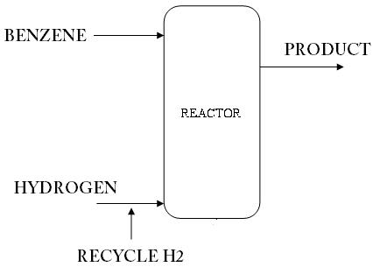
BALANCE ACROSS REACTOR (R-O1)
 |  | R-O1
Components | In (Kg/hr) | Out (Kg/hr)
Benzene | 1548.80 | 78

Slide 48
Cyclohexane | 0.3 | 1583.6
M.C.P. | 0195 | 0.4
Impurities | 1.00. | 1.7
Sulfur | Trace. | Trace
Hydrogen | 150 | 36
Carbon dioxide | 0.06 | 0.06
Carbonmonoxide | 0.04 | 0.04
Methane | 25 | 25
Total | 1725 | 1725
Temp (°C) | 204.4 | 204.4
Press (atm) | 35 | 34.625

Slide 49
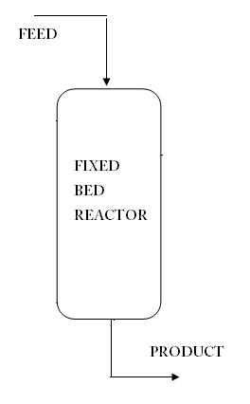
BALANCE ACROSS REACTOR (R-O2)

Slide 50
Components | In (Kg/hr) | Out (Kg/hr)
Benzene | 78 | 0.02
Cyclohexane | 1583.6 | 1667
M.C.P. | 0.4 | 0.4
Impurities | 1.7 | 1.7
Sulfur | Trace | Trace
Hydrogen | 36 | 30
Carbon dioxide | 0.06 | 0.06
Carbonmonoxide | 0.04 | 0.04
Methane | 25 | 25
Total | 1725 | 1725
Temp (°C) | 204.4 | 273
Press (atm) | 34.625 | 33.6

Slide 51
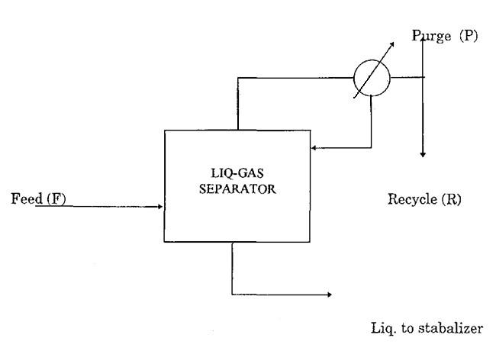
BALANCE ACROSS FLASH DRUM (V-O1)

Slide 52
 |  | V-O1
Components | In (Kg/hr) |  | Out (Kg/hr)
 |  | Liquid | Purge | Recycle
Benzene | 1.7 | 0.02 | - | -
Cyclohexane | 1666.545 | 1666.5 | - | -
M.C.P. | 0.4 | 0.4 | - | -
Impurities | 1.7 | 1.7 | - | -
Sulfur | Trace | - | - | -
Hydrogen | 30 | 0.498 | 16 | 13.25
Carbon dioxide | 0.06 | ⁶⁻10x6.6 | 0.03 | 0.025
Carbonmonoxide | 0.04 | ⁶⁻10x4.2 | 0.02 | 0.0167
Methane | 26.0 | ³⁻10x3 | 13.14 | 11.5
Total | 1725 | 1669 | 30 | 25

Slide 53
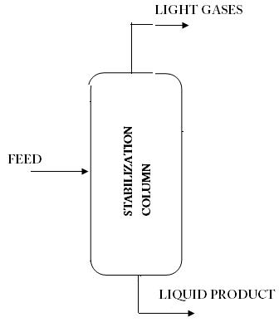
BALANCE ACROSS STABILIZATION COLUMN(V-02)

Slide 54
 |  | V-O2
Components | In (Kg/hr) | Out (Kg/hr)
 |  | Bottoms | Overheads
Benzene | 0.02 | 5.18X10⁻³ | 0.01482
Cyclohexane | 1666.5 | 1666.5 | 0
M.C.P. | 0.4 | 3.6x10⁻⁴ | 0.3996
Hydrogen | 0.996 | 0.0258 | 0.9702
Carbon dioxide | ⁶⁻10x6.6 | 0 | ⁶⁻10x6.6
Carbonmonoxide | ⁶⁻10x4.2 | 0 | ⁶⁻10x4.2
Methane | ³⁻10x3 | 0 | ³⁻10x3
Total | 1669 | 1666.53 | 1.3876

Slide 55
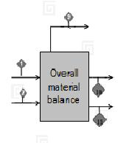
OVERALL MATERIAL BALANCE:

Slide 56
Streams | 1 (inlet) | 2 (inlet) | 9 (outlet) | 10 (outlet) | 11 (outlet)
Component | Kg/hr | Kg/hr | Kg/hr | Kg/hr | Kg/hr
Benzene | 1548.8 | ……. | ………… | 1.11*10^-5 | 0.0167
C6H12 | 0.2727 | ……. | ………….. | 0 | 1668.24
M.C.P | 0.195 | ……. | …………. | 1.13*10^_3 | 0.3662
Impurities | 1.00 | ……. | ………….. | 1.00 | ………..
Sulfur | Trace | ……. | trace | ………… | …………
Hydrogen | ……… | 136.75 | 15.6 | 0.594 | 2*10^-4
CO2 | ……… | 0.035 | 0.03 | 4.2*10^-6 | 0
CO | ……… | 0.0223 | 0.02 | 6.6*10^-6 | 0
CH4 | ……… | 13.5 | 13.2 | 2.9*10^-6 | 0
TOTAL | 1550 | 150.3 | 28.85 | 0.698 | 1668.6

Slide 57

Energy Balance

Slide 58
HEAT OF REACITON :-
C6H6 + 3H2 → C6H12
[Sum of products Heat of formation] – [Sum of products Heat of formation] =Heat of reaction
[- 29430] - [11720 + 0] = -74135.32 btu/lb-mol
SPECIFIC HEAT OF CYCLOHEXANE VAPORS:-
From537 R to 960 R
C⁰p = (1.8)(-7.701 +125.675xl0⁻³ T- 41.58x10⁻⁶ T⁻²) dt ÷ (1.8)dtC°p
=37.15 Btu/lb mol. °F
C°p = 154.43 kJ/ kg-mol. K

Slide 59
Critical pressure = 588 psia
Critical temperature= 996 R
Reduced Pressure,Pr= 0.87
Reduced temperature,Tr= 0.96.
Cp - C°p= 9.6 x 10⁻⁶
Specific Heat,Cp= 37.15 Btu/lb mol. °F
Specific Heat,Cp=155.5 kJ/ kg-mol.K
SPECIFIC HEAT OF HYDROGEN:-
Cpº = (6.52+0.78xl0⁻³T+0.l2xl0⁵ T⁻²)dt ÷ dt
= [(6.52T +0.78x10⁻/2³T² -0.12x10⁵ /T ) ] ÷ [960-537]
Cp° = (1532.2 + 76.16 + 17.754)/235
= 6.92Btu / lb-mol-ºF =28.96 kJ/ kg-mol.K

Slide 60
SPECIFIC HEAT OF LIQUID BENZENE:-
a, Cp at 77 °F=0.45 Btu / lb-mol-ºF
b, Cp at 400 °F=0.6 Btu / lb-mol-ºF
c, Cp=(0.6-0.45)/(400-77)=4.644xl0⁻⁴ Btu / lb-mol-ºF
Specific heat, Cp = (a + ct)dt ÷dt
Specific heat, Cp =[0.45dt +4.644/2x10 Tdt÷[400-77]= 43.74 Btu/lb mol °F
183.09 kJ/ kg-mol. K

Slide 61
SPECIFIC HEAT OF LIQUID CYCLOHEXANE:-
Average Temperature =434K
Reduced Temp.,Tr=0.784
Accentric factor ,ω=0.214
Cp°, vapor heat capacity = -7.701 + 125.675 x 10⁻³ (434) - 41.584 x 10⁻⁶ (434)²
= -7.701 + 54.543-0.02 = 195 KJ/ kg-mol.K

Slide 62
Cp l - Cpº )/2 = (0.5 + 2.2 ω)[3.67 + 11.64(1-Tr)⁴ + 0.634(1-Tr)⁻¹]
Where;
R = 2 Btu/ lb mol - ° F
(Cp l - Cpº )/2 = (0.971) [3.67 + 0.0253 + 2.935]
(Cp l - Cpº )/2 = 6.44
CpL = 59.7 Btu/ lb- mol °F
= 248.17 KJ/ kg-mol. K

Slide 63
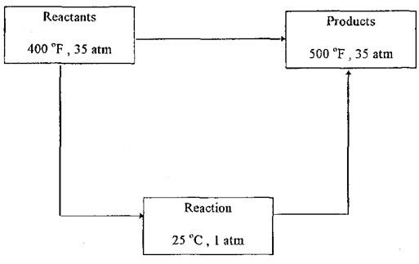
ENERGY BALANCE AROUND REACTORS:-

Slide 64
ΔHR,77F + ΔH PRODUCTS,500F - ΔHREACTANTS,400F (A)
Hr,77 =74135.32 Btu/lb mol (C.H.) °F x 45.157 moles/hr = 337728.65Btu/hr.
ΔHPRODUCT FROM 400 TO 500 °F
ΔHp = mCpΔT=45.157x37.15 Btu/lb mol - °F (500-77) +36.21(500-77) (6.93) 709617 + 106145.632 = 815762.632 Btu/hr.
3. ΔH reactants from 77 to 400 °F
ΔHR =mCpΔT= 45.45 moles/hr x 43.74 Btu/lb mol - °F x (400 - 77) + 166.26 x 6.91 x (400-77)= 1013052.4 Btu/hr

Slide 65
Inserting in (A):
-3347728.65 + 815762.632-1013052.4 =- 3.5 xlO⁶ Btu/hr.
So, = 3.5 x 10⁶ Btu/hr or 5.9 x 10⁴ Btu/min.
5.9 x 10 Btu/min. has to be removed by outer circulation.
FIXED BED REACTOR OUT-LET TEMPERATURE:-
Conversion=98 % to 100%
Moles converted=45.45 (0.02)= 0.909 lb moles/hr.
Heat generated at 77 °F =67389 Btu/hr.
Inlet temperature=500 °F
Assume adiabatic operation:
= 45.45 (-7.701+125.675x10⁻³ T)dt + 33.383(6.52+ 0.78x10⁻³T)dt
37438.33 = [-7.701(T2-533) + (T2² – 500²)] (45.45) + [6.52(T2 – 500) +
(T2²– 500²)](33.38)
37438.33 = [-350T2 + 186555.57+2.856T2² - 811348l]
+ [217.66T2 - 116011.3 + 0.013 7/
-3698.66]
37438.33 = -132.34 T2 + 2.87 T2² - 744502.5

Slide 66
Hence;
2.87 T²2 - 1 3 2 . 3 4 T 2 - 781940.82 = 37438.33
On solving the above quadratic equation, we get temperature in ºF
T2 = 522.55 °F
ENERGY BALANCE OF HEAT EXCHANGERS
ENERGY BALANCE OF OUTER RECIRCULATION COOLER:-
Item NO. E-01

Slide 67
PARAMETERS |  |  | STREAM | STREAM
 |  |  | 1 | 2
Fluid Entering |  |  | Benzene | Water
Flow-rate (kg/hr) |  |  | 26877.3 | 7978.7
Inlet Temperature ⁰C |  |  | 248.88 | 150.5
Outlet Temperature ⁰C |  |  | 204.44 | 243.3
Change in temperature ⁰C |  |  | 44.44 | 93.3
Heat Capacity |  | (J/kg K) | 2590.36 | 4169.7
Inlet Enthalpy |  | kJ/kg | 579 | 520
Oulet Enthalpy |  | kJ/kg | 191.9 | 907.4
Duty of exchanger (MJ/hr) |  |  | 3094 | 3094

Slide 68
Inlet enthalpy = outlet Enthalpy 579+520=191.9+907 1099kJ/kg=1099KJ/kg
ENERGY BALANCE OF CONDENSER FOR CYCLOHEXANE VAPORS:-
Item No. E-02
PARAMETERS |  | STREAM | STREAM
 |  | 1 | 2
Fluid Entering |  | Cyclohexane+Gas | Water
Flow-rate (kg/hr) |  | 1725 | 2478.5
Inlet Temperature | 0_{C} | 272.5 | 26.7
Outlet Temperature ⁰C |  | 62 | 149
Change in temp. | 0_{C} | 202 | 122.3
Heat Capacity | (j/kgK) | 3.6x10³ | 4.19x10³
Inlet Enthalpy | kJ/kg | 891 | 7.123
Oulet Enthalpy | kJ/kg | 378.563 | 519.56
Duty of exchanger |  | 1266 | 1266
(MJ/hr)

Slide 69
PARAMETERS |  |  | STREAM | STREAM
 |  |  | 1 | 2
Fluid Entering |  |  | cyclohexane | Water
Flow-rate (kg/hr) |  |  | 1669 | 11603.2
Inlet Temperature |  | ⁰C | 125 | 55.24
Outlet Temperature |  | 0_{C} | 125 | 65.6
Heat Capacity | (J/kg K) |  | 3.0x10³ | 4.19x10³
Inlet EnthalpykJ/kg |  |  | 515 | 126.7
Outlet Enthalpy | kJ/kg |  | 474 | 167.6
Duty of exchanger (MJ/hr) |  |  | 600 | 600

Slide 70
Inlet Enthalpy = Outlet Enthalpy 891+7.123 = 519.56+378.563 898.123kJ/kg = 898.123 kJ/Kg
ENERGY BALANCE OF OVERHEAD CONDENSER:-
Item No. E-03
Inlet Enthalpy = Outlet Enthalpy 503+9.23 = 419.56+84.03 512.23kJ/kg = 512.59 kJ/Kg
ENERGY BALANCE OF PRODUCT COOLER:-
Item No. E-05

Slide 71
PARAMETERS |  |  | STREAM | STREAM
 |  |  | 1 | 2
Fluid Entering |  |  | cyclohexane | Water
Flow-rate (kg/hr) |  |  | 1669 | 8042.22
Inlet Temperature |  | ⁰C | 184 | 25
Outlet Temperature |  | 0_{C} | 30 | 43
Heat Capacity | (J/kg K) |  | 3.0x10³ | 4.19x10³
Inlet Enthalpy | kJ/kg |  | 233.52 | 41.9
Outlet Enthalpy |  | kJ/kg | 200 | 75.42
Duty of exchanger |  | (MJ/hr) | 723.85 | 723.85

Slide 72
Inlet Enthalpy= Outlet Enthalpy
275.42=275.42(kJ/kg)

Slide 73
DESIGN OF EQUIPMENT

Slide 74
SELECTION CRITERIA FOR VAPOR LIQUID SEPARATORS
The configuration of a vapor/liquid separator depends on a number of factors. Before making a vessel design one has to decide on the configuration of the vessel with respect to among others:
Orientation
Type of feed inlet
Type of internals
Type of heads

Slide 75
Orientation of the Vessel
The selection of the orientation of a gas-liquid separator depends on several factors.
Both vertical and horizontal vessels have their advantages.
Depending on the application one has to decide on the best choice between the alternatives.
Advantages of a vertical vessel are:
a smaller plot area is required (critical on offshore platforms)
it is easier to remove solids
liquid removal efficiency does not vary with liquid level because the area in the vessel available for the vapor flow remains constant
generally the vessel volume is smaller
Advantages of a horizontal vessel are:

Slide 76
Application | Preferred orientation
Reactor Effluent Separator (V/L) | Vertical
Reactor Effluent Separator (V/L/L) | Horizontal
Reflux Accumulator | Horizontal
Compressor KO Drum | Vertical
Fuel Gas KO Drum | Vertical
Flare KO Drum | Horizontal
Condensate Flash Drum | Vertical
Steam Disengaging Drum | Horizontal

Slide 77
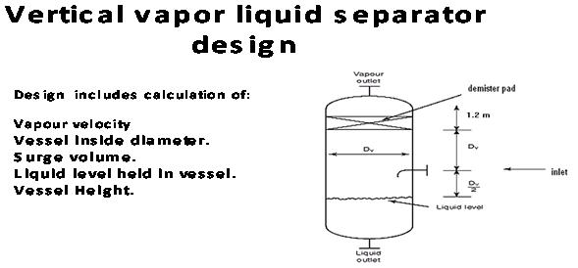

Slide 78
INLET STREAM
C.H= 1666.545 kg/hr
M.C.P= 0.367 kg/hr
Benzene= 0.0167 kg/hr
Impurities= traces
S= traces
H2=150-120= 30 kg/hr+ XH2R
CO2= 0.0327 kg/hr+ X CO2R
CO= 0.02 kg/hr+ X CO R
CH4=14.5 kg/hr+ X CH4R
INPUTS
Operating pressure : P=10 atm
Vapour mass flow rate: WV = 56.05 kg/hr
Vapor density = 1.23 kg/hr
Liquid mass flow rate : WL = 1669 kg/hr
Liquid density : = 39.6 kg/m³

Slide 79
Vapours
H2= 30 kg/hr
CO2= 0.0327 kg/hr
CO= 0.02 kg/hr
CH4=26 kg/hr
LIQUID
C.H= 1666.545 kg/hr
M.C.P= 0.367 kg/hr
Benzene= 0.0167 kg/hr
Impurities= traces
S= traces
Kg mole of Gases
H2= 15 kg mole
CO2= 1.363×10⁻³ kg mole
CO= 1.42857×10⁻³ kg mole
CH4=1.625 kg mole
VOLUME OF GASES

Slide 80
V=NRT/P
V= 16.627×0.082×335/10
V= 45.676 m³/ hr
Density of liquid
n= total moles=19.84 kg mole Specific gravity = 0.313 Density of liquid = 31.3 kg/m³
STEPS
Vv=A× Uv
Uv = kv {(ℓL - ℓv)/ ℓv}^{1/2}
kv= 0.0107 m/s with a mist eliminator
A=πD²/4
LLA=ts× VL
3≥ ts ≤5
L=LL+1.5D+1.5ft
CALCULATIONS
First we find velocity of gase
Uv = kv {(ℓL - ℓv)/ ℓv}^{1/2}
= 0.0579m/s

Slide 81
Now we find area
Vv=A× Uv
A= Vv/ Uv
=0.218 m²
^{DIAMETER:}
^{D=1.74Ft}
LENGTH OF LIQUID ENTRAINED
LLA=ts× VL˘
ts= 4 min
We assume 5 percent of entrainment of liquid in vapors
VL˘= VL× 5 %
0.908× 5 %
0.0454 m³ / min LLA=ts× VL˘
LL=ts× VL˘/ A
= 0.0454 ×4 / 0.218 m² m³ / min×min×1/ m²
=0.633027 m
=2.73 ft
L= LL+1.5D+1.5 ft
= 6.875 ft
Minimum length should be 8.5 ft

Slide 82
According to “vertical and horizontal vap liq separator design”
So length is 8.5 ft
L/D= 8.5/1.75 = 4.85
L/D < 5 for vertical separator
Ite m |  |  | Vapour Liquid Seperator
N um b e r o f item |  |  | 1
Ite m C o de |  |  | V-1 2 0 4
Operating temperature | 62◦C
Operating pressure |  | 10atm
h e igh t |  | 8.5ft
D ia m e te r |  | 1.75ft
Vortexbreaker |  | Radial vane vortex breaker
MATERIAL OF CONSTRUCTION Carbon steel

Slide 83


Slide 84
COST ESTIMATION
FIXED CAPITAL
The total cost of the plant ready for start-up and the cost paid to the contractors. It includes the cost of :
Design , engineering and construction supervision.
2. Equipment and their installation, piping, instrumentation and control systems.
3. Buildings and structures.
4. Auxiliary facilities, such as utilities, land and civil engineering work.
It is a once-only cost that is not recovered at the end of the project life, other than the scrap value

Slide 85
WORKING CAPTIAL
Working capital is the additional investment above the fixed capital, to start the plant and operate it to the point when income is earned. It includes the cost of :
1.Start up and initial catalyst charges.
2. Raw materials, intermediates in the process and finished product inventories.
3. Funds to cover outstanding accounts from customers.
Most of the working capital is recovered at the end of the project.
Total investment of a project = Fixed capital +working capital.

Slide 86
ESTIMATION OF OPERATING COSTS
The cost of producing a chemical product will include the items listed below.
They are divided into two groups.
1.Fixed operating costs: costs that do not vary with production rate. These are the bills that have to be paid whatever the quantity produced.
2.Variable operating costs: costs that are dependent on the amount of product produced.

Slide 87
FIXED COST
FIXED COSTS
1.Maintenance (labour and materials).
2. Operating labour.
3. Laboratory costs.
4. Supervision.
5. Plant overheads.
6. Capital charges.
7. Rates (and any other local taxes).
8. Insurance.
9. Licence fees and royalty payments.

Slide 88
VARIABLE COSTS
1.Raw materials.
2. Miscellaneous operating materials.
3. Utilities (Services).
4. Shipping and packaging.

Slide 89
ESTIMATION OF EQUIPMENT COST
STORAGE TANK
TK-1=3.1 x 10⁶ rupees
TK-2=3.54 x 10⁶ rupees
PUMPS
P-01=3.54 X 10⁵ rupees
P-02=2.88 x 10⁵ rupees
P-03=6.64xl0⁴ rupees
COMPRESSORS
C-01 = 5.7.6x10⁶ rupees
HEAT EXCHANGERS
E-01=1.45 xlO⁵ rupees
E-02=7.27xl0⁵ rupees
E-03=5.8x10⁵ rupees
E-04=5.8xl0⁵ rupees
E-05=2.2xl0⁵ rupees
E-06=9.25 xlO⁵ rupees

Slide 90
VESSELS
R-01=3.76xlO⁵rupees
R-02=9.5xl0⁴ rupees
V-01=3.3 x 10⁵rupees
V-02=l.lxlO⁵ rupees
STABALIZER (V-03)
Shell cost=3.54xlO⁵ rupees
Packing cost=1.94 x 10⁴rupees
Total cost=3.73xlO⁵ rupees
Total purchased equipment cost= Rs.2.56xl0⁷ rupees
ESTIMATION OF TOTAL CAPITAL INVESTMENT

Slide 91
• Direct Cost (Rs)
Installation costs=6.4 x 10⁵rupees
Instrumentation & control, installed=4.61x10⁵rupees
Piping, installed=1.15x10⁵rupees
Electrical, installed=6.4 xlO⁴rupees
Building, process & auxiliary=1.28 x 10⁶rupees
Service facilities & yard improvement =1.8x10⁵ rupees
Land=1.53 x 10⁶ rupees
Total direct cost=8.68 x 10⁶rupees
Indirect Cost
Engineering & supervision=1.514x10⁶rupees
Construction & contractor's fee=1.56x10⁶ rupees
Contingency=1.33 x 10⁷rupees
Total indirect costs=4.41 x 10⁷ rupees
Total fixed capital investment=1.31x10⁷ rupees
Working capital=3.3x10⁶ rupees
Total capital investment=1.64x10⁷ rupees

