Slide 1
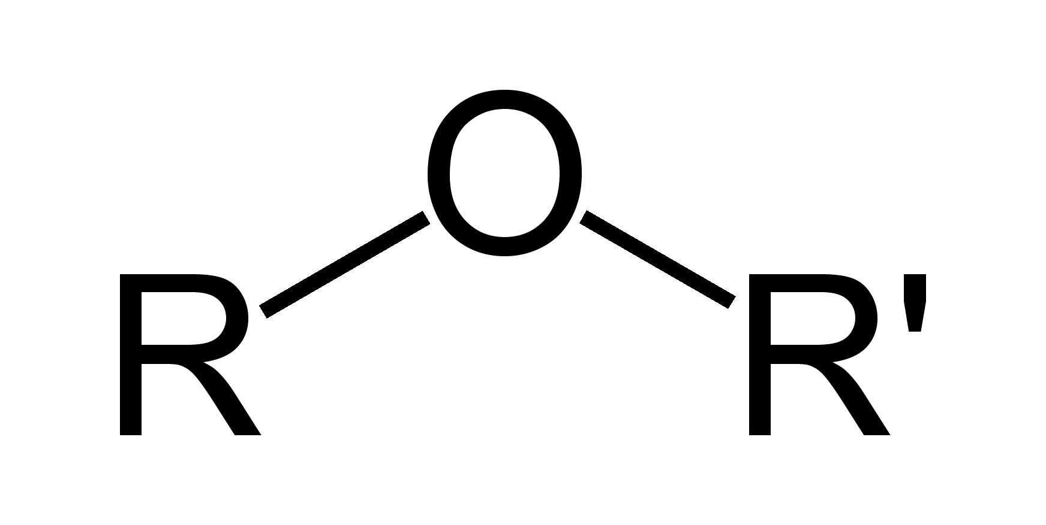
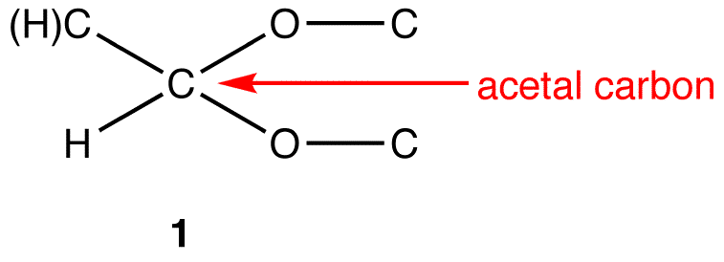
Glycosides
Hydrolysis
Glycoside
Glycon (sugar moiety) + Aglycon (non-sugar moiety)
(Acetals/ Sugar-ethers)
Facilitates absorption of glycoside and help in
Transportation of aglycone part to the site of action
Responsible for pharmacological activities
Acetal
Ether
Glycosidic bond
Formation of Glycosides:
-H₂O
Sugar-OH + H-Aglycone
Glycon
Aglycon
Beta-D-Glucose (Galactose, Rhamnose, Mannose etc.)

Slide 2
Properties of Glycosides:
1. Colourless, crystalline
Exception:
Antraquinone Glycosides: Red/ Orange Flavone Glycosides: Yellow
2. Water and Alcohol soluble / Ether and chloroform insoluble
3. Optically levo-rotatory (more active)
4. It is extracted by Stass-Otto method
Glycosides
Pharmacological action
Glycosidic linkage
Chemical nature
Classification of Glycoside:

Slide 3
Pharmacological action
Pharmacological action | Plant | Mnemonic
Laxative and purgative | Allo, Senna, Cascara | Purgative/Laxative SAC, Alu Sona Cara
Cardiac glycoside | Thevetia, Stropanthus, Digitalis, Squill | The Strong (Cardiac) Digital Squirrel
Immunomodulator | Ginseng, Picrorrhiza | Immuno GinPic
Expectorant | Liquorice, Wild cherry bark | Wild Cherry bark Liquor extract
Bitter glycosides and Hepatoprotectives | Gentian, Picrorrhiza, Chirata, Quassia | GenitalPic, Bitter Chirata, HepatoQuassim
Emetic | Black mustard | Kalo shorshe bomi bondho kore
Antidiabetic | Gymnema | Gym korle diabetis hobe na
Leucodarma | Psorelea, Ammi | Ami psoriasis darma

Slide 4
Glycosidic linkage
Type | Description | Example | Mnemonic/ Notes
C-glycosides | Aglycone-CH + OH-C₆H₁₁O₅ --------> Aglycone-C-C6H11O5 + Water | Alloe, Cascara, Cochineal | Alu Chara; Carmic acid in Cochineal is responsible for red colour
O-glycosides | Aglycone-OH + OH-C₆H₁₁O₅ --------> Aglycone-O-C6H11O5 + Water | Senna,Rhubarb, Flavonoids | Rongin (flavonoids) Rhubab Sona, Senna (3P): Primatic crystal, Paracytic stomata, Purgative in nature
S-glycosides | Aglycone-SH + OH-C₆H₁₁O₅ --------> Aglycone-S-C6H11O5 + Water | Sinigrin from balck mustard | Sinni Sorshe, Papi sorshe, Sorshe theke sulphur paoa jai
N-glycoside | Aglycone-NH + OH-C₆H₁₁O₅ --------> Aglycone-N-C6H11O5 + Water | Nucleosides | N for Nucleosides

Slide 5
Chemical nature
Type | Plant | Mnemonics/ Notes
Anthraquinone glycosides | Senna, Aloe, Rhubarb, Casara | SARC anthra
Cardiac glycosides | Digitalis, Stropanthus, Thevetia (Lucky nut tree), Squill, Ouabin, Oleander | The Strong Cardiac Digital Squirrel
Saponin Glycosides | Tetracyclic triterpinoids: Dioscorea, Shatavari | Shatabdi disco (tetracyclic saponin terpenoids)
Saponin Glycosides | Pentacyclic triterpinoids: Ginseng, Liquorice, Senega, Sarsaparila, Quillia bark | Gin Liquor, Sin (Senega) Sorshe (Sarsaparila), Quill
Cyanogenetic glycoside | Bitter almond, Wild cherry bark | bonyo cherry, teto almond cyanide toiri kore

Slide 6
Chemical nature
Type | Plant | Mnemonics/ Notes
Isocyanate glycoside | Black mustard | Kalo sorshe theke isocyanate paoa jai
Flavanol glycosides | Buckwheat, Ginko, Silymarin | Sily Gincobuck (Flavon)
Coumarin glycoside | Ammi, Visnaga, Psoralea | PAV kumari
Aldehyde glycosides | Vanilla | Vanilla Icecream e aldehyde thake
Phenol glycoside | Bear berry | Bear e phenol (alcohol) grp thake
Steroidal glycosides | Solanium | Steroidal Solanki
Bitter glycosides | Gentian, Picrorrhiza, Chirata, Quassia, Gymnema | GenitalPic, Bitter Chirata, HepatoQuassim

Slide 7
Chemical Tests for Glycosides

Slide 9
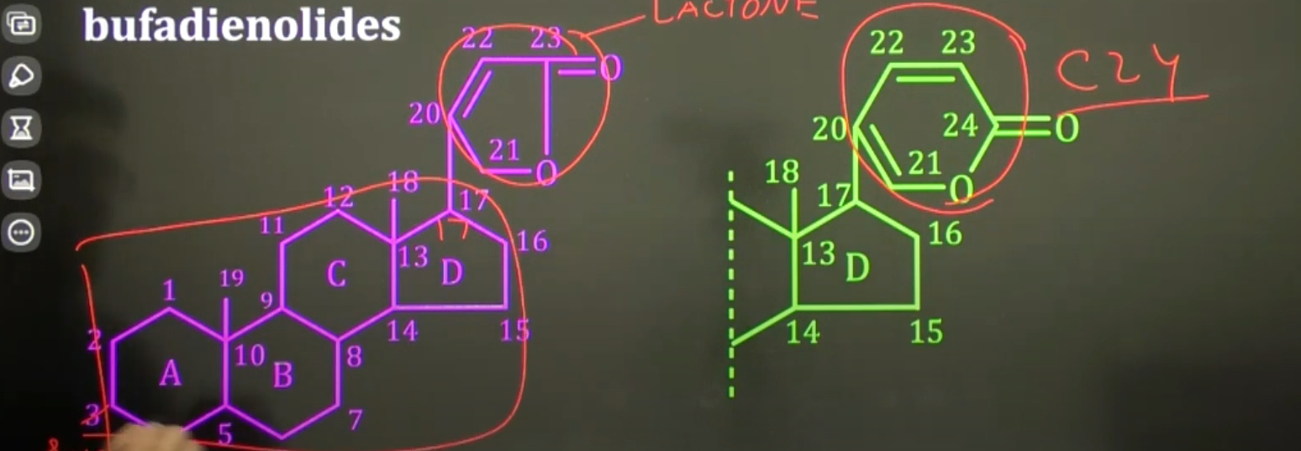
Cardiac Glycosides
Cardiac glycosides
Cardenolides
(23-C) (due to presence of Lactone (5C ring) ring at C’17 of steroidal moiety)
(Higher occurrence in nature)
Bufadienolyde
(24-C)
Aglycone part of cardiac glycoside is steroidal
Sugar is attached with the steroidal Aglycone at C’3 Max. activity obtained if attachment at 3-beta position
Lactone is attached with the steroidal Aglycone at C’17 Max. activity obtained if attachment at 17-beta position
Ring A/B, C/D shall be in cis position for max activity
Max no.of OH grp will increase actiivty

Slide 10
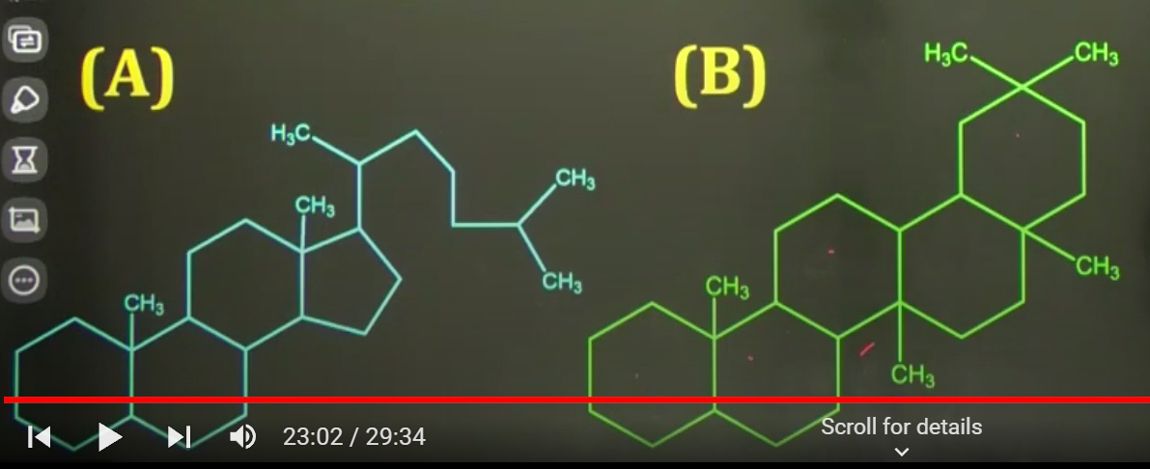
Saponin Glycosides
Aglycone part will show soap like action
Chemically Cyclopentene phenanthrene in nature
Saponin glycosides (Triterpenoid in nature)
Tetracyclic triterpenoid
(Steroidal saponin) e.g.Dioscorea, Satavari, Ginseng
Pentacyclic triterpenoid e.g. Quilia. Liquorice, Senega, Ginseng
Tetracyclic triterpenoid uses: As raw material of: Vitamin D, Cardiac glycosides, Sex hormones like Testosterone, Progesteron, Corticosteroids and Oral Contraceptives

Slide 11
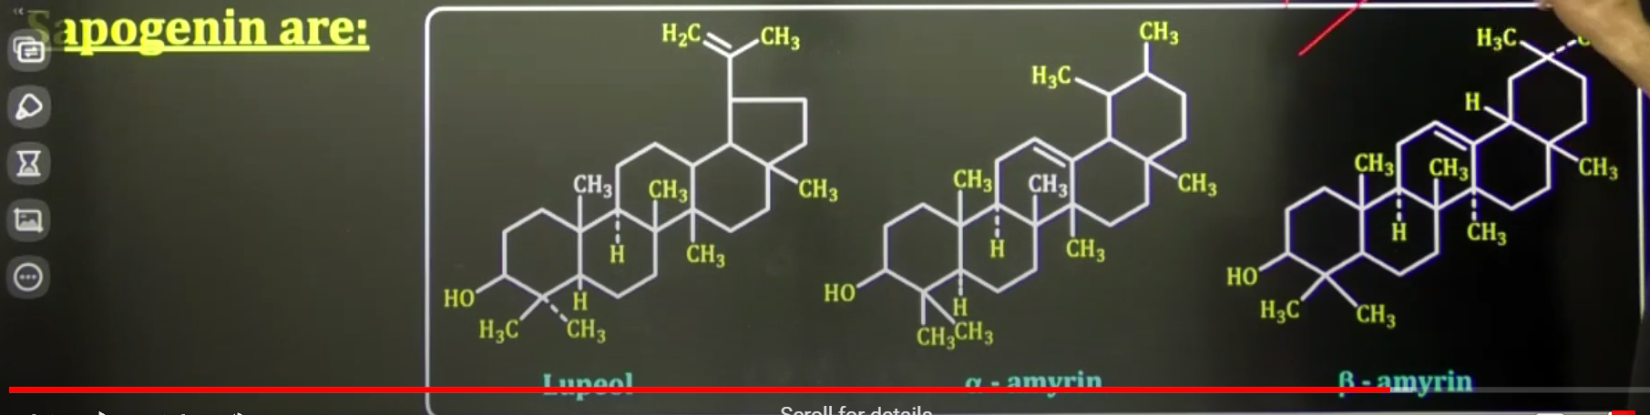
Saponin Glycosides
Pentacyclic triterpenoids contain Sapogenin aglycon moiety

Slide 12
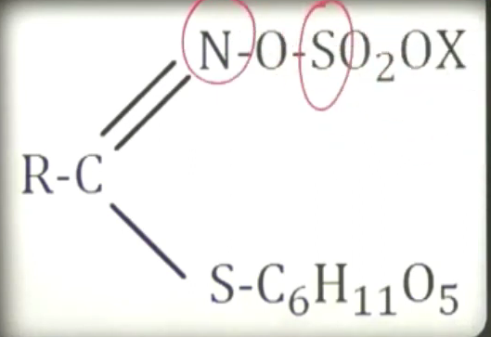
Cyanogenic Glycosides
Also called Cyanophore glycoside, as they contain Hydrocyanic acid in their aglycone moiety and on hydrolysis, they yield
Hydrocyanic acid and Benzaldehyde. E.g. Amygdalin from bitter almond
Isothiocyanate Glycoside
Also called Thioglycosides/ Sulphurated glycosides/ Glucosinolate compounds,
as they contain Isothiocyanate residue in their aglycone moiety, having Sulphur and Nitrogen.
Many plants in this class contain Myrosinate enzyme

Slide 13
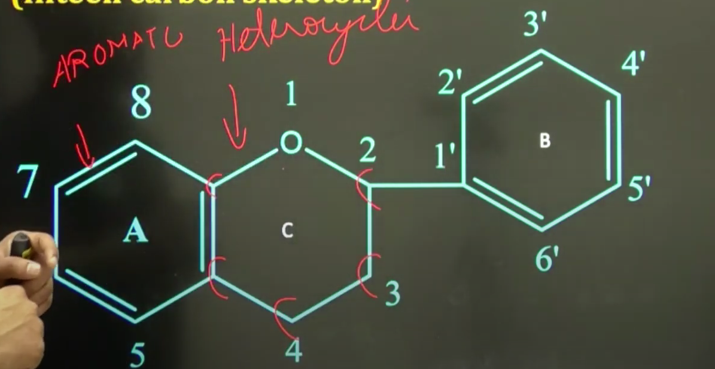
Flavonoid Glycoside
These are Polyphenolic compounds (there are 3 polyphenolic compounds: Flavonoid, Non-flavonoid and Phenolic acids)
Flavonoid contains an Aromatic ring A condensed to a Heterocyclic ring C, attached to an Aromatic ring B. This structure is
called Flavonoids diphenyl propane skeleton (15-C skeleton; C6-C3-C6). One or more phenolic grp combine with sugar moiety.
OH groups are commonly found in C’5/ C’7 of ring A, while ring B carries Alkoxyl grp.
Class | Example | Mnemonic
Flavones | Fisetin, Luteonin, Apiginin | nin-gin-tin
Flavonols | Kemferol, Myercetin, Quercetin | Ol-cetin
Flavonones | Hesperidin, Narinjin, Hesperitin | Hesperiflavone
Isoflavonones | Genestein, Diadzein | tein-zein
Anthocyanins | Pigments which give colors to fruits, leaves etc.
Anthocyanidins | Cyanidin, Delphenidin (Sugar free pigments)
Flavonoid glycosides
Anthocyanine (Anthocyanidine is the aglycon moiety of Anthocyanin) Forms water soluble plant pigments and are responsible for various colors like purple/blue/red to fruits , flowers and leaves
Anthoxanthine White/ yellowish/ colourless compound include Isoflavones, Flavonols and Flavonones

