Slide 1

Schuster Payment Analysis

Slide 2

Content 1. Data Handling 2. Model Building 3. Recommendations

Slide 3

Section1
Data Handling

Slide 4

Problem
Background
Schuster is a multinational retail company specializing in sports goods and accessories. It regularly deals with numerous vendors on credit terms. However, inconsistencies in payment compliance by these vendors lead to inefficiencies.
Objective:
To develop a predictive model that estimates the likelihood of late payments for open invoices. This will aid in prioritising collector activities, enhancing payment compliance, and sustaining healthy business relationships.

Slide 5
Data Description
Received Payment Data
RECEIPT_METHOD | In which method payments have been made | USD AMOUNT | Invoice Value converted to USD
CUSTOMER_NAME | Name of the customer/vendor | INVOICE_ALLOCATED | Invoice number that has been allocated to a particular vendor
CUSTOMER_NUMBER | Customer's unique identity number | INVOICE_CREATION_DATE | The date on which the invoice was created
RECEIPT_DOC_NO | Reference number of the payment receipt | DUE_DATE | The date by which the payment was to be made
RECEIPT_DATE | The date in which the payment has been made | PAYMENT_TERM | Days given to the vendor/customer for making the payments
CLASS | As the payment against these invoices have already been received so Transaction Class as PMT (short for Payment) assigned | INVOICE_CLASS | Three types of Invoice classes - Credit Memo or Credit Note (CM), Debit Memo or Debit Note (DM) or Invoice (INV)
CURRENCY_CODE | Currency used for the payment | INVOICE_CURRENCY_CODE | Currency code as per the invoice generated
Local Amount | Invoice value in local currency | INVOICE_TYPE | Invoice created for physical goods or services (non-goods)
Received Payments Data: Contains historical transactions with details including payment terms, dates, amounts, and customer details. (93937 entries, total 16 columns)

Slide 6
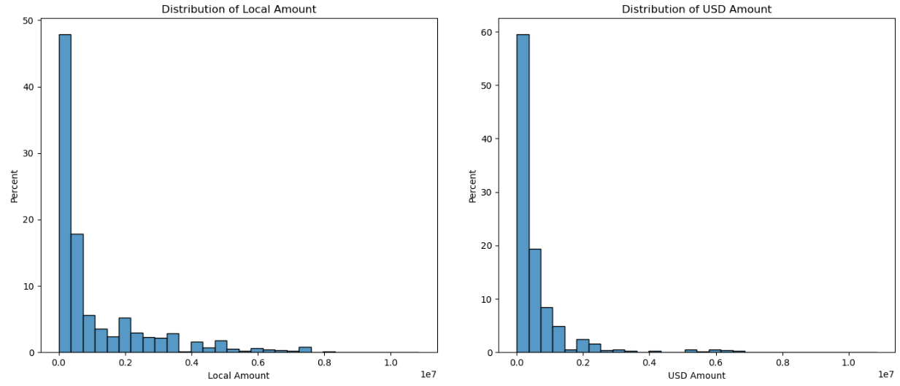
Exploratory Data Analysis (EDA)
The distribution of both local and USD amounts is skewed, with a concentration of values at the lower end and a long tail towards higher values (Received_payments_Data)

Slide 7
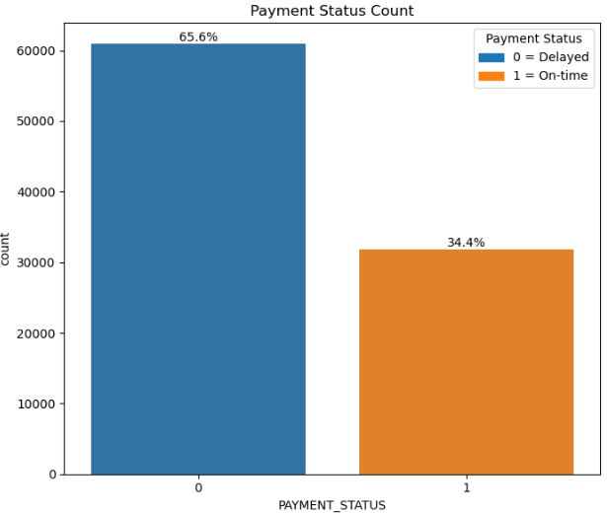
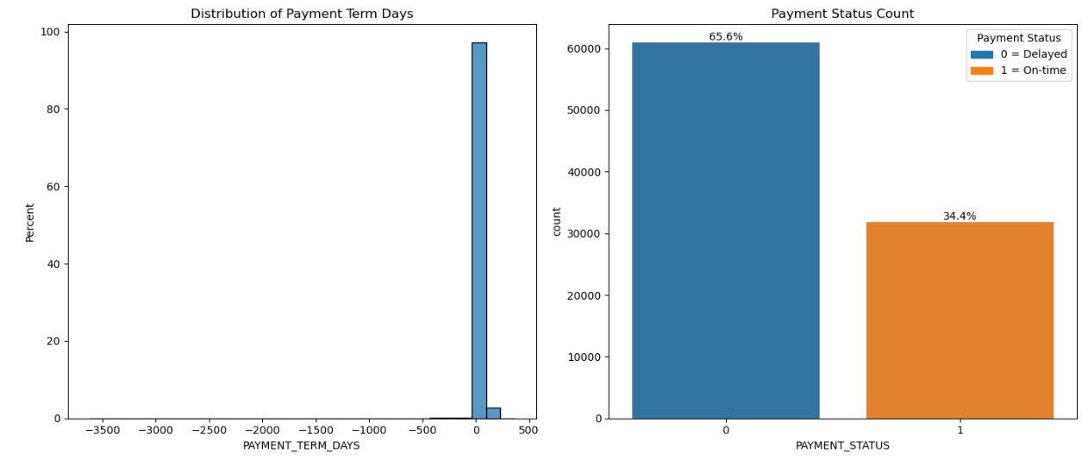
Exploratory Data Analysis (EDA)
The average payment term is around 42 days, with a standard deviation of 61 days, indicating a wide range of payment terms.
The distribution shows that most terms are concentrated around 30 to 60 days. Negative values might represent data entry errors or special cases where due dates are set before invoice creation dates.
Approximately 66% of the payments are late (represented by 1). Around 34% of the payments are on time (represented by 0).

Slide 8
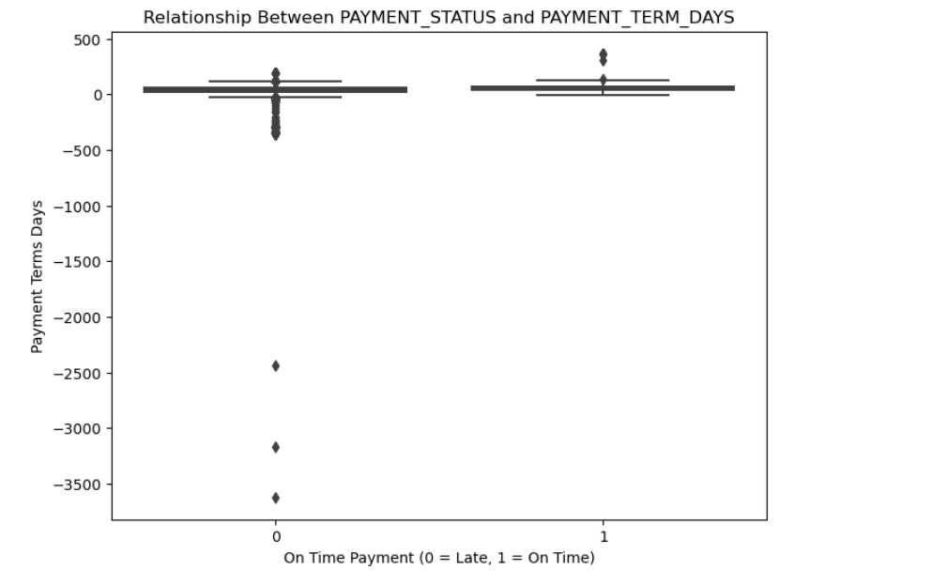
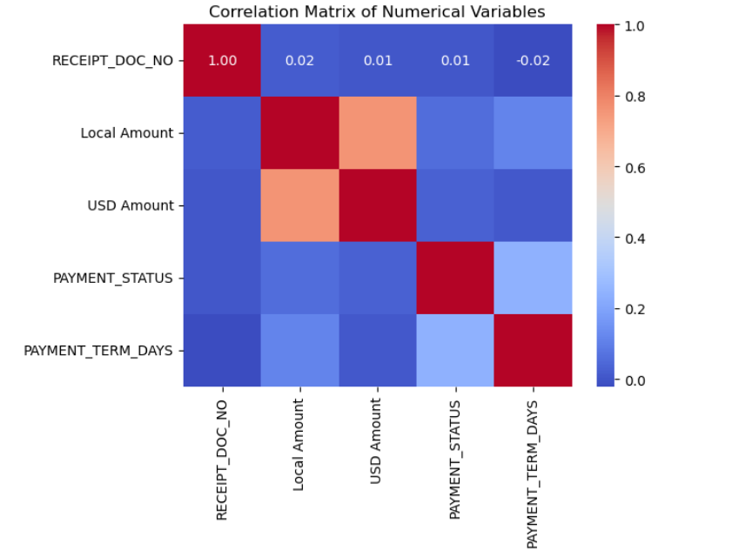
Exploratory Data Analysis (EDA)
The boxplot reveals that the distribution of payment terms days is quite similar for both on-time and late payments. However, it looks like on-time payments have a slightly higher median and a wider range in payment terms compared to late payments, suggesting that longer payment terms might be slightly more manageable for on-time payments.
The heatmap of the correlation matrix provides insights into the relationships between numerical features: PAYMENT_STATUS and PAYMENT_TERM_DAYS show some degree of correlation, suggesting that as the number of days from invoice creation to due date increases, the likelihood of a payment being late also increases, though the correlation is not very strong.
Local Amount and USD Amount are highly correlated, as expected since these are just currency conversions of the same underlying values. The other variables show less significant correlations with PAYMENT_STATUS, indicating that while useful, they are not as directly predictive of late payments as PAYMENT_TERM_DAYS.

Slide 9
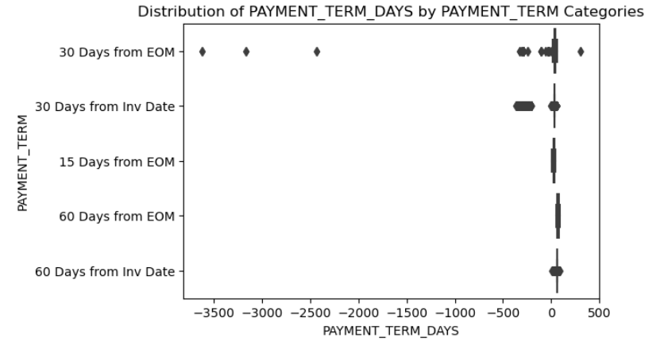
Exploratory Data Analysis (EDA)
Count: There are 3,258 entries with negative payment term days. RECEIPT_METHOD: Most payments were made via wire transfer. CUSTOMER_NAME: A diverse set of customers is involved, with 'YOUG Corp' being the most frequent. PAYMENT_TERM_DAYS: Values range from -1 to -3,622 days, with a mean of about -19.43 days. This suggests that invoices are often issued after the due date, or due dates are set retroactively. IS_LATE: Approximately 98.34% of these payments are classified as late, which is quite high and may indicate systemic issues with how due dates are set or invoices are processed.
Distribution of Payment Terms: 'Immediate Payment' is the most common payment term associated with these entries, which might be misaligned with actual payment processes if the terms are not adhered to. Currencies: SAR (Saudi Riyal) appears most frequently, suggesting a regional pattern or specific business operations impacting these transactions.
A significant number of invoices with negative payment term days and a high rate of late payments among them suggests either a procedural issue in how payment terms are set or in how transactions are recorded. This could be a critical area for improving business processes or data management practices to enhance payment efficiencies.

Slide 10
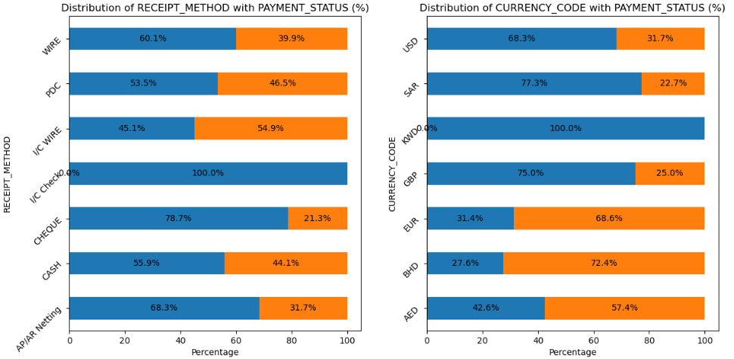
Exploratory Data Analysis (EDA)
RECEIPT_METHOD:
The method of receipt seems to show some variation in payment timeliness. Certain methods might be more conducive to on-time payments, potentially due to the efficiency or ease of processing.
CURRENCY_CODE:
Payment timeliness also appears to vary with the currency, which could reflect differences in banking processes or economic factors specific to regions using different currencies.

Slide 11
Exploratory Data Analysis (EDA)
INVOICE_CLASS:
Different classes of invoices show distinct patterns in their payment statuses, suggesting that the nature of the invoice (like goods, services, etc.) impacts payment behaviour.
INVOICE_TYPE:
Similarly, the type of invoice influences whether payments are made on time or are delayed, highlighting the importance of the transaction context.

Slide 12
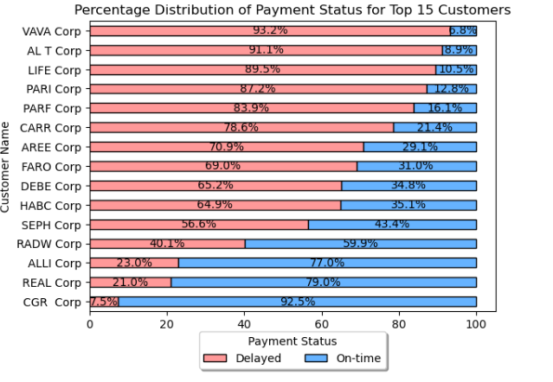
Exploratory Data Analysis (EDA)
IVAVA Corp has the highest % of Delayed payments among the top 15 customers with dealyed payments.
CGR Group is the lowest % among the top 15 customers with dealyed payments.

Slide 13
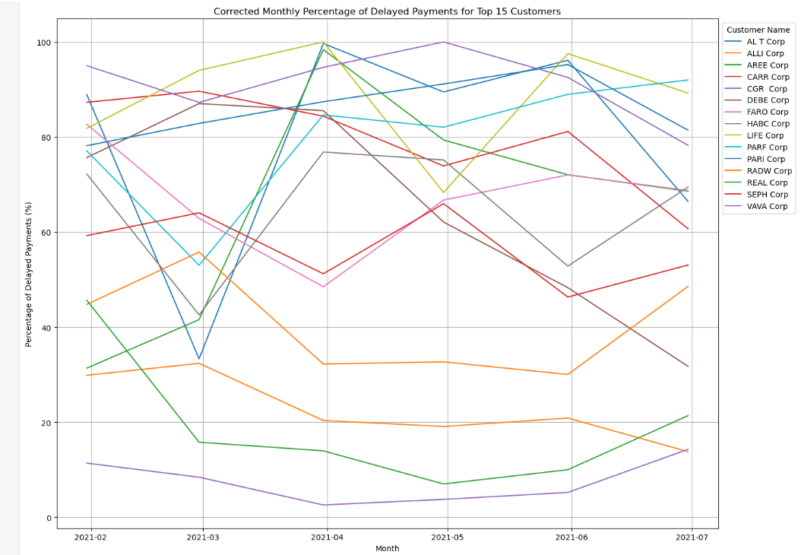
Exploratory Data Analysis (EDA)
It is observed for the Top 10 customers with late payments – there is no consistent pattern of delay as group.

Slide 14
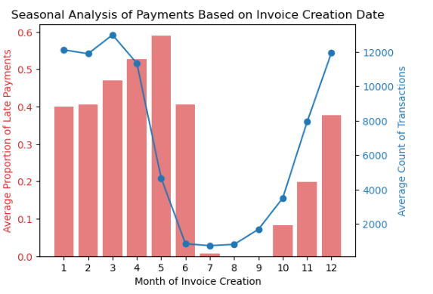
Exploratory Data Analysis (EDA)
Average Proportion of Late Payments:
Late Payments (Red Bars): There is noticeable seasonality in late payments based on Invoice Creation Date. Certain months show higher averages of late payments, potentially indicating when billing practices or financial pressures affect payment behaviours.
Average Transaction Volume:
Transaction Count (Blue Line): The pattern of transaction volumes also shows seasonal fluctuations, which might relate to business cycles, sales initiatives, or financial reporting periods.
Key Observations:
Alignment with Business Cycles:
The peaks in late payments might align with typical business cycles, such as end-of-quarter financial periods or seasonal sales, impacting the invoice creation practices.
Cyclical Transaction Volumes:
Transaction volumes vary across the year, suggesting strategic business activities like promotions or contract renewals often occur in specific months.

Slide 15
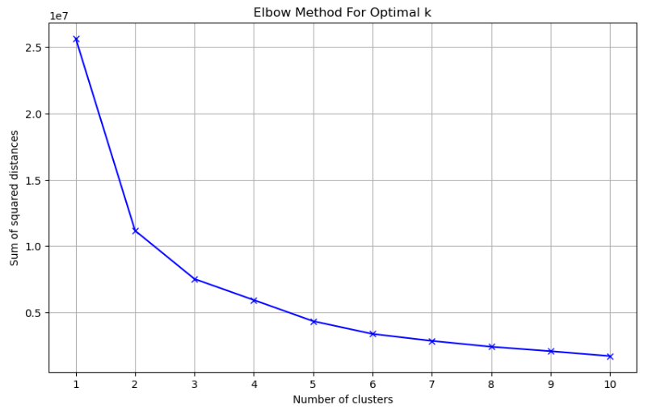
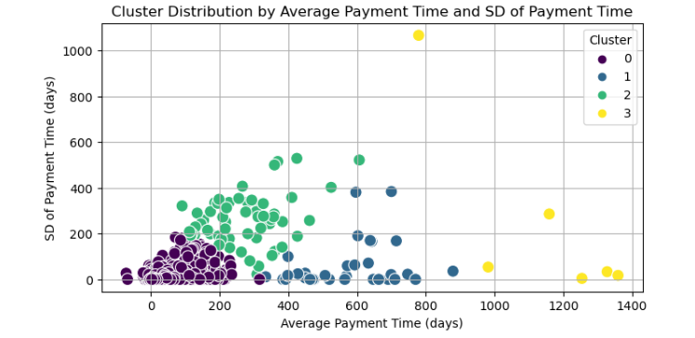
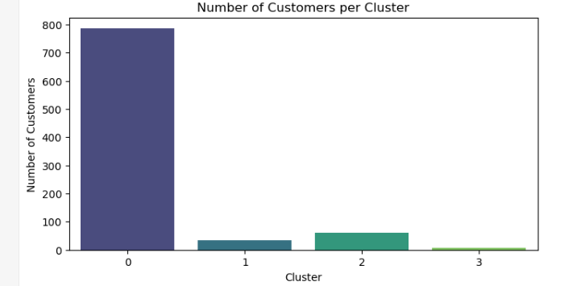
Exploratory Data Analysis (EDA)
Customers are categorized into 4 Clusters as per their Average Payment Time and SD of Payment Time
Majority at Cluster -0 can be observed are making payments within 200 days

Slide 16
Section2
Model Building

Slide 17
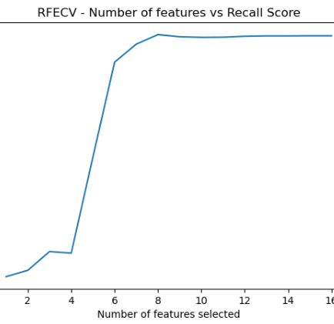
Model – Logistic Regression
Considering the intent to understand the pattern of late payments, recall is the metric for Model Evaluation.
Model – 1: Logistic Regression Model is created for analysis.
Average Recall Score: 0.4503747444923915
Feature Selection conducted through RFECV
Not satisfactory

Slide 18
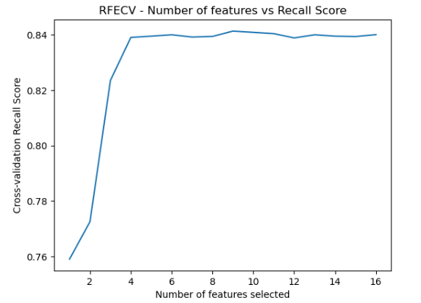
Model – Random Forest
Model – 2: Random Forest Model is created for analysis.
Average Recall Score (CV): 0.8411083352259823
Feature Selection conducted through RFECV – 10 features selected.
Hyperparameter tuning conducted - Best parameters found:
{'bootstrap': False, 'max_depth': None, 'max_features': 6, 'min_samples_leaf': 3, 'min_samples_split': 2, 'n_estimators': 326}

Slide 19
Model Evaluation
Classification Report on Training Set
 | precision | recall | f1-score | Support
0 | 0.93 | 0.97 | 0.95 | 34366
1 | 0.96 | 0.89 | 0.92 | 22015
Recall Score on Training Set: 0.8927549398137633
Classification Report on Test Set
 | precision | recall | f1-score | Support
0 | 0.9 | 0.94 | 0.92 | 14930
1 | 0.9 | 0.84 | 0.87 | 9234
Recall Score on Test Set: 0.8391812865497076

Slide 20
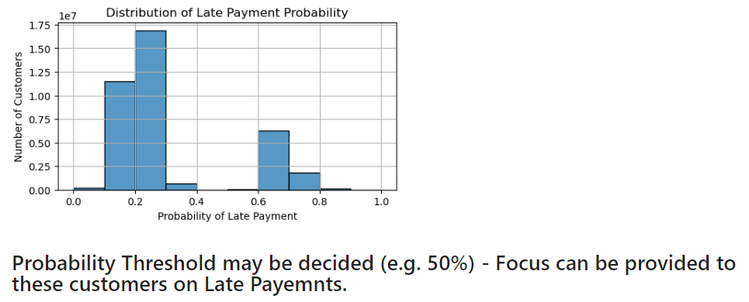
Inference from Training Dataset

Slide 21
Section3
Recommendations

Slide 22
Data Description
Open Invoice Data
AS_OF_DATE | As of the current date that is 4th April, 2022 (when the report was extracted by Schuster) | DUE DATE | Date when the actual payment is due from the vendor
CUSTOMER TYPE | Whether the customer is a third party or holding a direct relationship with Schuster | TRANSACTION CURRENCY | In which currency the goods or services were sold
CUSTOMER_NAME | Name of the customer/vendor | LOCAL AMOUNT | Invoice value in local currency
CUSTOMER ACCOUNT NO | Customer's unique identity number | TRANSACTION CLASS | It is the invoice class - CM, DM, INV or PMT
TRANSACTION NUMBER | Transaction number against each invoice | AGE | It is the age of the open invoice. This is the difference between the Invoice Due date and the as-of-date
TRANSACTION DATE | This represents the date when the goods or services were sold by Schuster | USD AMOUNT | Invoice value in USD
PAYMENT TERM | Days given to the vendor/customer for making the payments | INV_CREATION_DATE | Date when the invoice was created
Open Invoices Data:
This contains data related to Open Invoices – to be used for testing the model built (88,204 entries and 14 columns)

Slide 23
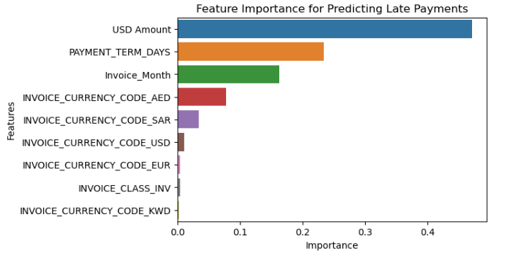
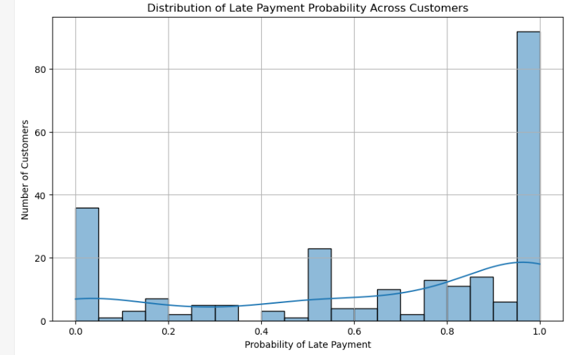
Recommendations from Test Data
Defaulters risk profile:
It can be observed that Invoice Value (USD Amount) plays a major role in late payments.
Payment term and Invoice Month are the next two most critical parameters to be reviewed by Schuster while identifying defaulters.
Risk of Default and Range | No of Customers
Very Low (0-0.1) | 37
Low (0.1-0.2) | 10
Moderately Low (0.2-0.3) | 6
Moderate (0.3-0.4) | 6
Moderately High (0.4-0.5) | 4
High (0.5-0.6) | 25
Very High (0.6-0.7) | 14

Slide 24
Thank You

