Slide 1
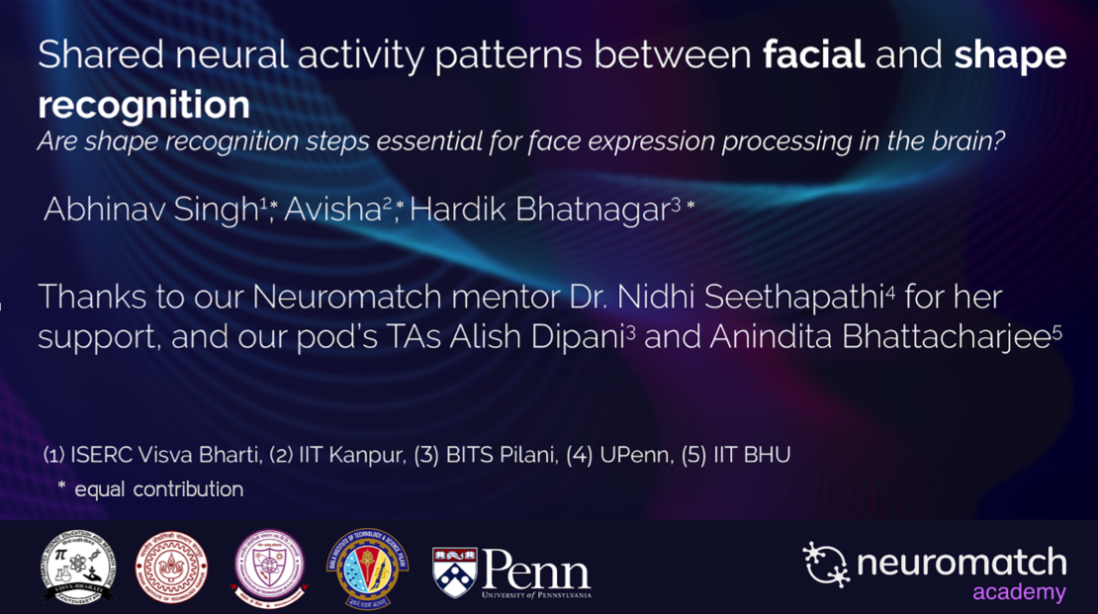

Slide 2
Proposal
Scientific question
Can we differentiate facial expressions recognition and shape recognition using brain activity during the two tasks?
Hypothesis
Facial expression recognition mechanism shares some shape recognition steps in the visual system in the cortical areas.
Scientific question: How does the brain activity differ when identifying geometrical features during the identification of facial expressions and shapes?
And some text
But remember not to overload your slides with content
Your audience will listen to you or read the content, but won’t do both.

Slide 3
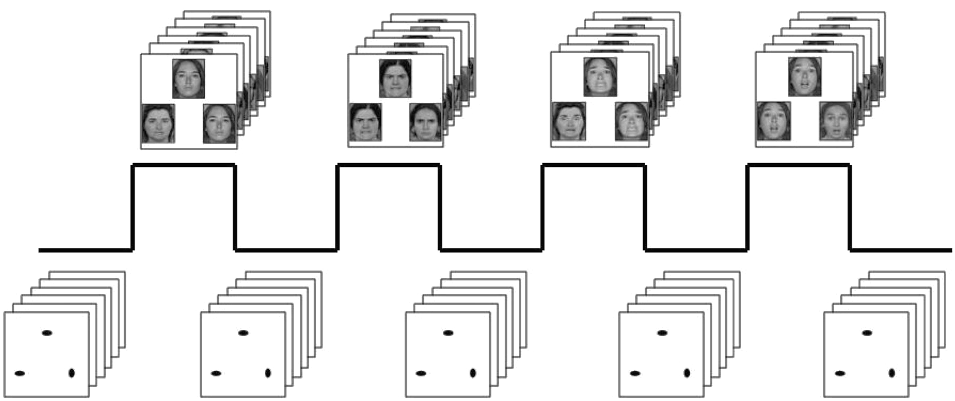
Dataset
Face task
Run 1
Shape task
339 Subjects
Face task
Human connectome project emotion task fMRI dataset
3 seconds cue given before each 18 seconds task
Match upper object with one from the bottom row by clicking on them
BOLD activity of 360 parcels over the entire task, over 2 runs, of 2 tasks.
Run 2
Shape task
Hariri et al. 2005

Slide 4

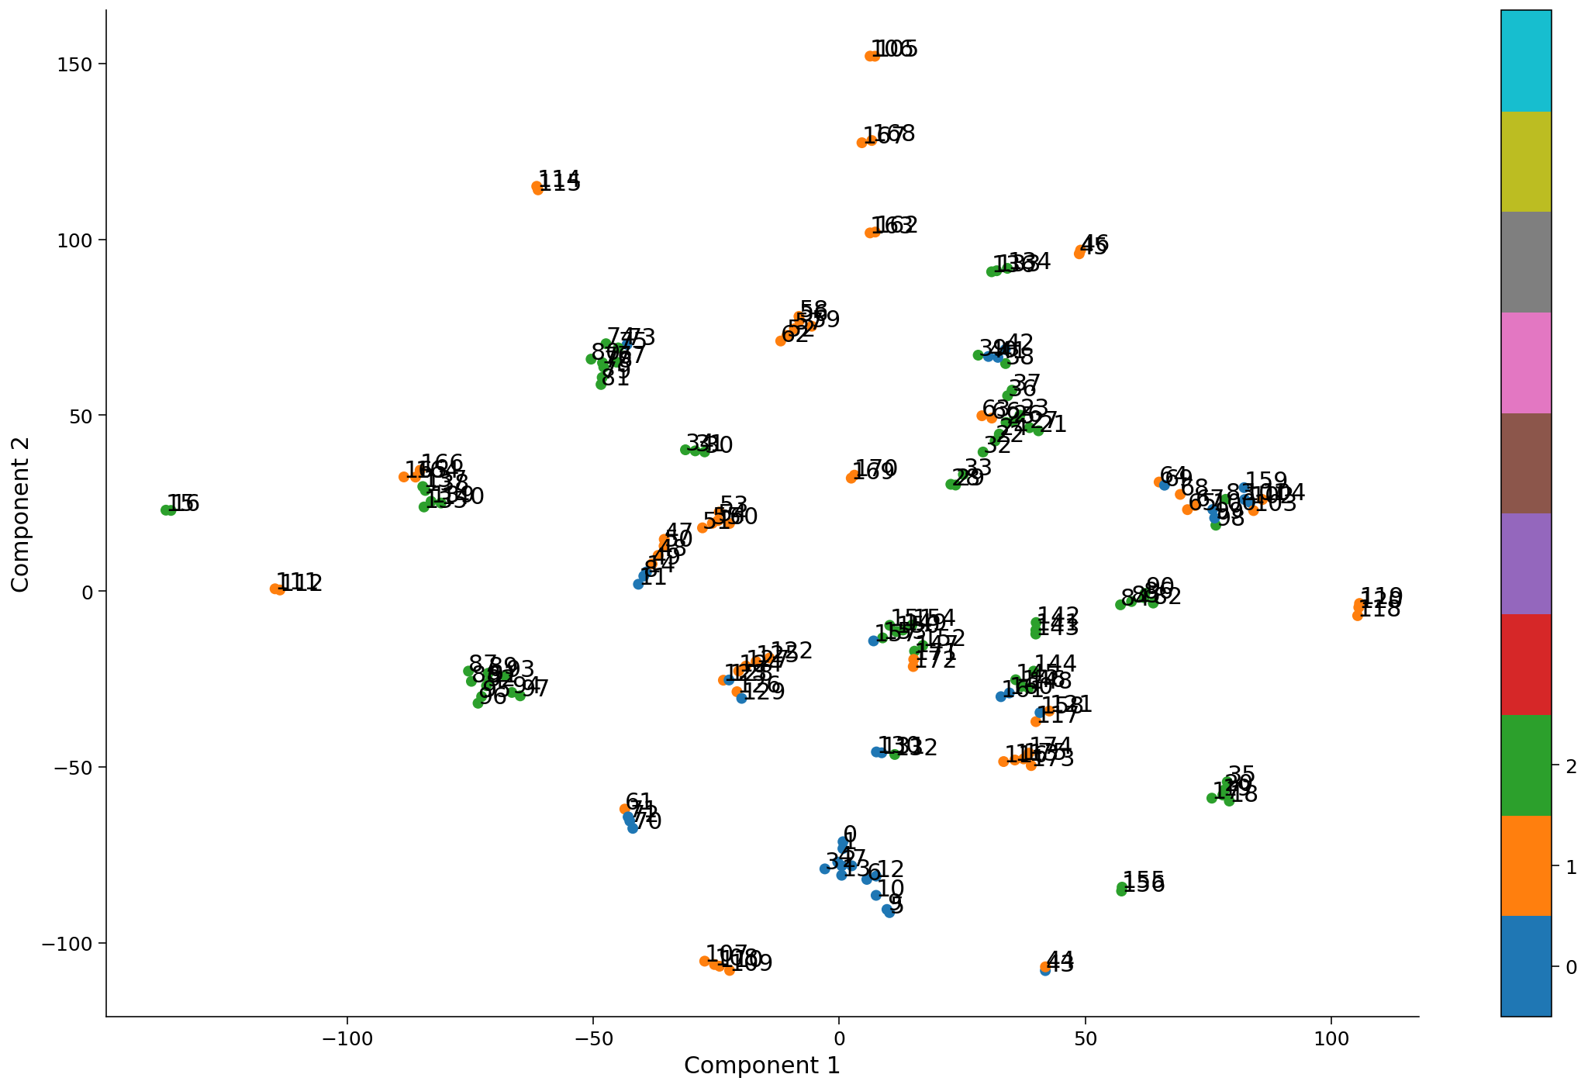
Data visualization
Face frames
Shape frames
Blank frames
t-SNE: 360 features embedded into 2D plane
Task wise clusters observed annotated with a time frame of each task.
Notes:
t-distributed stochastic neighbor embedding
Perplexity: 1 (tried 1-50), tries to preseve high dimenstional clustering.
increasing the perplexity value the dots scatter more,
a tendency towards clearer shapes as the perplexity value increases,
controls the trade-off between global high-dimensional and local low-dimensional space
The size, the distance and the shape of clusters may vary upon initialization, perplexity values and does not always convey a meaning.
It embeds the points from a higher dimension to a lower dimension trying to preserve the neighborhood of that point.
Unlike PCA it tries to preserve the Local structure of data by minimizing the Kullback–Leibler divergence (KL divergence)

Slide 5
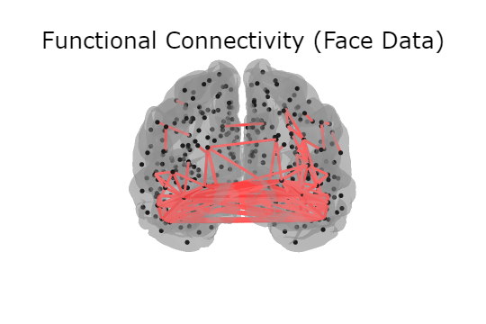
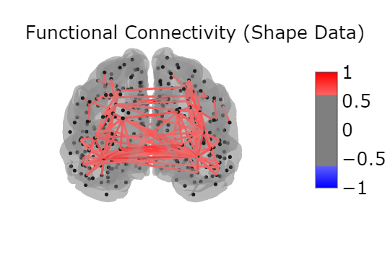
Functional Connectivity
Parcel coordinates
Connectivity between parcels
Posterior View
Posterior View
Notes:
Brain connectivity refers to a pattern of anatomical links ("anatomical connectivity"), of statistical dependencies ("functional connectivity")
Functional connectivity is defined as the temporal correlation (Pearson’s r) in the high amplitude, low-frequency spontaneously generated BOLD signal between voxels

Slide 6
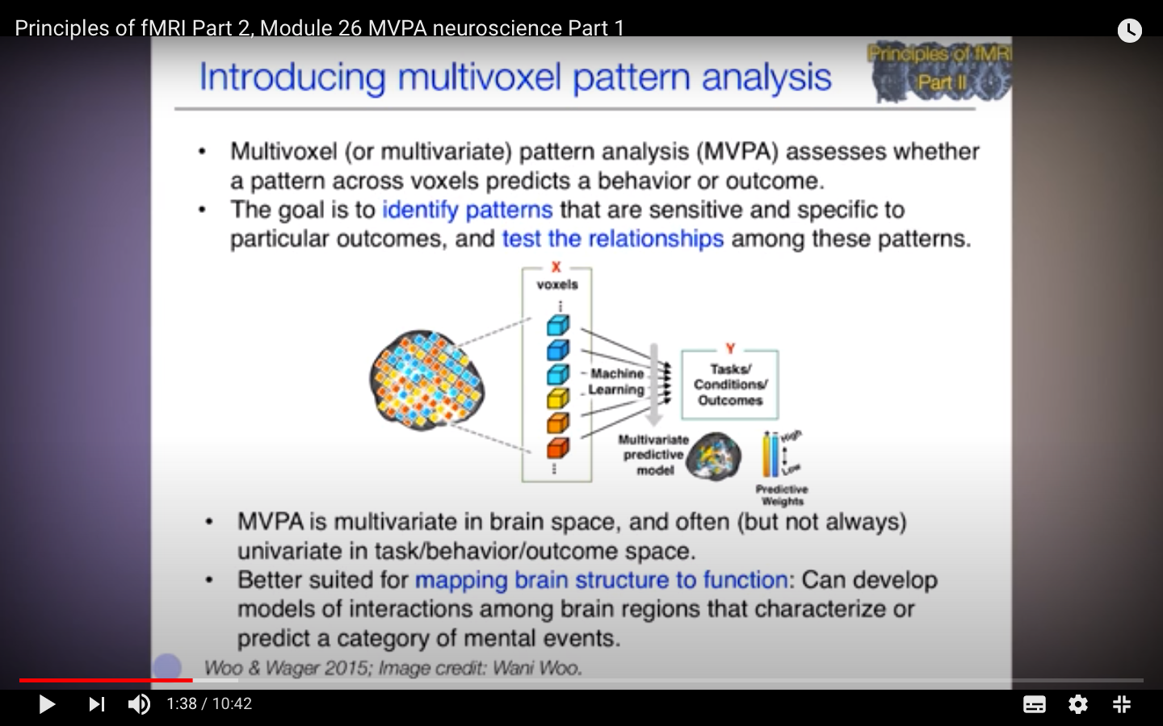
MVPA (Multivariate Pattern Analysis)
Feature selection
ANOVA feature selection in sklearn
Classification
SVM linear kernel (task v/s none)
Parcel selection
Comparing parcels of both tasks
Haxby, James et al. 2012
Notes:
Feature selection = top 5%, so 18 out of 360
ANOVA ( Analysis of Variance)
MVPA
Traditionally brain mapping treat brain as the outcome, and task as the predictor, and no accounting for interactions b/w voxels
Binary classification: we applied SVM linear kernel both the sets separately (blank frames, face task frames) and (blank frames, shape frames).
got around 82.5% and 80.5% test data accuracy
Weights interpretation: they have highly interpretable weights and they directly correlate to features. Since we applied feature selection we got two outputs, one was the weights for all 360 parcels for both the models and other was top 18 voxel weights for both the models.
All subjects all run logistic regression:
Training data accuracy: 72.5%
8 fold cross-validation accuracy: 71.7%

Slide 7
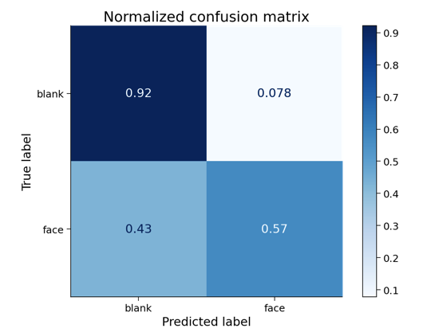
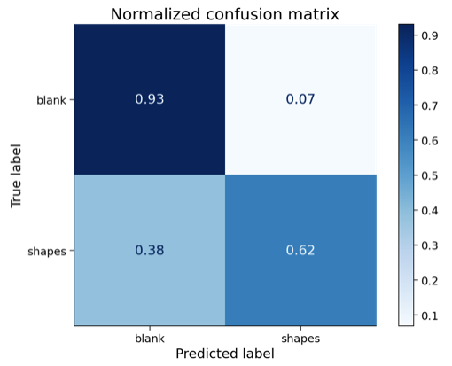
Results
Face v/s rest classification
Classification accuracy : 81%
Shape v/s rest classification
Classification accuracy : 83%
Notes:
Classification using SVM linear kernel because it’s weights are interpretable and give activations of different parcels
Not very high accuracy because very simple model

Slide 8
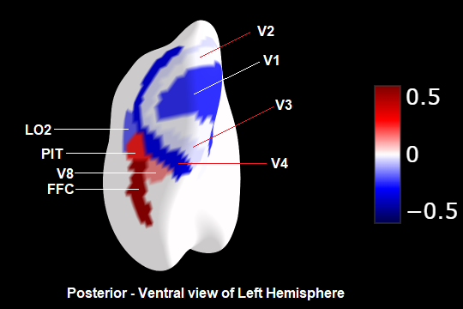
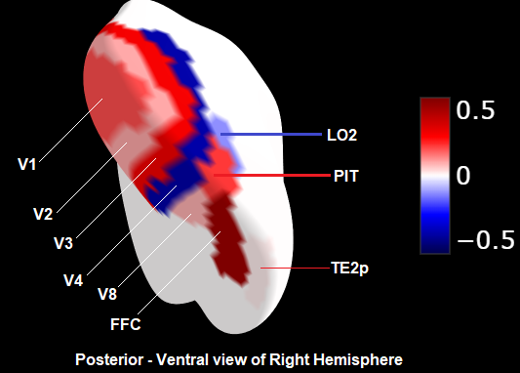
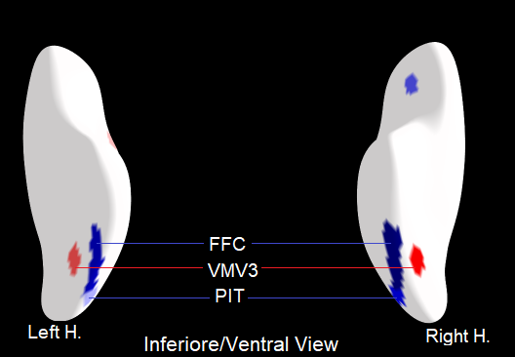
Face task
Shape task
Parcel activation
Notes:
Common regions PIT, FFC, VMV3

Slide 9
Conclusions
Posterior Inferior Temporal, Fusiform face complex, VMV3 in ventromedial visual area correlated highly with shape recognition as well as facial expression recognition
Few visual cortical areas were also highly active during both the tasks
Shape and facial expressions recognition activity involve some common brain regions

Slide 10
Further discussion
Improve the interpretability of the model
Taking temporal aspect of the data into account
Taking behavioural data into account

Slide 11
Thank you!

