Slide 1
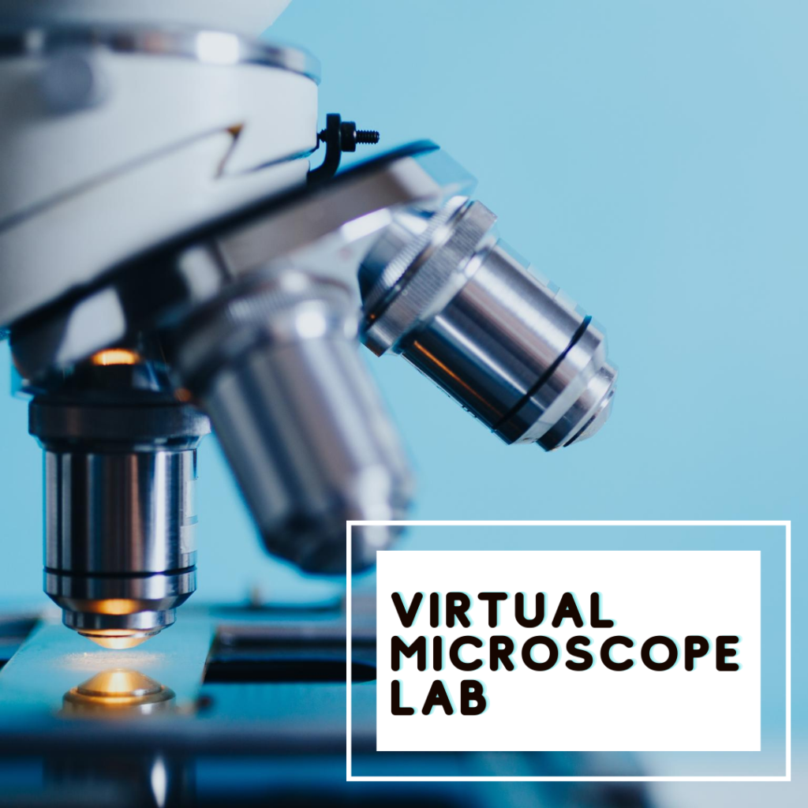
Team 1- The virtual microscope
Team members: Ariel Abramovitz, Shahar Zuntz, Avishai Wizel, Noy Porat

Slide 2
Introduction
In this project, we built the “Virtual microscope”.
The virtual microscope will get n frames from real observation of molecules, and add K frames between every frame.
This will increase the resolution of the movie, allowing the researchers to better follow and understand molecules dynamics.
We called this tool “Up Scaler”.
Notes:
יצרנו כלי שמקבל פריימים ממיקרוסקופ שמצלם מולקולות זזות,

Slide 3
Approach
Because we didn’t have real observation, we generate the movie using brownian motion, with a given parameters.
Then, the Up scaler will learn diffusion coefficient of every molecule type, and will add frames using brownian motion.
The learning will be according to the Mean Square Displacement algorithm.
Then, the Up scaler will move the molecules using brownian motion, with an addition of force vector towards the “desire” coordinate.
We created the “viewer” that will view our movies, and a GUI for friendly user interface.

Slide 4
Live Demo

Slide 5
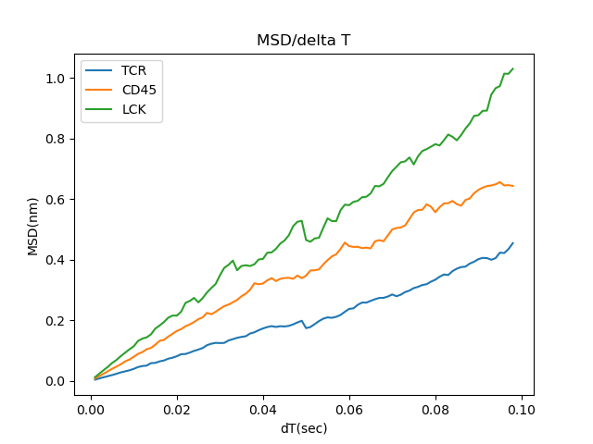
Results- the diffusion coefficients
Original coefficients: TCR = 1, CD45 = 2, LCK = 3.
Calculated coefficients using first 50% frames:
{'D_TCR': 1.01, 'D_CD45': 1.97, 'D_LCK': 2.762}

Slide 6
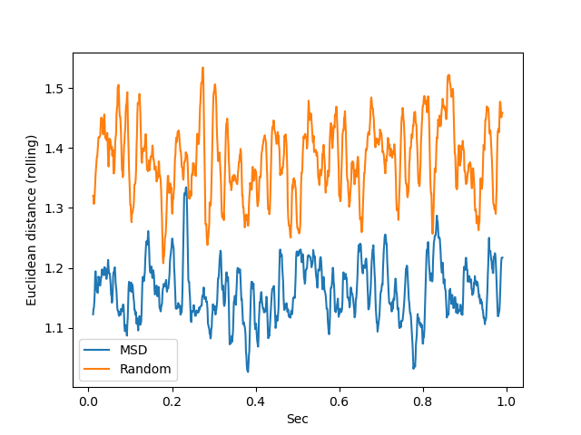
Results- compare with “True” results
We generate X frames, and then deleted Y frames. Then, we used the Up scaler to complete these frames.
Finally, we compare the “True” frames with the Up scaler output frames, and to Up scaler that guess the diffusion coefficients:

Slide 7
Summary and discussion
We used the Up scaler as virtual microscope, resulting in higher resolution of molecular movement movie.
We also provide easy-to-use GUI and a movie viewer for the users, creating accessible and understandable tool.
This might help researcher to better understand the molecular dynamics and interactions.
Nevertheless, we did not succeed the learn all the other parameters.

Slide 8
Further possible upgrades
Create a 3D virtual microscope. Can better resemble membranes and more.
Learn all the other Browning motion parameters.
Using other ways to learn the parameters (SVM, KNN, neural network, etc)

