Slide 1

DG INTERNS HUB
WEEK 3 – ADVANCED CYBERSECURITY
Practical Assessment Report
Network Security Assessment & Traffic Investigation
Submitted by: Avisha Masih | Cybersecurity Intern | 7th September 2026

Slide 2
Project objective
What this assessment set out to achieve
Discover live hosts and exposed services on an authorized lab network
Run basic and advanced Nmap scans to identify ports, services, versions, and OS
Capture and analyze live traffic with Wireshark (DNS, TCP, UDP, ICMP, ARP)
Correlate Nmap scan activity with packet-level Wireshark evidence
Perform a vulnerability assessment and classify risk for each finding
Apply security hardening and verify improvement with before/after scans
Scope note
All scanning and traffic capture was performed strictly within an isolated, authorized VirtualBox lab network (10.0.2.0/24). No external or public IP addresses were tested at any point.
Week 3 – Cybersecurity Practical Assessment
2

Slide 3
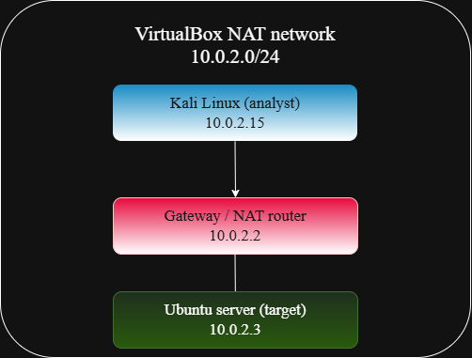
Lab architecture
Isolated VirtualBox NAT network
Kali Linux
Analyst machine · 10.0.2.15
Gateway / NAT router
10.0.2.2
Ubuntu server
Target machine · 10.0.2.3
Week 3 – Cybersecurity Practical Assessment
3

Slide 4
Tools used
Oracle VirtualBox
Kali Linux 2026.2
Ubuntu Server 26.04.1 LTS
Virtualization platform for the isolated lab VMs
Analyst machine, pre-loaded with Nmap & Wireshark
Target machine exposing real network services
Nmap
Wireshark 4.6.6
draw.io
Host discovery, port scanning, version/OS detection, NSE vuln scripts
Live packet capture and protocol-level traffic analysis
Network topology diagram
Week 3 – Cybersecurity Practical Assessment
4

Slide 5
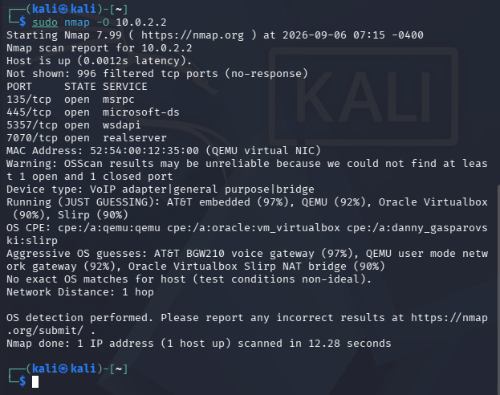
Nmap assessment
Discovery through advanced scanning (Tasks 7–8)
Host discovery (nmap -sn) found 3 live hosts on 10.0.2.0/24
Basic scan of gateway (10.0.2.2) revealed 4 open TCP ports
Service/version detection (-sV): msrpc, microsoft-ds, wsdapi, realserver
OS detection (-O): best guess VirtualBox Slirp NAT bridge (90%)
SYN scan (-sS) and UDP scan (-sU) confirmed findings
NSE vulnerability scripts (--script vuln) checked for known SMB CVEs
Week 3 – Cybersecurity Practical Assessment
5

Slide 6
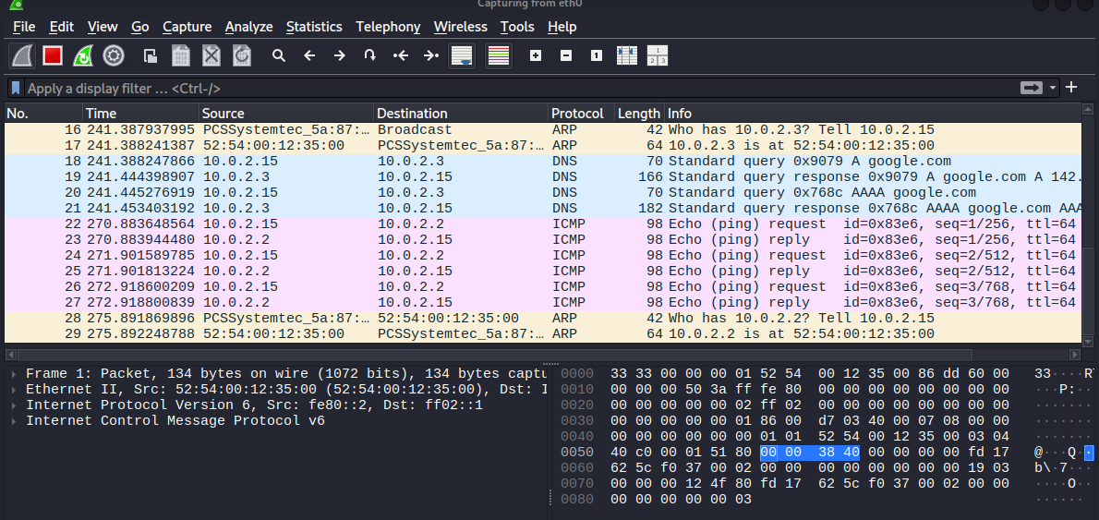
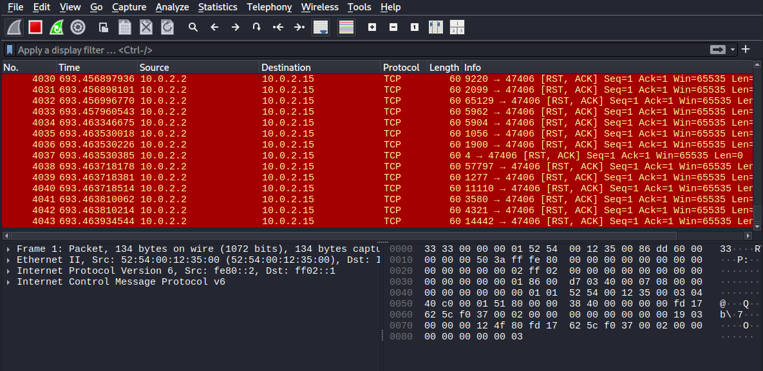
Wireshark analysis
Traffic capture and Nmap-at-the-packet-level (Tasks 9–10)
ARP → DNS → ICMP sequence during normal traffic generation
Burst of RST,ACK responses captured during the Nmap SYN scan
Key correlation: open ports → SYN/ACK · closed ports → RST,ACK · filtered ports → no response. The Kali↔Gateway conversation alone totaled 4,005 packets / 237 KB — a clear scanning signature.
Week 3 – Cybersecurity Practical Assessment
6

Slide 7
Security findings
5 findings identified across Tasks 11–12
# | Finding | Risk
1 | SMB (port 445) exposed | High
2 | RPC endpoint mapper (port 135) exposed | Medium
3 | Unidentified service on port 7070 | Medium
4 | Ambiguous UDP services (67, 137, 4500) | Low
5 | Vulnerability scan inconclusive (NAT gateway target) | Low
Top communicating host pair during assessment: Kali (10.0.2.15) ↔ Gateway (10.0.2.2) — 4,005 packets / 237 KB, driven by the Nmap scan activity itself.
Week 3 – Cybersecurity Practical Assessment
7

Slide 8
Vulnerability & risk assessment
Why each finding was classified the way it was
High
SMB (445)
Well-documented history of critical remote-code-execution exploits (e.g. EternalBlue-class attacks).
Medium
RPC (135) & port 7070
Required for legitimate Windows networking, but historically leveraged for lateral movement; port 7070's purpose was unconfirmed.
Low
UDP services & vuln scan gaps
Common/expected in a NAT/DHCP environment; scan ambiguity reflects environment limits, not confirmed exposure.
Week 3 – Cybersecurity Practical Assessment
8

Slide 9
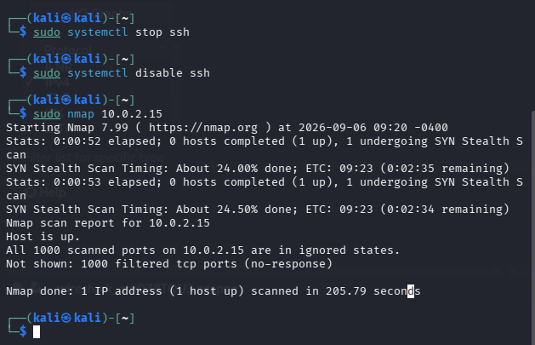
Hardening performed
Three controlled improvements on the exposed SSH service (Task 13)
Installed and enabled UFW host-based firewall
Added an explicit deny rule for port 22 (ufw deny 22)
Stopped and disabled the SSH service entirely (systemctl)
Each step was re-verified with a follow-up Nmap scan
Week 3 – Cybersecurity Practical Assessment
9

Slide 10
Before vs after
Measurable reduction in attack surface
Security issue | Before | After
Host firewall | UFW not installed / inactive | UFW active and enabled on startup
SSH port 22 | Open (nmap confirmed) | Deny rule added at firewall level
SSH service | Running and exposed | Stopped & disabled — all 1000 scanned ports show no open services
Result: nmap 10.0.2.15 confirmed ‘all 1000 scanned ports are in ignored states’ — the demonstrated SSH exposure was fully eliminated.
Week 3 – Cybersecurity Practical Assessment
10

Slide 11
Recommendations
Five professional next steps for the lab network
1
Restrict SMB (445) and RPC (135) to trusted internal hosts only
2
Investigate and disable any unidentified service (e.g. port 7070) that isn't justified
3
Prefer disabling unused services over relying on firewall rules alone
4
Enable a host-based firewall by default, with a deny-by-default inbound posture
5
Re-run scans after every configuration change to verify hardening took effect
Week 3 – Cybersecurity Practical Assessment
11

Slide 12
Conclusion
This assessment covered the full lifecycle of a basic network security assessment: discovery, enumeration, traffic analysis, vulnerability identification, and verified hardening.
Nmap and Wireshark proved complementary: Nmap efficiently identified what was exposed, while Wireshark revealed how that exposure looked at the protocol level — valuable both for understanding attacker behavior and verifying defensive controls.
Outcome: the demonstrated SSH exposure was fully eliminated after hardening, verified by a follow-up Nmap scan.
Thank you.

