Slide 1
Deception Detection in Diplomacy
Avi Sharma -2022119
Dasari Sai Harsh -2022144
Parth Sandeep Rastogi -2022352

Slide 2
INTRODUCTION
Deception is a nuanced challenge in human communication, notably in strategic settings like Diplomacy, where players’ messages are dual-annotated for both intent and perception. The study reveals that only about 5% of messages are deceptive, and current models face challenges due to sparse signals, isolated context, and inadequate cross-player interaction, despite deceptive messages often being verbose and contextually rich.
LieDetectorGAT: A graph-based model that builds dynamic player interaction graphs where messages are connected via BERT embeddings, power differentials, and linguistic cues, using multi-head edge-aware attention to capture message-level deception within game-specific social structures.
HiS-Attention: A transformer architecture that integrates the current message, game metadata, and multi-turn dialogue history with cross-modal attention to generate deception-aware representations at the message level.

Slide 3
Methodology:HiS-Attention
Message: Encoded via BERT for linguistic deception cues.
Game State: Encoded using FFNN; includes score, season,score_delta, etc.
History: Last 10 messages encoded with BERT + Transformer.
Player Embeddings: Learnable vectors per sender/receiver.
Multi-head attention: Replaces feature concatenation with Learnable Query Attention Pooling over all modalities for adaptive, context-aware fusion.
Output: Fused vector passed to classifier for deception prediction.

Slide 4
Methodology:LieDetectorGAT
1)Graph Structure: Each game = directed graph -Nodes: Players (7-d one-hot encoding) -Edges: Messages (u → v), sorted by time
2)Edge Features (782-d): ` -BERT [CLS]: Message semantics (768-d) -Deception Lexicon: Psychological cues (10-d) -Strategic Metadata: Lie count, avg. score delta, season, year bucket, msg index
3)Graph Attention (GATv2): Multi-layer, edge-aware updates capture "who says what to whom" and how deceptive
4)Classification:
-2-layer MLP on sender, receiver, and edge embeddings -Outputs deception probability using weighted BCE loss
Models message interactions and deception cues in a structured, game-aware manner.
-

Slide 5
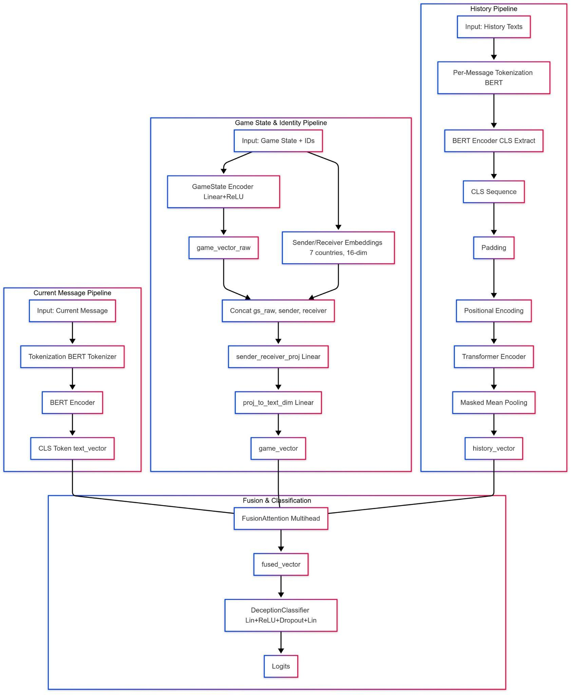
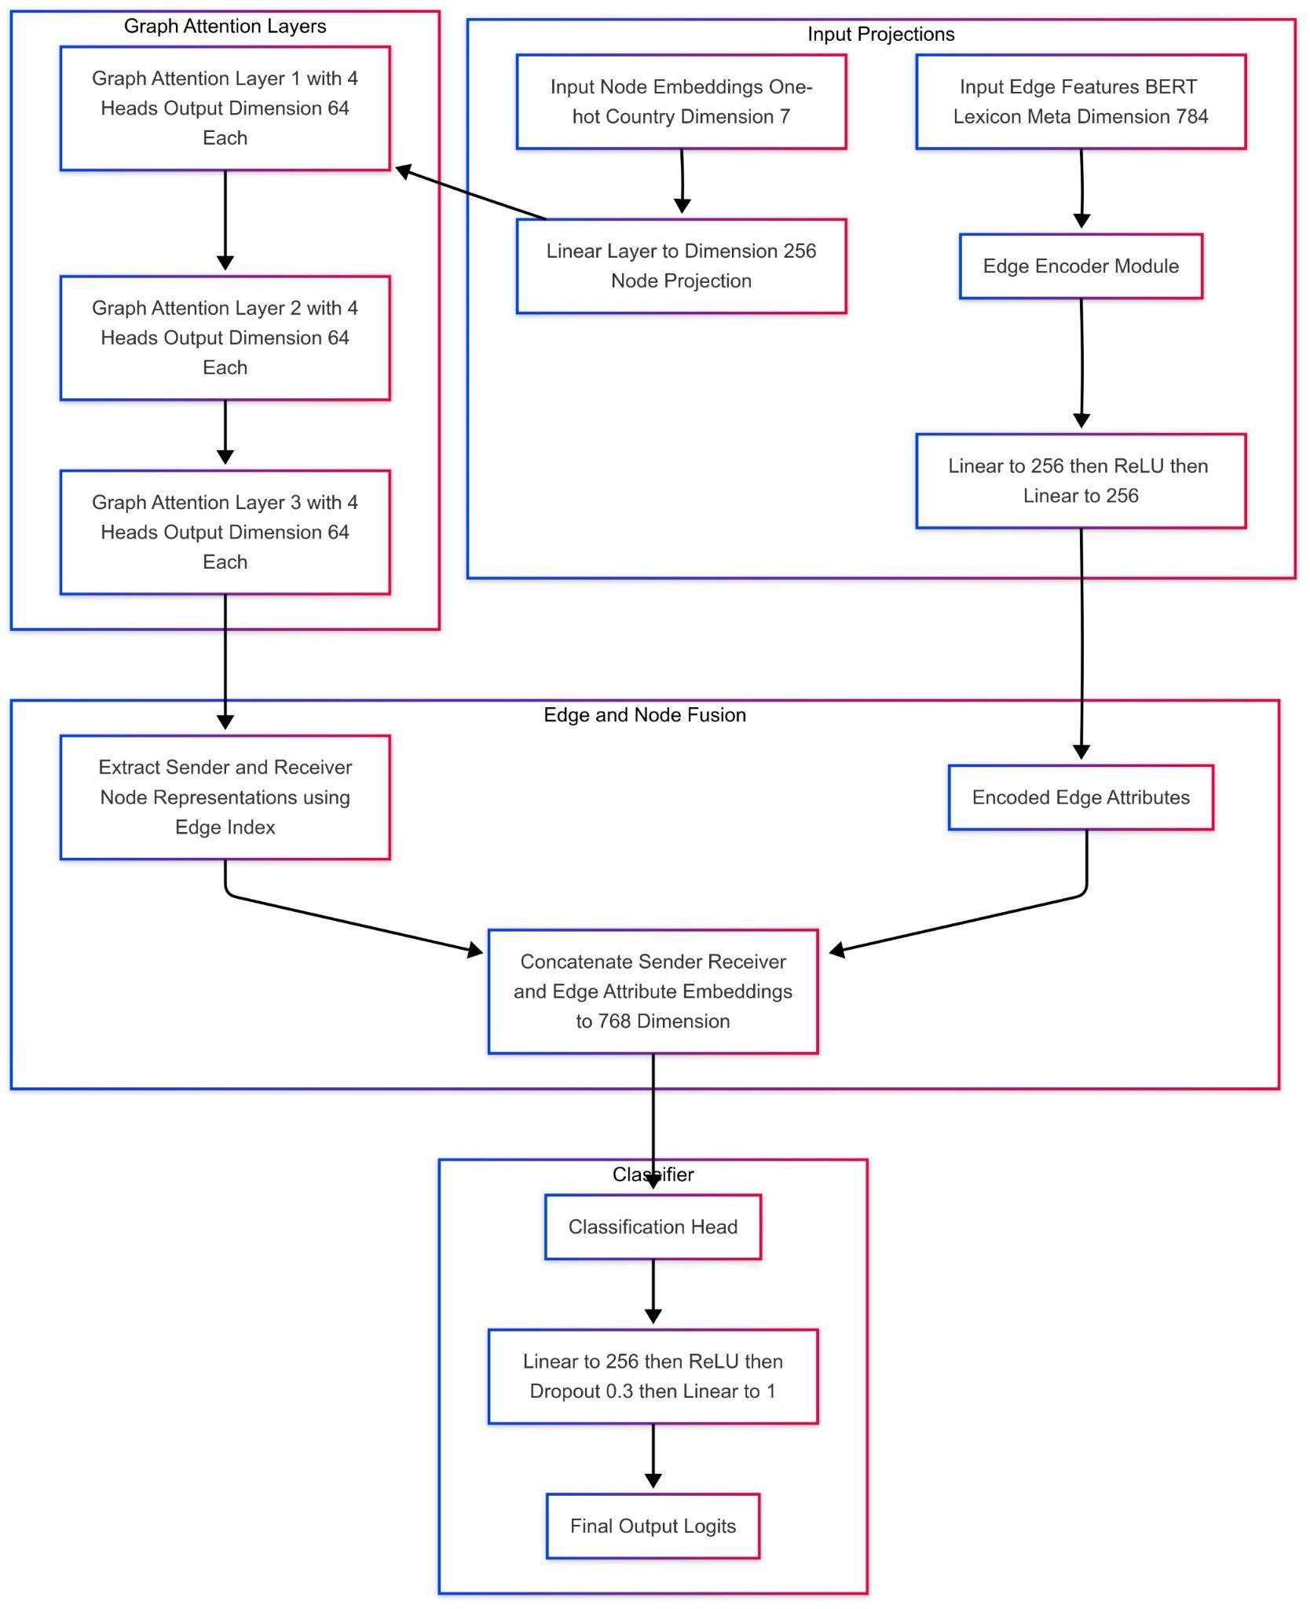
HiS-Attention
LieDetectorGAT

Slide 6
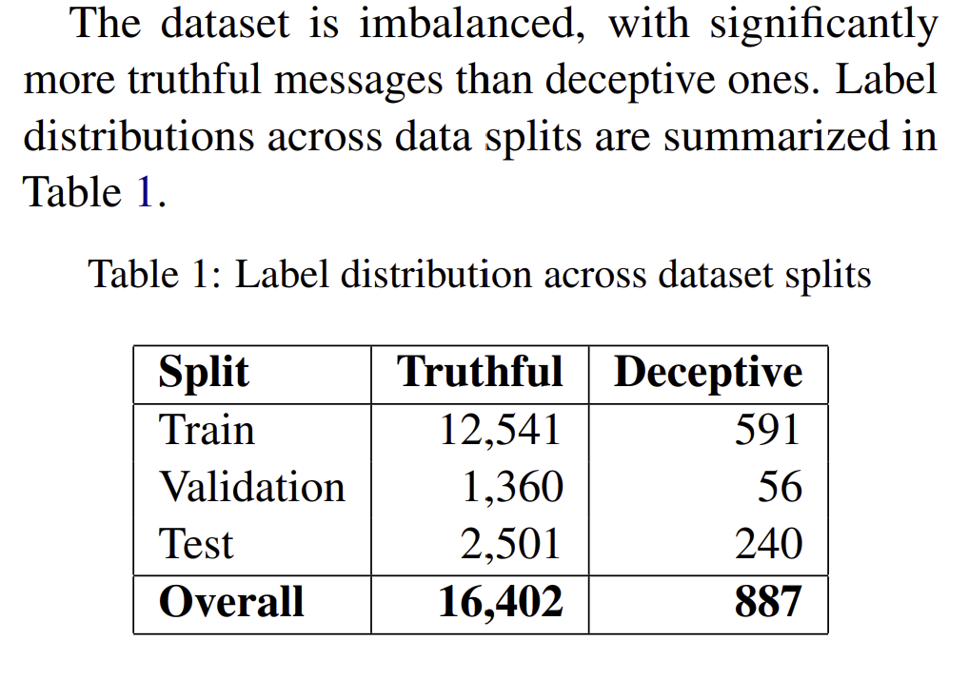
Dataset Description and Preprocessing
The dataset used in this work is sourced from the QANTA Diplomacy Deception Detection task, de4 signed to predict whether messages exchanged between players in the game Diplomacy are deceptive or truthful. Each sample corresponds to a single message exchanged between two players, along with contextual metadata.In this work, we do not use this field, as we are only concerned with whether the sender actually intended to lie, not how the receiver perceives the message.
PreProcessing
1. Text Cleaning: -Convert to lowercase -Remove URLs, emojis, special characters -Normalize whitespace 2. Conversation History Augmentation: -For each message, track (game_id, sender, receiver) -Retrieve last 10 messages from sender → receiver -Attach as history for contextual understanding -Update history after each message → Enhances input quality and contextual depth for deception detection.

Slide 7
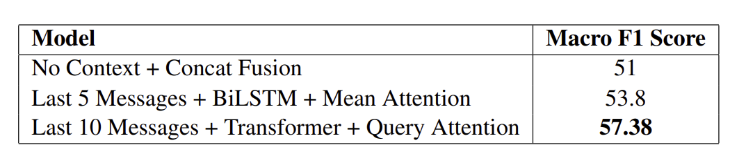
Experimental Setup
HiS Attention
Model Variants: -Model 1 No Context (Concat), BERT + Game State, concatenated. -Model 2: 5-Message Context + BiLSTM + Mean Attention: History via BiLSTM, fused with Multi-head Attention. Macro F1: 53.8 -Model 3 – 10-Message Context + Transformer + Query Attention: History via Transformer, fused with Query Attention Pooling. Macro F1: 57.38 Training Details:Epochs: 10, Batch Size: 16 , Optimizer: Adam, LR = 1e-5 ,Loss: Weighted BCE (pos_weight = 21.22) ,Scheduler: Patience = 1, Decay = 0.5 ,Gradient Clipping: Max norm = 1.0
LieDetectorGAT
Training Parameters: Epochs: 20 , Optimizer: AdamW , Learning Rate: 3 × 10⁻⁴ ,Loss Function: BCEWithLogitsLoss with positive class weighting to address class imbalance (~5% lies) Gradient Clipping: Maximum norm of 1.0
Data Handling: 1 graph per batch (each game instance) We used PyTorch Geometric DataLoader for shuffling Disabled to preserve conversational sequence . For Preprocessing we made Datasets sorted to maintain dialogue flow . For Linguistic Features we Utilized deception lexicon from dataset's utils​
→ Query Attention + Transformer History yields strongest deception detection performance.

Slide 8
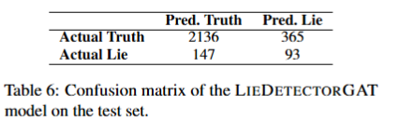
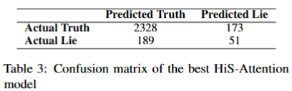
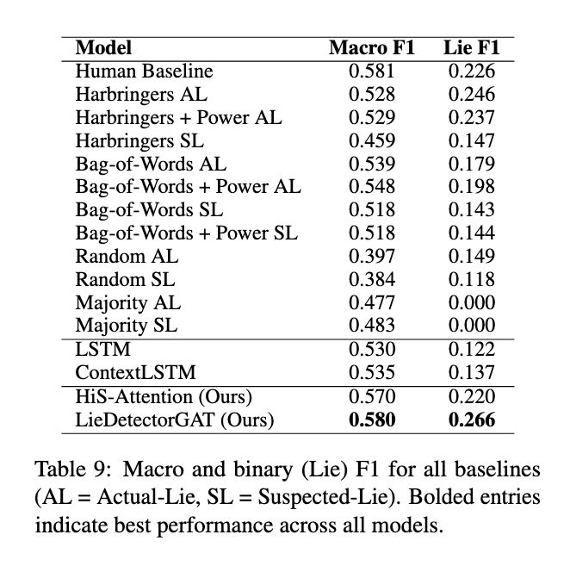
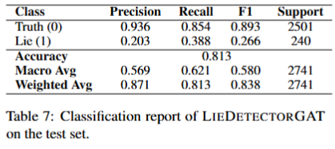
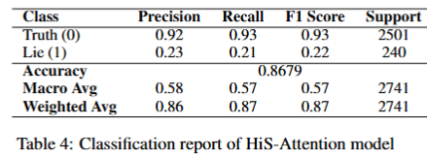
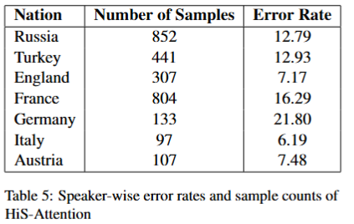
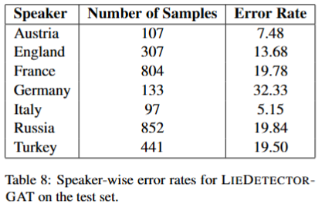
Results

Slide 9
Error Analysis -HiS-Attention
Quantitative Analysis
Best-performing architecture uses Transformer encoding with 10 prior messages and query-based attention
Achieved a Macro F1 score: 57.38 and Lie-F1: 21.98
Outperformed all baseline models
Despite using a weighted loss function, the model still struggles with the minority (deceptive) class
Qualitative Analysis
False Positives:
Diplomatic vagueness and cautious planning misinterpreted as lies
Many truthful, strategically worded messages flagged as deceptive
False Negatives:
Lies are mimicking cooperative or neutral tones often missed
Speaker-Level Observations:
Higher misclassification in nations like Germany (21.8%) and France (16.3%)
Lower error rates in Italy and Austria, likely due to clearer communication
Overall:
The model tends to overfit to dominant truthful patterns
Suggests a need for refined deception cue modeling, possibly with speaker-specific conditioning

Slide 10
Error Analysis -LieDetectorGAT
Quantitative Analysis
Overall Accuracy: Achieved an accuracy of 81.3%.
Deception (Lie) Class Performance: Recall is 0.388 (higher than the HiS-Attention model), indicating improved detection of lies. Precision is only 0.203, which shows the model tends to flag more false positives.
Truthful Class: Maintains a high F1 score of 0.893.
Key Insight: While the model effectively captures more deceptive cases, the trade-off is a reduction in precision due to increased false alarms.
Qualitative Analysis
Speaker-wise Error Trends:
Germany shows the highest error rate at 32.33%, suggesting difficulties with complex or multi-turn strategic messaging.
Italy displays the lowest error rate at 5.15%, implying that clearer, more consistent communication is easier to classify correctly.
Error Patterns: Overly detailed or cautious phrasing is often misclassified as deception. Lies that mimic friendly or neutral tones are sometimes missed.
Overall Observation: The graph-based approach of LieDetectorGAT enhances the recall of deceptive messages by explicitly modeling inter-player interactions, yet it also overestimates deceptive intent, leading to a higher rate of false positives.

Slide 11
Conclusion and Future Work
While our models advance the state of deception detection in Diplomacy, several promising directions remain open. First, the current model lacks adversarial awareness; future iterations could incorporate counterfactual training, where deceptive messages are paired with hypothetical truthful variants to strengthen representation learning In addition, leveraging reinforcement learning (RL) techniques and agent-based simulation can enable adaptive decision-making frameworks that better mirror the dynamics of multi-agent deception. Moreover, improved linguistic cue extraction using tools like LIWC could supplement our current lexicon-based approaches by providing more fine-grained semantic and psychological markers. Finally, fine-tuning large language models (LLMs) specifically for deception understanding promises to provide nuanced interpretations of context and subtle cues that may escape traditional methods

