Slide 1
BRAMIGO Product-app
A SMART ACCESSORIES’ APP
Avisha Sati
(Refer slides 4-7 for Bramigo Sample App Download)

Slide 2
WHY MENTAL HEALTHCARE?
WHO Reports : 5 crore Indians suffer from Depression, 3 crore from Anxiety Disorders
The number is ever-growing with 7.5% experiencing the more serious mental disorders
Motivation behind the product-app :
Self-sufficiency in the detection of a mental abnormality.
Instant/Near-Instant Psychological help provision (of varying degrees) based on the Mental Health Status assessed by our proposed product, Bramigo
Personal Past Experiences
An attempt at achieving the far goal of reducing the number and rate of suicides in India owing to anxiety and depression through tech [AI(ML)].

Slide 3
BRAMIGO : OVERALL SETUP
Smart Jewellery/Accessories such as bracelets, necklaces, wrist bands, watches etc. enclosing or laterally accommodating touch, gesture and breathing/heart rate sensors, in an inconspicuous manner for aesthetic purposes.
The sensors are connected to the Bramigo app and automatically transfer sensed data to the app via 3G/4G or Bluetooth, whichever locational connectivity permits.
App performs graphical or mathematical analysis to produce results through a classification model (mentally healthy/mentally ill), assessing the individual and cumulative effects of parameters on the mental health of the user. Machine Learning algorithms have been employed.
A “Mental Health Social Media” on the app to support the user each time he/she needs it through a chat interface, call option, other users with anxiety or depression, expert help (psychologists, psychiatrists, psychotherapists) and an emergency icon.

Slide 4
BRAMIGO : APP SETUP
The app contains the map of India with the placement of users in every region (North, South, West, East) indicated by markers. Markers together show the density of users (mentally ill/healthy) in each region.
These markers are colour-changing (transitions between red-yellow-green) and indicate the user’s mental health. Red, Yellow and Green denote emergency, poor but not extreme and decent mental health status, respectively. A separate purple marker to indicate the presence of expert help in the region.
Zooming into the map for every region gives the user access to the entire set of user profiles available to contact in that region.
Every user profile consists of numerical values of the user's sensor-measured, entered parameters and past mental-health problems or shareable encounters regarding the same. Expert Profiles contain expertise, papers, treatments and additional skills required for problem treatment besides payment and contact/chat options to give confidence to the contacting user.

Slide 5
INSTRUCTIONS TO ACCESS THE BRAMIGO APP
Steps to install/compile Bramigo :
1) Extract the zip file named Bramigo_Avisha.zip .
2) You need Android Studio to compile the source code.
2.1) Link to android studio software.
3) Go to "Open an existing Android Studio Project" in Android Studio.
4) Select the extracted folder.
5) You need to create an android emulator a-priori or use your phone with developer mode enabled.
5.1) Link to installing an emulator.
6) Once the emulator has finished downloading, click on Run and select the emulator to run it on the phone.

Slide 6
EXISTING APP FEATURES
We have created sample users on the current Bramigo app. Nolan (the doctor/psychologist), Isaac(the sickest patient, mentally), Avisha (the sicker patient (less sick than Isaac)) and Ellie (the least mentally sick patient).
Each user has been given a certain rating (0-10), 0 denoting no illness and 10 denoting a serious mental case.
Every user can be chatted with or called (options available when the marker associated with the user is clicked). The bottom right corner has these options. The green option is the link to his profile. Call and chat options are disabled for the user until he clicks on the marker of another user.
Each marker is linked to a profile which describes the details of the user and his past illnesses. The colour of the marker associated with the user profile highlights how sick the patient is or identifies the expert. The graph in each profile tracks parameter data. In the sample app we’ve shown the graph of one single parameter only (heart-rate). The colours are as follows : Red : Serious Problem Yellow : Serious but not extremely serious Green : Not serious at all Purple : Psychologist/Doctor

Slide 7
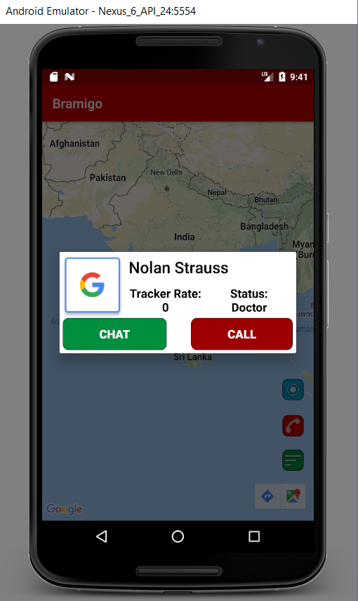
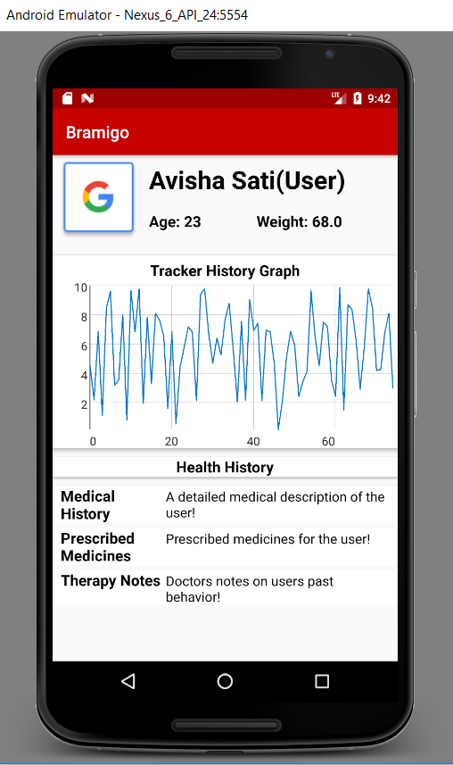
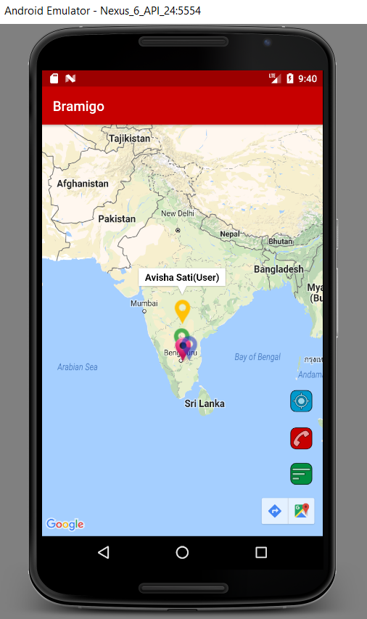
APP SCREENSHOTS

Slide 8
Parameters
Age
Blood Pressure
Body Temperature
Body Mass Index
Muscle Activity
Heart-rate

Slide 9
Data
Synthetic data
Hierarchical generative model to generate the data
Parameters:
Age | BMI
BP | Heart rate
Body temperature | Muscle activity

Slide 10
ALGORITHM AND PARAMETERS
Mentally healthy/ill: 2 dimensional 1 hot column vector, ‘c’. c = [1, 0]^{T} if healthy, c = [0, 1]^{T} if ill. 10% ill.
Age: a ~ N(c𝝁^{T},10), where 𝝁 = [22, 35]^{T}.
BMI: b ~ N(c𝝁^{T},3), where 𝝁 = [22, 27]^{T}.
BP: bp1 ~ N(c𝝁^{T},10), where 𝝁 = [120, 140]^{T}. bp2 ~ N(c𝝁^{T},5), where 𝝁 = [80, 90]^{T}
Heart rate: 3 classes. Inactive, normal, active. P(inactive|healthy)=0.2, P(inactive|ill)=0.4, P(normal|healthy)=0.6, P(normal|ill)=0.2.
Body temperature: bt ~ N(c𝝁^{T},0.6), where 𝝁 = [98.13, 98.38]^{T}. (Source = https://www.ncbi.nlm.nih.gov/pubmed/12759553)
Muscle activity: 3 classes. Hypoactive, normal, hyperactive. P(hypoactive|healthy)=0.2, P(hypoactive|ill)=0.4, P(normal|healthy)=0.6, P(normal|ill)=0.2.

Slide 11
Model
A binary classification model is trained on synthetic data
Two classes - mentally healthy or mentally ill
Logistic regression is used for the binary classification
On a sample data set of 1 million people, > 98% accuracy is achieved

