Slide 1


confidential
Mastering Application Security at a Security Company

Slide 2




Today’s Speakers
Simon Maple
VP, Developer Relations
Avishay Bar
Security Architect

Slide 3
Today’s Agenda
What does “shift left” mean?
Shifting left at CyberArk
ESG’s 2020 Modern Application Development Security Report
Top Developer security challenges
How CyberArk develops a dev-first security approach

Slide 4

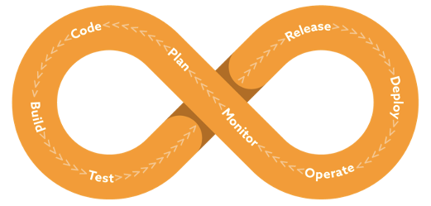
confidential
What does “Shift Left” mean?

Slide 5
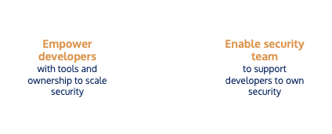
confidential
What does “Shift Left” mean?

Slide 6
confidential
What “Shift Left” means at CyberArk
“Security is everyone’s responsibility”
Security requirements are “down to earth”, developers understand them
Security standards is being handled as part of our SDLC
We’re using tools and software that are IDE and pipeline friendly
Developers are taking active part in designing and developing internal security tools
Security training activities are distributed among development groups

Slide 7
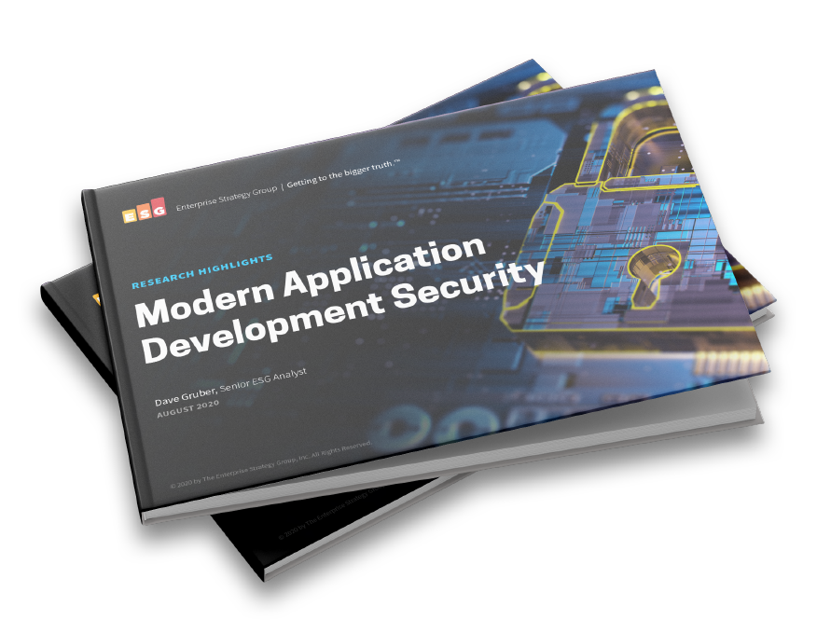

confidential
ESG’s Latest Report: Modern Application Development security

Slide 8
Poll Question #1!

Slide 9


confidential
29%
of Developers lack the knowledge to mitigate risk
Developers Struggle to Mitigate Issues.

Slide 10
Poll Question #2!

Slide 11

confidential
26%
of Developers use security tools that slow down
development cycles
Existing Tools Hinder Development

Slide 12
Poll Question #3!

Slide 13

confidential
24%
of Developers are not utilizing their current testing tools
Poor Adoption of Existing Tools by Developers

Slide 14
Poll Question #4!

Slide 15

confidential
23%
of Developers lack tools that integrate into the SDLC
Lack of Integrations

Slide 16
confidential
Key Takeaways
Most think their application security programs are solid, though many still push vulnerable code.
Multiple security testing tools are needed to secure the potpourri of application development and deployment models in use today.
The proliferation of AppSec testing tools is an issue for many, with more than a third focusing investments on consolidation.
Developer security training is spotty, and programs to improve developer security skills are lacking.
Organizations are investing, with more than half planning to significantly increase spending on application security over the prior year.

Slide 17
confidential
Questions?
Download the Full ESG Report:
https://info.snyk.io/esg-application-development-security

