Slide 1
Capstone Project
Fraud Detection System

Slide 2
Data Overview
Credit Card Transactions of European cardholders over a period of two days in September 2013
Out of a total of 2,84,807 transactions, 492 were fraudulent
Structured Highly Imbalanced Dataset
Time (seconds elapsed between first and subsequent transactions), Amount and other features (V1-V28) are the principal components obtained using PCA

Slide 3
Problem Background
Retaining high profitable customers is the number one business goal
Banking fraud, however, poses a significant threat to this goal for different banks
Nilson report estimated, $30 billion worldwide banking fraud by 2020
Losses owing to fraud have increased from an average of 4.57% in the global recession phase of 2007–2008 to 7.15% in 2017–2018
Federal Trade Commission (US) has estimated that around 10 million people become victims of credit card theft each year, lose 50B$/ yr

Slide 4
Model Evaluation
Linear, Logistic, Decision Tree and Random Forest – every algorithm got verified based on performance parameters.
Evaluate every transactions over 5000$ for fraud analysis
Top 5 features – V14, V17, V12, V16 and V10.
Scaled high imbalanced dataset for better prediction
Target Variable is not continuous, so linear regression is not applicable
Huge dataset, KNN algorithm will take enormous time and decision tree will be overfit

Slide 5

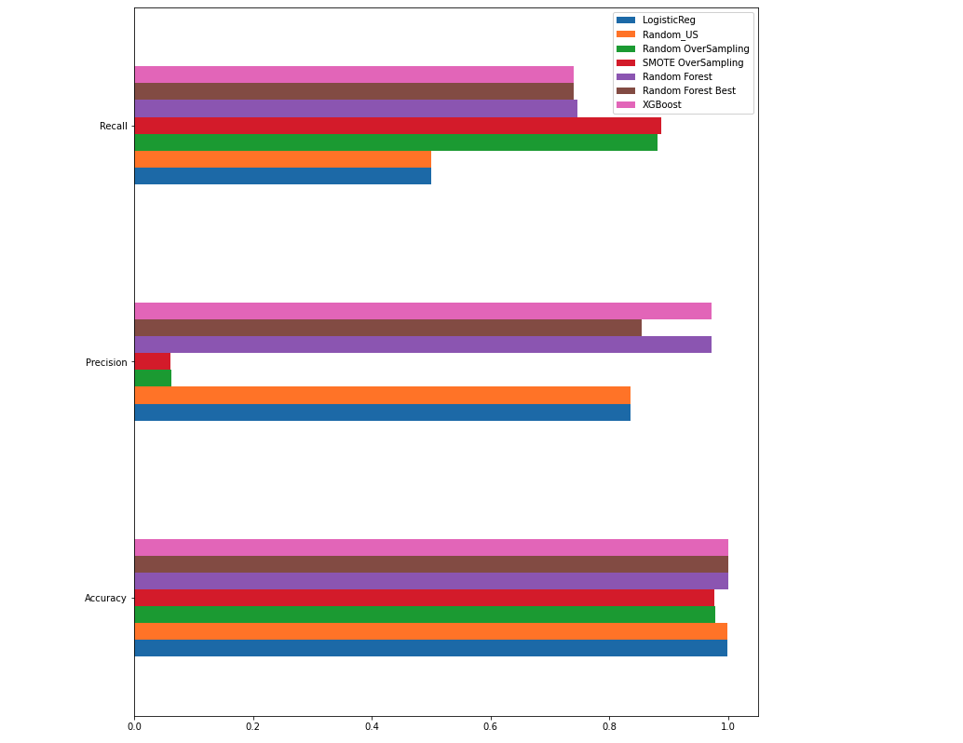
Model Evaluation

Slide 6
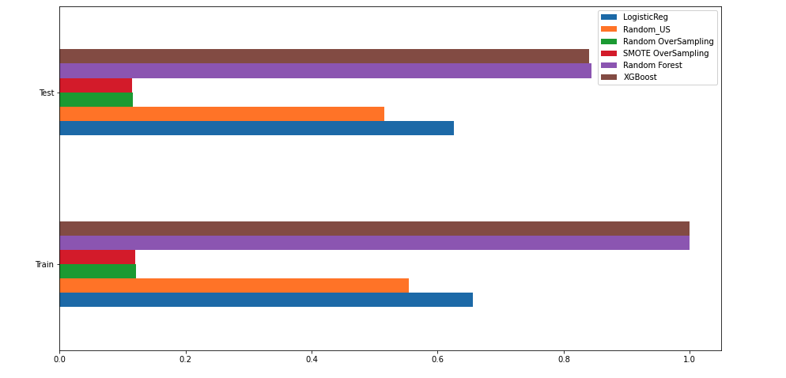
Model Evaluation – Test, Train F1Score evaluation

Slide 7
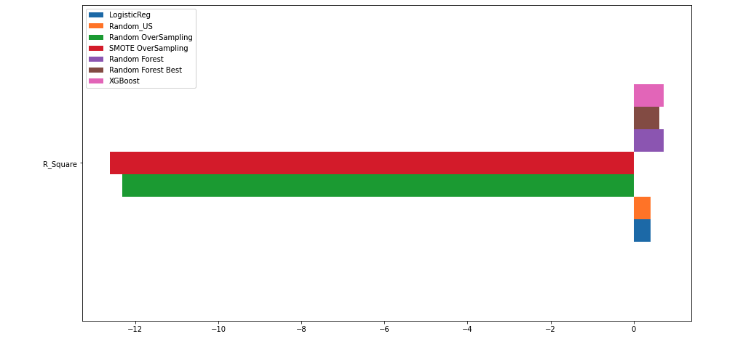
Model Evaluation – R_Squared

Slide 8
RCA

