Slide 1

Java Basics Session 2
Autoboxing and Unboxing
Why Primitive or Wrapper
Nested and Inner Classes
Package and Interface
Array Revisited
Loop and Variable Length of Arguments
Final keyword

Slide 2
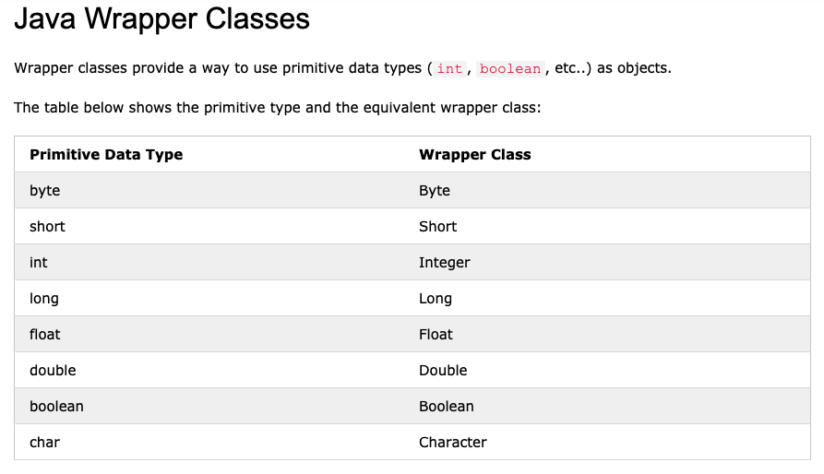
Autoboxing and Unboxing

