Slide 1

E-Commerce Platform Presentation
By Avishek Bista
14892/22
ST. Xavier’s College, BIM Program

Slide 2
Problem Statement
Limited market reach due to lack of online presence
No customer engagement or digital marketing tools
Competition from bigger brands
No feedback or review system
Need for an e-commerce platform to boost visibility and sales

Slide 3
Objectives
Develop a user-friendly e-commerce website
Enable product browsing, ordering, and reviewing
Manage inventory, track orders, and offer discounts
Collect customer data and feedback
Build brand loyalty through digital engagement

Slide 4
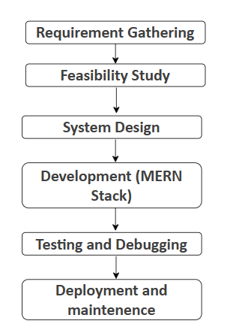
Research Methodology

Slide 5
Proposed Tool
Agile Development Model
Frontend: HTML, CSS, JavaScript (React)
Backend: Django (Python) or Laravel (PHP)
Database: MySQL
Payment Gateway: Esewa or Khalti
Version Control: GitHub
Design Tools: Use Case, ER Diagrams, Wireframes, Flowcharts, figma

Slide 6
Deliverables
Fully functional e-commerce website
Product catalog, cart, and secure checkout
Order tracking and reviews
Email/SMS promotions
Admin dashboard for management
Sales analytics and reporting
Documentation and training

Slide 7
Conclusion
Project empowers local manufacturer via digital presence
Enhances customer interaction and trust
Boosts sales and builds brand visibility
Offers a cost-effective and scalable solution
Competes effectively with larger brands

