Slide 1
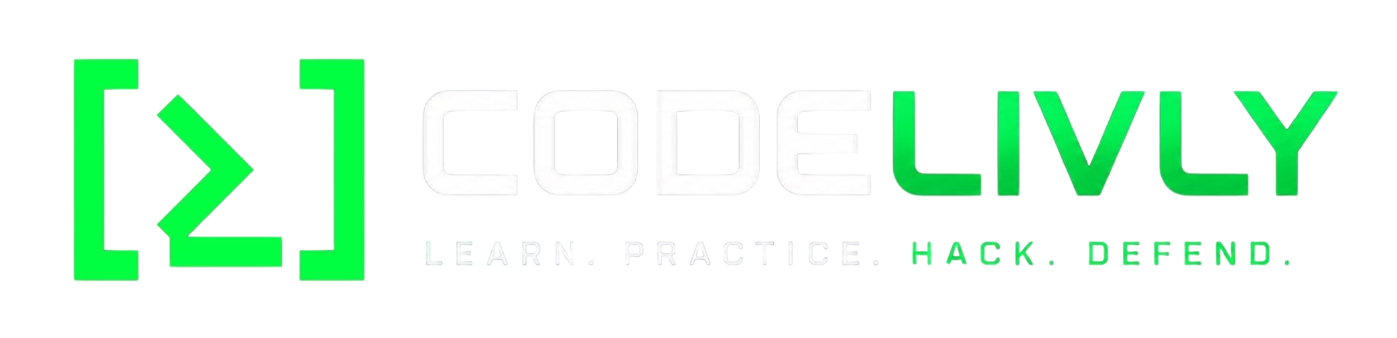

IPv4 Fundamentals & Addressing
3-Month Networking Class — Week 2, Day 1
CODELIVLY · Week 2, Day 1 · IPv4 Fundamentals & Addressing
1

Slide 2
Quick Recap — Week 1
Everything today builds straight off last week
1
What's the difference between a packet and a frame?
2
What does a router actually do, versus a switch?
3
What's an IP address, in the analogy terms we used last week?
CODELIVLY · Week 2, Day 1 · IPv4 Fundamentals & Addressing
3

Slide 3
3
Before IPv4: What Is a Bit?
The smallest unit of binary information
Grouping bits together
0
1 bit
A bit (binary digit)
10
2 bits
Can only have two possible values: 0 or 1
101
3 bits
There is no 2, 3, 4, or any other value — just 0 or 1. That's it.
1010
4 bits
10101100
8 bits = 1 byte / octet
CODELIVLY · Week 2, Day 1 · IPv4 Fundamentals & Addressing
4

Slide 4
5
Decimal vs. Binary
Same idea, different base
Decimal — Base 10
Binary — Base 2
10 digits: 0 1 2 3 4 5 6 7 8 9
2 digits: 0 and 1
25 = (2 × 10) + (5 × 1)
10 (binary) = 2 (decimal)
Counting in binary
0
1
2
3
4
5
6
7
8
0
1
10
11
100
101
110
111
1000
Same symbols, different meaning: 10 in decimal = ten. 10 in binary = two. The base changes everything.
CODELIVLY · Week 2, Day 1 · IPv4 Fundamentals & Addressing
5

Slide 5
6
Bytes & Octets
The 8-bit group networking is built on
1
0
1
0
1
1
0
0
8 bits = 1 byte = 1 octet
Why "octet" instead of "byte"? A byte is commonly 8 bits on modern computers, but "octet" specifically and unambiguously means a group of 8 bits — so networking uses octet.
The chain to remember
1 bit = 0 or 1 → 8 bits = 1 byte = 1 octet → 4 octets = 32 bits → 32 bits = 1 IPv4 address
CODELIVLY · Week 2, Day 1 · IPv4 Fundamentals & Addressing
6

Slide 6
7
IPv4 Address Structure
192.168.1.10 — four octets, 32 bits total
Octet 1
Octet 2
Octet 3
Octet 4
192
168
1
10
.
.
.
11000000
10101000
00000001
00001010
8 bits
8 bits
8 bits
8 bits
192.168.1.10 = 11000000.10101000.00000001.00001010
Two representations of the same address — one decimal (for people), one binary (underneath, for the network).
IP address vs. MAC address: an IP address is a logical, network-layer address. A MAC address belongs to the network interface at the data-link layer — a different thing entirely.
CODELIVLY · Week 2, Day 1 · IPv4 Fundamentals & Addressing
7

Slide 7
8
Binary Place Values
Why 128, 64, 32, 16, 8, 4, 2, 1?
128
64
32
16
8
4
2
1
2⁷
2⁶
2⁵
2⁴
2³
2²
2¹
2⁰
Every time the exponent increases by 1, we multiply the previous answer by 2:
1 →×2→ 2 →×2→ 4 →×2→ 8 →×2→ 16 →×2→ 32 →×2→ 64 →×2→ 128
All zeros
All ones
00000000 = 0
11111111 = 255
Minimum value of one octet
128+64+32+16+8+4+2+1 = 255 — maximum value of one octet (256 possible values: 0–255)
CODELIVLY · Week 2, Day 1 · IPv4 Fundamentals & Addressing
8

Slide 8
9
Binary ⇄ Decimal Conversion
Add up the place values where there's a 1
11000000
128 + 64
=
192
10101000
128 + 32 + 8
=
168
11001001
128 + 64 + 8 + 1
=
201
CODELIVLY · Week 2, Day 1 · IPv4 Fundamentals & Addressing
9

Slide 9
10
Network Portion, Host Portion & Subnet Mask
192.168.1.10 /24
11111111
11111111
11111111
00000000
Network
Network
Network
Host
Subnet mask (/24): 255.255.255.0
The /24 (prefix length) tells us the first 24 bits are the network portion; the remaining 8 bits are the host portion. With 8 host bits: 2⁸ = 256 total addresses.
CODELIVLY · Week 2, Day 1 · IPv4 Fundamentals & Addressing
10

Slide 10
11
Network, Broadcast & Usable Host Addresses
Using 192.168.1.10 /24 as our example
Network address
First usable
Last usable
Broadcast address
192.168.1.0
192.168.1.1
192.168.1.254
192.168.1.255
First address — identifies the network
Start of the assignable range
End of the assignable range
Last address — reaches all local hosts
254
The quick calculation: 2⁸ = 256 total addresses. 256 − 2 = 254 usable hosts.
The two removed addresses are the network address and the broadcast address — a rule you'll use constantly in subnetting.
CODELIVLY · Week 2, Day 1 · IPv4 Fundamentals & Addressing
11

Slide 11
12
The Default Gateway
The exit door from your local network
PC1
Router (Gateway)
192.168.1.10
same /24 network
192.168.1.1
to other networks
Outside networks
(e.g. 8.8.8.8)
The default gateway is normally the router interface on the local network that a host uses to reach destinations outside its own subnet.
CODELIVLY · Week 2, Day 1 · IPv4 Fundamentals & Addressing
12

Slide 12
13
Private, Public & Loopback Addresses
Not every IPv4 address is reachable from the internet
Private IPv4 ranges (not routed on the public internet)
10.0.0.0 /8
172.16.0.0 /12
192.168.0.0 /16
When private devices need to reach the public internet, NAT is typically used at the network edge (covered later in the program).
Quick check — private or public?
Loopback
192.168.1.5
Private
127.0.0.1
10.20.30.40
Private
Refers back to the local machine — used to test whether the local TCP/IP stack is working.
8.8.8.8
Public
CODELIVLY · Week 2, Day 1 · IPv4 Fundamentals & Addressing
13

Slide 13
4
Worked Examples — /24, /26, /27
Prefix length changes how many host bits remain
 | /24 | /26 | /27
Address | 192.168.1.10 | 10.0.0.5 | 192.168.100.55
Subnet mask | 255.255.255.0 | 255.255.255.192 | 255.255.255.224
Host bits | 8 | 6 | 5
Block size | 256 | 64 (2⁶) | 32 (2⁵)
Network | 192.168.1.0 | 10.0.0.0 | 192.168.100.32
Broadcast | 192.168.1.255 | 10.0.0.63 | 192.168.100.63
Usable range | 192.168.1.1 – .254 | 10.0.0.1 – .62 | 192.168.100.33 – .62
Usable hosts | 254 | 62 | 30
CODELIVLY · Week 2, Day 1 · IPv4 Fundamentals & Addressing
14

Slide 14
CODELIVLY · Week 2, Day 1 · IPv4 Fundamentals & Addressing
Wednesday: subnetting — breaking networks into smaller networks and calculating address ranges.
Thanks, everyone — see you Friday!
1
17

