Slide 1
Using Word Embedding in Statistical Learning Models
Oren Glickman
Data Science Institute, Bar-Ilan University
Notes:
While textual data is abundant (e.g Book recommendations, transcriptions of conversations with customers) using it in statistical learning models has always been a challenge.
Word embedding aims at capturing the semantic similarity of words and has been extended to other textual structures (such as documents).
General word embedding models are available as well as tools for learning word embedding from domain specific corpora (such as medical diagnosis).
In this talk, a word embedding model that was trained on Hebrew Twitter records will be presented along with its use in statistical learning models.

Slide 2
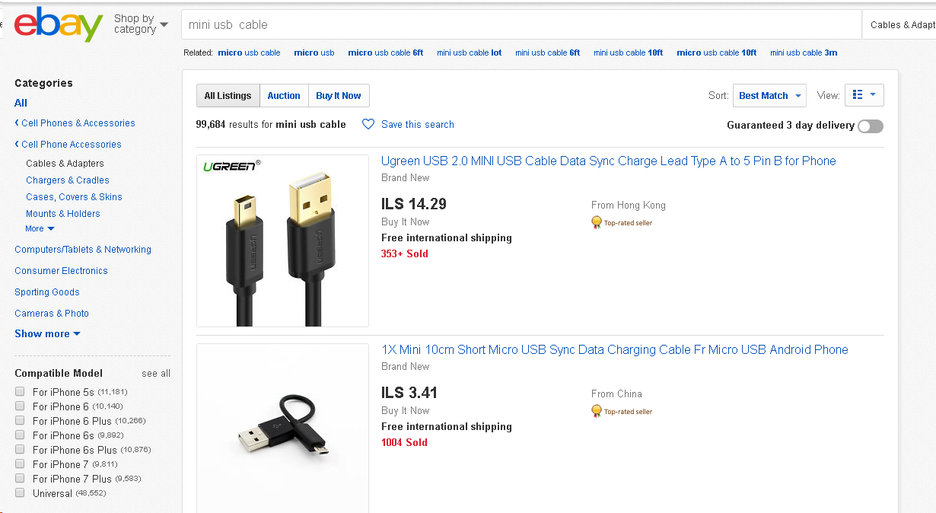
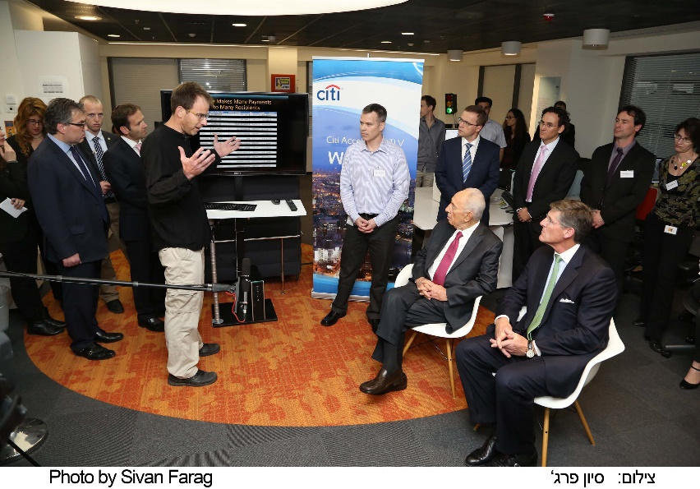
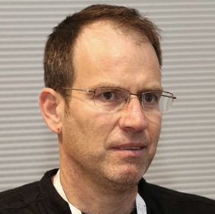

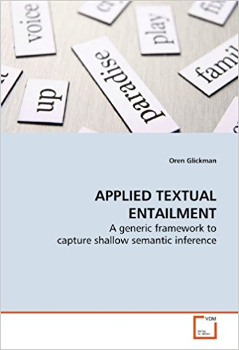
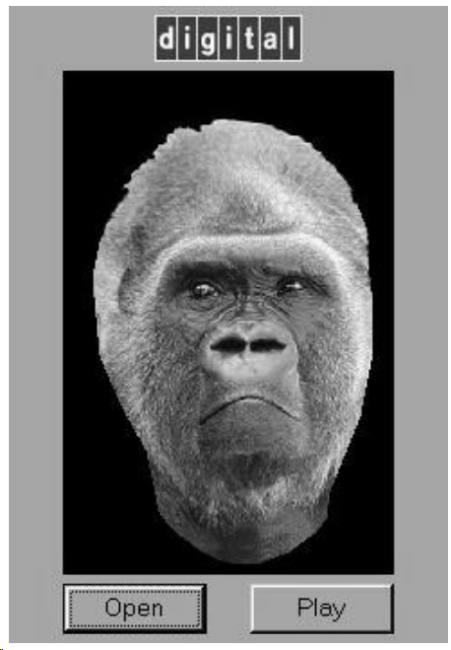

Slide 3
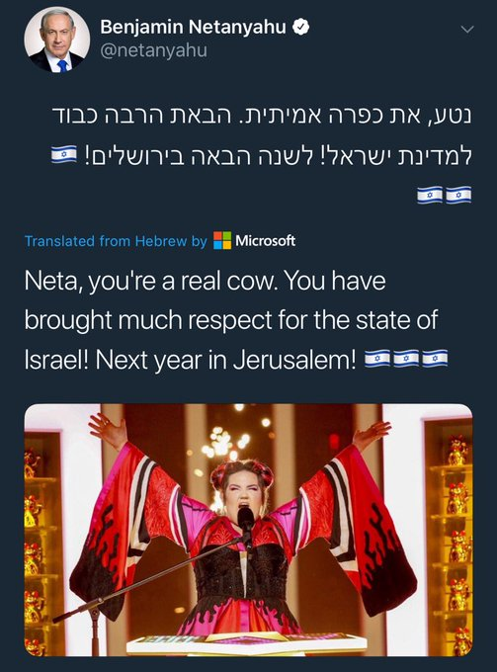

Slide 4
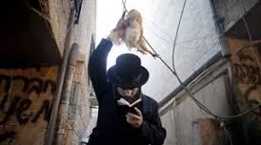
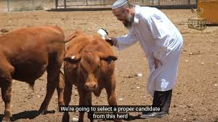
כפרה או כפרה?

Slide 5
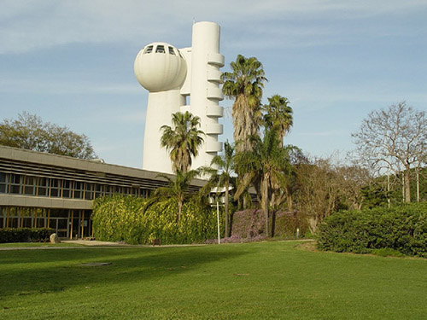
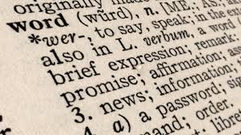
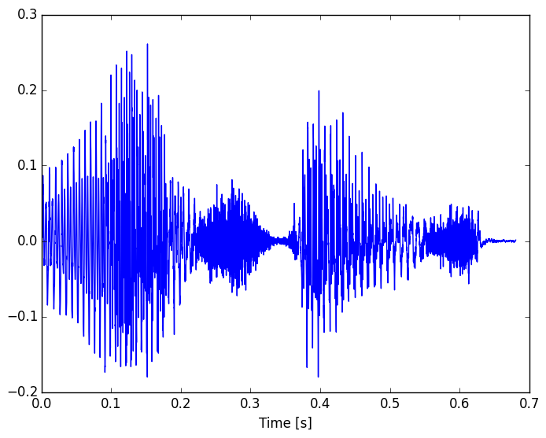

Representing Text
Continuous
Symbolic
Images
Speech
Language/Text

Slide 6


One Hot Representation
Words as atomic symbols:
dog

Slide 7
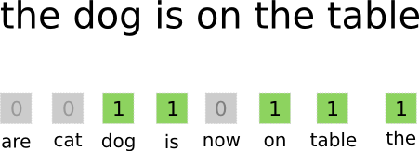
One Hot Representation
Words as atomic symbols:
Bag of words (BOW)
dog

Slide 8
Disadvantages of symbolic representation
Representation does not capture semantic similarity!
The words “strong” and “powerful” are as far from each other as they are from “Paris”
Dimensionality of vectors is very high
Typically 30-100K

Slide 9
Sparse Word representations
Word-Context Matrices
C7 | C6 | C5 | C4 | C3 | C2 | C1
1 | 9 | 2 | 2 | 11 | 0 | 5 | dog
2 | 7 | 1 | 1 | 7 | 1 | 4 | cat
9 | 1 | 9 | 0 | 0 | 12 | 0 | bread
10 | 0 | 14 | 2 | 1 | 8 | 0 | pasta
8 | 1 | 11 | 1 | 1 | 7 | 0 | meat
1 | 8 | 1 | 0 | 8 | 0 | 4 | mouse

Slide 10
Sparse Word representations
Word-Context Matrices
Possible Contexts: Documents, co-occurring words, …
Con: Sparse, High dimension
C7 | C6 | C5 | C4 | C3 | C2 | C1
1 | 9 | 2 | 2 | 11 | 0 | 5 | dog
2 | 7 | 1 | 1 | 7 | 1 | 4 | cat
9 | 1 | 9 | 0 | 0 | 12 | 0 | bread
10 | 0 | 14 | 2 | 1 | 8 | 0 | pasta
8 | 1 | 11 | 1 | 1 | 7 | 0 | meat
1 | 8 | 1 | 0 | 8 | 0 | 4 | mouse

Slide 11
Approaches for dense word representations
Distributional Semantics (Count)
Used since the 90’s
Sparse word-context PMI/PPMI matrix
Decomposed with SVD
Word Embeddings (Predict)
Inspired by deep learning
word2vec (Mikolov et al., 2013)
GloVe (Pennington et al., 2014)
Underlying Theory: The Distributional Hypothesis (Harris, ’54; Firth, ‘57)
“Similar words occur in similar contexts”
Notes:
There are two approaches for creating these vectors:
First, we’ve got the traditional count-based approach,
where the most common variant is the word-context PMI matrix.
The other, cutting-edge, approach, is word embeddings,
Which has become extremely popular with word2vec.
Now, the interesting thing…
…is that both approaches rely on the same linguistic theory: the distributional hypothesis.
<pause>
Now, in previous work, that I’ll talk about in a minute,
we showed that the two approaches are even more related.

Slide 12
Don’t count, Predict!
Approach:
Represent words by the context in which they usually appear
Define a prediction task involving a word and its context
Build a neural net for the problem
Derive the word representations from the trained neural net
Implementations:
[Collobert and Weston, 2008], [Bengio et al., 2009]
word2vec [Mikolov et al., 2013]
CBOW
Skip Grams
GloVe [Pennington et al., 2014]

Slide 13
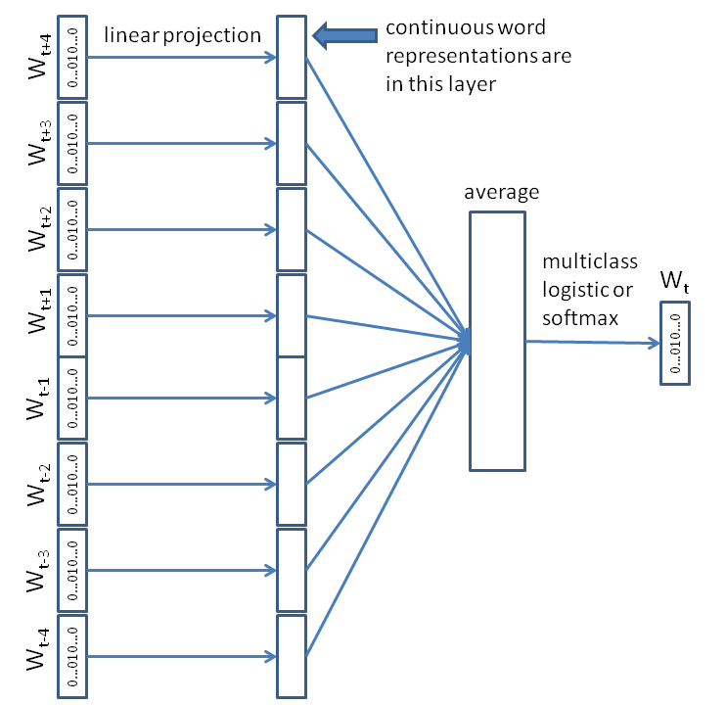
The CBOW Model
hidden layer
M_{v,d}
Input: surrounding words (4 words before, 4 words after the word)
Output: predicted word (probability for each word in the vocabulary)
Notation: there are v words in the vocabulary and we want to represent them by vectors of length d
The linear projection is the same for all words (all words are multiplied by the same matrix M_{v,d})
Multiplying the binary word representation by the linear projection matrix results in the vector representation
M_{v,d} is learned when the model is trained
M_{v,d}
M_{v,d}
M_{v,d}
M_{v,d}
M_{v,d}
M_{v,d}
M_{v,d}

Slide 14
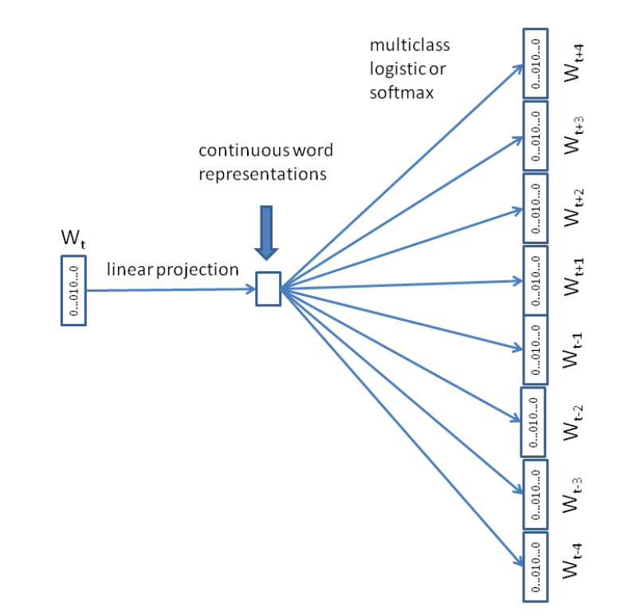
The Skip-gram Model
hidden layer
Input: word
Output: predictions for surrounding words (probabilities)
Notation: there are v words in the vocabulary and we want to represent them by vectors of length d
M_{v,d} is learned when the model is trained
M_{v,d}

Slide 15
The output
Word embedding
That capture word semantics
Similar words are close to each other (cosine similarity) in the vector space
dog
cat
(4.2, 0.5, 8.31, 7.48,..., 6.17)
(4.6, 0.8, 8.4, 7.1,..., 5.9)

Slide 16
It works!
[English Wikipedia]
Words most similar to
“France”: Austria, Belgium, Germany, Italy, Greece, Sweden, Norway, Europe, Hungary and Switzerland
“Mozart”: Beethoven, Bach, Mendelssohn, Brahms, …
[Hebrew Twitter]
המילים הכי דומות ל -
"עפולה": נתניה, אשקלון, אשדוד, עכו, רעננה, חדרה, נהריה, חיפה, ...
"יוגה": פילאטיס, מדיטציה, ספינינג, אירובי, פילטיס, אשטנגה, ...

Slide 17
Hebrew Embeddings
Embeddings depend on
dataset
Desired dimension
and algorithm/context/hyper parameters
מילים הכי דומות ל "ברק":
ערוץ 7: אהוד, יצחקי, אפק, בכר, אובמה, מנור
פסקי דין: אהרון, אהרן, א.ברק, זמיר
ויקיפדיה: רבין, אריאל, הרצוג, וברק, גור, נתניהו
טוויטר: יהודה, גנץ, בגין, יערי

Slide 18
Hebrew Embeddings
Embeddings depend on
dataset
Dimension
context
Algorithm & hyper parameters
מילים הכי דומות ל "ברק":
ערוץ 7: אהוד, יצחקי, אפק, בכר, אובמה, מנור
פסקי דין: אהרון, אהרן, א.ברק, זמיר
ויקיפדיה: רבין, אריאל, הרצוג, וברק, גור, נתניהו
טוויטר: יהודה, גנץ, בגין, יערי
ברק יצחקי וברק בכר - ספורטאים
בני ברק, בני יהודה?!

Slide 19
Vector Math!!
king – man + woman = ?
Madrid –Spain + France = ?

Slide 20
Vector Math!!
king – man + woman = queen
Madrid –Spain + France = Paris

Slide 21
It Captures Linguistics/Semantic notions !!
מוזר + קטנה – קטן =
נחמד + וקטן – קטן =
כמשימה + פתרון – כפתרון =
קפדן + רע - טוב =
בדיחה + טוב - רע =
בדיחה + רע - טוב =

Slide 22
It Captures Linguistics/Semantic notions !!
מוזר + קטנה – קטן = מוזרה
נחמד + וקטן – קטן = ונחמד
כמשימה + פתרון – כפתרון = משימה
קפדן + רע - טוב = דוגמטי, פנאט, פריבילגי
בדיחה + טוב - רע = הלצה, הברקה, דאחקה
בדיחה + רע - טוב = דאחקה, הנפצה, הטרלה

Slide 23
כפרה או כפרה?
אליבא דה טוויטר – המילים הכי דומות ל"כפרה":
כפרע, כפרהה, כפרההה, כםרה, כפרות, כפרהההה, כפרעעע, שרופה, יכפרה, כפרהההההה, כפרוש

Slide 24
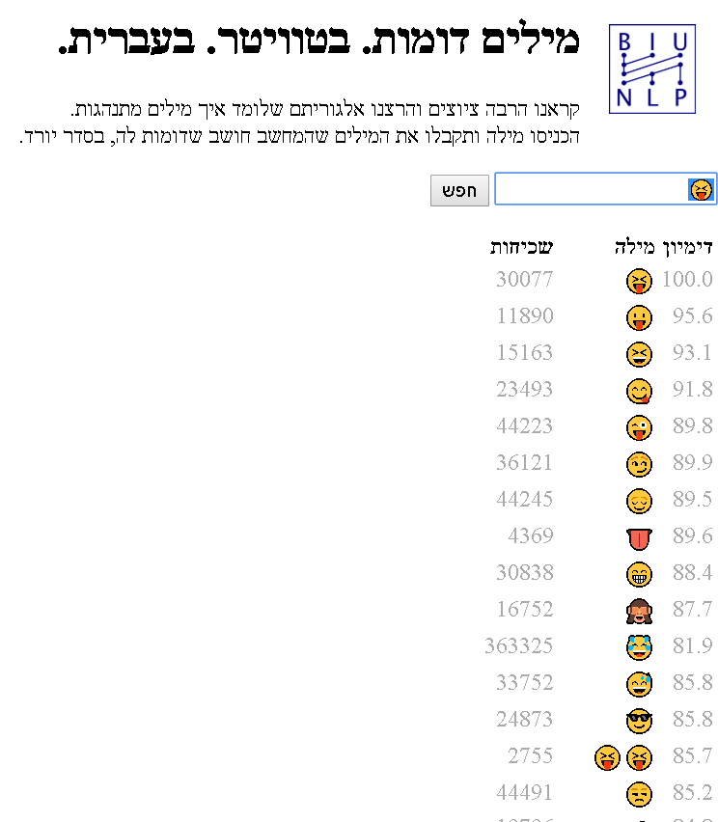
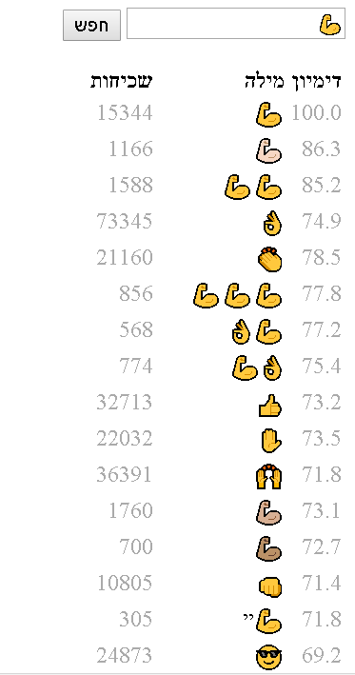
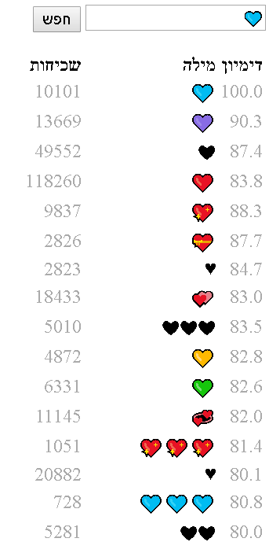
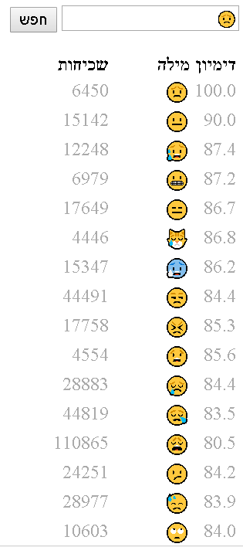
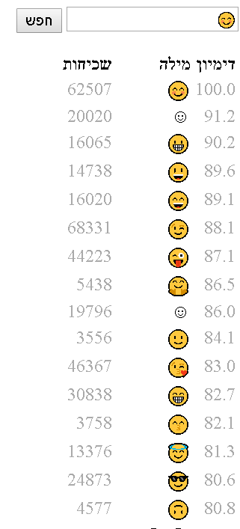
Not only words :- )

Slide 25
Using embeddings in learning tasks
Dense feature representation of words
Options:
Pre-trained
Seed with pre-trained
Random initialization

Slide 26
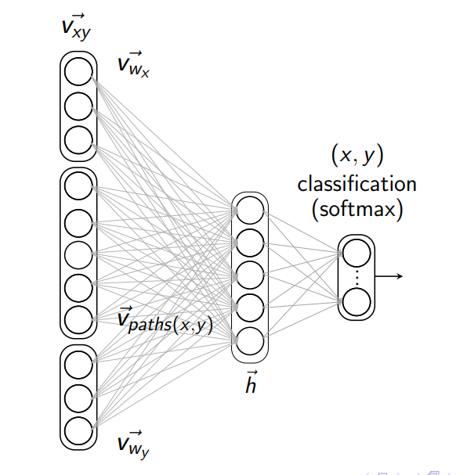
Hypernymy Detection
Task:
"tuvalu" is a country
"ninjaken" is a weapon
"ninjaken" is a weapon
Classifier trained on embeddings of the two input words
[Vered Shwartz, Yoav Goldberg, and Ido Dagan, ACL 2016]

Slide 27
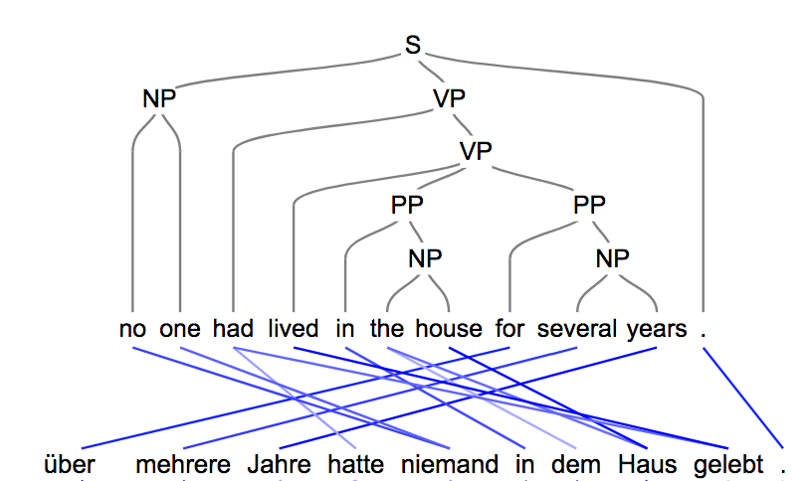
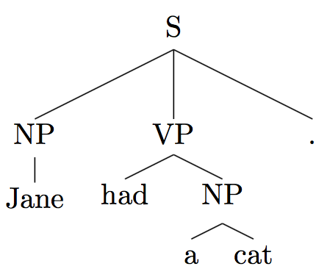
Machine Translation
Neural Machine Translation using RNN’s and an Attention Mechanism
Word embeddings are learned as part of the model
Trained using parallel sentence pairs (from 100k up to 4m)
Novelty: predict syntactic trees using brackets in the english side
Improves the translation quality, especially in low-resource cases
Roee Aharoni & Yoav Goldberg, ACL 2017

Slide 28

Hebrew Sentiment
Learned on Hebrew Twitter
Emotion bearing Emojis as indicator of sentiment
NN to predict embedding of emoji in text
Use word embeddings as features
Will soon be available….

Slide 29
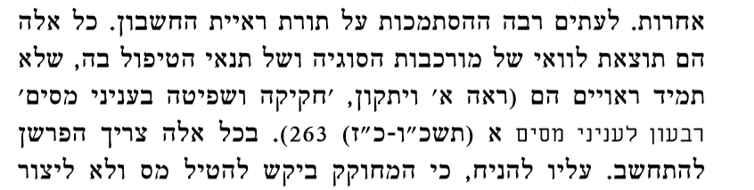

Extraction of Citations from court verdicts
Annotated data available only on 300 verdicts
Word embeddings pre-trained on all verdicts
Joint work with Oren Perez, Reuven Cohen, Ido Datan, Avi Yeger and David Gabay.

Slide 30
Splitting and Rephrasing Complex Sentences
Task: Learn to split a complex sentence into several simple ones while preserving the meaning
The address , 11 Diagonal Street is located in South Africa where the leader is Cyril Ramaphosa and some Asian South Africans live.
1M example dataset by Narayan et al, EMNLP 2017
Embeddings learned as part of task. Shared between the source and the target
Very hard task!
- The address 11 Diagonal Street is located in South Africa. - South Africa leader is Cyril Ramaphosa. - Some Asian South Africans live in 11 Diagonal Street.
Roee Aharoni & Yoav Goldberg, ACL 2018

Slide 31
SetExpander: End-to-end Term Set Expansion based on Multi-Context Term Embeddings
Task: expand a seed set of terms into a more complete set of terms that belong to the same semantic class.
For example:
[‘Siri’, ‘Cortana’] -> [‘Siri’, ‘Cortana’, ‘Amazon Echo’, ‘Google Now’]
Example use case: Automated Recruitment System
Recruiters use system to generate skills lists
Terms are represented by their word2vec embeddings
pre-trained; 5 different context types
Classifier learns group based on the embedding similarity scores
Intel & BIU EMNLP 2018 Submission

Slide 32

Thank You
כפרה עליכם!

