Slide 1


Customer Shopping Behavior Analysis
Analysis of 3,900 transactions to surface spending patterns, segments, product preferences, and subscription effects to guide strategy.

Slide 2

Dataset Snapshot
Rows & Columns
Key Features
3,900 rows · 18 columns
Demographics, purchase details, behavior signals (discounts, frequency, reviews)
Missing Data
Summary Stats
37 missing values in Review Rating
Avg purchase: $59.76 · Avg rating: 3.75

Slide 3

EDA & Cleaning (Python)
Process: Load with pandas, inspect with df.info() and .describe(), standardize column names to snake_case.
Missing Ratings: Imputed using median rating per product category.

Slide 4

Feature Engineering & Database
Created age_group bins and purchase_frequency_days. Checked redundancy and dropped promo_code_used. Integrated cleaned DataFrame into PostgreSQL for SQL analysis.

Slide 5
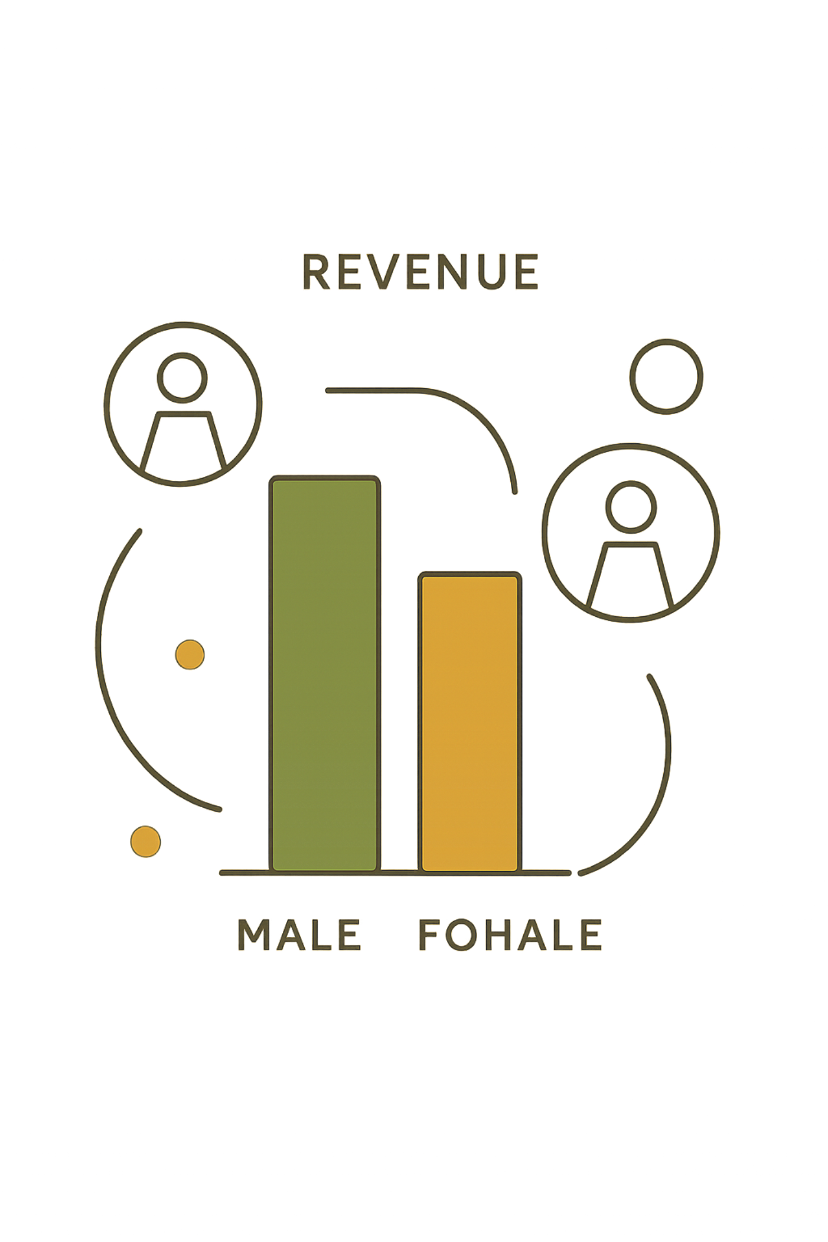



Revenue & Demographic Insights (SQL)
Revenue by Gender
Female: 75,191 · Male: 157,890
Revenue by Age Group
Young Adult: 62,143 · Middle-aged: 59,197 · Adult: 55,978 · Senior: 55,763
Subscribers vs Non-Subscribers
Subscribers (1,053): avg $59.49 total 62,645 · Non-subs (2,847): avg $59.87 total 170,436

Slide 6
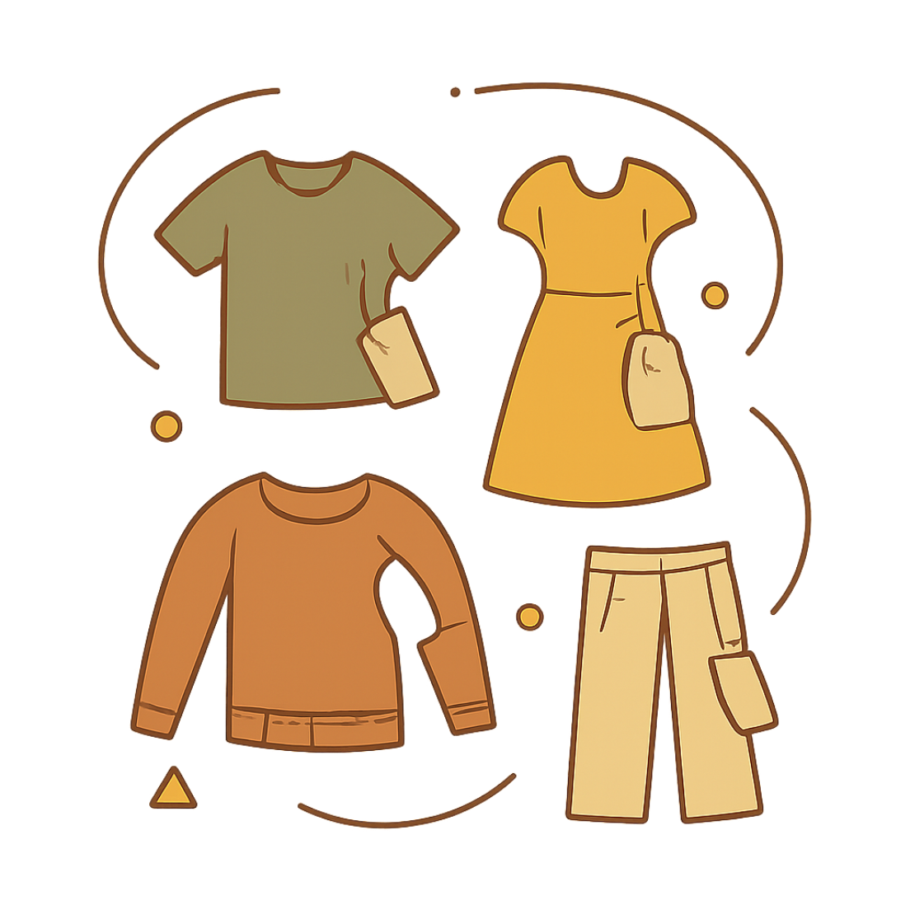


Product & Discount Patterns
Top Discounted Items
Top Rated Items
Gloves 3.86 · Sandals 3.84 · Boots 3.82 · Hat 3.80 · Skirt 3.78
Hat 50%, Sneakers 49.66%, Coat 49.07%, Sweater 48.17%, Pants 47.37%

Slide 7

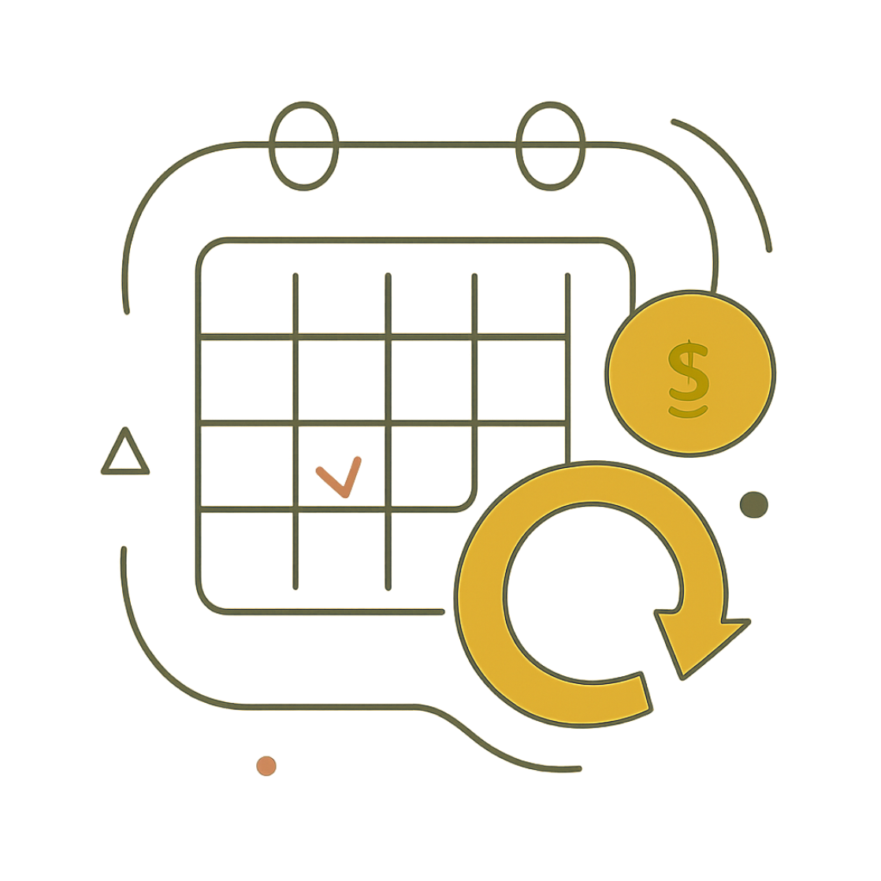
Behavioral Segments & Frequency
Returning701
New83
Loyal3,116
Frequency example: common cadence “Every 3 Months”. Repeat buyers (>5 purchases) are more common among subscribers: Repeat buyers — No: 2,518 · Yes: 958.
Majority of customers fall into the Loyal segment (3,116).

Slide 8
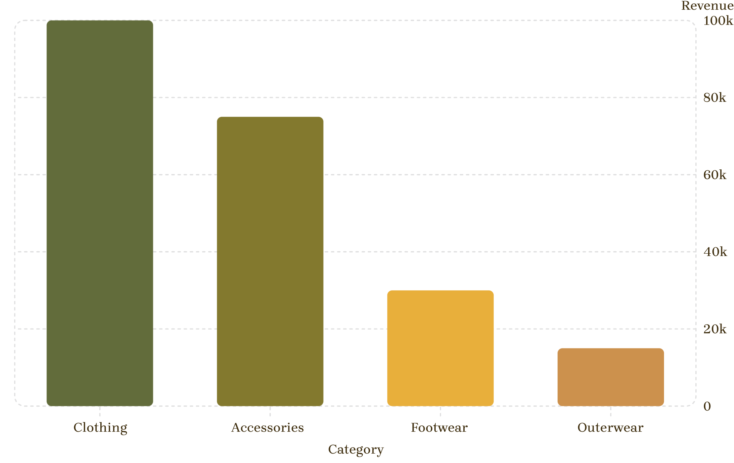
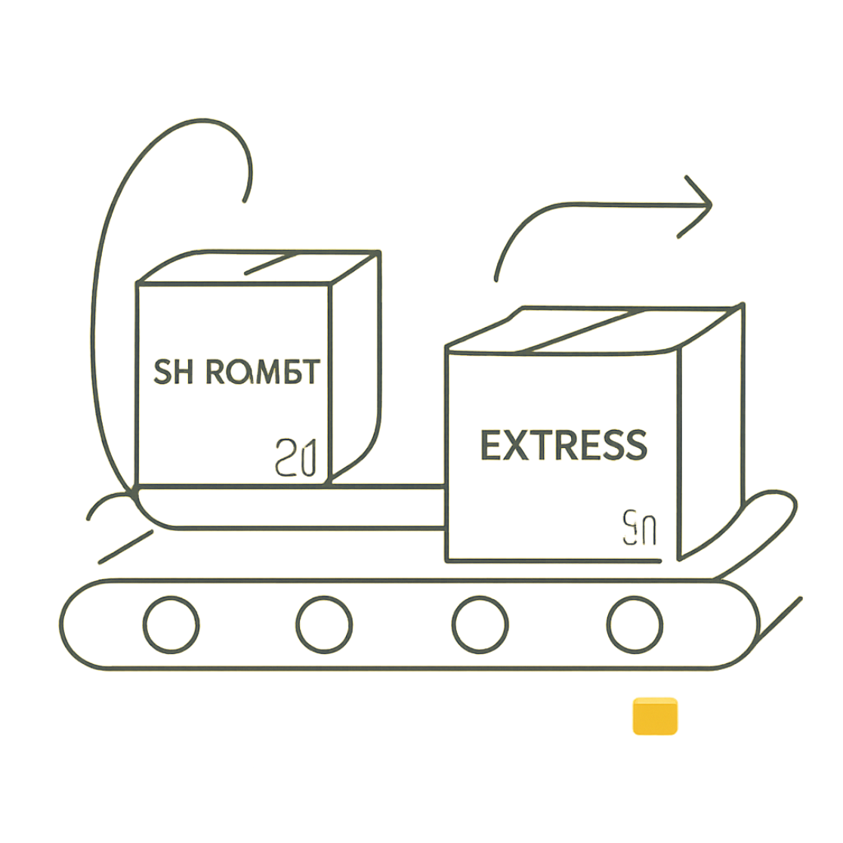
Sales & Shipping Insights
Shipping comparison: Standard avg $58.46 · Express avg $60.48. Sales by category: Clothing 1,800 · Accessories 1,200 · Footwear 600 · Outerwear 200.

Slide 9
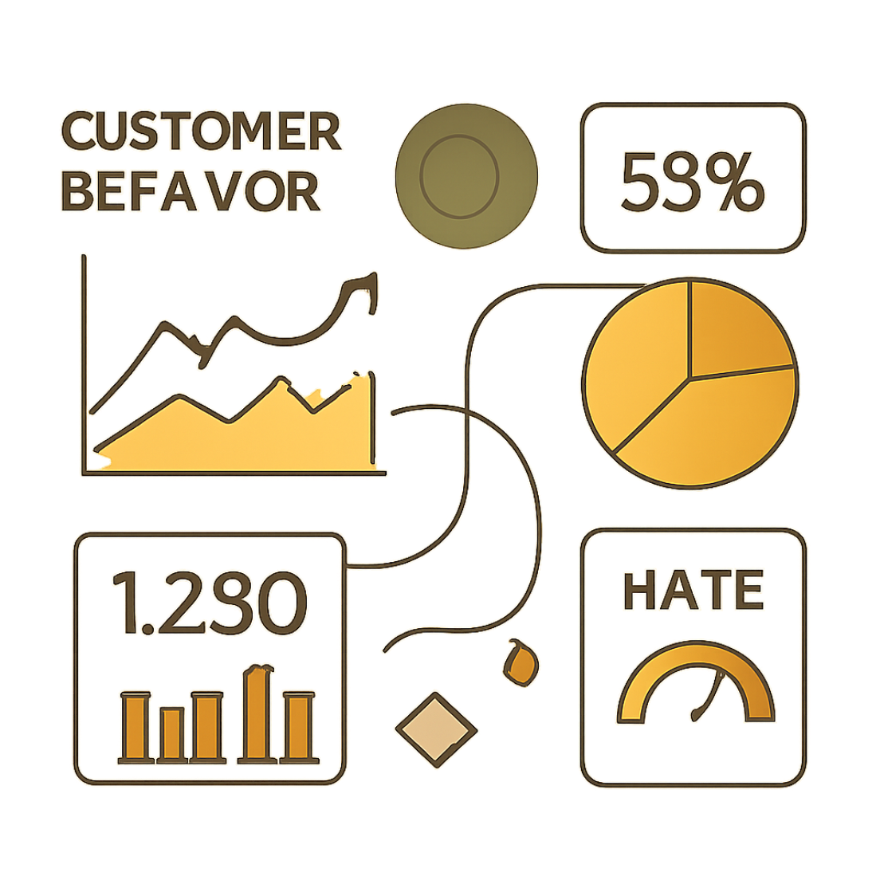
Dashboard Snapshot (Power BI)
Key metrics: Number of Customers 3.9K · Average Purchase $59.76 · Avg Review 3.75. Donut: Subscribers 27% · Non-subs 73%. Visuals include revenue and sales by category and age group.

Slide 10
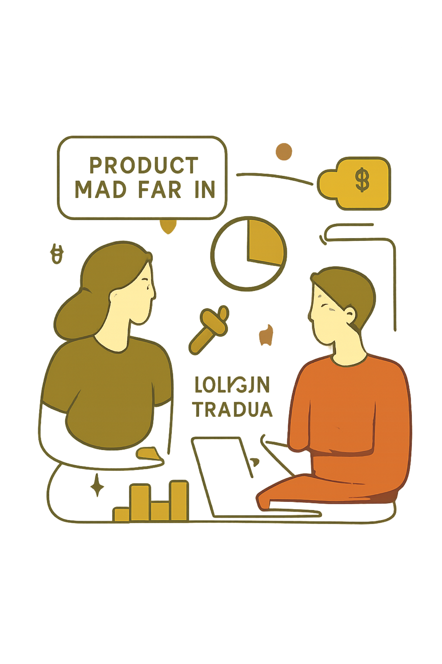




Business Recommendations
Boost Subscriptions
Loyalty Programs
Promote exclusive subscriber benefits to increase recurring revenue.
Reward repeat buyers to move more customers into the Loyal segment.
Review Discount Policy
Product Positioning & Targeting
Balance promotional lift with margin control — target high discount rates on selective SKUs.
Highlight top-rated and top-selling products; focus marketing on high-revenue age groups and express-shipping users.

