Slide 1


INTERNET OF THINGS
ATULYA
AVISHI SAXENA
21JE0200
STREET LIGHT MONITORING SYSTEM

Slide 2
Present Scenario Of Street Lights
Simple timer control are installed for almost all circuits but there is no regular check-up to alter regulate the time setting irrespective of weather sensitivities to switch ON/OFF lamps leading to extra lightning hours.
Due to absence of any control systems on the input power supply quality especially voltage conditions. Voltage levels vary between 250-280V at light terminal leading to high power consumption and premature lamp failures.

Slide 3

Photo switches do not function properly after some time due to settling of dust on photo cells.
Inadequate / poor fault reporting mechanism and hence delayed repair of the faulty lights and human discomfort.
Non uniform intensity levels due to several reasons and higher intensity levels during off peak traffic hours, leading to energy wastage.
No control or mechanism to check power theft from the lines meant for street lighting supply leading to high unnecessary bills for municipality.

Slide 4
Objective
The objective of this project is to design a smart lightning system whose main focus is on energy saving and implementing autonomous as well as economical operation on street lights.
To build an energy saving smart lightning system with integrated sensors and controllers.

Slide 5
Methodology
For us to achieve the above mentioned objectives, chips should be installed on the light. These chips will consist of microcontroller along with several sensors like motion detectors, light intensity sensor, and GSM modules for wireless data transmission and reception between concentrator and PC. Efficient programming should be accompanied to ensure minimum consumption of energy.

Slide 6
Components used
IR sensors
Arduino UNO R3
Light Dependent Resistor (LDR)
Resistors
Connecting wires
LEDs
Breadboard

Slide 7
IR Sensors
They are used to detect motion and hence turn on the corresponding street light.
It is necessary for IR sensors to have sufficient range in order to detect the vehicles from a distance.
They should be placed just before the LED post to light the street just before the vehicle reaches a particular point on the street.

Slide 8
LDR Circuit
The LDR circuit is a light dependent sensor which increases resistance of path as the intensity of incident light decreases.
As the intensity of light is very less at night, the resistance increases thus enabling the LED light to switch off.

Slide 9
INPUT
DEVICE
DURING DAYTIME (WHEN INTENSITY OF LIGHT IS HIGH)
STREET LIGHT IS TURNED OFF
VEHICLE APPROACHES (MOTION DETECTORS ARE ACTIVATED)
STREET LIGHT IS TURNED ON

Slide 10
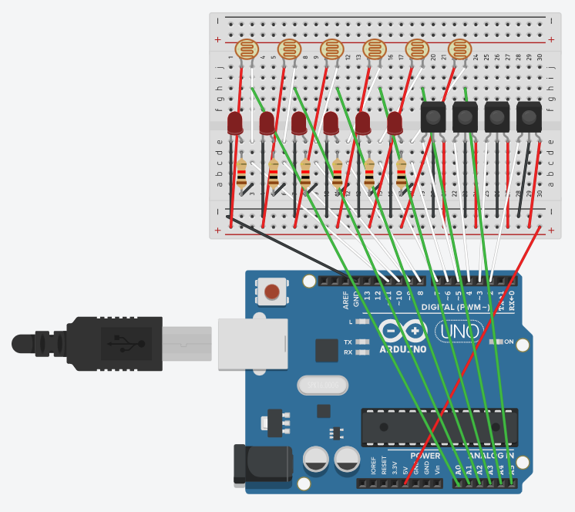
Circuit Diagram

Slide 11
Takeaways: Brief knowledge about coding with Arduino and how to connect components in circuit.
Resources: Free code camp, a Youtube channel and Tinkercad helped me along the making of my project.
Ideas: CO2 sensors and fog sensors along with fog lights can be introduced. In case of excessive fog, these lights will help in guiding vehicles. Furthermore, street lights should be equipped to be remotely operated and detection of defects.

Slide 12
THANK YOU

