Slide 1
IoT based Pollution Monitoring and Control System
Team - SATTVA
The LNM Institute of Information Technology, Jaipur

Slide 2
Project Objective
As a smart city citizen, to develop an IoT based system to find the sources of pollution and solution to control the same so that the policymakers can identify the big polluters and take corrective actions to control the same.
10/20/2019

Slide 3
Major Pollutants in Air
According to various research and studies conducted by the govt. and some IITs, there are 3 major types of pollutants in the air:
Gaseous Pollutants (mainly NO2)
Particulate matter - PM10
Particulate matter - PM2.5

Slide 4
Pollution Levels
10/20/2019
Pollution Monitoring, The LNMIIT, Jaipur, India.

Slide 5
Pollution Levels
10/20/2019
Pollution Monitoring, The LNMIIT, Jaipur, India.

Slide 6
Pollution Levels
10/20/2019
Pollution Monitoring, The LNMIIT, Jaipur, India.

Slide 7
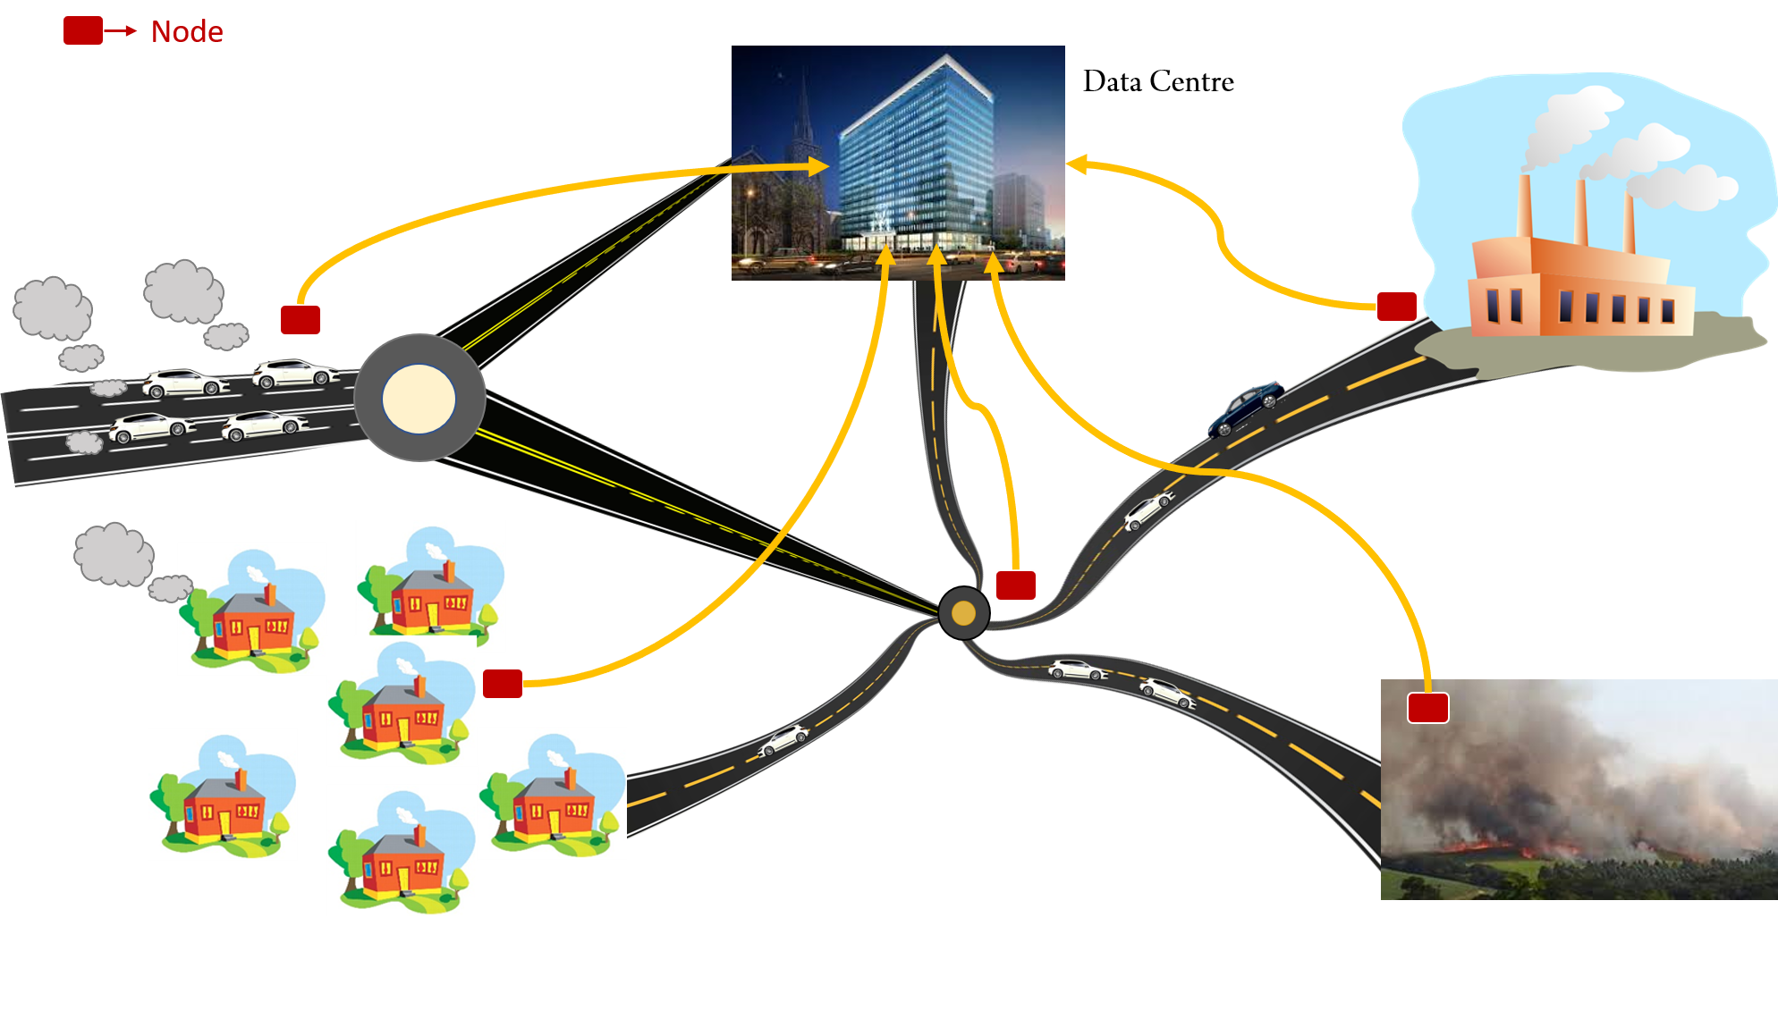
Our Solution: IOT Based Pollution Monitoring and Control System
10/20/2019
Pollution Monitoring, The LNMIIT, Jaipur, India.

Slide 8
Our Solution
In our proposed solution, there will be two types of nodes:
Stationary Nodes: Installed at locations where pollution is high, like factories, industries, burning farms, and traffic signals etc. These Nodes will consist of NodeMCU as the processing unit. (Assuming WiFi is available in the above mentioned areas.)
Mobile Nodes: Installed in vehicles/mobile units to provide pollution data of the areas where generally pollution is considered to be low. Such mobile nodes can be installed in the government vehicles in the initial phase and later with respect to the success of the solution it may be deployed in private vehicles too. (These Nodes will consist of Arduino Uno with GSM/GPRS Module.)
10/20/2019
Pollution Monitoring, The LNMIIT, Jaipur, India.

Slide 9
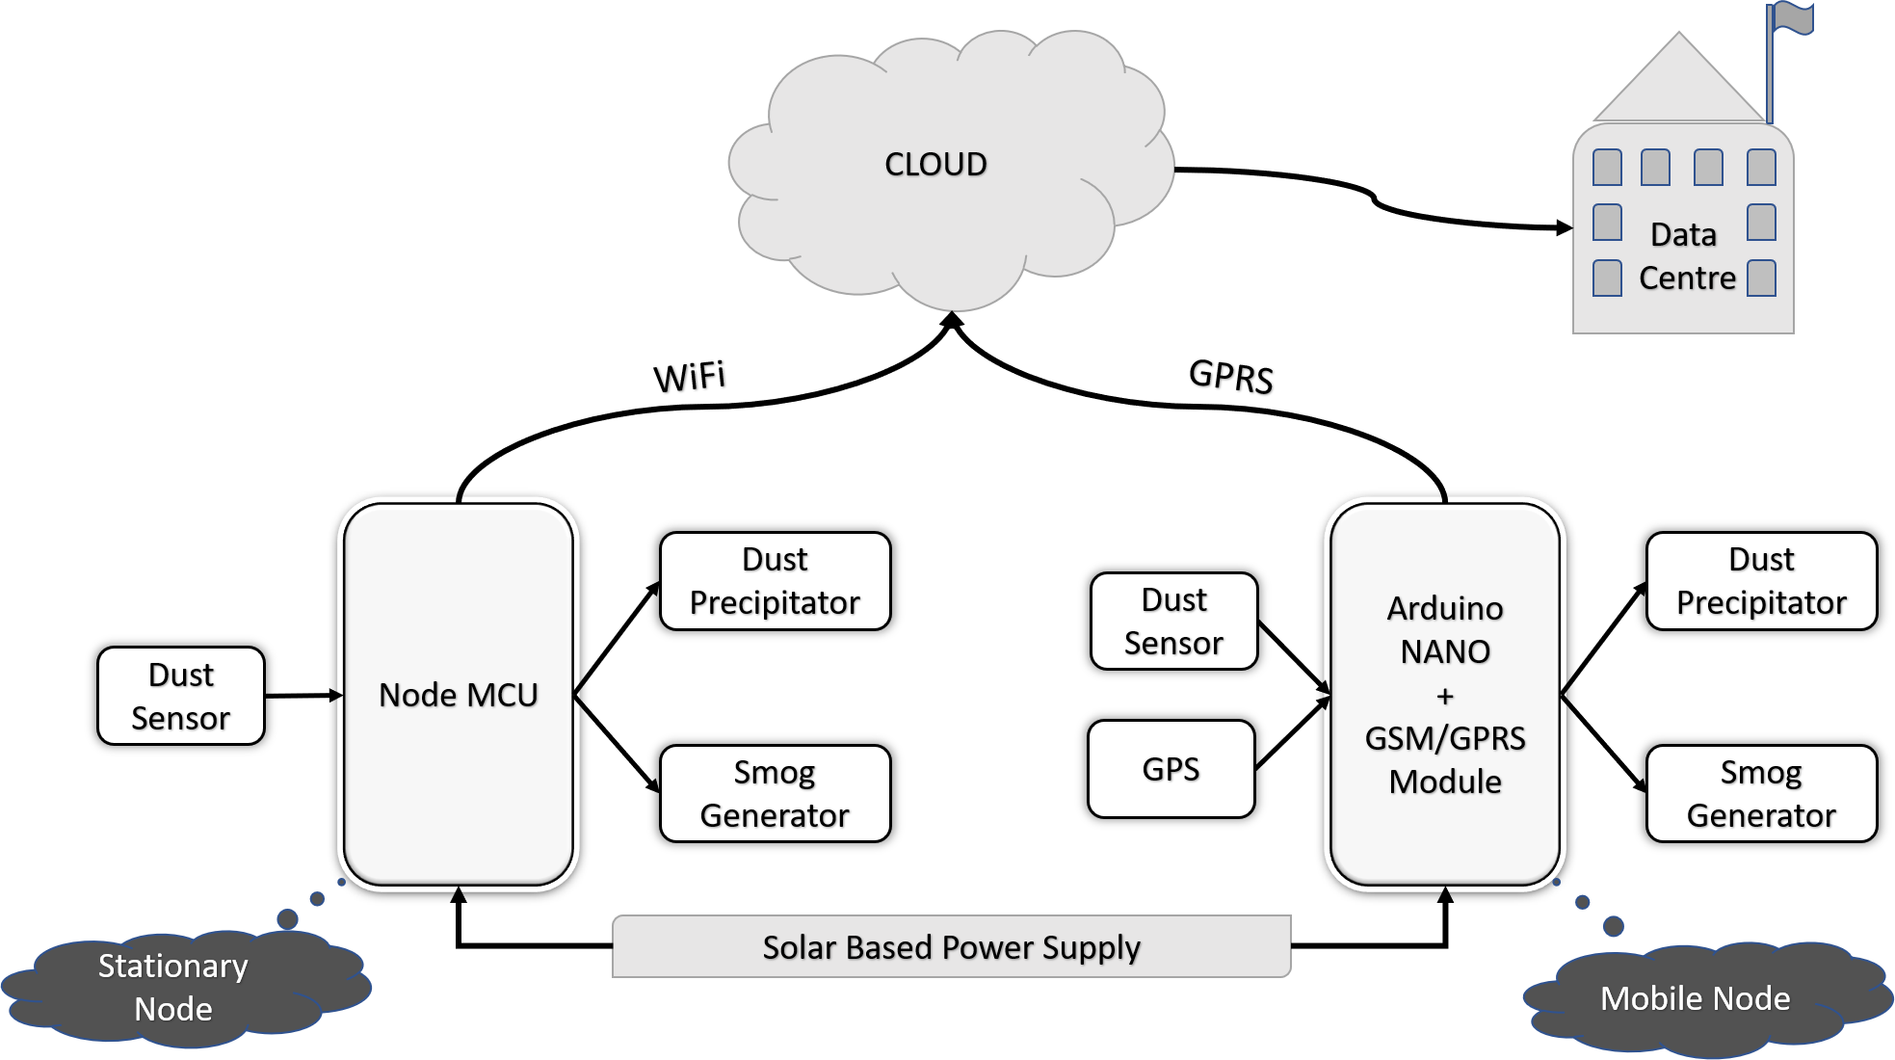
Block Diagram of Proposed System
10/20/2019
Pollution Monitoring, The LNMIIT, Jaipur, India.

Slide 10
Why our Solution?
Proposed cloud based Pollution Monitoring will be a cost effective device due to its cost saving components used.
The simplistic design will allow easy modifications and adaptive solutions for futuristic problems too.
Data collected from both stationary and mobile nodes can be sent to a Centralized Data Hub (CDH) or Server for data analysis.
CDH can also send the instructions to the stationary nodes to activate the pollution control systems whenever the levels rise beyond a predefined threshold.
10/20/2019
Pollution Monitoring, The LNMIIT, Jaipur, India.

Slide 11
Comparison with Present Solutions
Current pollution monitoring system(like SAFAR, developed by IITM) can only provide pollution data for some fixed locations.
Our mobile nodes can provide data for many unnoticed locations.
These nodes are also cost effective as they can be implemented with a minimal increase in the hardware of the IOT network.
10/20/2019
Pollution Monitoring, The LNMIIT, Jaipur, India.

Slide 12
Future Goals
Installing the nodes at various points across the smart city and provide an expandable and adaptive solution.
Setting it up nodes at places prone to heavy pollution like - traffic lights, factories, farms, etc. to measure and prevent highly polluted areas.
Mounting of various mobile nodes on government vehicles to monitor pollution of unnoticed zones.
Placing nodes near houses which are in close proximity of industries.
Developing device which could also control the pollution by measuring dangerous particles like PM2.5, PM10.5, etc.
Make it a highly efficient and low resources consuming system.
10/20/2019
Pollution Monitoring, The LNMIIT, Jaipur, India.

Slide 13
Business Plans
Production and installing of nodes.
Maintaining the setup.
Managing Cloud database.
Generating analysis reports for pollution and environment authorities.
Manufacturing and deploy an efficient IOT based Pollution Controlling Units (PCUs) along with cloud based network which can be accessed by any mobile phone, tablet or computer.
10/20/2019
Pollution Monitoring, The LNMIIT, Jaipur, India.

Slide 14
Thank You!

