Slide 1
STUDENT PORTFOLIO
STUDENT NAME: M AVISHNA REGISTRATION NUMBER : 23131210500122005 NMID:
DEPARTMENT: BCA COLLEGE: IMMACULATE COLLEGE FOR WOMEN, CUDDALORE UNIVERSITY : ANNAMALAI UNIVERSITY

Slide 2
Agenda
Problem Statement
End Users
Tools & Techniques
Portfolio Design & Layout
Result & Output
Conclusion

Slide 3
Problem Statement
Many students and professionals lack a structured online portfolio to showcase their skills, education, and contact information effectively.

Slide 4
End Users
- Students
Job Seekers
Freelancers
Professionals
Recruiters & Employers

Slide 5
Tools & Techniques
- HTML, CSS, JavaScript
- CodePen for live coding
- PowerPoint for presentation
- GitHub/Hosting Platforms for deployment

Slide 6
Portfolio Design & Layout
- Contact Information Section
- About Me Section
- Education Section
- Website/Link Section
- Clean & Minimalist Layout

Slide 7
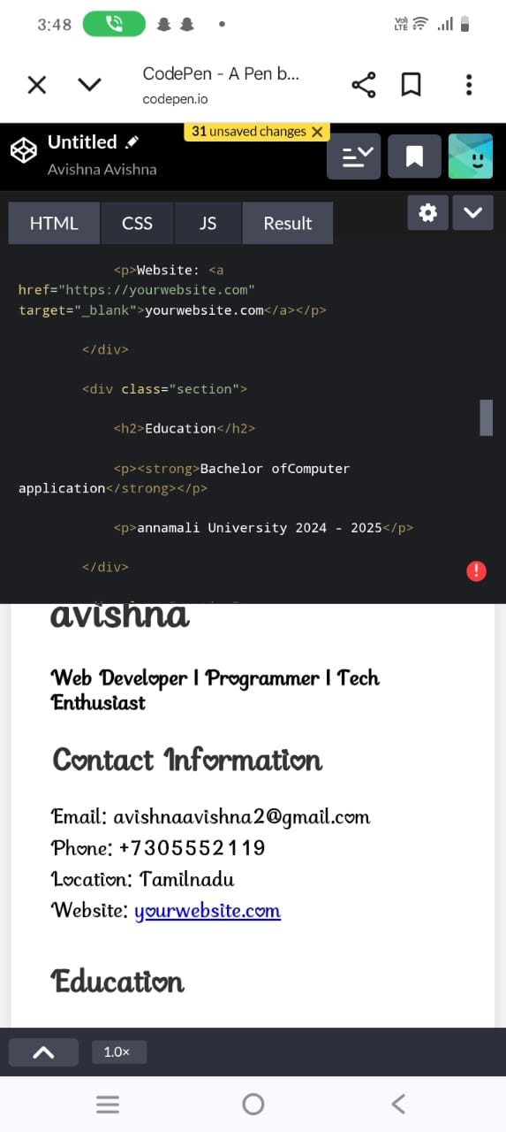
Result & Output
The portfolio displays:
- Personal Information
- Skills & Enthusiasm
- Education Details
- Contact Information
- Website Link

Slide 8
Conclusion
A well-structured portfolio helps individuals present their skills and qualifications effectively, making them more visible to recruiters and clients.

