Slide 1










DEPARTMENT OF COMPUTER SCIENCE AND ENGINEERING & III CELL
Problem Statement ID – PS-2
Problem Statement Title - Building a Real-Time, Al- Powered Mobile Application for Early Disease Detection in Cows and Buffaloes
Theme – HEALTH TECHOLOGY
PS Category – PS-2
Team ID – SKB-F26
Team Name – PANDA

Slide 2
PANDA
Problem Statement
Why It Matters
The Result
Farmers face HUGE losses due to late detection of livestock diseases. Common Diseases: 🔴 Lumpy Skin Disease (LSD) 🔴 Foot and Mouth Disease (FMD) Lack of: ❌ Veterinary access in rural areas ❌ Real-time monitoring tools
💔
Animal Deaths
Thousands lost every year
💸
Economic Loss
Farmers lose livelihoods
🏥
No Vet Access
80% rural areas underserved
⏰
Late Detection
Disease spreads before noticed

Slide 3
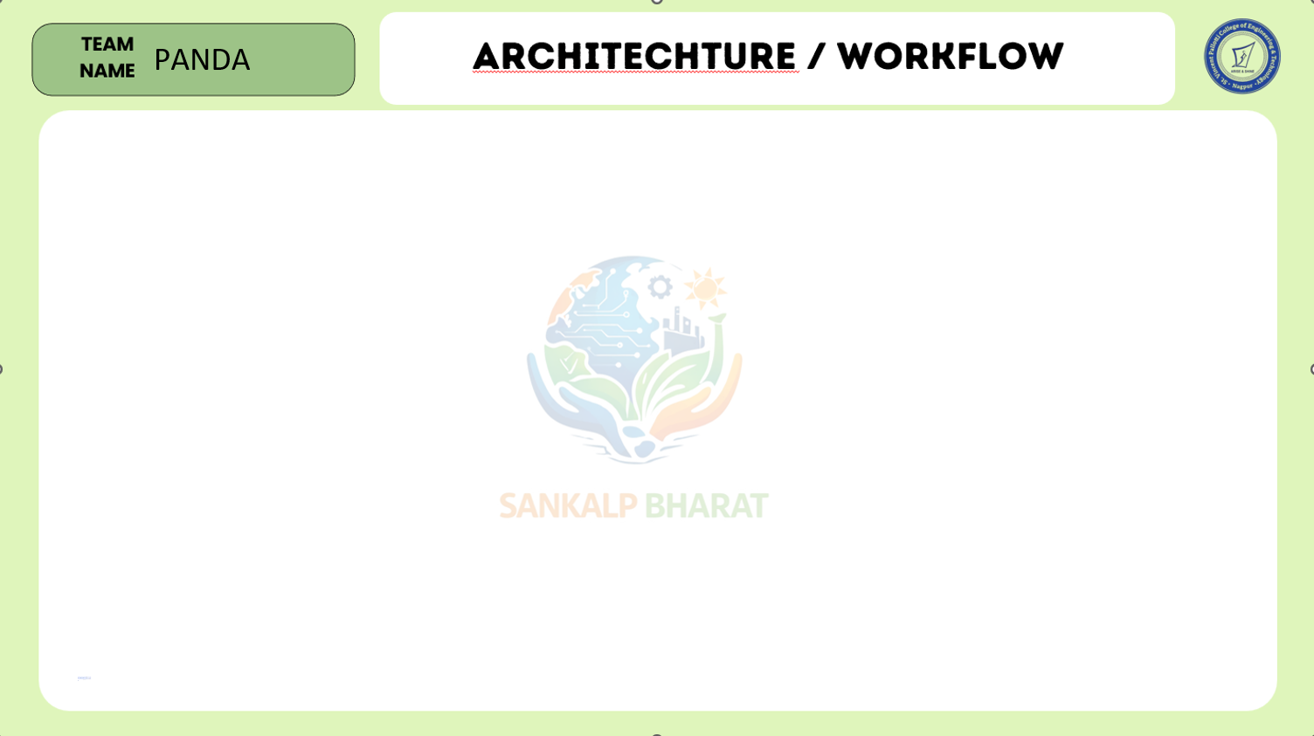
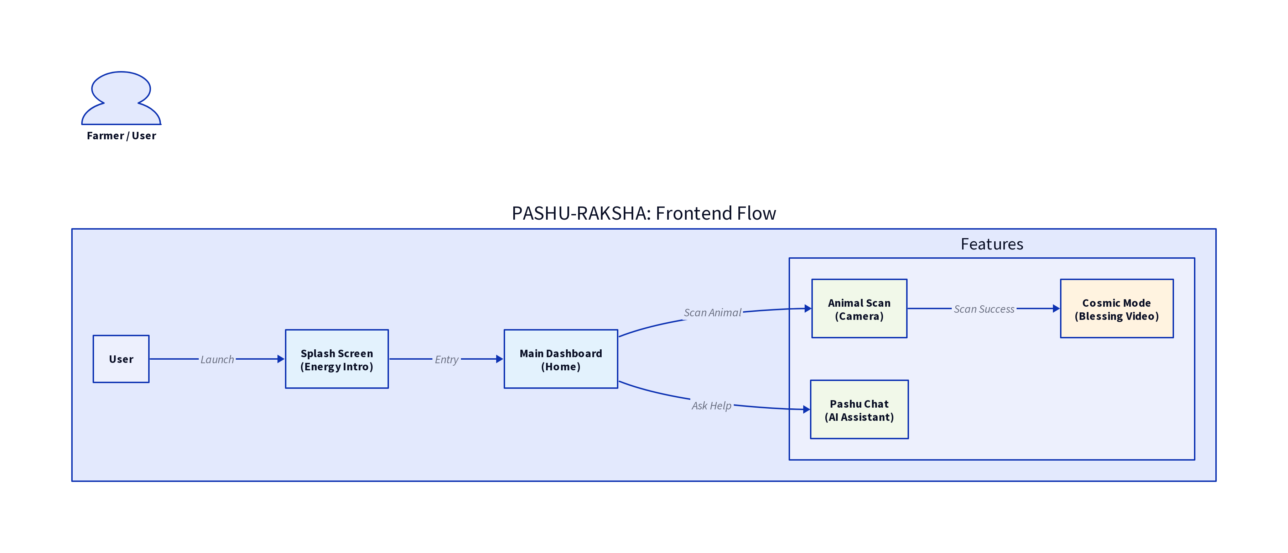

Slide 4

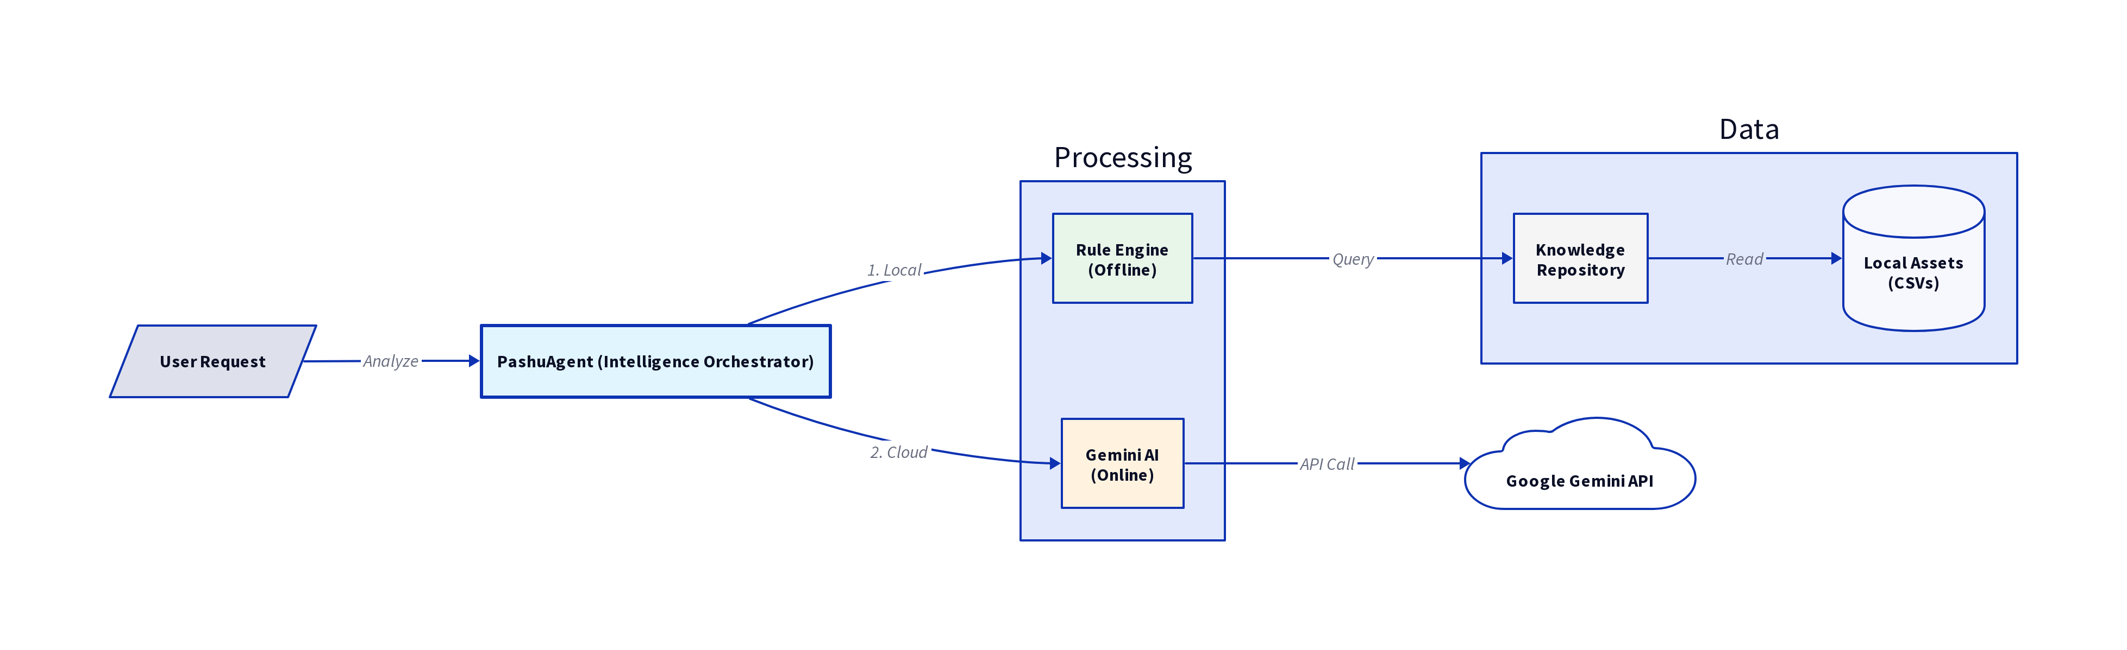
PANDA

Slide 5
PANDA
Our Solution — PashuRakshak AI
📷
AI + Camera Detection
⚡
Instant Diagnosis
Scan animals to detect early symptoms instantly
Get disease probability in seconds on your phone
📴
Offline Mode
🚨
Early Alerts
Works without internet — built for rural India
Alerts farmers before disease spreads in the herd
🐄 Smart • Mobile • Offline-First • Rural-Friendly

Slide 6
PANDA
Key Features — Pashupatinath AI
🧠
AI Disease Detection
📴
Offline-First (Edge AI)
🐄
Herd Risk Intelligence
LSD, FMD, Mastitis probability scan
Zero internet needed for rural use
Outbreak risk from multiple animals
📊
Spread Simulator
⚠️
Real-Time Risk Alerts
📝
Simple Symptom Input
Predicts how disease spreads over time
Green / Yellow / Red color alerts
One-tap symptom selection
🛡️
Actionable Guidance
👨‍🌾
Farmer-Friendly UI
🌍
Multilingual + Voice
Monitor, isolate, disinfect, call vet
Big buttons, icons, minimal text
Regional languages (future scope)

Slide 7
PANDA
Technology Stack
Frontend
📱 Kotlin / Java
Backend
⚙️ Node.js / Firebase
AI Model
🧠 TensorFlow / PyTorch
Database
🗄️ Cloud + Local Storage
APIs
🔌 Weather + Disease Data APIs

Slide 8
PANDA
Impact & Future Scope
📈 Impact
🚀 Future Scope
🐄
Reduce livestock deaths significantly
🏛️
Integration with Govt. veterinary systems
👨‍🌾
Help farmers take early action
📡
IoT wearable devices for animals
💰
Increase farmer income & stability
🗄️
National livestock disease database
🏥
Improve rural healthcare access
🐔
Expansion to poultry & other animals

Slide 9

Thank You
"Protecting Livestock, Empowering Farmers"
Team PANDA | Aavish • Dipak • Sagar • Prajwal • Saurabh
Sankalp Bharat Hackathon 2026

